Slide 1
Smash Bros Guessing Game

Slide 2
Instructions
Importing Game Data:
Open Microsoft SQL Server, then go to databases and create one named PROG455FA23
Right click the new database and go to Tasks->Import Flat File
Import the csv file as SmashBrosFighters
Run the “CreateSmashBrosUserTable” and “CreateSmashBrosLogTable” scripts in My SQL
Execute all stored procedures found in SQL->Stored Procedures
Playing the Game:
Open the main solution file and run the game
You can create an account, login, or play as a guest
Start guessing Super Smash Bros fighters!

Slide 3









Gameplay Flow
(Complete until successful)
Create Account
Win Game
Guessed correctly
(Complete until successful)
Game Start
Login
Show Profile
Start Guessing
Play Again?
(Complete until successful)
Could not guess within 8 tries
Lose Game
Guest Mode
Quit Game

Slide 4
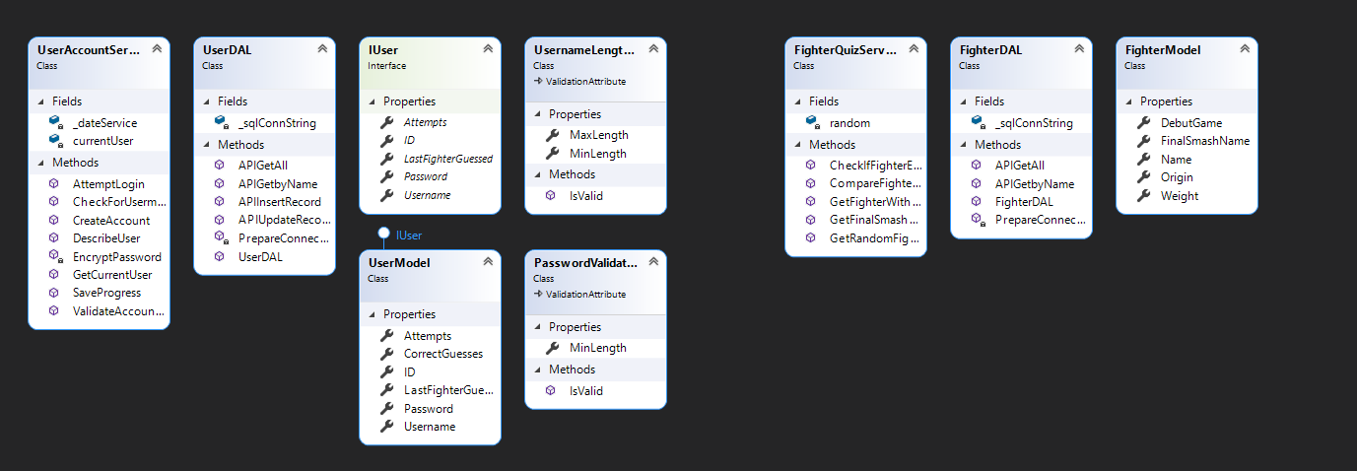
Service Layer

Slide 5
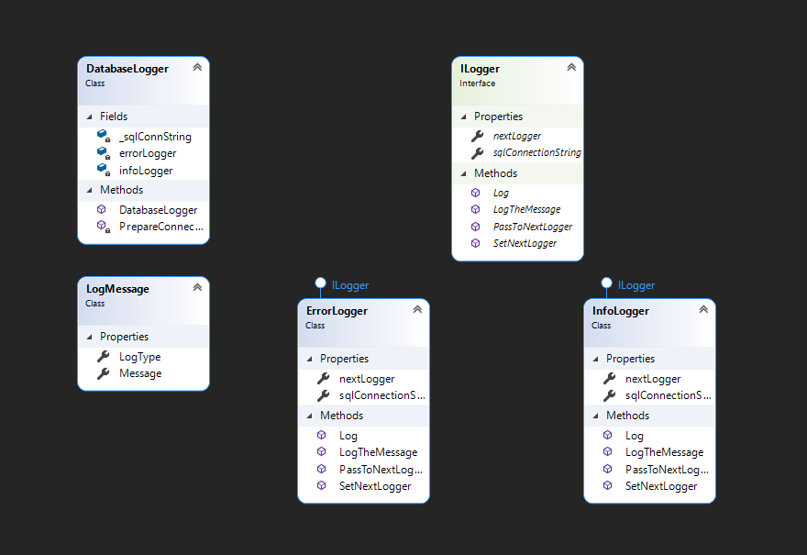
Database Logger

