Slide 1
AirParking Smart Contract
林昱嘉
Karen Wang
柯承佑
2019 / 04 / 24

Slide 2
Dapp 應用
停車場業主可將停車位資訊上傳至智能合約，讓有停車需求的駕駛人可以進行線上預約。
為了保障停車場業主的權益，若是駕駛人未於約定時間使用停車位，將會執行罰款機制。

Slide 3
Blockchain architecture can prevent double transaction
Blockchain architecture can prevent double transaction
End
User
OTAs
AirParking
API
API
101010
Smart Contract
Alliance
AirParking Chain
Alliance

Slide 4
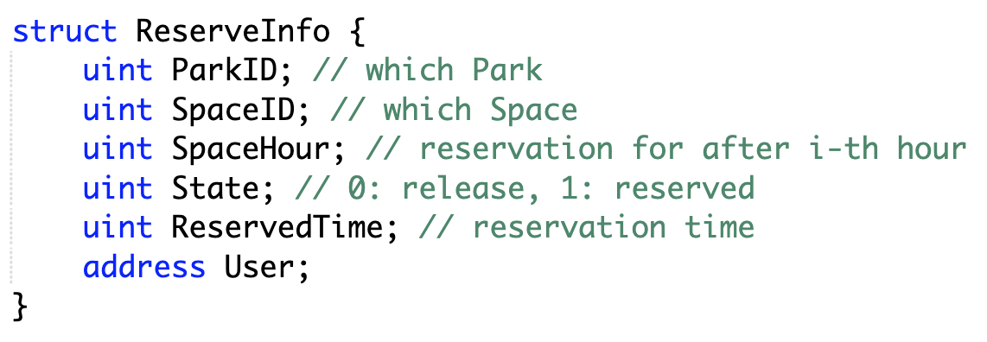
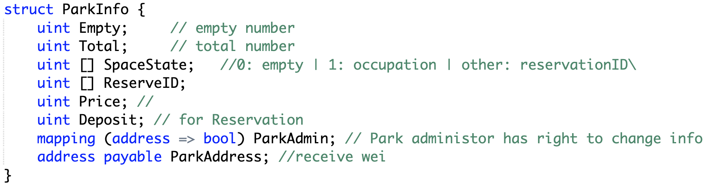
Two main struct

Slide 5
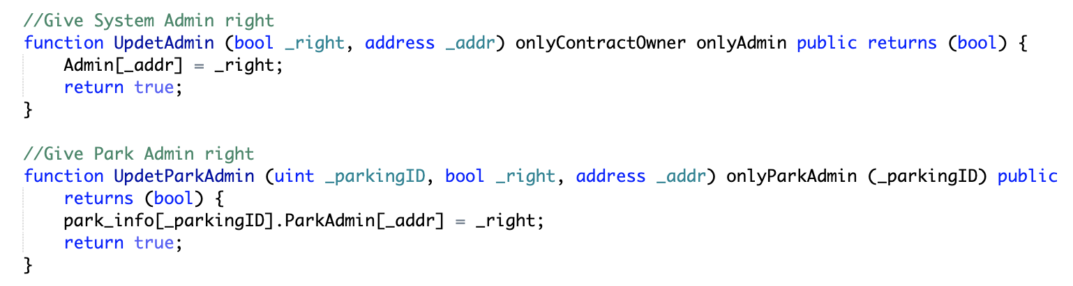
Add Administration

Slide 6
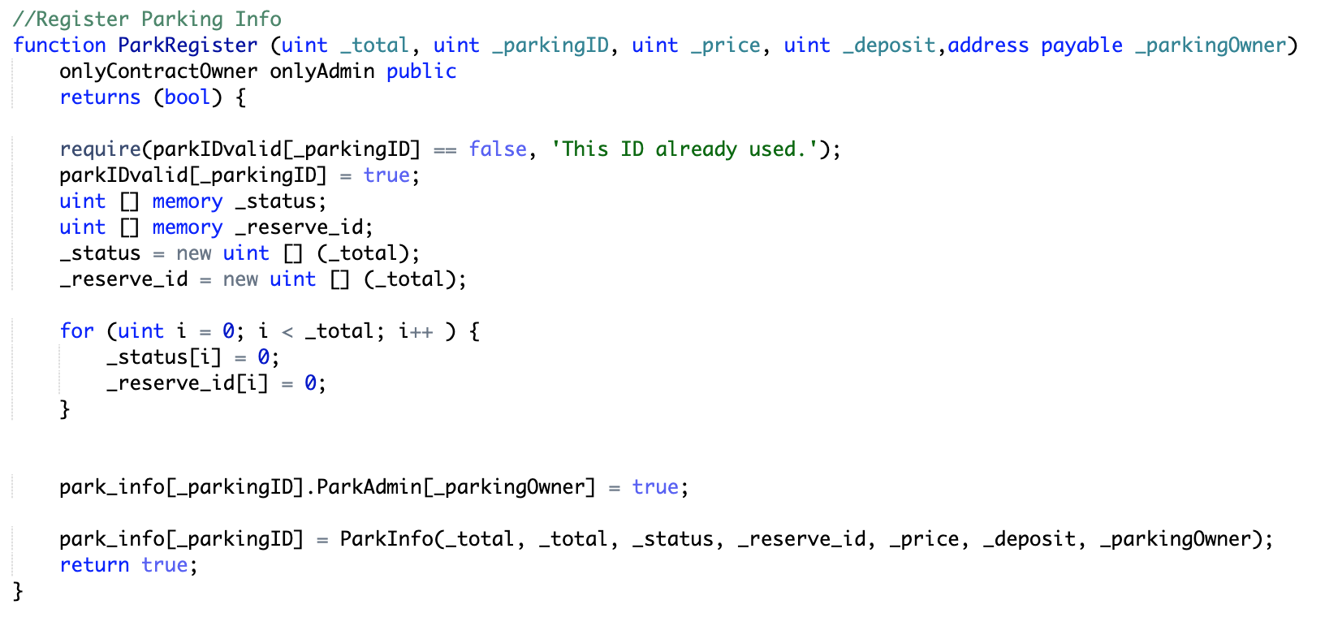
Register parking space

Slide 7
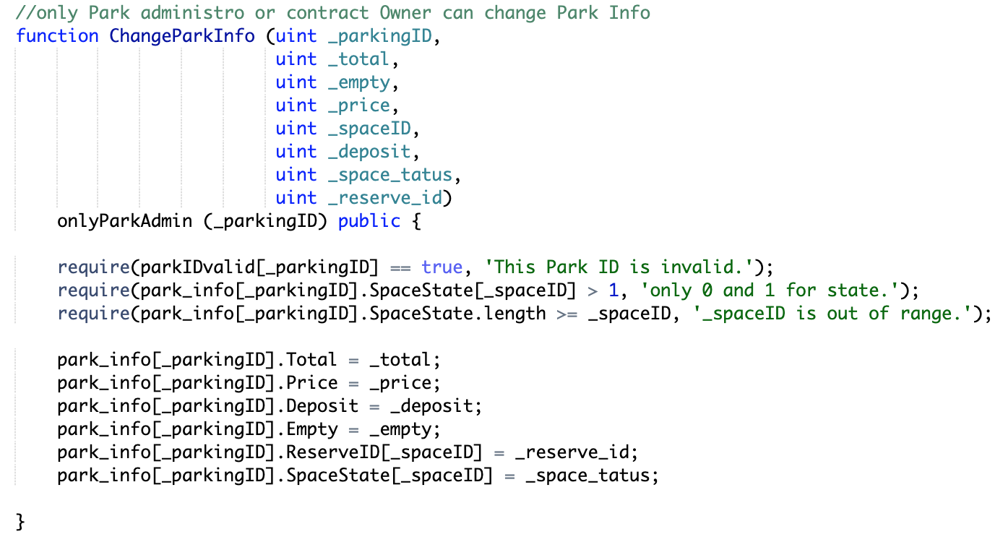
Change parking space

Slide 8
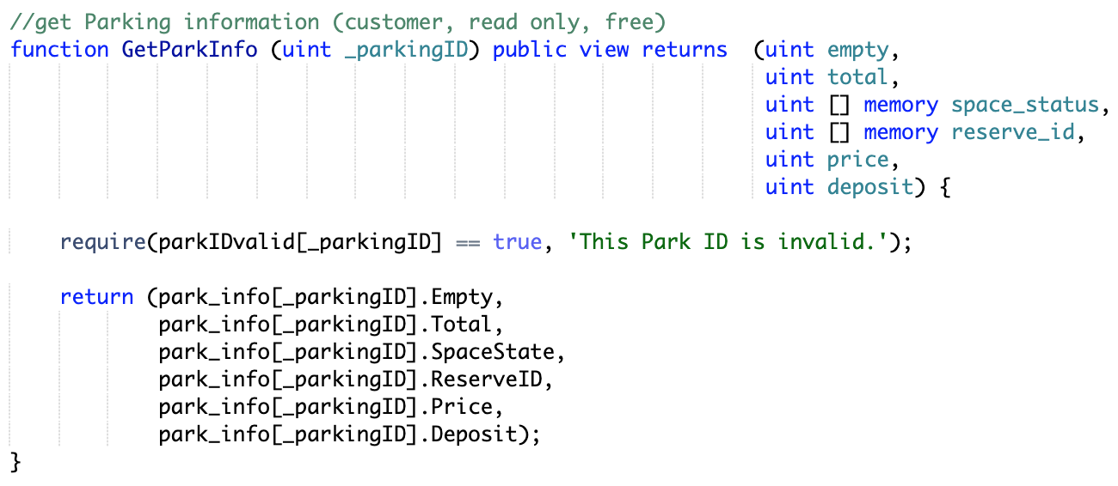
Get parking space information

Slide 9
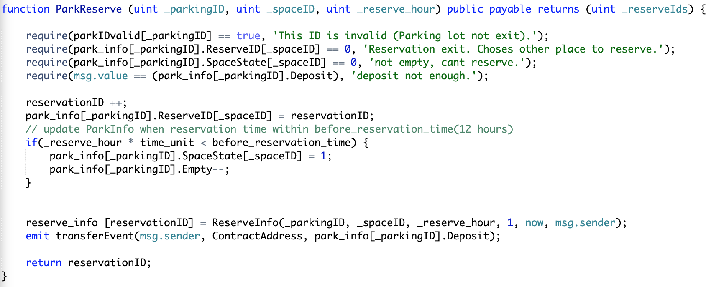
Park reserve

Slide 10
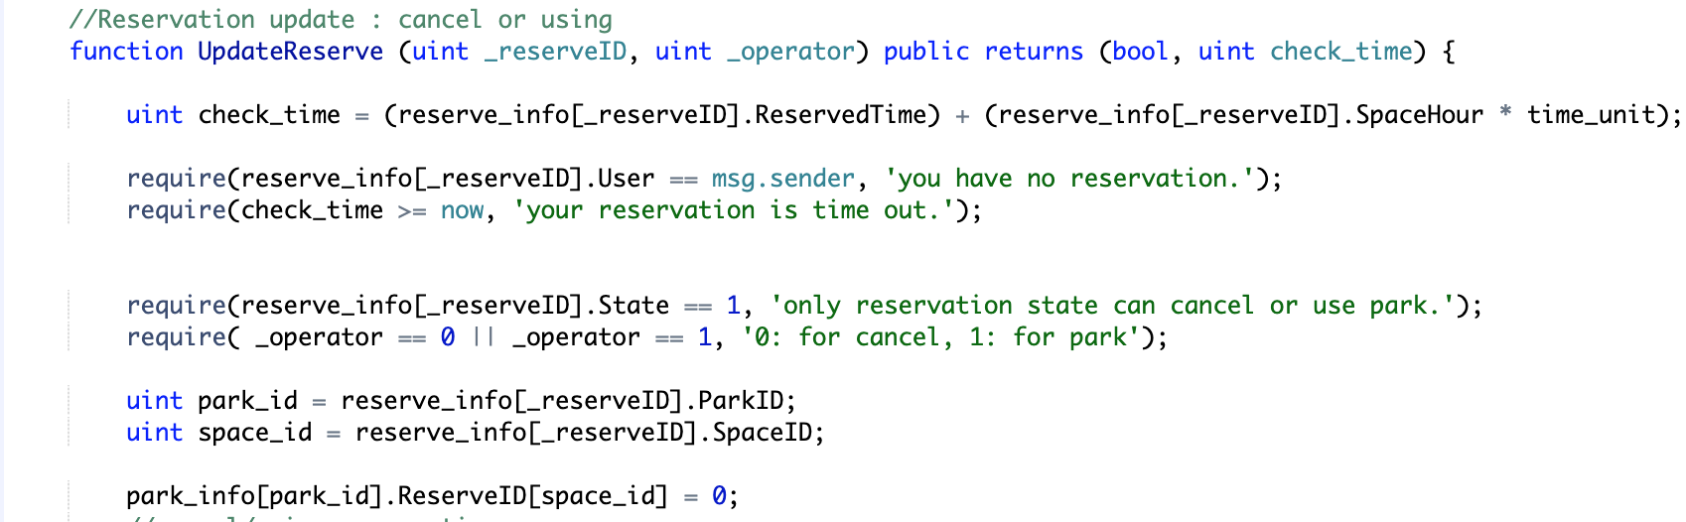
Reservation update (1)

Slide 11
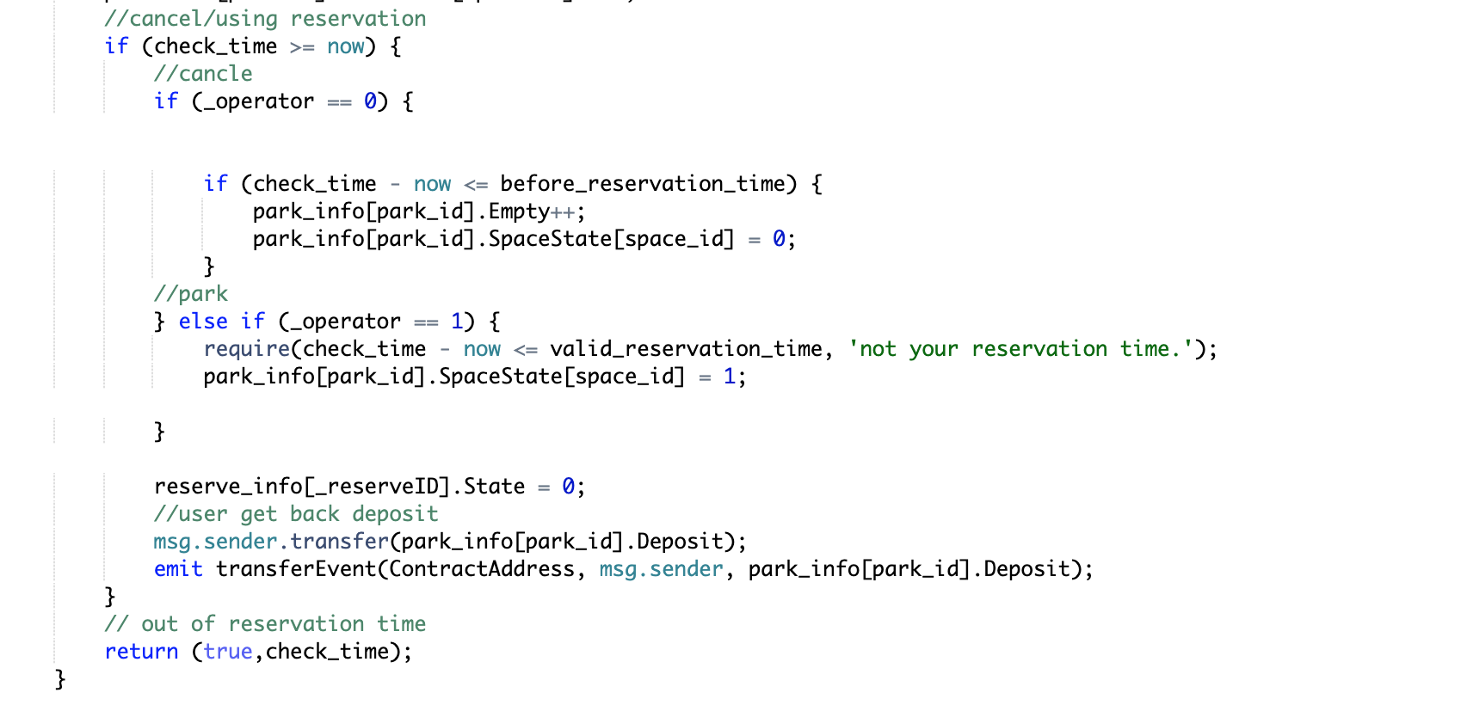
Reservation update (2)

Slide 12
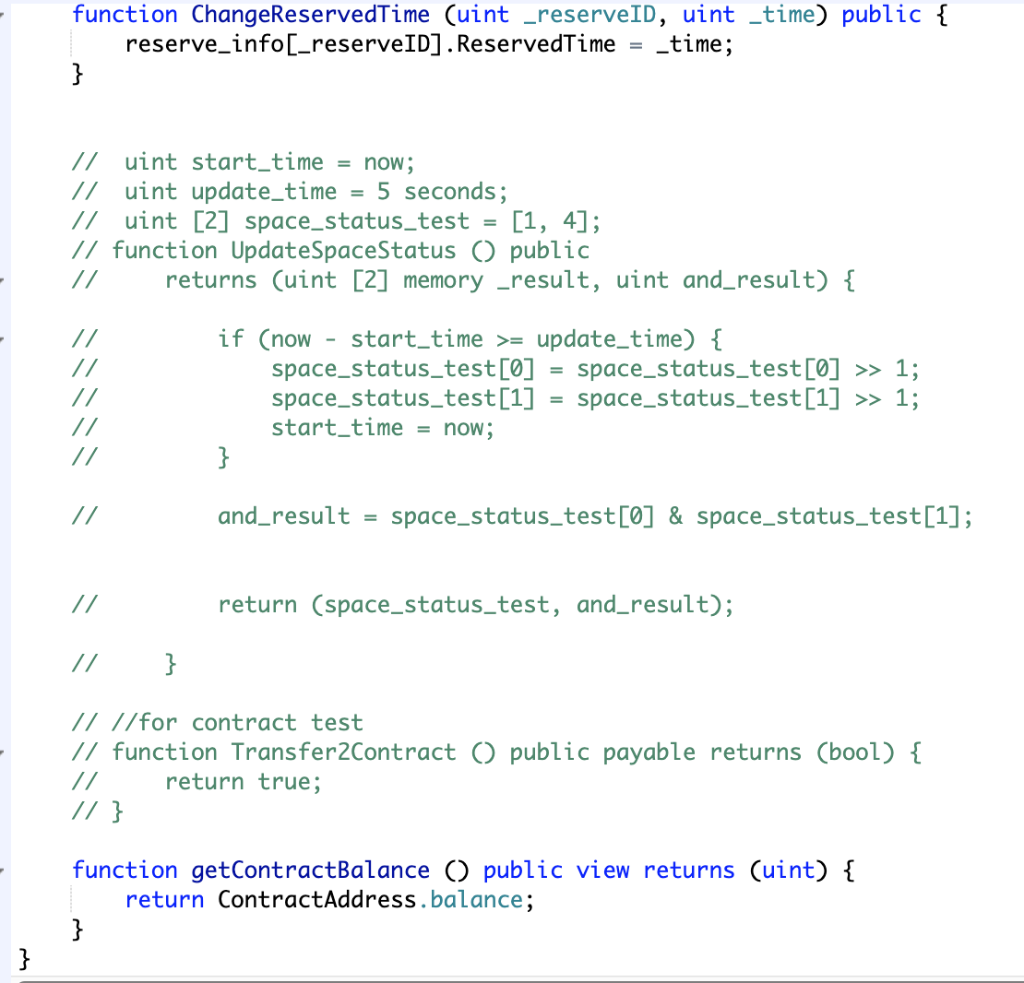
Change Reservation time

Slide 13
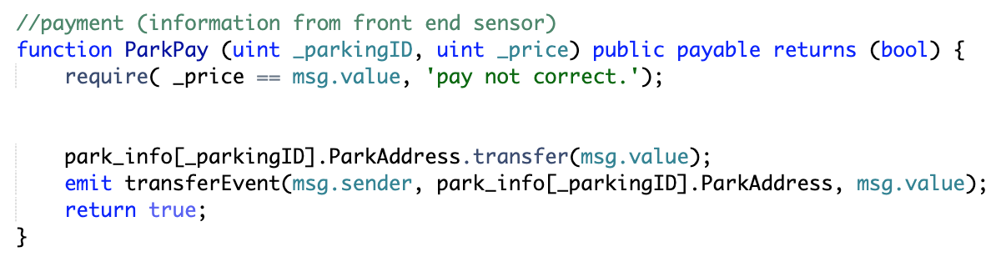
Payment

Slide 14
Q & A

Slide 15
Thank you !

