Slide 1
Introducing TechSolve
Empowering teams through innovative software solutions.

Slide 2
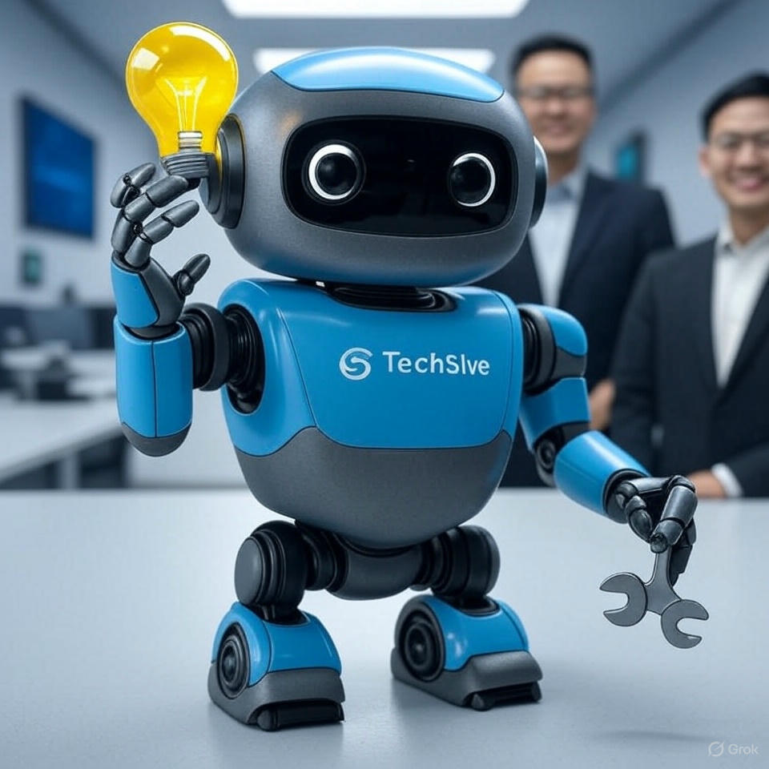
Introduction
This presentation introduces TechSolve, a company dedicated to enhancing productivity and simplifying workflows for businesses of all sizes.

Slide 3
Mission
01

Slide 4
Empowering teams
At TechSolve, our mission is to empower organizations to optimize their workflows and achieve greater efficiency. By leveraging advanced tools and technologies, we aim to enable teams to focus on critical tasks, driving innovation and growth.
Innovative software solutions
We provide cutting-edge software solutions designed to address complex business challenges. Our products aim to streamline processes, improve collaboration, and enhance overall productivity, ensuring that businesses can adapt and thrive in a competitive landscape.
Simplifying workflows
At TechSolve, we aim to simplify complex workflows through user-friendly interfaces and automation. By integrating our solutions into daily operations, teams can minimize manual tasks, reduce errors, and maximize efficiency, allowing them to focus on core objectives.

Slide 5
Founders
02

Slide 6
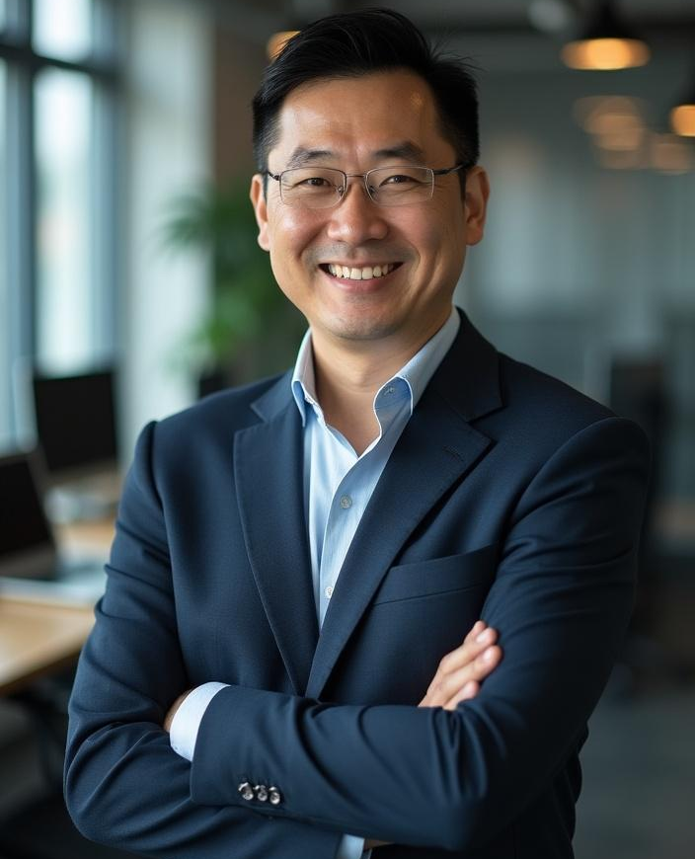
Alex Chen - CTO
As a co-founder and Chief Technology Officer, Alex Chen brings over 15 years of experience in software engineering to TechSolve. His passion for automation and creating innovative tools drives the development of our technology. Alex holds a Ph.D. in Computer Science from MIT and leverages his extensive knowledge to pioneer effective solutions.

Slide 7
Sarah Thompson - CXO
Sarah Thompson, our Chief Experience Officer, focuses on project management and user experience design. With an MBA from Stanford University, she combines a thorough understanding of user needs with a meticulous attention to detail. Sarah ensures that TechSolve’s products are intuitive, effective, and align with our mission to improve workflow efficiency.

Slide 8

Conclusions
TechSolve's commitment to empowering teams through innovative software solutions is evident in our mission and foundational leadership. With experts like Alex Chen and Sarah Thompson at the helm, we are equipped to simplify workflows and enhance productivity for businesses of all sizes.

