Slide 1
DS 200 Lab5 Building A Decision Tree Predictive Model for Classifying Relevant Tweets
Instructor: John Yen
LA: Luwei Lei
February 8, 2018

Slide 2
In this lab, you will learn to
Set up the Python and jupyter notebook environment to use relevant packages (slide 3-4)
Create training and testing data set for a Relevant Classifier from your tagged twitter data. (slide 5-13)
Build a decision-tree Relevant Classifier from training data (using scikit-learn package). (slide 14-19)
Evaluate the predictive model on the testing data. (15-19)
Visualize the decision-tree predictive model (20-21)

Slide 3
Install Necessary Python Packages
Open terminal or command
Windows, run: pip install -U scikit-learn graphviz
macOS/Linux, run: pip3 install -U scikit-learn graphviz
brew install graphviz
graphviz package is for later use to visualize decision trees

Slide 4
Step 1. Import relevant packages in jupyter
Launch jupyter notebook and import the following packages
from datascience import *
from sklearn.feature_extraction.text import CountVectorizer
from sklearn.pipeline import Pipeline
from sklearn import tree
from sklearn import metrics
import graphviz
import numpy as np
Import random

Slide 5
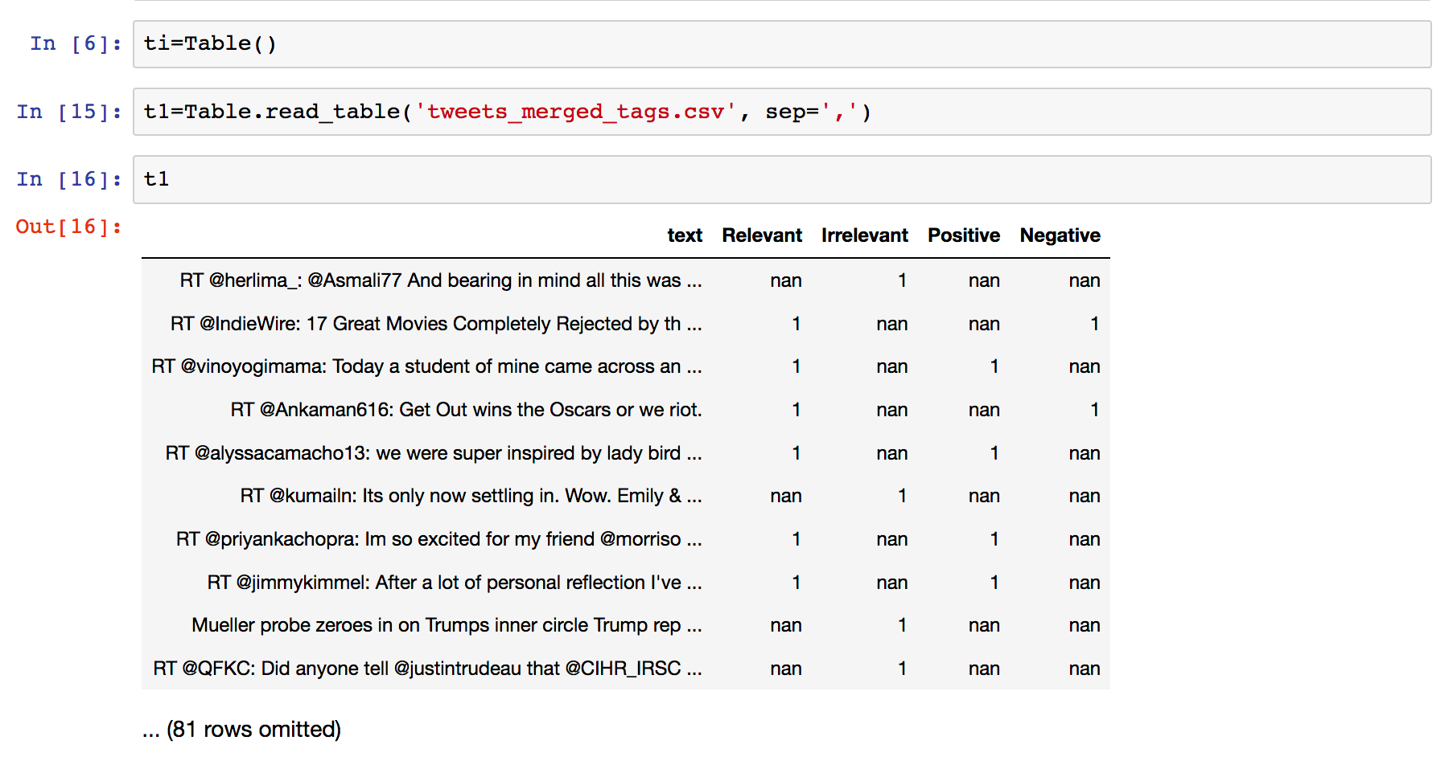
Step 2: Divide Tagged Data into Training and Testing sets
Type the following in Jupyter to load tagged data (the CSV file that merges the results of two taggers)
t1 = Table.read_table(‘tweets_merged_tags.csv’, sep = ‘,’)
If you use Tab as delimiter in the CSV file, use ‘\t’
as the value of sep here.

Slide 6
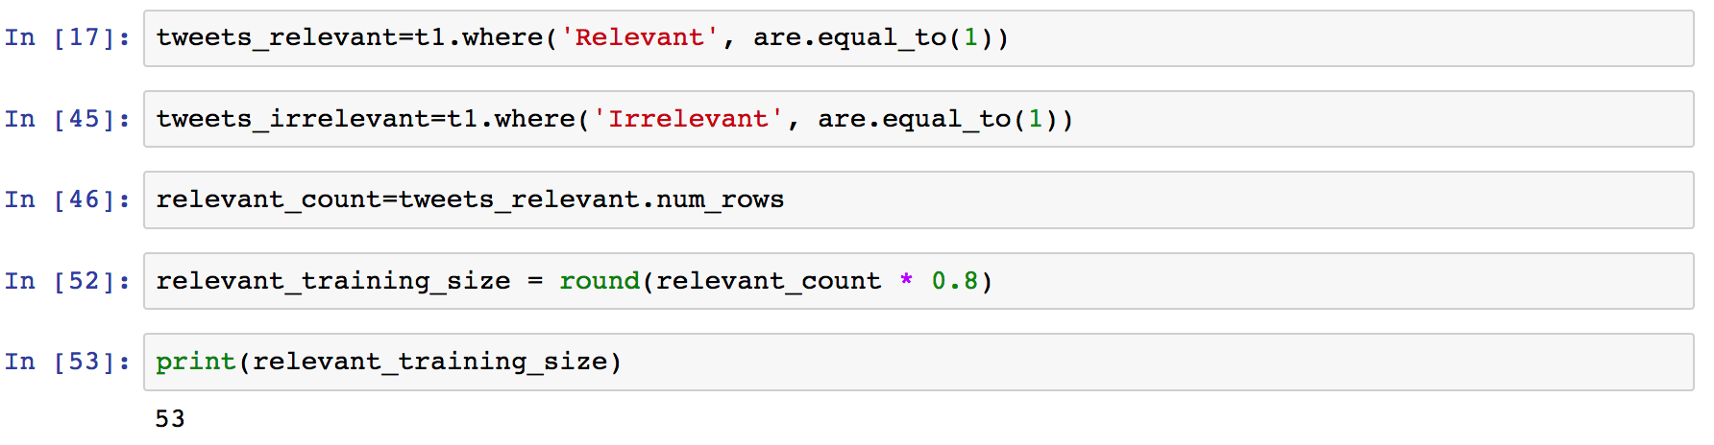
Create train and test sets
3. Separate data by relevant vs. irrelevant
tweets_relevant = t1.where(‘Relevant’, are.equal.to(1))
tweets_irrelevant= t1.where(‘Irrelevant’, are.equal.to(1))
4. Count the total number of relevant tweets and irrelevant tweets
relevant_count = tweets_relevant.num_rows
Irrelevant_count=tweets_irrelevant.num_rows

Slide 7
Use 80% of Labelled Tweets as Training Data
5. Select first 80% of relevant tweets for training
relevant_training_size = round(relevant_count * 0.8)
relevant_rows_train= list(range(relevant_training_size))
print(relevant_rows_train)
irrelevant_training_size = round(irrelevant_count * 0.8)
Irrelevant_rows_train= list(range(irrelevant_training_size) )
print(irrelevant_rows_train)
A list of row index to the relevant tweets to be used for training.
A list of row index to the irrelevant tweets to be used for training.

Slide 8
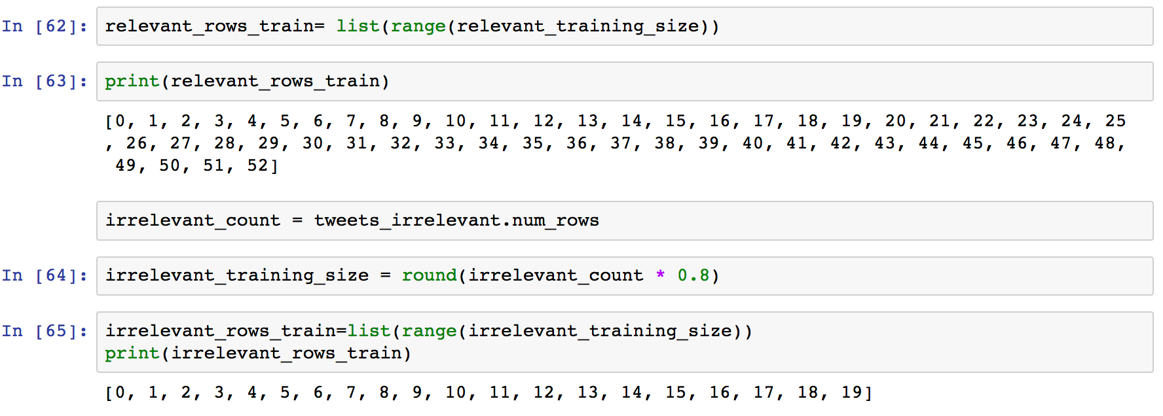

Slide 9
Create training sets
This indicates this Python statement is continued in the next line.
5. Create training data
x_train = list(tweets_relevant.take(relevant_rows_train)[‘text’]) + \
list(tweets_irrelevant.take(irrelevant_rows_train)[‘text’]
The take method of Table object takes a specified list of rows (by row index), and return a new Table formed by these rows and the column(s) specified.
y_train = [1]*relevant_training_size + [0]*irrelevant_training_size

Slide 10
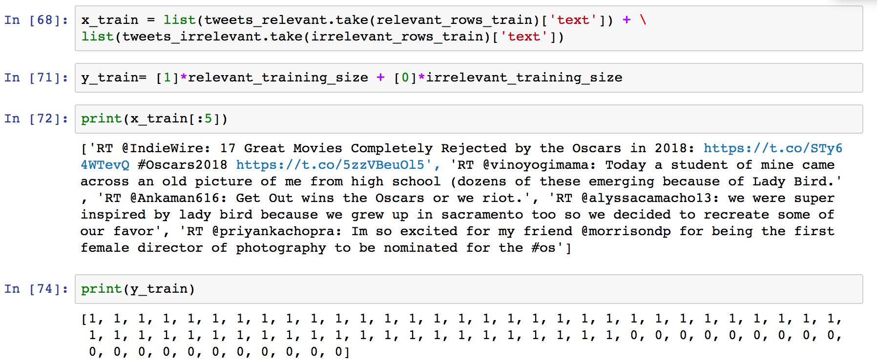

Slide 11
Use 20% of labelled data for testing
The sublist of relevant tweet index starting from the row index after the last row used for training
6. Create testing data
relevant_rows_test= list(range(relevant_count))[ relevant_training_size : ]
Irrelevant_rows_test= list(range(irrelevant_count))[irrelevant_training_size : ]
x_test = list(tweets_relevant.take(relevant_rows_test)[‘text’]) + \
list(tweets_irrelevant.take(irrelevant_rows_test)[‘text’]
y_test = [1]*(relevant_count - relevant_training_size ) + \
[0]*(irrelevant_count - irrelevant_training_size)

Slide 12
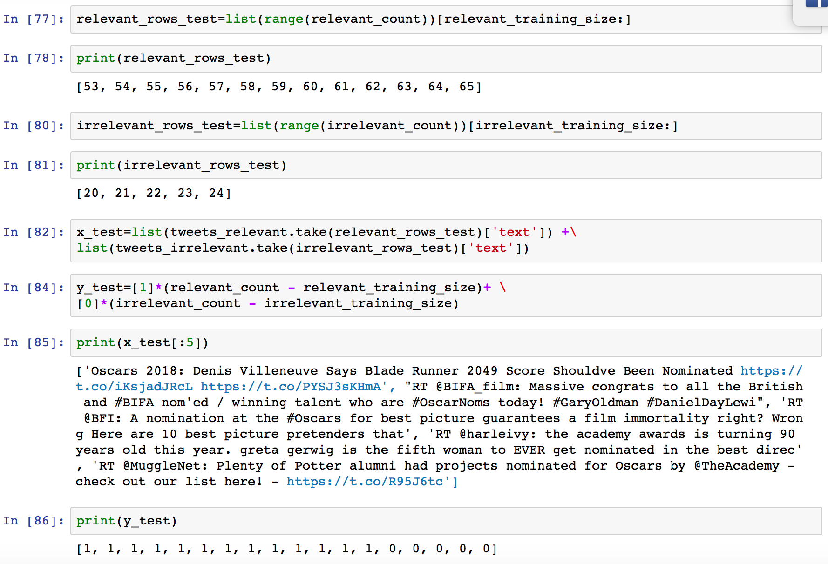

Slide 13
A glance of training data and testing data
x_train and x_test are two lists of str type (i.e., text of tweets)
y_train and y_test are two list of int type (i.e, 1 indicates relevant, 0 indicates irrelevant)
Display the first 5 tweets in x_train and x_test
print(x_train[:5])
print(x_test[:5])
Display the y value (target output) of all training data and testing data
print(y_train)
print (y_test)

Slide 14
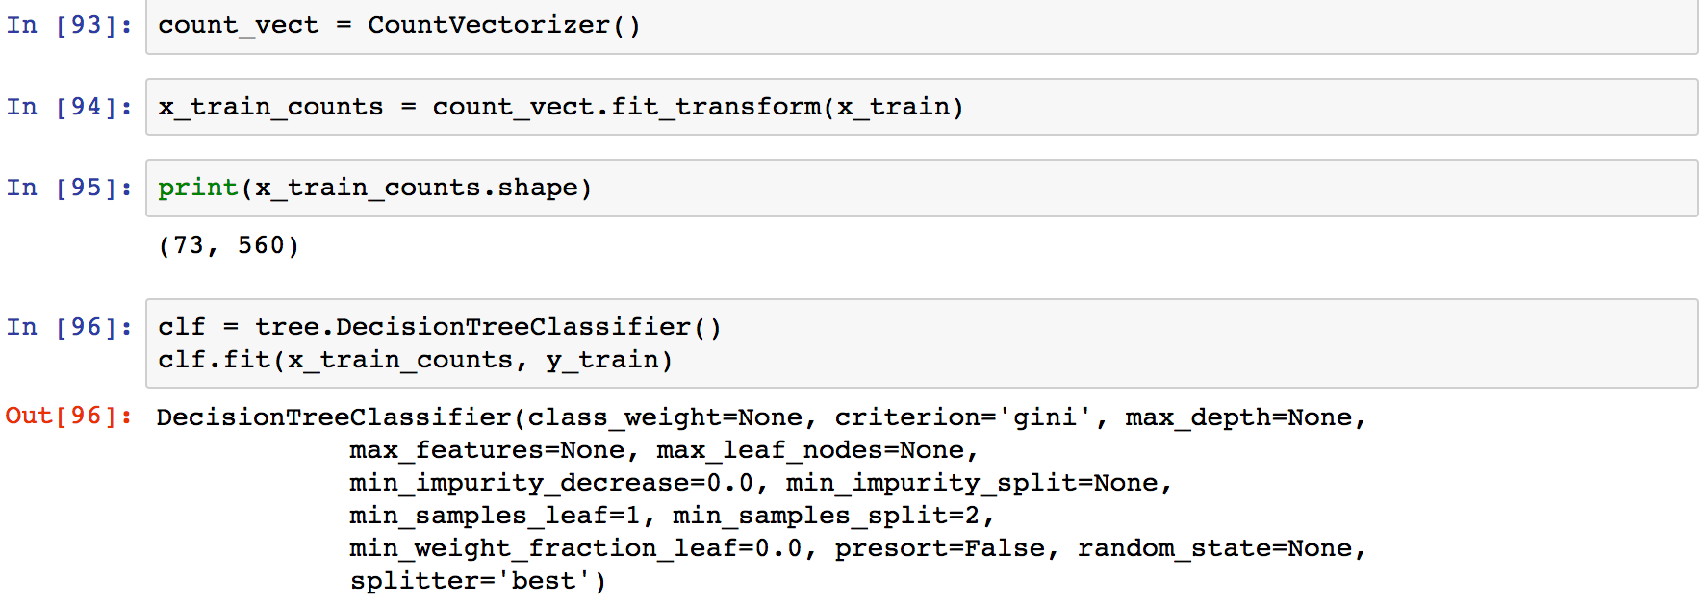
Build a decision tree classifier
Uses the input tweets to learn all words and hashtags, returns a word vector for each tweet (i.e., a matrix A(i,j) is 1 if jth word appears in tweet i.).
Use a step-wise method
1. Extract bag-of-words features
2. Create and train a decision tree classifier
Number of tweets in the training data.
Number of words (i.e., features) in the training data.

Slide 15
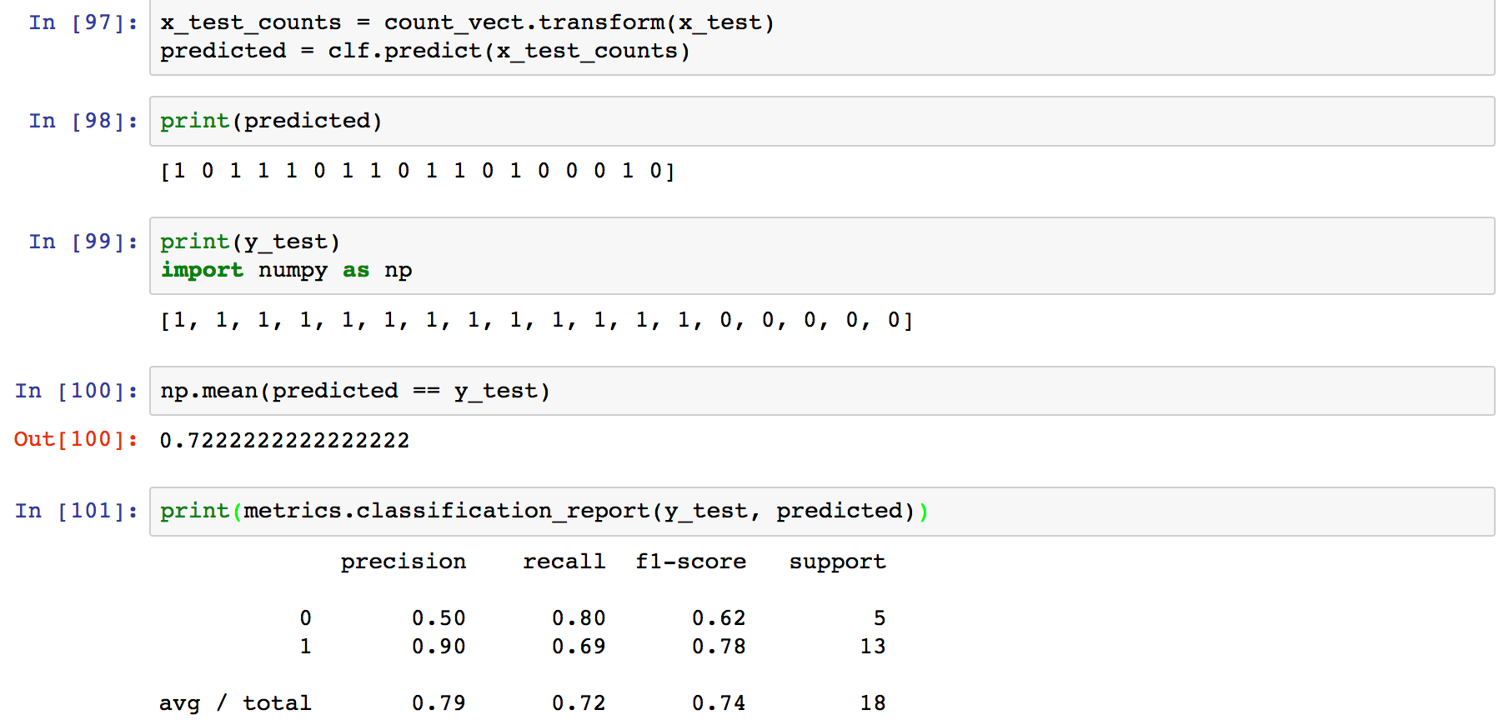
Evaluate a decision tree classifier on testing tweets
Accuracy (the percentage of testing data whose prediction result is the same as its target output): 72%

Slide 16
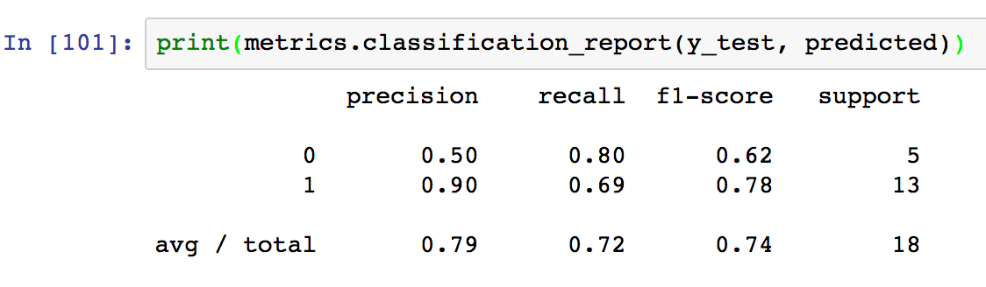
Evaluating a decision tree classifier
Precision (for Relevant): 90% of predicted relevant tweets are labelled relevant.
Recall (for Relevant): 69% of relevant tweets have been predicted relevant.
In another word, the model misses some about 30% of relevant tweets. (large False Negative)
Based on this testing data, only 10% of the relevant tweets predicted by the model are incorrect. (small False Positive)

Slide 17
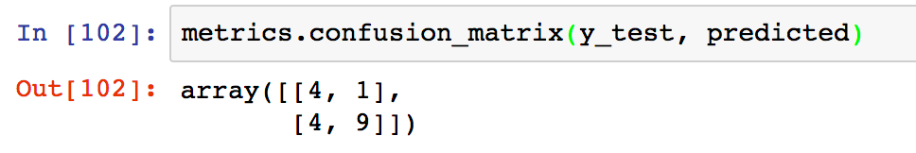
The Confusion Matrix shows False Positive and False Negative more clearly
 | Predicted No | Predicted Yes
Actual No | 4 | 1
Actual Yes | 4 | 9
False Positive
False Negative
Can we calculate Precision and Recall from the Confusion Matrix?

Slide 18
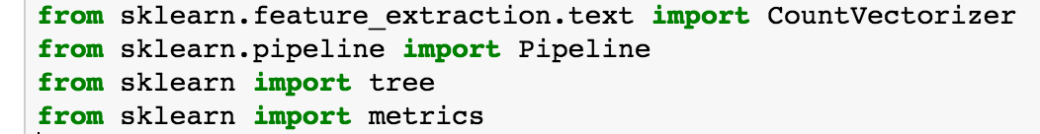
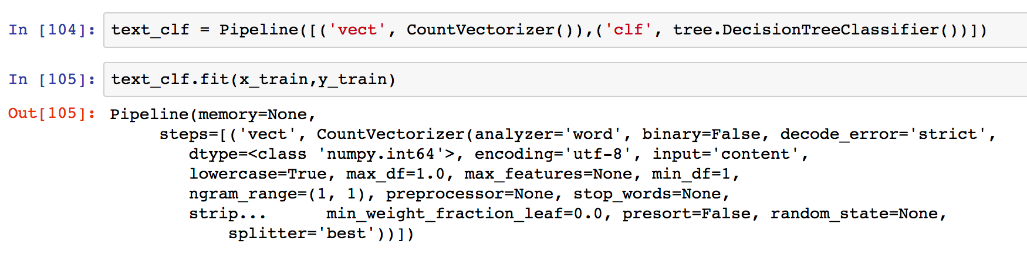
Build a decision tree classifier (alternative)
An alternative way: use the pipeline method provided by scikit-learn.
Build and fit
Directly use x_train

Slide 19
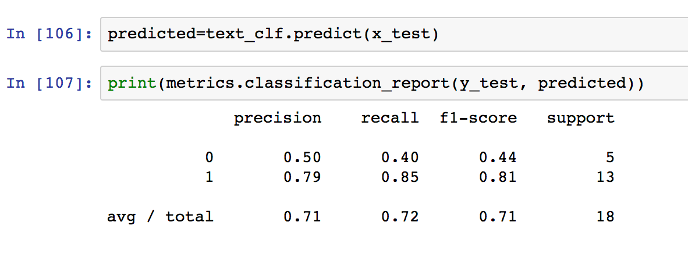
Build a decision tree classifier (alternative)
Directly use x_test
Evaluate

Slide 20
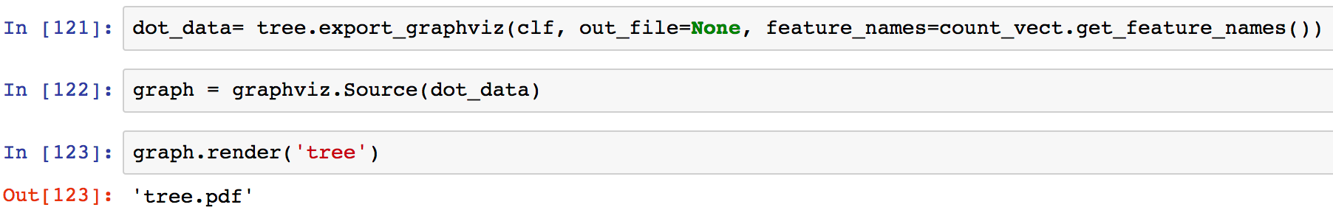
Visualize decision tree
Use graphviz package
Inline plot in Jupyter Notebook
Save a visualization of the tree as tree.pdf file

Slide 21
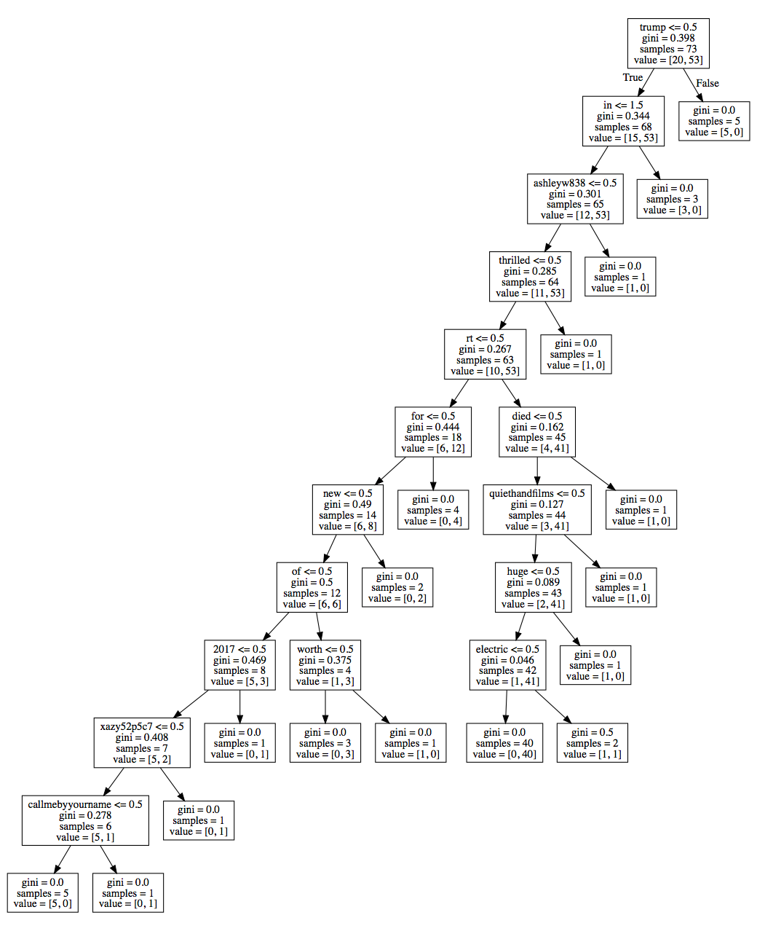
Visualization of a Decision Tree

Slide 22
Lab5 Assignment
Build a Decision Tree predictive model that classifies tweets as “relevant” based on your merged tagging results of lab4.
Submit a doc, docx, or PDF file containing the following information:
Screenshot showing tweets data loaded into Jupyter Notebook as Table object.
Screenshots showing the sizes of your training and testing sets (x_train, y_train, x_test, y_test).
Screenshots showing the detailed evaluation of your Decision Tree classifier, including precision, recall, false positive, and false negative (in confusion matrix).
A visualization of your decision tree.
Inspect the decision tree to evaluate it. For example, does the tree use features that you did not expect? Does the tree provide new insights that you did not have originally?

