Slide 1
DS 200 Lab4 Inter-tagger Consistency Analysis
Instructor: John Yen
LA: Luwei Lei
Feb 1, 2018

Slide 2
What did we learn on Tuesday?
The construction of predictive models involve finding a mapping from input data to target (prediction) output
The foundation of predictive modeling is induction
From specifics (data) to general (model)
Logic-based representation provides the structure of decision tree-based predictive models
Construction of a predictive model can involve
Tagging a set of data to provide the target output
Preparation for Lab today
Each team member tags 300 tweets independently

Slide 3
The Importance of Independent Tagging
Due to the subjective nature of the tagging, we need to have more than one people performing the tagging independently.
After you and your teammate have each performed tagging of the tweets you gathered, you conduct “inter-tagger” agreement analysis to evaluate the degree your tagging results are in agreement.
The tagging result is “acceptable” if the inter-tagging result is higher than a threshold.

Slide 4
What will we learn today?
Analyze the independent tagging results from two people to determine their level of agreement for Relevant tagging.
Compute an inter-tagger consistency using Python
Discuss with your teammate the ‘differences’ of the relevant tagging to generate a tagging guideline.

Slide 5
Generate a Tagging Guideline
For each tweet you two tagged differently, try first to explain to each other the rationale of your choice.
Based on your discussion, try to reach an agreement on whether the tweet is relevant or not.
If the agreement can be reached, write down the rationale why the tweet is relevant (or irrelevant) as a part of the Tagging Guideline together with the tweet as an example.
If no agreement can be made for the tweet, record the tweet on the Tagging Guideline under the section “Tagging Difficulties”.
For the purpose of model construction, remove the tweets with tagging difficulties from the tagged data set.

Slide 6
How to use the Tagging Guidelines
The Tagging Guidelines should be read by anyone (including you) before any future tagging.
The document informs/reminds the tagger(s) the criteria to use for tagging so that the tagging results can be more consistent.
The Tagging Guidelines should also be updated as a result of Inter-tagger Consistency Analysis (after additional tagging efforts).

Slide 7
Two Outcomes of Inter-tagger Analysis
Included in future Presentations/Reports of
Predictive Modeling Results
Tagging
Results of
A
Cohen’s
Kappa
Measure
Tagger
A
Inter-tagger
Agreement
Analysis
Acceptable
Evaluate
Tagging Results
Tagging
Results of
B
Tagger
B
Inter-tagger
Disagreement
Analysis
Not Acceptable
updates
Tagging
Guidelines

Slide 8
Inter-rater Agreement Measure
Given a well-defined Tagging Guidelines, inter-rater agreement shows the degree of agreement among taggers
If various taggers do not agree on a large proportion of the instances, the Tagging Guidelines need to be refined
https://en.wikipedia.org/wiki/Inter-rater_reliability
Inter-rater agreement between two raters: Cohen’s kappa https://en.wikipedia.org/wiki/Cohen%27s_kappa

Slide 9
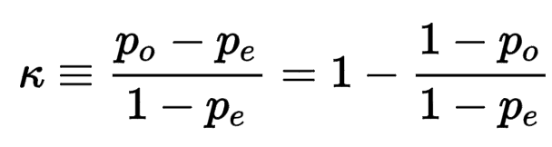

Cohen’s Kappa
Definition:
where $p_{o}$ is the proportion of agreement among raters, and $p_{e}$ is the hypothetical probability of chance agreement

Slide 10
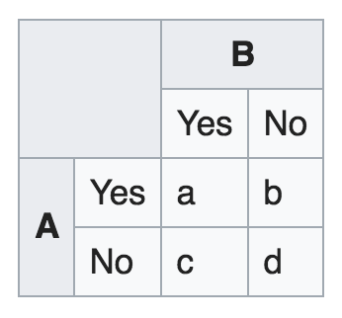
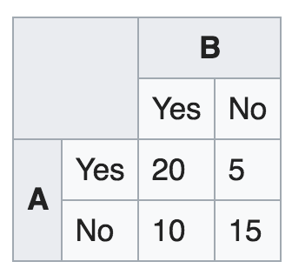
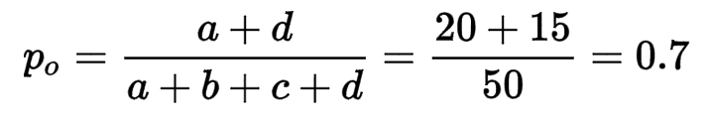
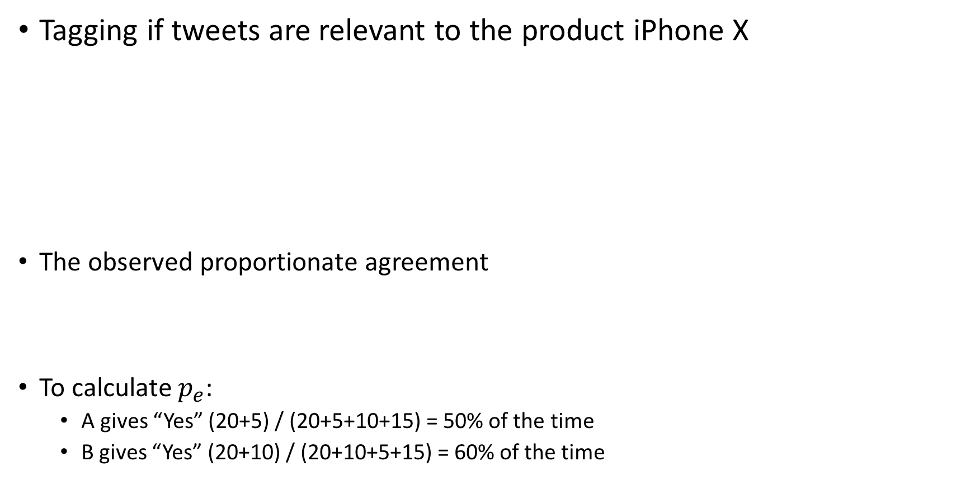
Cohen’s Kappa (example)
Tagging if tweets are relevant to the product iPhone X
The observed proportionate agreement
To calculate $p_{e}$:
A gives “Yes” (20+5) / (20+5+10+15) = 50% of the time
B gives “Yes” (20+10) / (20+10+5+15) = 60% of the time

Slide 11
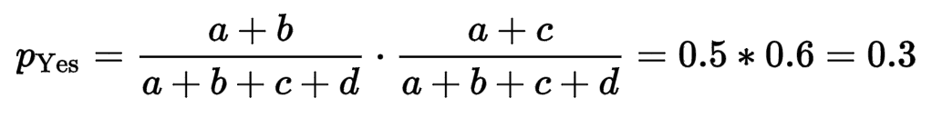
Cohen’s Kappa
The probability that both taggers label a tweet relevant (by chance) is
Prob. For A to tag a tweet relevant or “1”
Prob. For B to tag a tweet as relevant (i.e., “1”)

Slide 12
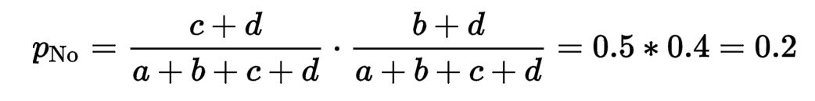
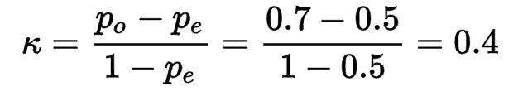

Cohen’s Kappa
Similarly, the probability that both say “No” (by chance) is
Overall agreement probability by chance is
Cohen’s Kappa is

Slide 13
What Cohen’s Kappa value means good?
One possible interpretation of Cohen’s Kappa.
Poor agreement = Less than 0.20
Fair agreement = 0.20 to 0.40
Moderate agreement = 0.40 to 0.60
Good agreement = 0.60 to 0.80
Very good agreement = 0.80 to 1.00
Ref: http://www.pmean.com/definitions/kappa.htm

Slide 14
Lab 4-1 Merge Tagging Results
Before the merge, decide one of you will be “tagger A”, the other “tagger B”.
Double check you are tagging the same set of tweets.
Open both spreadsheets that record the tagging results. Rename the column heading of tagger A’s relevant tagging as “taggerARelevant”. Rename the column heading of tagger B’s relevant taggings as “taggerBRelevant”.
Copy and insert the column “taggerBRelevant” to the spreadsheet of tagger A.
Save the spreadsheet that contains both tagging results as a CSV file (choosing comma “,” as delimiters) tweets_merged_tags.csv

Slide 15
Lab 4-2 Import the CSV file into Jupyter Notebook
Use the name of YOUR CSV file containing merged tagging results.
Type the following in jupyter
import datascience
from datascience import *
table1 = Table.read_table('tweets_merged_tags.csv‘, sep=‘,’)
table1
a = table1.where('taggerARelevant', are.equal_to('1')).where('taggerBRelevant', are.equal_to('1')).num_rows
b = table1.where('taggerARelevant', are.equal_to('1')).where('taggerBRelevant', are.equal_to('0')).num_rows
c = table1.where('taggerARelevant', are.equal_to('0')).where('taggerBRelevant', are.equal_to('1')).num_rows
d = table1.where('taggerARelevant', are.equal_to('0')).where('taggerBRelevant', are.equal_to('0')).num_rowsd
total = a + b + c + d
If you saved CSV file using “Tab” as delimiter, put ‘\t’ as the parameter for sep.
You should see the content of table1 after you type this into jupyter, with columns aligned.
You can type each variable individually to find out their value.

Slide 16
Lab 4-3 Calculate Your Inter-tagger Consistency Measure
proportion_agreement = (a + d) / total
Yes_chance= ((a + b) / total) * ((a + c) / total)
No_chance = ( (c + d) / total) * ( (b + d) / total )
agreement_chance = Yes_chance + No_chance
CohenKappa = (proportion_agreement - agreement_chance) / (1 - agreement_chance)

Slide 17

Cohen’s Kappa for Three Classes
What if I have more than two categories of labels
$p_{o}$= (10+16+8) / Total
$p_{e}=p_{\text{Negative}}+p_{\text{Positive}}+p_{\text{Neutral}}$
Ref: http://www.real-statistics.com/reliability/cohens-kappa/
 |  | Rater A
 |  | Negative | Positive | Neutral
Rater B | Negative | 10 | 4 | 1
 | Positive | 6 | 16 | 2
 | Neutral | 0 | 3 | 8

Slide 18
Lab 4 assignment
Combine two independent tagging results and compute the Cohen’s Kappa score. (Capture a screen shots of Jupyter Notebook for the calculation.)
Generate a Tagging Guidelines based on your discussion of disagreements (to improve the consistency of future tagging).
Submit to Canvas
The CSV file of your collected tweets with two tagging results (from two taggers).
A word or pdf document including (1) the Cohen’s Kappa score for your tagging results (include a screen shot of jupyter notebook for the calculation), and (2) the Tagging Guidelines generated.

