Slide 1
Chapter 12: Part C
Part A:
  Index Definition in SQL
  Ordered Indices
  Index Sequential
Part B:
  B+-Tree Index Files
  B-Tree Index Files
Part C: Hashing
  Static and Dynamic Hashing
  Comparison of Ordered Indexing and Hashing
  Multi-Key Access

Slide 2
Static Hashing
A bucket is a unit of storage containing one or more records (a bucket is typically a disk block). In a hash file organization we obtain the bucket of a record directly from its search-key value using a hash function.
Hash function h is a function from the set of all search-key values K to the set of all bucket addresses B.
Hash function is used to locate records for access, insertion as well as deletion.
Records with different search-key values may be mapped to the same bucket; thus entire bucket has to be searched sequentially to locate a record.

Slide 3
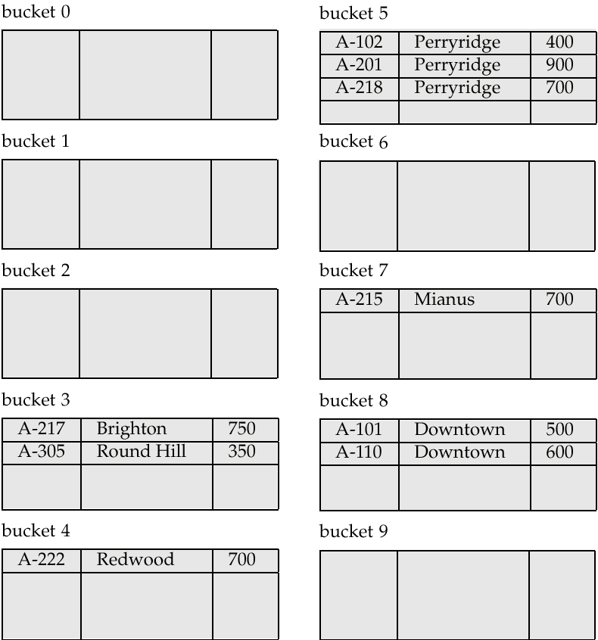
Example of Hash File Organization

Slide 4
Example of Hash File Organization (Cont.)
Hash file organization of account file, using branch-name as key.
(See figure in previous slide.)
There are 10 buckets,
The binary representation of the ith character is assumed to be the integer i.
The hash function returns the sum of the binary representations of the characters modulo 10.

Slide 5
Hash Indices
Hashing can be used not only for file organization, but also for index-structure creation. A hash index organizes the search keys, with their associated record pointers, into a hash file structure.

Slide 6
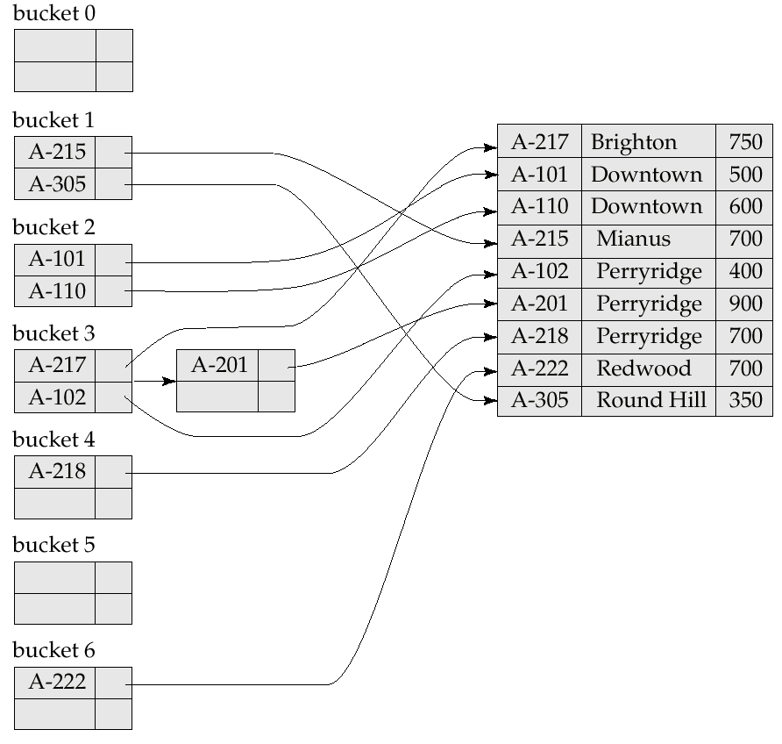
Example of Hash Index

Slide 7
Handling of Bucket Overflows
Bucket overflow can occur because of
  Insufficient buckets
  Skew in distribution of records. This can occur due to two reasons:
    multiple records have same search-key value
    chosen hash function produces non-uniform distribution of key values
Although the probability of bucket overflow can be reduced it cannot be eliminated; it is handled by using overflow buckets.
Overflow chaining – the overflow buckets of a given bucket are chained together in a linked list.
Above scheme is called closed hashing. An alternative, called open hashing, is not suitable for database applications.

Slide 8
Deficiencies of Static Hashing
In static hashing, function h maps search-key values to a fixed set of B of bucket addresses.
  Databases grow with time. If initial number of buckets is too small, performance will degrade due to too much overflows.
  If we allocate a large space there is waste
  If database shrinks, again space will be wasted.
  One option is periodic re-organization of the file with a new hash function, but it is very expensive.
These problems can be avoided by using techniques that allow the number of buckets to be modified dynamically.

Slide 9
Dynamic Hashing
Good for database that grows and shrinks in size
Allows the hash function to be modified dynamically
Extendable hashing – one form of dynamic hashing
  Hash function generates values over a large range — typically b-bit integers, with b = 32.
  At any time use only a prefix of the hash function to index into a table of bucket addresses. Let the length of the prefix be i bits,
  0 ≤ i ≤ 32
  Initially i = 0
  Value of i grows and shrinks as the size of the database grows and shrinks.
  Actual number of buckets is < 2^{i}, and this also changes dynamically due to coalescing and splitting of buckets.

Slide 10
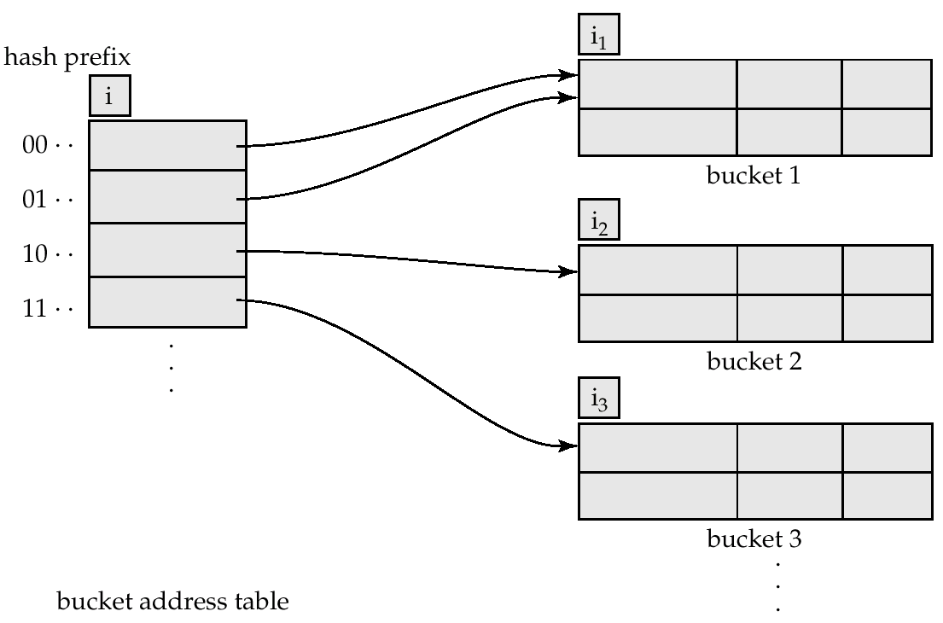
General Extendable Hash Structure
In this structure, i₂ = i₃ = i, whereas i₁ = i – 1

Slide 11
Use of Extendable Hash Structure
Multiple entries in the bucket address table may point to a bucket. Each bucket j stores a value i_{j}; all the entries that point to the same bucket have the same values on the first i_{j} bits.
To locate the bucket containing search-key K_{j}:
  1. Compute h(K_{j}) = X
  2. Use the first i high order bits of X as a displacement into bucket address table, and follow the pointer to appropriate bucket
To insert a record with search-key value K_{j} follow same procedure as look-up and locate the bucket, say j.
If there is room in the bucket j insert record in the bucket. Else the bucket must be split and insertion re-attempted. (See next slide.)

Slide 12
Updates in Extendable Hash Structure
To split a bucket j when inserting record with search-key value K_{j}:
If i > i_{j} (more than one pointer to bucket j)
  allocate a new bucket z, and set i_{j} and i_{z} to the old i_{j} -+ 1.
  make the second half of the bucket address table entries pointing to j to point to z
  remove and reinsert each record in bucket j.
  recompute new bucket for K_{j} and insert record in the bucket (further splitting is required if the bucket is still full)
If i = i_{j} (only one pointer to bucket j)
  increment i and double the size of the bucket address table.
  replace each entry in the table by two entries that point to the same bucket.
  recompute new bucket address table entry for K_{j.} . Now i > i_{j}, so use the first case above.

Slide 13
Updates in Extendable Hash Structure (Cont.)
When inserting a value, if the bucket is full after several splits (that is, i reaches some limit b) create an overflow bucket instead of splitting bucket entry table further.
To delete a key value, locate it in its bucket and remove it. The bucket itself can be removed if it becomes empty (with appropriate updates to the bucket address table). Coalescing of buckets and decreasing bucket address table size is also possible.

Slide 14
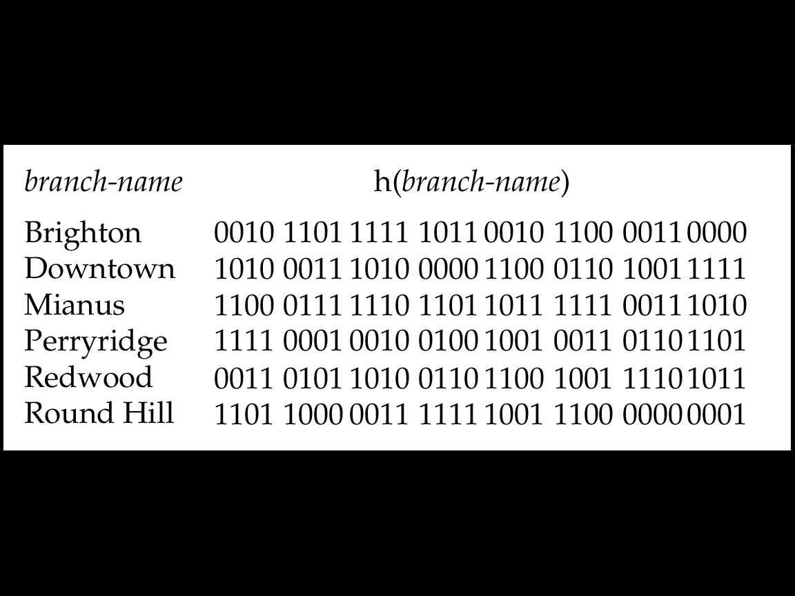
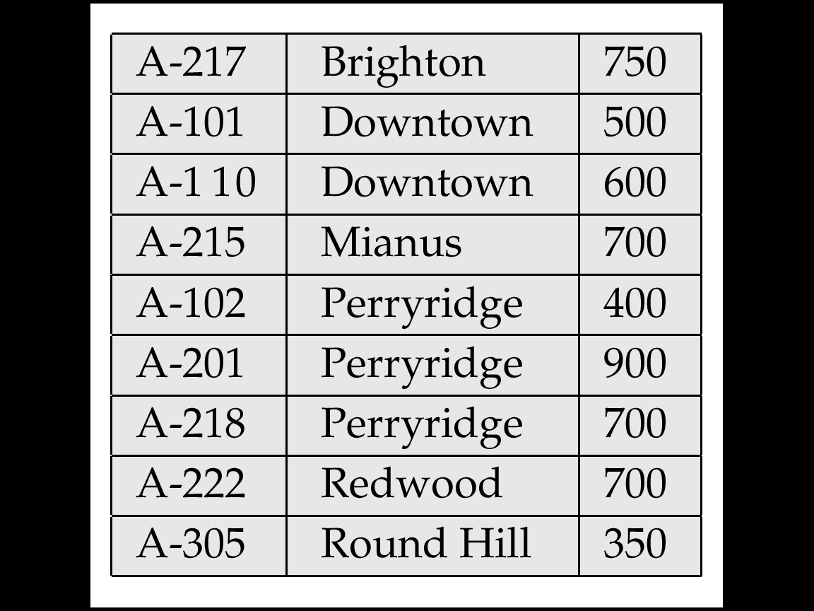
Hash Function of branch-name

Slide 15
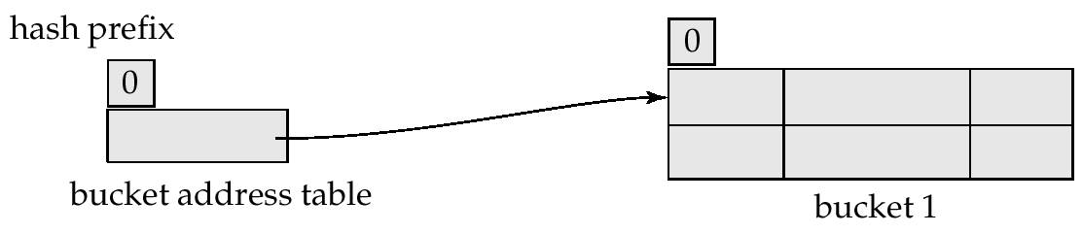
Use of Extendable Hash Structure: Example
branch-name h(branch-name)
Brighton 0010 1101 1111 1011 0010 1100 0011 0000
Downtown 1010 0011 1010 0000 1100 1010 1001 1111
Mianus 1100 0111 1110 1101 1011 1111 0011 1010
Perryridge 1111 0001 0010 0100 1001 0011 0110 1101
Redwood 0011 0101 1010 0110 1100 1001 1110 1011
Round Hill 1101 1000 0011 1111 1001 1100 0000 0001
Initial Hash Structure, Bucket size = 2

Slide 16
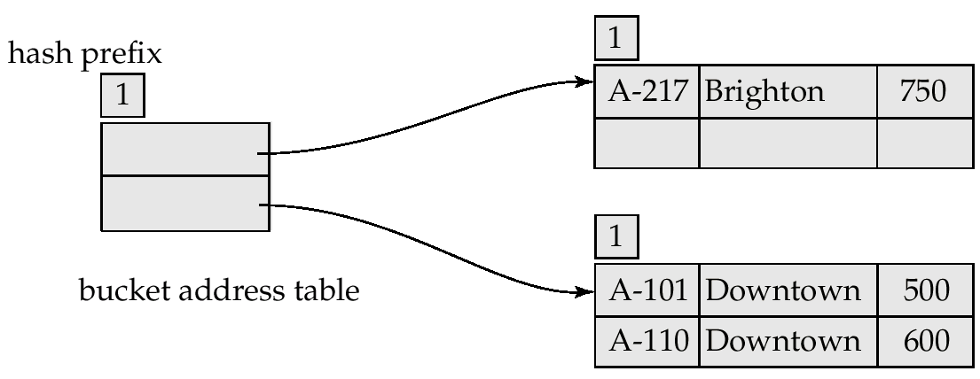
Hash Structure After Three Insertions

Slide 17
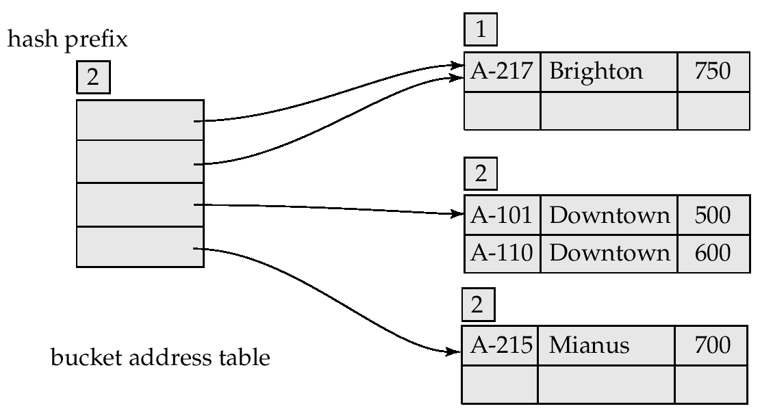
Example (Cont.)
Hash Structure after four insertions

Slide 18
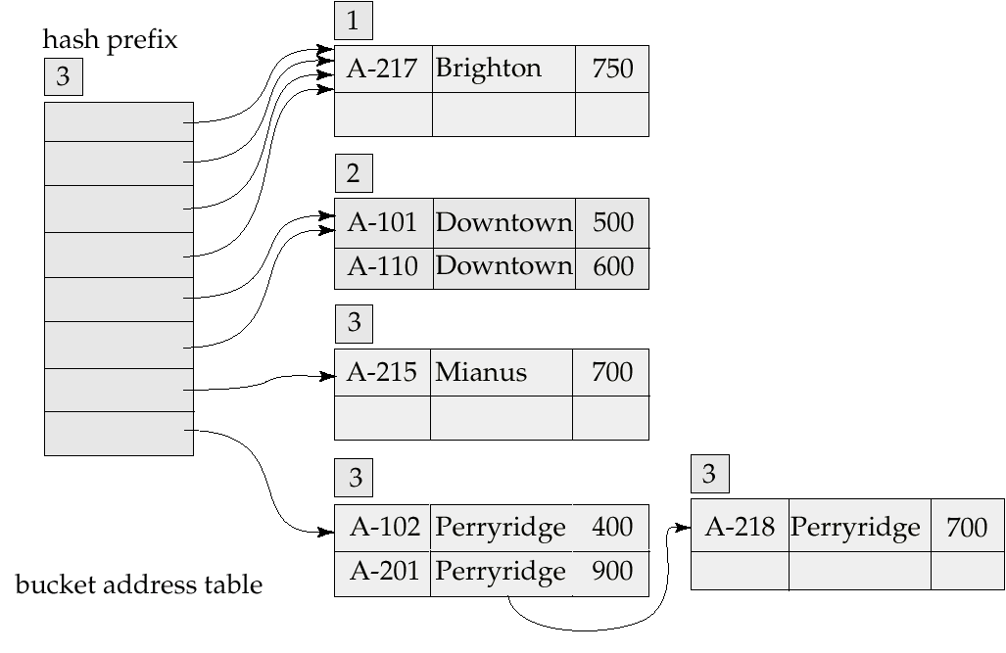
Hash structure after insertion

Slide 19
Comparison of Ordered Indexing and Hashing
Cost of periodic re-organization
Relative frequency of insertions and deletions
Is it desirable to optimize average access time at the expense of worst-case access time?
Expected type of queries:
  Hashing is generally better at retrieving records having a specified value of the key.
  If range queries are common, ordered indices are to be preferred

Slide 20
Multiple-Key Access
Use multiple indices for certain types of queries.
Example:
  select account-number
  from account
  where branch-name = “Perryridge” and balance - 1000
Possible strategies for processing query using indices on single attributes:
  1. Use index on branch-name to find accounts with balances of $1000; test branch-name = “Perryridge”.
  2. Use index on balance to find accounts with balances of $1000; test branch-name = “Perryridge”.
  3. Use branch-name index to find pointers to all records pertaining to the Perryridge branch. Similarly use index on balance. Take intersection of both sets of pointers obtained.

Slide 21
Indices on Multiple Attributes
Suppose we have an index on combined search-key
(branch-name, balance).
With the where clause
where branch-name = “Perryridge” and balance = 1000
the index on the combined search-key will fetch only records that satisfy both conditions.
Using separate indices in less efficient — we may fetch many records (or pointers) that satisfy only one of the conditions.
Can also efficiently handle
where branch-name - “Perryridge” and balance < 1000
But cannot efficiently handle
where branch-name < “Perryridge” and balance = 1000
May fetch many records that satisfy the first but not the second condition.

Slide 22
Grid Files
Structure used to speed the processing of general multiple search-key queries involving one or more comparison operators.
The grid file has a single grid array and one linear scale for each search-key attribute. The grid array has number of dimensions equal to number of search-key attributes.
Multiple cells of grid array can point to same bucket
To find the bucket for a search-key value, locate the row and column of its cell using the linear scales and follow pointer
If a bucket becomes full, new bucket can be created if more than one cell points to it. If only one cell points to it, overflow bucket needs to be created.

Slide 23
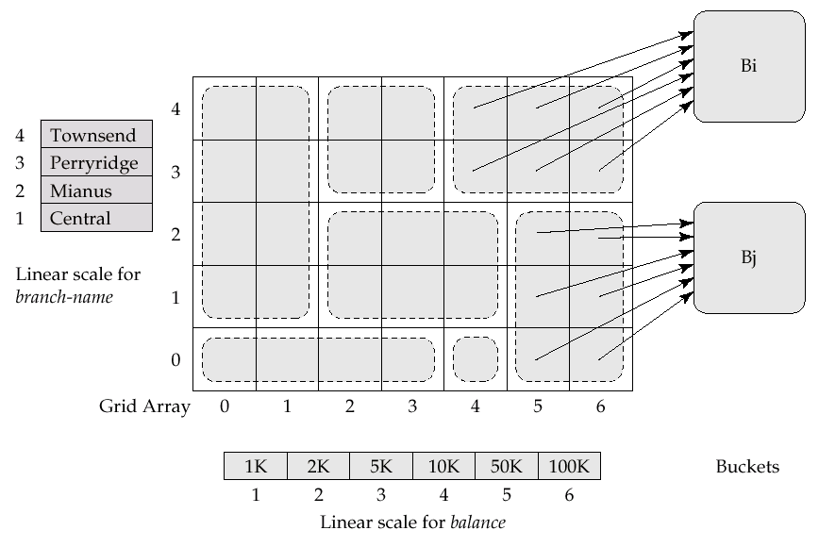
Example Grid File for account

Slide 24
Grid Files (Cont.)
A grid file on two attributes A and B can handle queries of the form (a₁ ≤ A ≤ a₂), (b₁ ≤ B ≤ b₂) as well as
(a₁ ≤ A ≤ a₂ ∧ b₁ ≤ B ≤ b₂), with reasonable efficiency.
E.g., to answer (a₁ ≤ A ≤ a₂ ∧ b₁ ≤ B ≤ b₂), use linear scales to find candidate grid array cells, and look up all the buckets pointed to from those cells.
Linear scales must be chosen to uniformly distribute records across cells. Otherwise there will be too many overflow buckets.
Periodic re-organization will help. But reorganization can be very expensive.
Space overhead of grid array can be high.
R-trees (Chapter 21) are an alternative

Slide 25
Partitioned Hashing
Hash values are split into segments that depend on each attribute of the search-key.
(A₁, A₂, . . . , A_{n}) for n attribute search-key
Example: n = 2, for customer, search-key being
(customer-street, customer-city)
search-key value hash value
(Main, Harrison) 101 111
(Main, Brooklyn) 101 001
(Park, Palo Alto) 010 010
(Spring, Brooklyn) 001 001
(Alma, Palo Alto) 110 010
To answer equality query on single attribute, need to look up multiple buckets. Similar in effect to grid files.

Slide 26
Other Multi Key Indices
R* trees
R+ trees (e.g., supported in ORACLE)
Quad Trees
Very important in spatio-temporal applications.

