Slide 1
Cassandra
Structured Storage System over a P2P Network
Avinash Lakshman, Prashant Malik

Slide 2
Why Cassandra?
Lots of data
  Copies of messages, reverse indices of messages, per user data.
Many incoming requests resulting in a lot of random reads and random writes.
No existing production ready solutions in the market meet these requirements.

Slide 3
Design Goals
High availability
Eventual consistency
  trade-off strong consistency in favor of high availability
Incremental scalability
Optimistic Replication
“Knobs” to tune tradeoffs between consistency, durability and latency
Low total cost of ownership
Minimal administration

Slide 4
Data Model
Columns are added and modified dynamically
KEY
ColumnFamily1 Name : MailList Type : Simple Sort : Name
Name : tid1
Value : <Binary>
TimeStamp : t1
Name : tid2
Value : <Binary>
TimeStamp : t2
Name : tid3
Value : <Binary>
TimeStamp : t3
Name : tid4
Value : <Binary>
TimeStamp : t4
Column Families are declared upfront
ColumnFamily2 Name : WordList Type : Super Sort : Time
Name : aloha
Name : dude
SuperColumns are added and modified dynamically
C1
V1
T1
C2
V2
T2
C3
V3
T3
C4
V4
T4
C2
V2
T2
C6
V6
T6
Columns are added and modified dynamically
ColumnFamily3 Name : System Type : Super Sort : Name
Name : hint1
<Column List>
Name : hint2
<Column List>
Name : hint3
<Column List>
Name : hint4
<Column List>

Slide 5
Write Operations
A client issues a write request to a random node in the Cassandra cluster.
The “Partitioner” determines the nodes responsible for the data.
Locally, write operations are logged and then applied to an in-memory version.
Commit log is stored on a dedicated disk local to the machine.

Slide 6
Write cont’d
Key (CF1 , CF2 , CF3)
Data size
Number of Objects
Lifetime
Memtable ( CF1)
Commit Log
Binary serialized
Key ( CF1 , CF2 , CF3 )
Memtable ( CF2)
FLUSH
Memtable ( CF2)
Data file on disk
Dedicated Disk
<Key name><Size of key Data><Index of columns/supercolumns>< Serialized column family>
---
---
---
---
<Key name><Size of key Data><Index of columns/supercolumns>< Serialized column family>
K₁₂₈ Offset
K₂₅₆ Offset
K₃₈₄ Offset
Bloom Filter
BLOCK Index <Key Name> Offset, <Key Name> Offset
(Index in memory)

Slide 7
Compactions
D E L E T E D
K1 < Serialized data >
K2 < Serialized data >
K3 < Serialized data >
--
--
--
K2 < Serialized data >
K10 < Serialized data >
K30 < Serialized data >
--
--
--
K4 < Serialized data >
K5 < Serialized data >
K10 < Serialized data >
--
--
--
Sorted
Sorted
Sorted
MERGE SORT
Index File
K1 < Serialized data >
K2 < Serialized data >
K3 < Serialized data >
K4 < Serialized data >
K5 < Serialized data >
K10 < Serialized data >
K30 < Serialized data >
Loaded in memory
K1 Offset
K5 Offset
K30 Offset
Bloom Filter
Sorted
Data File

Slide 8
Write Properties
No locks in the critical path
Sequential disk access
Behaves like a write back Cache
Append support without read ahead
Atomicity guarantee for a key
“Always Writable”
  accept writes during failure scenarios

Slide 9
Read
Client
Query
Result
Cassandra Cluster
Read repair if digests differ
Closest replica
Result
Replica A
Digest Query
Digest Response
Digest Response
Replica B
Replica C

Slide 10
Partitioning
And Replication
h(key1)
1
0
E
A
N=3
C
h(key2)
F
B
D
1/2

Slide 11
Cluster Membership and Failure Detection
Gossip protocol is used for cluster membership.
Super lightweight with mathematically provable properties.
State disseminated in O(logN) rounds where N is the number of nodes in the cluster.
Every T seconds each member increments its heartbeat counter and selects one other member to send its list to.
A member merges the list with its own list .

Slide 12



Slide 13


Slide 14
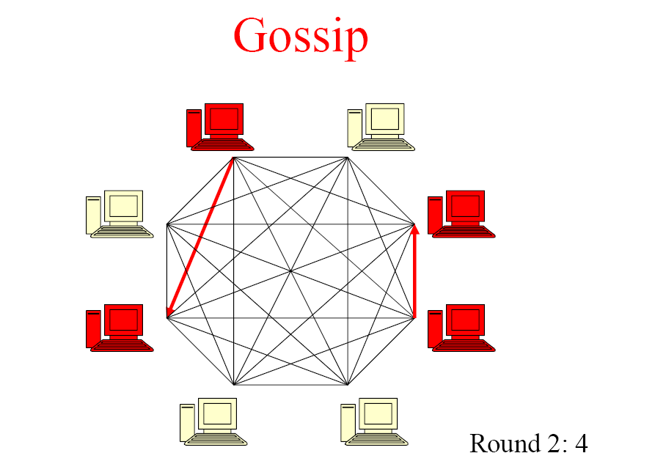

Slide 15


Slide 16
Accrual Failure Detector
Valuable for system management, replication, load balancing etc.
Defined as a failure detector that outputs a value, PHI, associated with each process.
Also known as Adaptive Failure detectors - designed to adapt to changing network conditions.
The value output, PHI, represents a suspicion level.
Applications set an appropriate threshold, trigger suspicions and perform appropriate actions.
In Cassandra the average time taken to detect a failure is 10-15 seconds with the PHI threshold set at 5.

Slide 17
Properties of the Failure Detector
If a process p is faulty, the suspicion level
Φ(t) → ∞as t → ∞.
If a process p is faulty, there is a time after which Φ(t) is monotonic increasing.
A process p is correct ⬄ Φ(t) has an ub over an infinite execution.
If process p is correct, then for any time T,
Φ(t) = 0 for t >= T.

Slide 18
Implementation
PHI estimation is done in three phases
  Inter arrival times for each member are stored in a sampling window.
  Estimate the distribution of the above inter arrival times.
  Gossip follows an exponential distribution.
  The value of PHI is now computed as follows:
    Φ(t) = -log₁₀( P(t_{now} – t_{last}) )
        where P(t) is the CDF of an exponential distribution. P(t) denotes the probability that a heartbeat will arrive more than t units after the previous one. P(t) = ( 1 – e^{-tλ} )
The overall mechanism is described in the figure below.

Slide 19
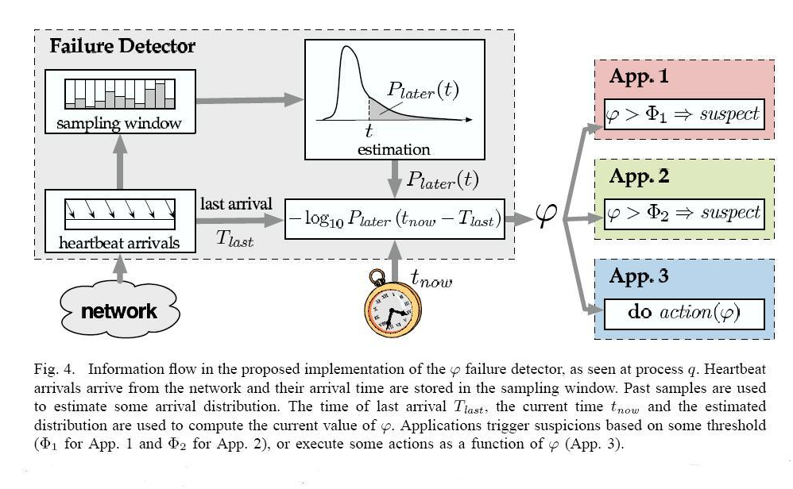
Information Flow in the Implementation

Slide 20
Performance Benchmark
Loading of data - limited by network bandwidth.
Read performance for Inbox Search in production:
 | Search Interactions | Term Search
Min | 7.69 ms | 7.78 ms
Median | 15.69 ms | 18.27 ms
Average | 26.13 ms | 44.41 ms

Slide 21
MySQL Comparison
MySQL > 50 GB Data
Writes Average : ~300 ms
Reads Average : ~350 ms
Cassandra > 50 GB Data
Writes Average : 0.12 ms
Reads Average : 15 ms

Slide 22
Lessons Learnt
Add fancy features only when absolutely required.
Many types of failures are possible.
Big systems need proper systems-level monitoring.
Value simple designs

Slide 23
Future work
Atomicity guarantees across multiple keys
Analysis support via Map/Reduce
Distributed transactions
Compression support
Granular security via ACL’s

Slide 24
Questions?

