Slide 1
Object Oriented Databases and Object Persistence

Slide 2
Introduction
Recap: Basic Concepts of OO
Advanced Concepts of OO
Basic Principles of Object Persistence
OODBMS
Evaluating OODBMSs

Slide 3
Recap: Basic Concepts of OO
Object is an instance of a class
Class contains a blueprint description of all the object’s characteristics
Object bundles both variables (which determine its state) and methods (which determine its behavior) in a coherent way

Slide 4
Recap: Basic Concepts of OO
public class Employee {
private int EmployeeID;
private String Name;
private String Gender;
private Department Dep;
public int getEmployeeID() {
return EmployeeID;
}
public void setEmployeeID( int id ) {
this.EmployeeID = id;
}
public String getName() {
return Name;}
public void setName( String name ) {
this.Name = name;
}
public String getGender() {
return Gender;
}
public void setGender( String gender ) {
this.Gender = gender;
}
public Department getDep() {
return Dep;
}
public void setDep(Department dep) {this.Dep = dep;}}

Slide 5
Recap: Basic Concepts of OO
Getter and setter methods implement the concept of information hiding (aka encapsulation)
Encapsulation enforces a strict separation between interface and implementation.
  interface consists of the signatures of the methods.
  implementation is based upon the object’s variables and method definitions

Slide 6
Recap: Basic Concepts of OO
public class EmployeeProgram {
public static void main(String[] args) {
Employee Bart = new Employee();
Employee Seppe = new Employee();
Employee Wilfried = new Employee();
Bart.setName("Bart Baesens");
Seppe.setName("Seppe vanden Broucke");
Wilfried.setName("Wilfried Lemahieu");
}
}

Slide 7
Advanced Concepts of OO
Method overloading
Inheritance
Method overriding
Polymorphism
Dynamic binding

Slide 8
Advanced Concepts of OO
Method overloading refers to using the same name for more than one method in the same class.
OO language environment can then determine which method you are calling, provided the number or type of parameters is different in each method

Slide 9
Advanced Concepts of OO
public class Book {
String title;
String author;
boolean isRead;
int numberOfReadings;
public void read(){
isRead = true;
numberOfReadings++;
}
public void read(int i){
isRead = true;
numberOfReadings += i;
}
}
read(1) same effect as read()
Notes:
One method has read and no parameters. One has one integer parameter. These are two different methods for Java

Slide 10
Advanced Concepts of OO
Method overloading is a handy feature when defining constructors for a class
A constructor is a method which returns an object of a class
Examples:
  Student(String name, int year, int month, int day)
  Student(String name)

Slide 11
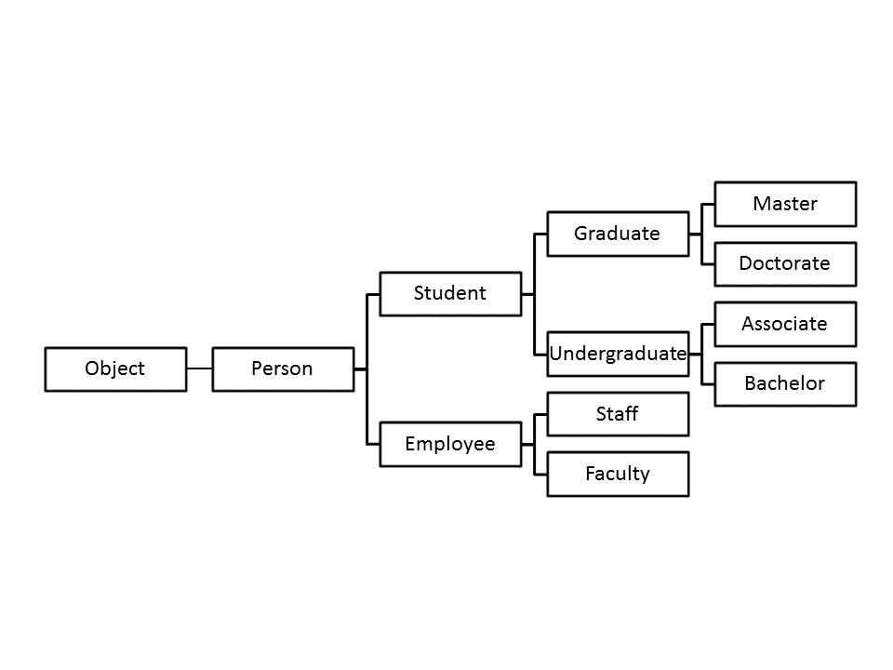
Advanced Concepts of OO
Inheritance represents an “is a” relationship
  E.g. Student and Employee inherit from Person
  Superclass versus Subclass

Slide 12
Advanced Concepts of OO
public class Employee extends Person {
private Employee manager;
private int id;
public Employee(String name, Employee manager, int empID) {
super(name);
this.setManager(manager);
this.setEmployeeID(empID);
}
public Employee getManager() {
return manager;
}
public void setManager(Employee manager) {
this.manager = manager;
}
public int getEmployeeID() {
return id;
}
private void setEmployeeID(int employeeID) {
this.id = employeeID;}}
public class Person {
private String name;
public Person(String name){
this.setName(name);
}
public String getName(){
return this.name;
}
public void setName(String name){
this.name = name;
}
}
Notes:
EXTENDS keyword specified the inheritence relationship in Java. How do we code this in Python? Class Employee(Person):

Slide 13
Advanced Concepts of OO
Method overriding: subclasses can override an inherited method with a new, specialized implementation

Slide 14
Advanced Concepts of OO
Student Class
Graduate Class
public double calculateGPA() {
double sum = 0;
int count = 0;
for (double grade : this.getGrades()){
sum += grade;
count++;
}
return sum/count;
}
public double calculateGPA(){
double sum = 0;
int count = 0;
for (double grade : this.getGrades()){
if (grade > 80){
sum += grade;
count++;
}
}
return sum/count;
}

Slide 15
Advanced Concepts of OO
Polymorphism refers to the ability of objects to respond differently to the same method
  closely related to inheritance
  depending on the functionality desired, the OO environment might consider a particular Master object as a Master, a Graduate, a Student, or a Person
Static binding binds a method to its implementation at compile time
Dynamic binding binds a method to its appropriate implementation at runtime, based on the object and its class.
Notes:
When a method is overriden, multiple implementations can be called depending on method – check superclass above if it doesn’t find a match.

Slide 16
Advanced Concepts of OO
public class PersonProgram {
public static void main(String[] args){
Student john = new Master("John Adams");
john.setGrades(0.75,0.82,0.91,0.69,0.79);
Student anne = new Associate("Anne Philips");
anne.setGrades(0.75,0.82,0.91,0.69,0.79);
System.out.println(john.getName() + ": " + john.calculateGPA());
System.out.println(anne.getName() + ": " + anne.calculateGPA());
}
}
OUTPUT:
John Adams: 0.865
Anne Philips: 0.792
Notes:
Getname – is only in person.
John.calculateGPA – Master doesn’t have calculateGPA, but Graduate does.
Anne calculateGPA – Associate and Undergraduate don’t have calculateGPA but student does

Slide 17
Basic Principles of Object Persistence
Transient object is only needed during program execution and can be discarded when the program terminates
Persistent object is an object that should survive program execution
Persistence strategies:
  Persistence by class
  Persistence by creation
  Persistence by marking
  Persistence by inheritance
  Persistence by reachability

Slide 18
Basic Principles of Object Persistence
Persistence by class implies that all objects of a particular class will be made persistent
Persistence by creation is achieved by extending the syntax for creating objects to indicate at compile-time that an object should be made persistent
Persistence by marking implies that all objects will be created as transient. An object can then be marked as persistent during program execution

Slide 19
Basic Principles of Object Persistence
Persistence by inheritance indicates that the persistence capabilities are inherited from a pre-defined persistent class
Persistence by reachability starts by declaring the root persistent object(s). All objects that are referred to (either directly or indirectly) by the root object(s) will then be made persistent as well.

Slide 20
Basic Principles of Object Persistence
Persistence orthogonality
  persistence independence: persistence of an object is independent of how a program manipulates it
  type orthogonality: all objects can be made persistent, irrespective of their type or size
  transitive persistence: refers to persistence by reachability

Slide 21
Basic Principles of Object Persistence
Persistent programming languages extend an OO language with a set of class libraries for object persistence
Serialization translates an object’s state into a format that can be stored (for example, in a file) and reconstructed later

Slide 22
Basic Principles of Object Persistence
def delete_profile(profile_name):
"""
delete specified profile
"”’
store = shelve.open(db_file)
try:
if profile_name is not "active":
del store[str(profile_name)]
try:
if str(store["active"]) == profile_name:
del store["active"]
except KeyError:
pass
click.echo("Profile '{}' successfullydeleted".format(str(profile_name)))
except KeyError:
click.echo("No such profile '{}'".format(str(profile_name)))
finally: store.close()
persistence by reachability!
Notes:
In Python, a ”shelf” is a persistent, dictionary-like object.

Slide 23
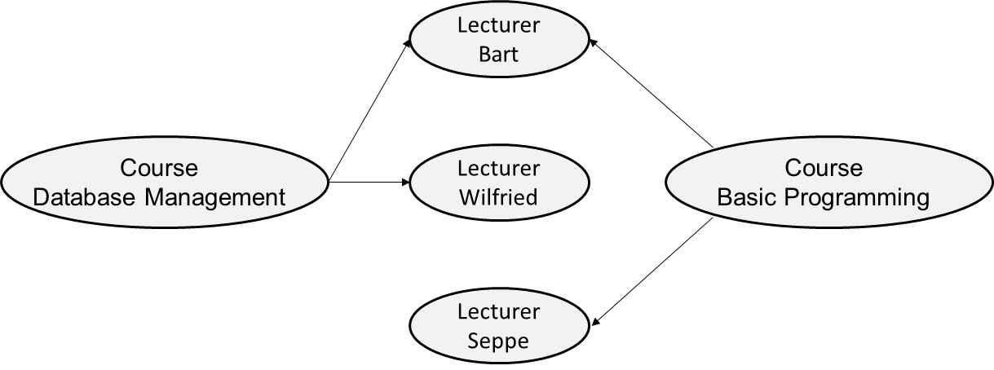
Basic Principles of Object Persistence
Serialization suffers from the same disadvantages of the file based approach
Lost object identity

Slide 24
OODBMS
Object-oriented DBMSs (OODBMSs) store persistent objects in a transparent way
OODBMSs originated as extensions o OO programming languages
OODBMSs support persistence orthogonality
OODBMSs guarantee the ACID properties

Slide 25
OODBMS
Every object has a unique and immutable object identifier (OID)
  Not dependent upon state of object (↔ primary key)
  Unique within entire OO environment (↔ primary key)
  Invisible to the user (↔ primary key)
OIDs are used to identify objects and to create and manage references between objects
OO model is often referred to as an identity-based model
  Relational model: value based model
Notes:
OID is DIFFERENT from Primary Key:
Primary Key updated, OID never is

Slide 26
OODBMS
Two objects are said to be equal when the values of their variables are the same (object equality)
  Shallow versus deep equality
Two objects are said to be identical or equivalent when their OIDs are the same (object identity)

Slide 27
OODBMS
The Object Database Management Group (ODMG) was formed in 1991 by a group of OO database vendors
  Changed to Object Management Group (OMG) in 1998
Promote portability and interoperability for object persistence by introducing a DDL and DML similar to SQL
only one language for dealing with both transient and persistent objects

Slide 28
OODBMS
OMG introduced 5 standards( most recent ODMG 3.0 in 2000 ) with following components:
  Object Model: provides a standard object model for OODBMS
  Object Definition Language (ODL): specifies object definitions (classes and interfaces)
  Object Query Language (OQL): allows to define SELECT queries
  Language Bindings (e.g., for C++, Smalltalk and Java): retrieve and manipulate object data.

Slide 29
OODBMS
Object Model provides a common model to define classes, variables or attributes, behavior and object persistence.
Two basic building blocks are objects and literals
A literal does not have an OID and cannot exist on its own (↔ an object)
Types of literals: atomic, collection, structured

Slide 30
OODBMS
Atomic literals: short (short integer), long (long integer), double (real number), float (real number), boolean (true or false), char, and string
Collection literals:
  Set: unordered collection of elements without duplicates
  Bag: unordered collection of elements which may contain duplicates
  List: ordered collection of elements
  Array: ordered collection of elements which is indexed
  Dictionary: unordered sequence of key-value pairs without duplicates
Notes:
Atomic – indivisible units

Slide 31
OODBMS
A structured literal consists of a fixed number of named elements
E.g., Date, Interval, Time and TimeStamp
struct Address{
string street;
integer number;
integer zipcode;
string city;
string state;
string country;
};

Slide 32
OODBMS
Object Definition Language (ODL) is a DDL to define the object types that conform to the ODMG Object Model

Slide 33
OODBMS
class EMPLOYEE
(extent employees
key SSN)
{
attribute string SSN;
attribute string ENAME;
attribute struct ADDRESS;
attribute enum GENDER {male, female};
attribute date DATE_OF_BIRTH;
relationship set<EMPLOYEE> supervises
inverse EMPLOYEE:: supervised_by;
relationship EMPLOYEE supervised_by
inverse EMPLOYEE:: supervises;
relationship DEPARTMENT works_in
inverse DEPARTMENT:: workers;
relationship set<PROJECT> has_projects
inverse PROJECT:: has_employees;
string GET_SSN();
void SET_SSN(in string new_ssn);}
…

Slide 34
OODBMS
class DEPARTMENT
(extent departments
key DNR)
{
attribute string DNR;
attribute string DNAME;
attribute set<string> DLOCATION;
relationship set<EMPLOYEE> workers
inverse EMPLOYEE:: works_in;
relationship set<PROJECT> assigned_to_projects
inverse PROJECT:: assigned_to_department
relationship MANAGER managed_by
inverse MANAGER:: manages;
string GET_DNR();
void SET_DNR(in string new_dnr);
…}
class MANAGER extends EMPLOYEE
(extent managers)
{
attribute date mgrdate;
relationship DEPARTMENT manages
inverse DEPARTMENT:: managed_by
}

Slide 35
OODBMS
Relationships can be defined using the keyword relationship.
Only unary and binary relationships with cardinalities of 1:1, 1:N, or N:M are supported in ODMG.
Ternary (or higher) relationships and relationship attributes need to be decomposed by introducing extra classes and relationships.

Slide 36
OODBMS
Every relationship is defined in a bidirectional way, using the keyword inverse
relationship DEPARTMENT works_in
inverse DEPARTMENT:: workers;
relationship set<EMPLOYEE> workers
inverse EMPLOYEE:: works_in;

Slide 37
OODBMS
Many-to-many relationship can be implemented by defining collection types (e.g. set, bag)
relationship set<PROJECT> has_projects
inverse PROJECT:: has_employees;
relationship SET<EMPLOYEE> has_employees
inverse EMPLOYEE:: has_projects;
Notes:
OODBMS will automatically add to the inverse

Slide 38
OODBMS
Object Query Language (OQL) is a declarative, non-procedural query language
OQL can be used for both navigational (procedural) as well as associative (declarative) access

Slide 39
OODBMS
A navigational query explicitly navigates from one object to another
Bart.DATE_OF_BIRTH
Bart.ADDRESS
Bart.ADDRESS.CITY

Slide 40
OODBMS
An associative query returns a collection (e.g., a set or bag) of objects which are located by the OODBMS.
Employees

Slide 41
OODBMS
SELECT… FROM … WHERE OQL queries
OQL query returns a bag
SELECT e.SSN, e.ENAME, e.ADDRESS, e.GENDER
FROM employees e
WHERE e.name=“Bart Baesens”

Slide 42
OODBMS
SELECT e.SSN, e.ENAME, e.ADDRESS, e.GENDER, e.age
FROM employees e
WHERE e.name=“Bart Baesens”
SELECT e
FROM employees e
WHERE e.age > 40

Slide 43
OODBMS
OQL join queries
SELECT e.SSN, e.ENAME, e.ADDRESS, e.GENDER, e.age
FROM employees e, e.works_in d
WHERE d.DNAME=”ICT”
SELECT e1.ENAME, e1.age, d.DNAME, e2.ENAME, e2.age
FROM employees e1, e1.works_in d, d.managed_by e2
WHERE e1.age > e2.age

Slide 44
OODBMS
count(employees)
SELECT e.SSN, e.ENAME
FROM employees e
WHERE EXISTS e IN (SELECT x FROM projects p WHERE p.has_employees x)
SELECT e.SSN, e.ENAME, e.salary
FROM employees e

Slide 45
OODBMS
ODMG language bindings provide implementations for the ODL and OQL specifications in popular OO programming languages (e.g. C++, Smalltalk or Java)
Object Manipulation Language (OML) is kept language-specific
E.g., for the Java language binding, this entails that Java’s type system will also be used by the OODBMS, that the Java language syntax is respected and that the OODBMS should handle management aspects based on Java’s object semantics

Slide 46
Evaluating OODBMSs
Complex objects and relationships are stored in a transparent way (no impedance mismatch!)
Success of OODBMSs has been limited to niche applications
  E.g., processing of scientific data sets by CERN
Disadvantages
  the (ad-hoc) query formulation and optimization procedures
  robustness, security, scalability and fault-tolerance
  no transparent implementation of the 3 layer database architecture (e.g. views)

Slide 47
Evaluating OODBMSs
Most mainstream database applications will, however, typically be built using an OO programming language in combination with an RDBMS
Object Relational Mapping (ORM) framework is used as middleware to facilitate the communication between both environments: OO host language and RDBMS

Slide 48
Conclusions
Recap: Basic Concepts of OO
Advanced Concepts of OO
Basic Principles of Object Persistence
OODBMS
Evaluating OODBMSs

Slide 49
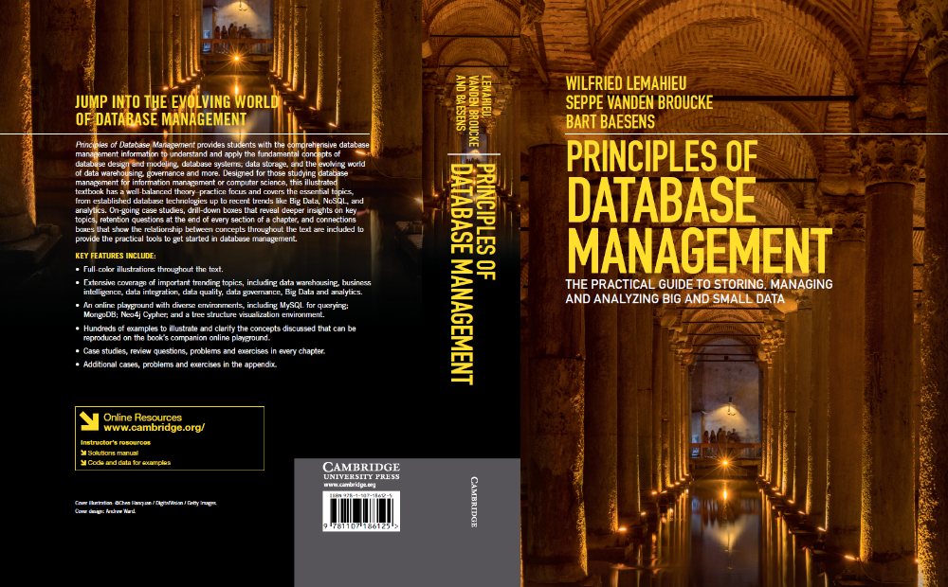
More information?
www.pdbmbook.com

