Slide 1
Nonparametric Methods: Nearest Neighbors
Oliver Schulte
Machine Learning 726
Notes:
If you use “insert slide number” under “Footer”, that text box only displays the slide number, not the total number of slides. So I use a new textbox for the slide number in the master.

Slide 2
Instance-based Methods
Model-based methods:
estimate a fixed set of model parameters from data.
compute prediction in closed form using parameters.
Instance-based methods:
look up similar “nearby” instances.
Predict that new instance will be like those seen before.
Example: will I like this movie?

Slide 3
Nonparametric Methods
Another name for instance-based or memory-based learning.
Misnomer: they have parameters.
Number of parameters is not fixed.
Often grows with number of examples:
More examples ➔ higher resolution.

Slide 4
k-nearest neighbor classification

Slide 5
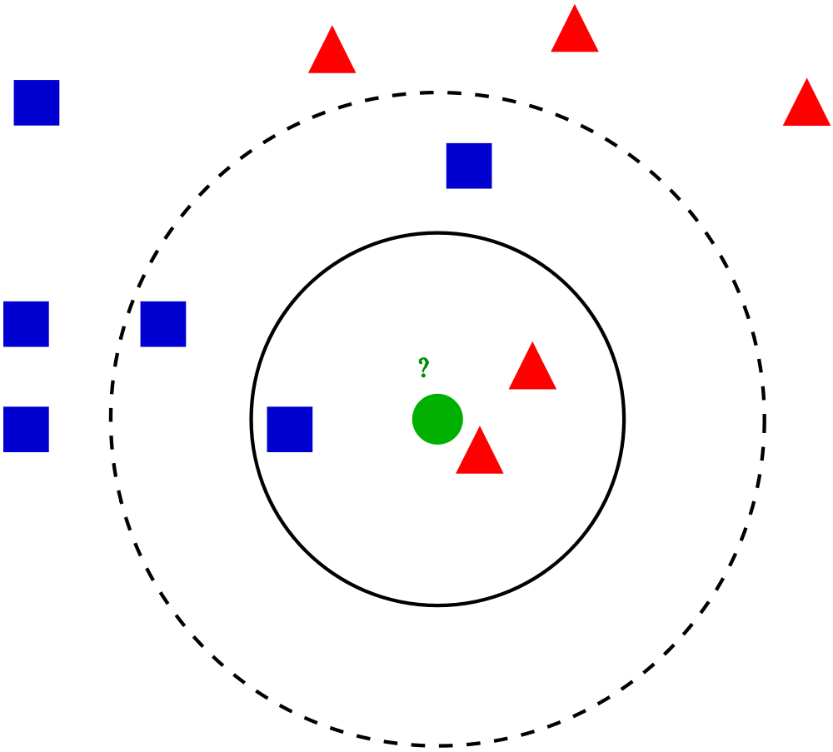
k-nearest neighbor rule
Choose k odd to help avoid ties (parameter!).
Given a query point x_{q}, find the sphere around x_{q} enclosing k points.
Classify x_{q} according to the majority of the k neighbors.
Notes:
At least k points in sphere.
Legend:
Green circle = test case.
Solid circle: k = 3
Dashed circle: k = 5.

Slide 6
Overfitting and Underfitting
k too small ➔ overfitting. Why?
k too large ➔ underfitting. Why?
k = 1
k = 5
Notes:
What is overfitting and underfitting?
Overfitting: k too small, fits neighborhood too much.
Underfitting: k too large, doesn’t generalize enough. In extreme case, k = N -> prior class label.
black region: classified as nuclear explosion by nearest neighbor method.
Overfits outlier at x2 = 6.
Events in Asia and Middle East between 1982 and 1990.
white = earthquake, black = nuclear explosion

Slide 7
Example: Oil Data Set

Slide 8
Implementation Issues
Learning very cheap compared to model estimation.
But prediction expensive: need to retrieve k nearest neighbors from large set of N points, for every prediction.
Nice data structure work: k-d trees, locality-sensitive hashing.
Notes:
k-d trees: generalized binary trees.
Locality-sensitive hashing: like hashing, but similar points have similar hash values.

Slide 9
Distance Metric
Does the generalization work.
Needs to be supplied by user.
With Boolean attributes: Hamming distance = number of different bits.
With continuous attributes: Use L2 norm, L1 norm, or Mahalanobis distance.
Also: kernels, see below.
For less sensitivity to choice of units, usually a good idea to normalize to mean 0, standard deviation 1.
Notes:
Mahalanobis distance looks at covariance between dimensions.
Basically, it’s the term in the exponent of the Gaussian distribution (see Bishop).

Slide 10
Curse of Dimensionality
Low dimension ➔ good performance for nearest neighbor.
As dataset grows, the nearest neighbors are near and carry similar labels.
Curse of dimensionality: in high dimensions, almost all points are far away from each other.
Notes:
number of grid cells of fixed side lengths grows exponentially with dimension

Slide 11
Point Distribution in High Dimensions
How many points fall within the 1% outer edge of a unit hypercube?
In one dimension, 2% (x < 1%, x> 99%).
In 200 dimensions? Guess...
Answer: 94%.
Similar question: to find 10 nearest neighbors, what is the length of the average neighbourhood cube?

Slide 12
k-nearest neighbor regression

Slide 13
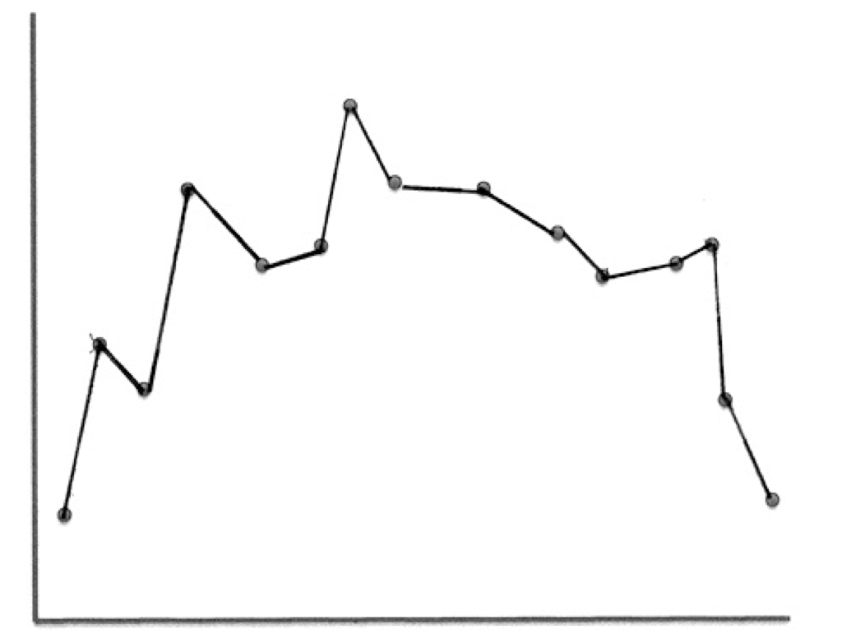
Local Regression
Basic Idea: To predict a target value y for data point x, apply interpolation/regression to the neighborhood of x.
Simplest version: connect the dots.
Notes:
Doesn’t generalize well for noisy data (outliers).

Slide 14
k-nearest neighbor regression
Connect the dots uses k = 2, fits a line.
Ideas for k =5.
Fit a line using linear regression.
Predict the average target value of the k points.
Notes:
What is k?

Slide 15
Local Regression With Kernels
Spikes in regression prediction come from in-or-out nature of neighborhood.
Instead, weight examples as function of the distance.
A homogenous kernel function maps the distance between two vectors to a number, usually in a nonlinear way. k(x,x’) = k(distance(x,x’)).
Example: The quadratic kernel.
Notes:
Legend: the arrrow shows the negated gradient, indicating the direction that produces steepest descent along the error surface

Slide 16
The Quadratic Kernel
k = 5
Let query point be x = 0.
Plot k(0,x’) = k(|x’|).
Notes:
weight vector = black. points in direction of red class. Add weight vector to misclssified feature vector to get new weight vector.

Slide 17
Kernel Regression
For each query point x_{q}, prediction is made as weighted linear sum: y(x_{q}) = w• x_{q.}
To find weights, solve the following regression on the k-nearest neighbors:

