Slide 1
DS 200 Lab3 Gather and Convert Real-Time Twitter Data
January 23-25, 2018
Instructor: John Yen
LA: Luwei Lei

Slide 2
Preparation for Lab 3
Create a Twitter Account
Have a personal Web page (can be your Facebook page)
Download and install Atom (a tool for editing code)

Slide 3
Table of content
Create a Twitter app (Slide 3 -- 9)
Install tweepy package (Slide 10)
Edit Python code (Slide 11 -- 12)
Download tweets (Slide 13 -- 15)
Convert to CSV file (Slide 16)
Load CSV data (Slide 17 -- 18)

Slide 4
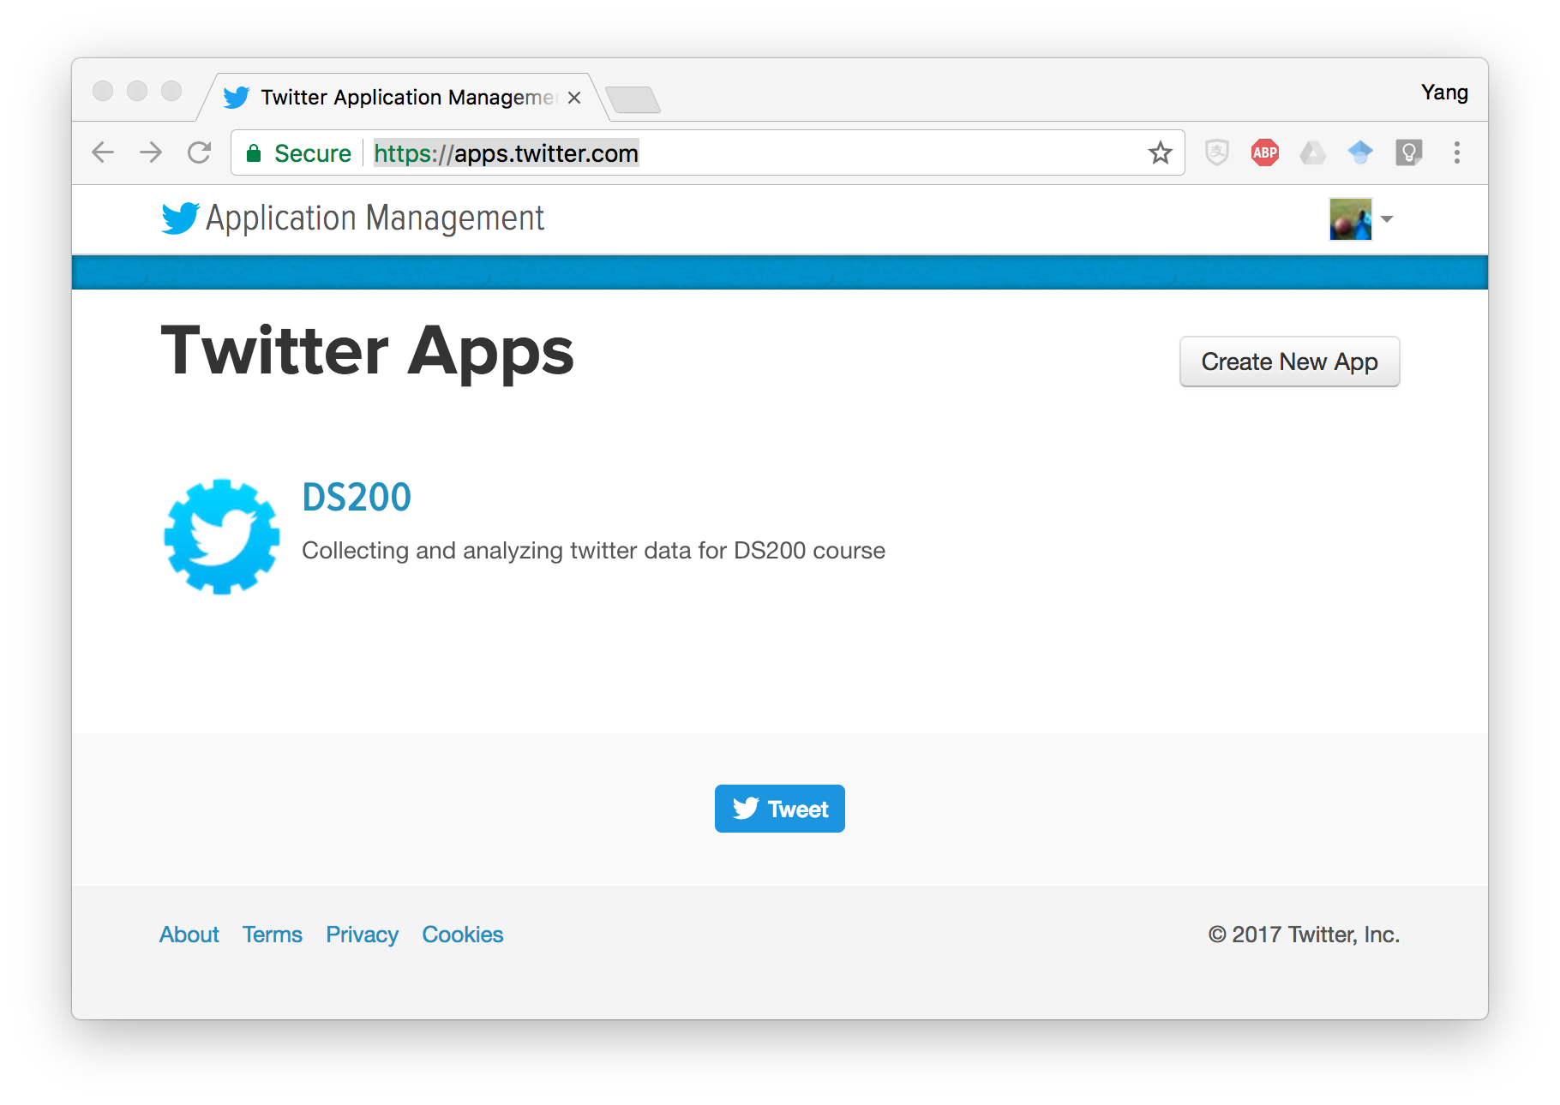
Create a Twitter app
Go to https://apps.twitter.com/
Login with your Twitter account
Click on the “Create New App” Button

Slide 5
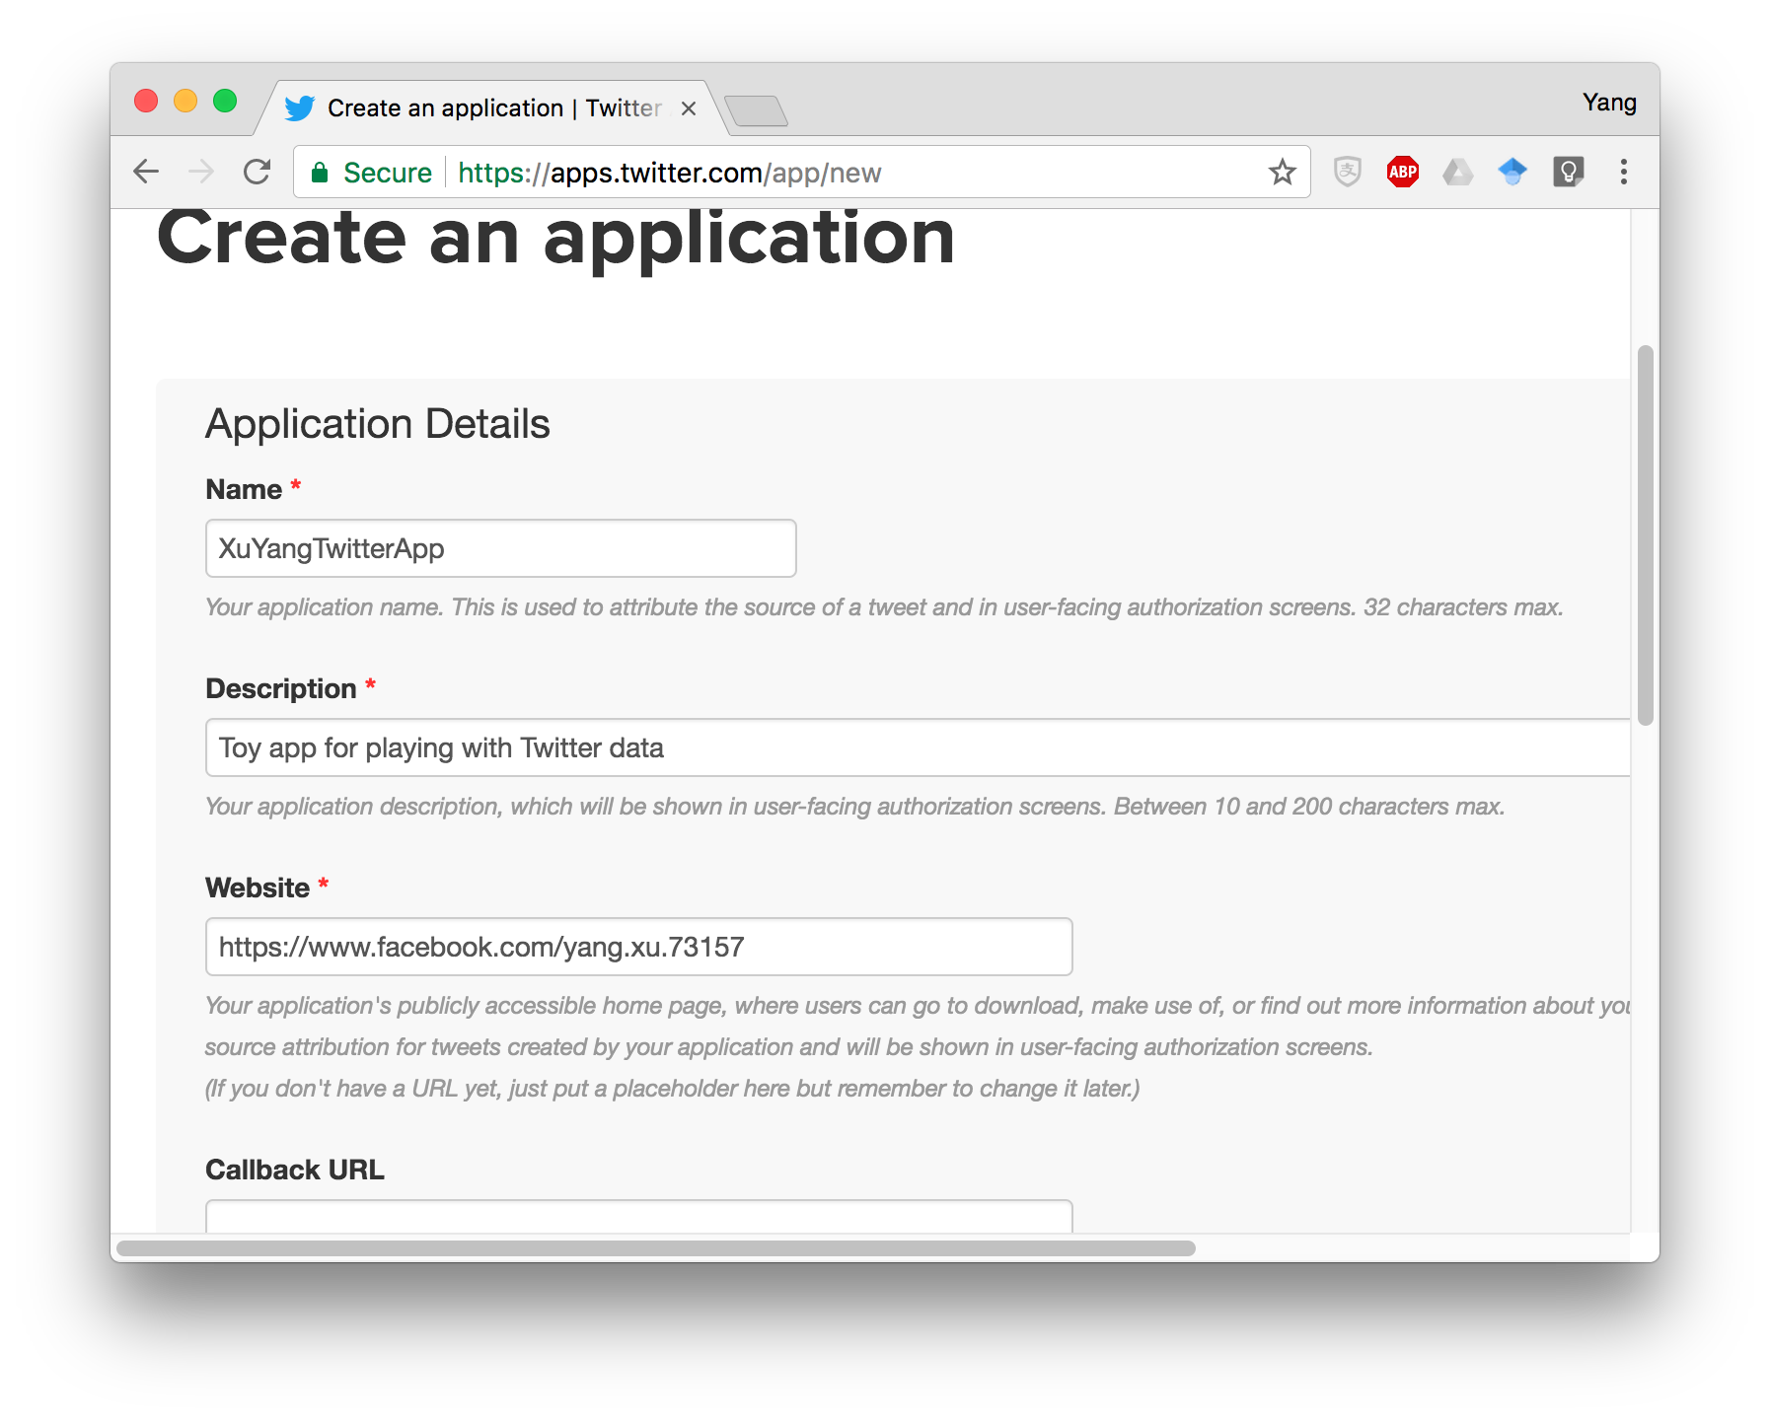
Create a Twitter app
Fill in all the necessary information
“Name”, “Description”, and “Website” must exist
“Website” could be your Facebook Homepage address
Scroll down and click on “Create Application”

Slide 6
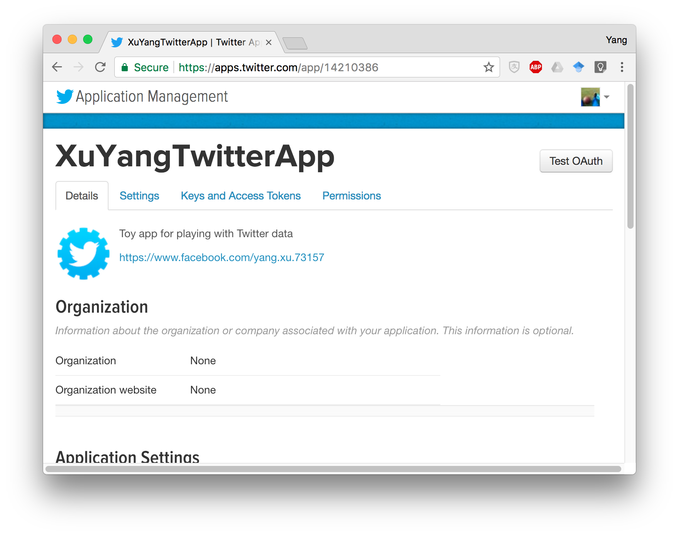
Create a Twitter app
App created!
The information we need for Python programming is in the “Keys and Access Tokens” panel

Slide 7
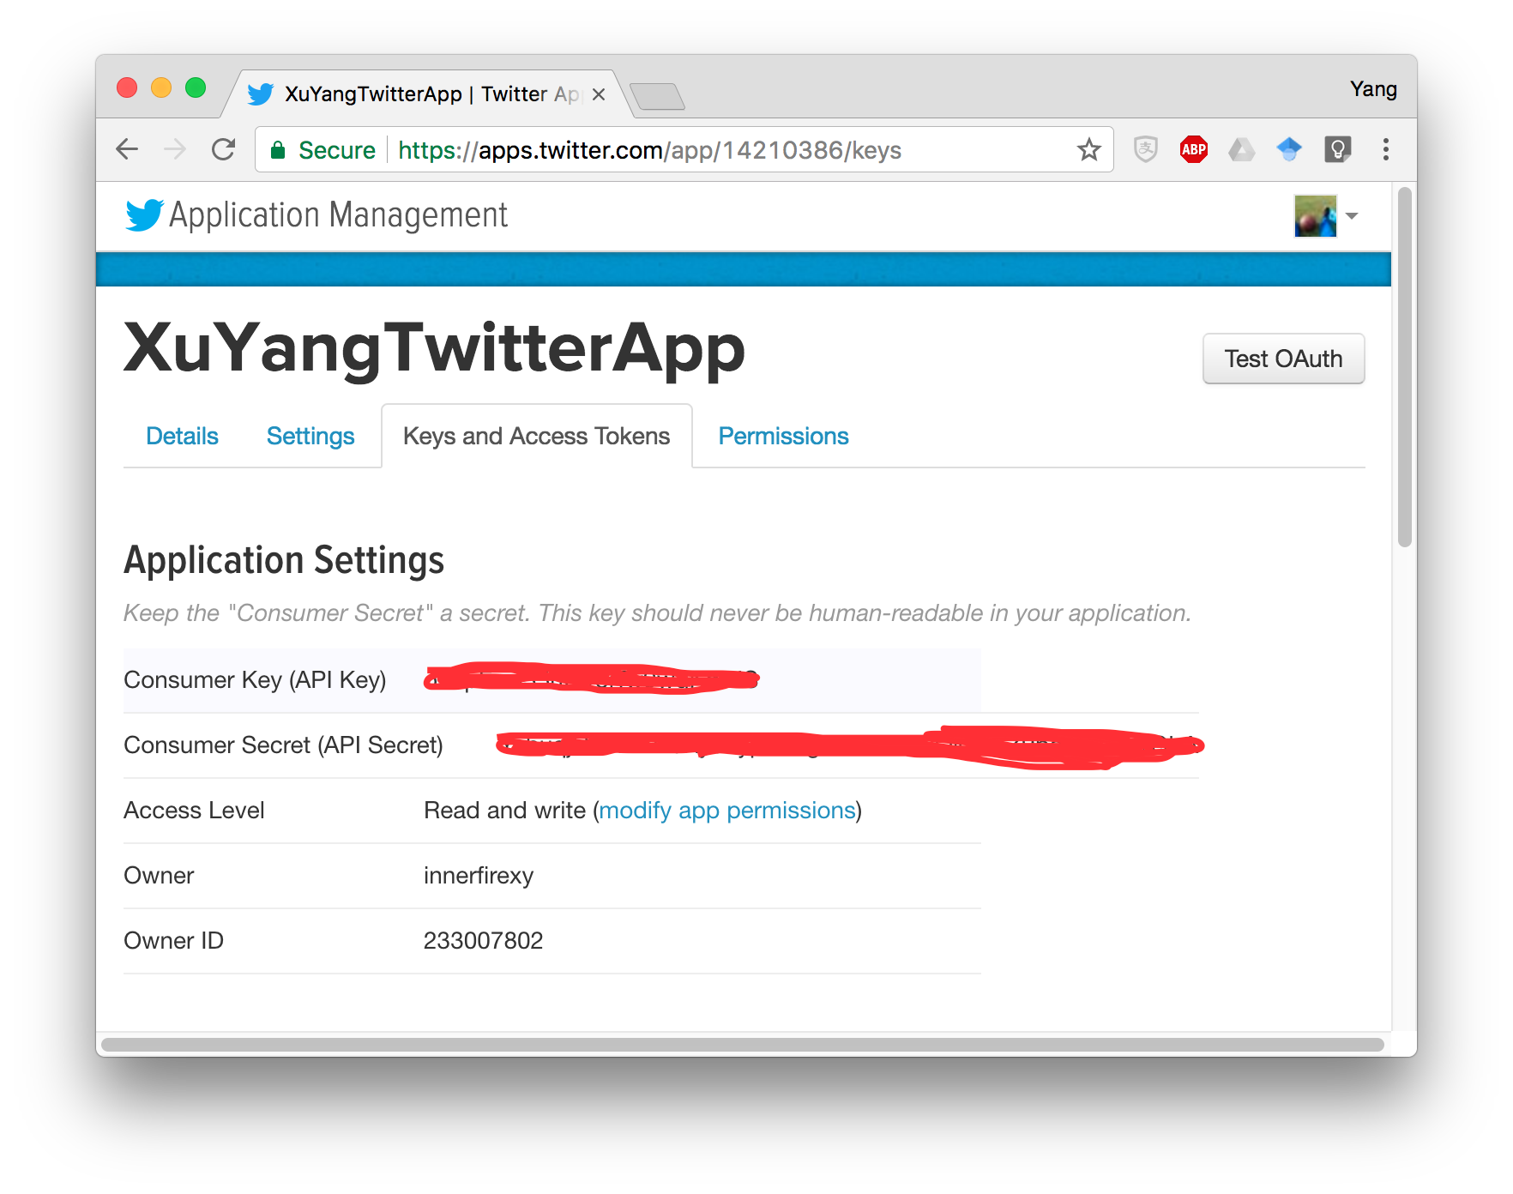
Create a Twitter app
“Consumer Key” and
“Consumer Secret”
Keep them only known
to YOU!
Copy and save them somewhere.
You will need to use them later.

Slide 8
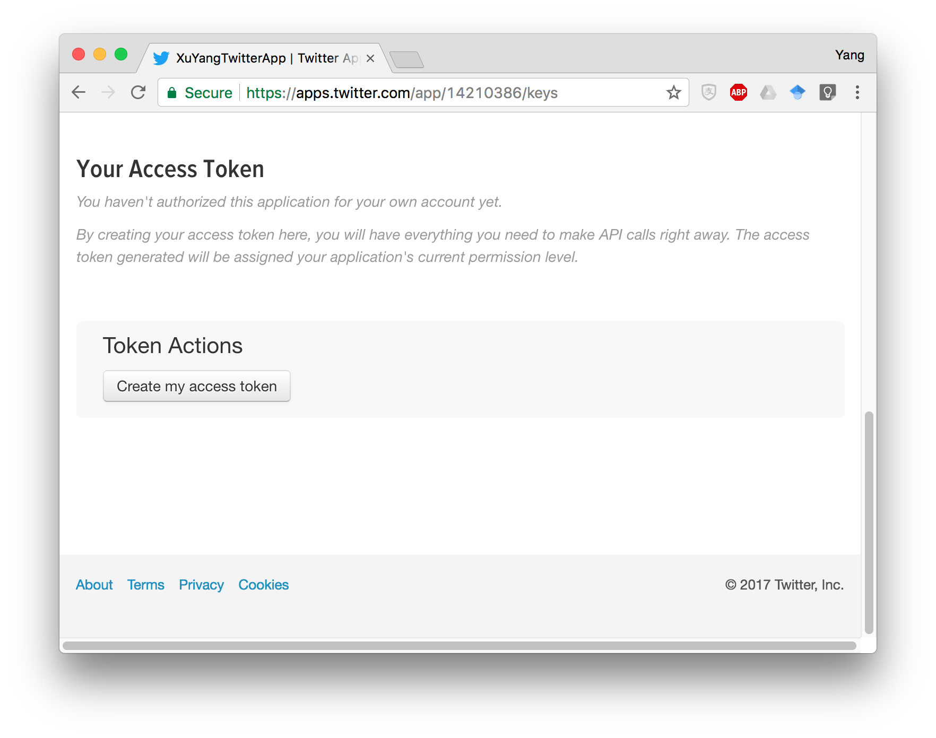
Create a Twitter app
Scroll down and click on “Create my access token”

Slide 9
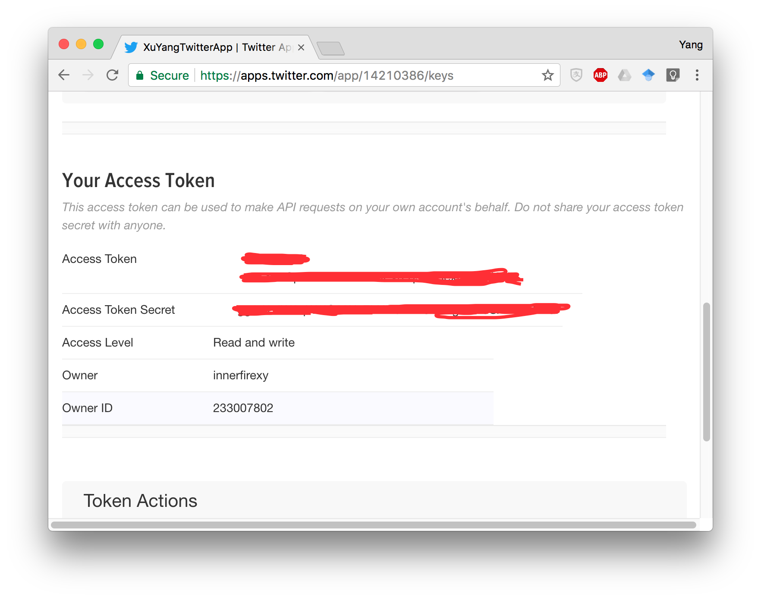
Create a Twitter app
Now you have the “Access Token” and “Access Token Secret”
Copy and save them somewhere.
You will need to use them later.

Slide 10
Create a Twitter app -- Done
Now you have four long strings of digits and letters for the following:
Consumer Key
Consumer Secret
Access Token
Access Token Secret
These are what you need for using Twitter API in Python

Slide 11
Install tweepy package
Open Command Line (Windows) or Terminal (Mac/Linux)
Type: pip install tweepy
Use pip3 in case you also have python2 in your system

Slide 12
Commands for Navigating and Creating Files
Change the Current Director: cd
List the content of the Current Directory: ls
Create a New subdirectory under the Current Directory: mkdir
Copy a File to a Directory: cp <file name> <path of the target directory>

Slide 13
Edit the Python code
Download the get_tweets.py and json_to_csv.py files from Canvas.
Open Command Line in Windows, or Terminal in Mac/Linux
Create a directory for the lab using “mkdir” command
E.g., “mkdir C:\Users\YourName\MyDocument\DS200lab3” for Windows
E.g., “mkdir ~/DS200lab3” for Mac/Unix (“~” refers to your home directory)
Enter the directory where you download get_tweets.py and json_to_csv.py
E.g., “cd C:\Users\YourName\Downloads” for Windows
E.g., “cd ~/Downloads” for Mac/Linux
Copy the files to your lab3 directory
E.g., “cp get_tweets.py C:\Users\YourName\MyDocument\DS200lab3” for Windows
E.g., “cp get_tweets.py ~/DS200lab3” for Mac/Linux

Slide 14
Edit the Python code using Text Editor
Open get_tweets.py file using one of the following text editors (NOT WORD):
Recommended text editors:
Windows: Atom, sublime text, Notepad++,
Mac/Linux: Atom, sbulime text, gedit, vim, etc.

Slide 15
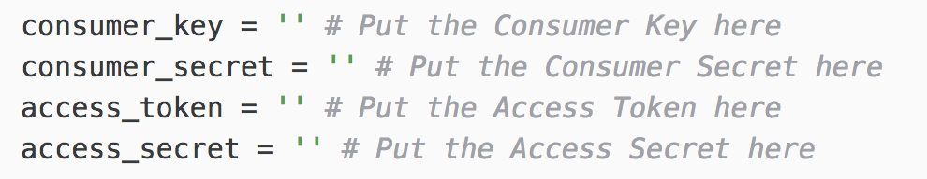
Edit the Python code using Text Editor
Invoke the text editor for editing get_tweets.py
Assign your own Consumer Key, Consumer Secret, Access Token and Access Token Secret to the corresponding variables
Copy and paste them between the single quotes
Save the file get_tweets.py (If you don’t save, you will loose the changes you made above)

Slide 16
What the code get_tweets.py does?
Specify keywords and hashtags for gathering tweets
Specify how many tweets to gather

Slide 17
Gather tweets
Open Command Line in Windows, or Terminal in Mac/Linux
Enter the directory (e.g., lab3) to which you copied the downloaded files get_tweets.py and json_to_csv.py
E.g., “cd C:\Users\MyDocument\DS200lab3” for Windows
E.g., “cd ~/DS200lab3” for Mac/Linux
Invoke get_tweets.py to gather tweets
Type: python3 get_tweets.py “KeyWord1” “KeyWord2” …
You can replace KeyWord1, KeyWord2 with whatever words or hashtags (in double quotes) you are interested in using for gathering tweets (see next page)

Slide 18
Gather tweets
Examples:
python3 get_tweets.py Houston hurrycane
python3 get_tweet.py Houston hurrycane “#Harvey”
Note: Key words that are hashtags (e.g., “#Harvey”), must be put in double quotes.

Slide 19
Gather tweets
After you run the code, the Python program will tell you the progress of downloading the tweets
By default, 300 most recent tweets that contain the key words you specified will be gathered through the Twitter API
Tweets are saved into a file named “my_tweets_YYYY-MM-DD_HH-MM-SS.json” in JSON format
YYYY-MM-DD is the date you gathered tweets
HH-MM-SS is the time you gathered tweets
This way, you do not need to worry about tweets gathered on one day override tweets gathered in an earlier time

Slide 20
Convert JSON to CSV
After you have completed gathering tweets, we want to convert it to a more friendly format: comma-separated values (CSV) file
We will do this using “my_tweets_*.json” you downloaded from Canvasa for this lab.
In Terminal, type: python3 json_to_csv.py my_tweets_*.json
Then you should see a my_tweets_*.csv file generated (By default, it contains 5 columns: user_id, user_name, time, location, text)

Slide 21
Load CSV data in Jupyter Notebook
In the same directory, type “jupyter notebook” in Terminal
from datascience import *
tweets = Table.read_table('my_tweets_*.csv', sep='\t')
tweets

Slide 22
Import CSV file into Excel
Submit JSON file, CSV file, and a screenshot of EXCEL after importing the CSV file as Lab 3.

Slide 23
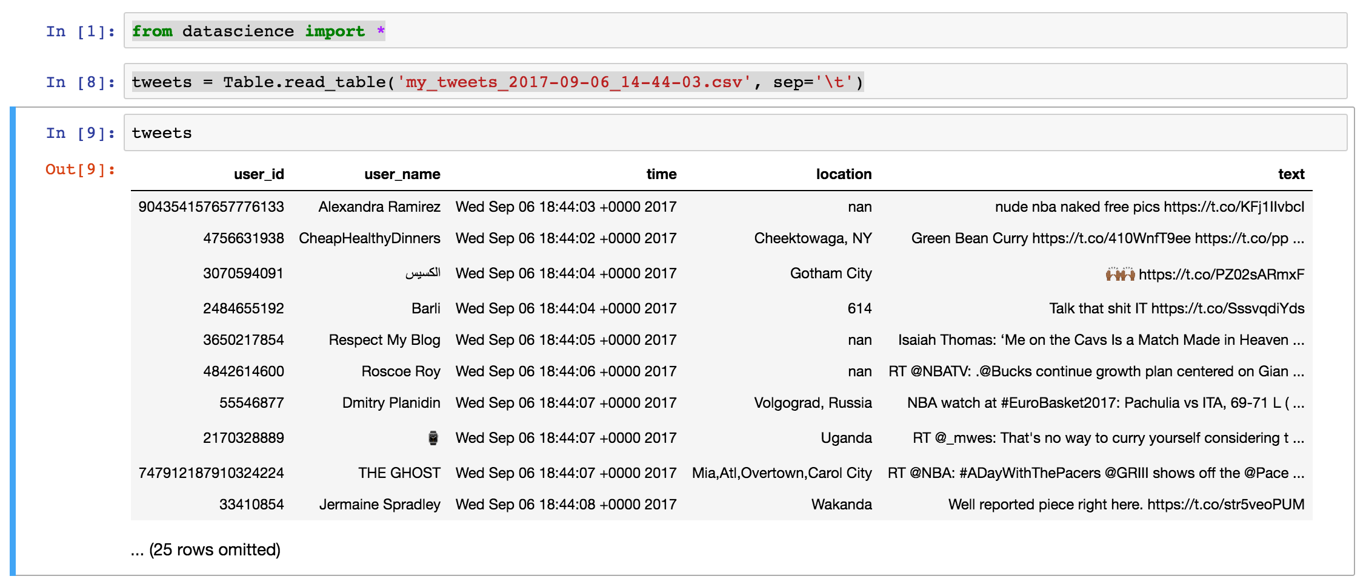
Load CSV data in Jupyter Notebook
Submit the JSON file, the CSV file, and the screen shot as Lab3 Assignment

