Slide 1




Wide-AdGraph: Detecting Ad Trackers with a Wide Dependency Chain Graph
Amir Hossein Kargaran, Mohammad Sadegh Akhondzadeh, Mohammad Reza Heidarpour,
Mohammad Hossein Manshaei, Kave Salamatian, and Masoud Nejad Sattary
13th ACM Web Science Conference 2021
Notes:
Hello everyone. My name is Amirhossein. And I’m going to talk about our paper Wide-adgraph an approach to detect ad and web trackers with a wide dependency chain graph. This is a joint work with collaborators from Isfahan University of Technolgy, University of Savoie Mont Blanc and Chavoosh ICT.

Slide 2
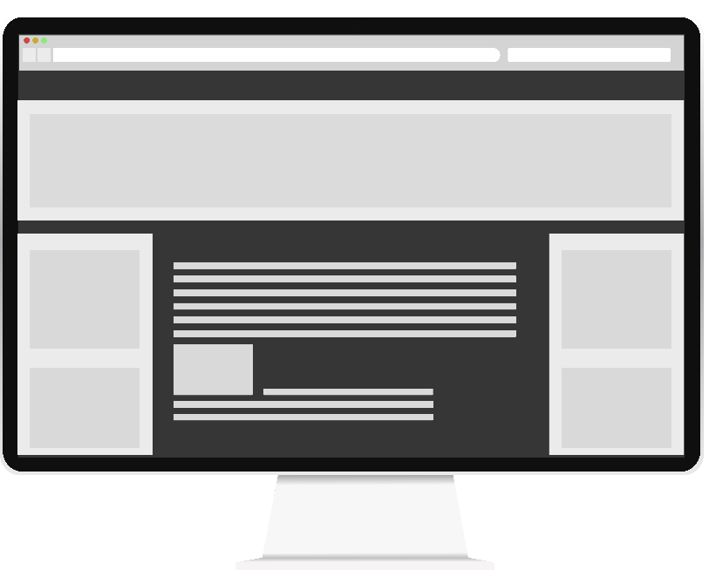
Online Advertising and Web Tracking
Internet growth
Free access to online resources
Earn revenue with advertisements
Problem with advertisements
Privacy
Security
Users satisfaction
Performance
AD

Slide 3
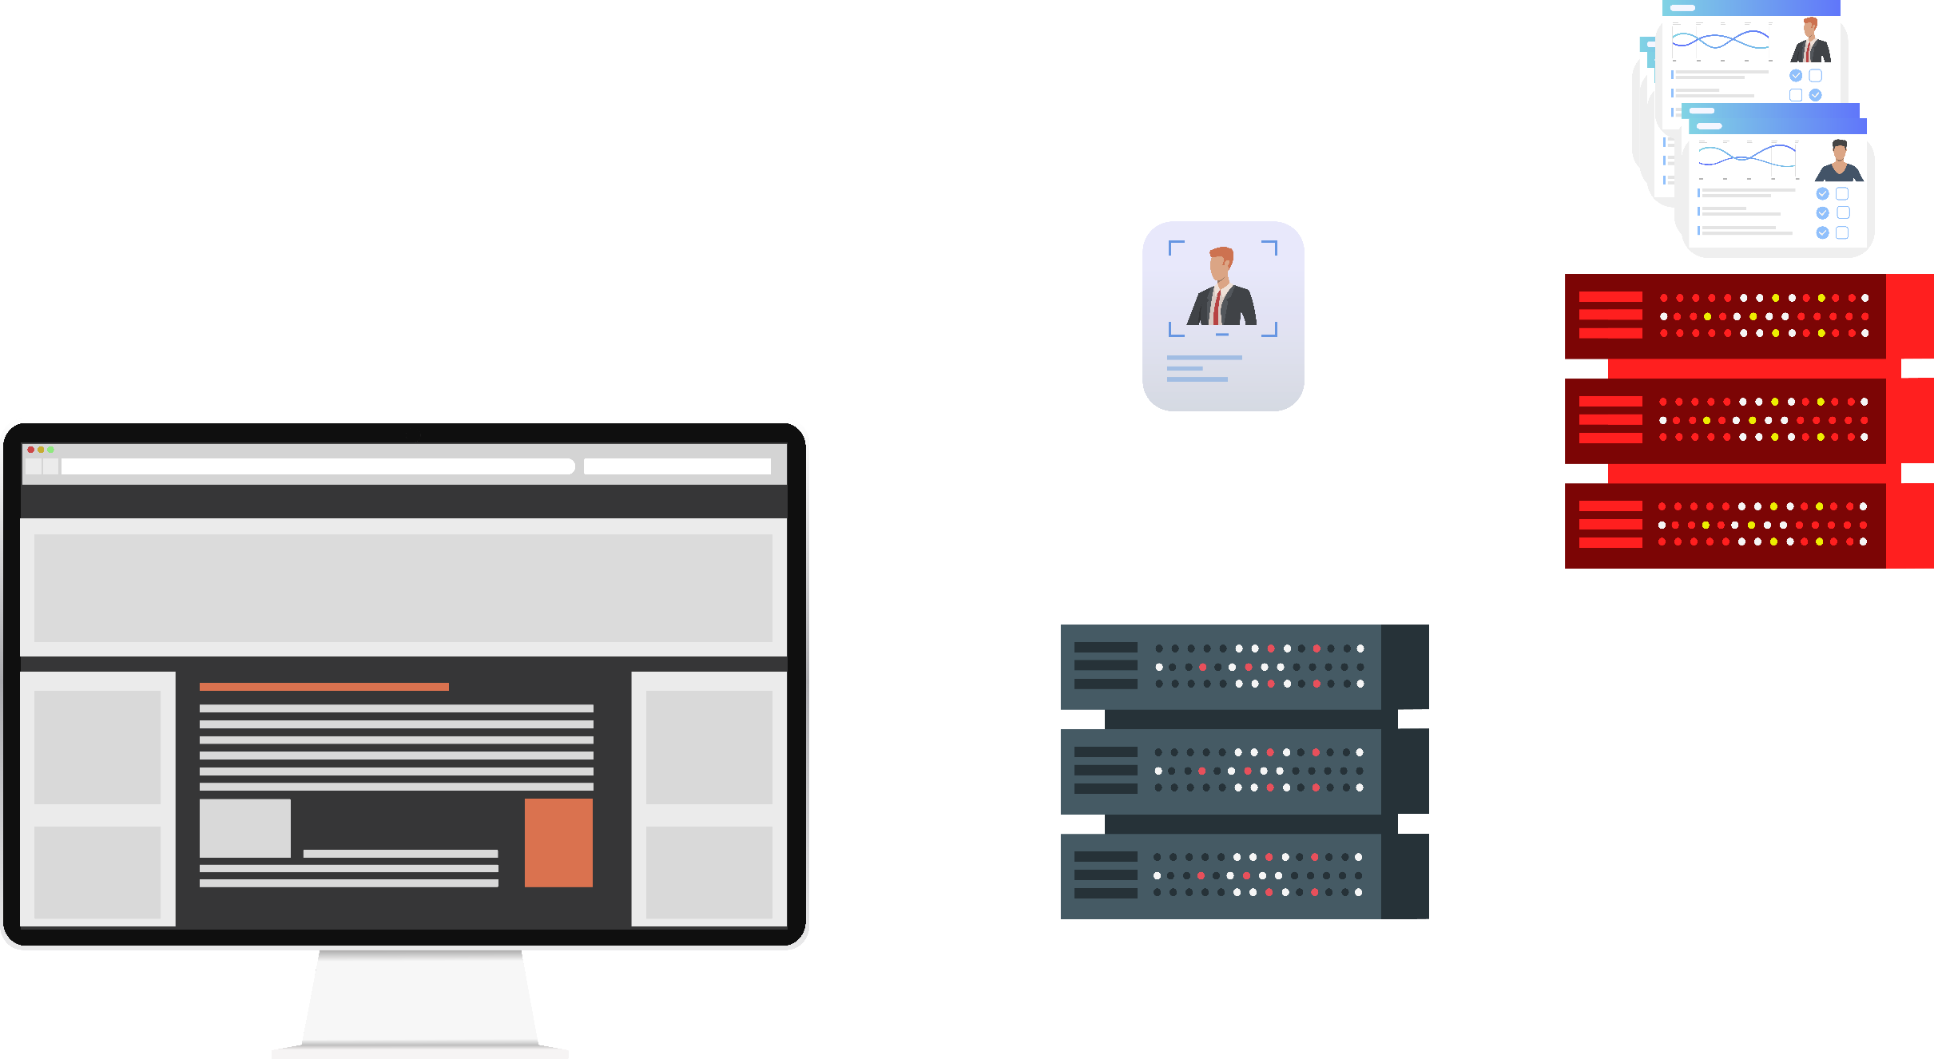

How do Ads and Trackers work?
How Ads and Trackers work?
IP address
HTTP cookies
Web beacons
Browser fingerprinting
Solution?
Adblcocker Tools
Adblock Plus
Ad block
Ublock Origin
Adguard
Ghostery
Disconnect
Privacy Badger
…
HTTP Request
https://example.com
AD
Third Party Server
First Party Server
Requested Content
Tracking objects

Slide 4
Filter List Based Blocking
What is a Filter List?
A set of rules
Problems?
Manually created
Delay to add a new rule
Large number of rules
Scalability and Accuracy Issues

Slide 5
Machine Learning Based Blocking
Network Layer
Bhagavatula et al. 14
Gugelmann et al. 15
JavaScript Layer
Wu et al. ’16
Ikram et al. 17
Multi Layer
Iqbal et al. ‘20
Sjösten et al.’20
Solve Scalability and Accuracy Issues
Operate each Layer in Isolation
Possibility of Bias
Solve Scalability and Accuracy Issues
Operate all Layers together
Possibility of Bias

Slide 6
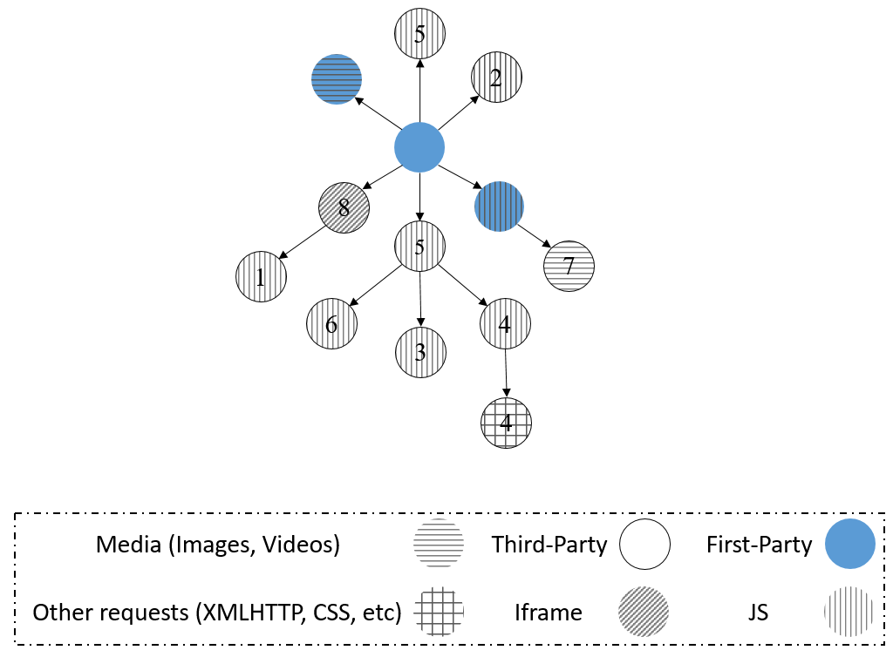
Dependency Chain Graph
http://exmple.com
http://5.com/?5.js&id=example&..
http://exmple.com/1.jpg
http://exmple.com/a/2.png
http://sub.exmple.com/b/3.gif
…
http://4.com/?4.js&id=example&..
http://4.com/track/&id=example&..

Slide 7
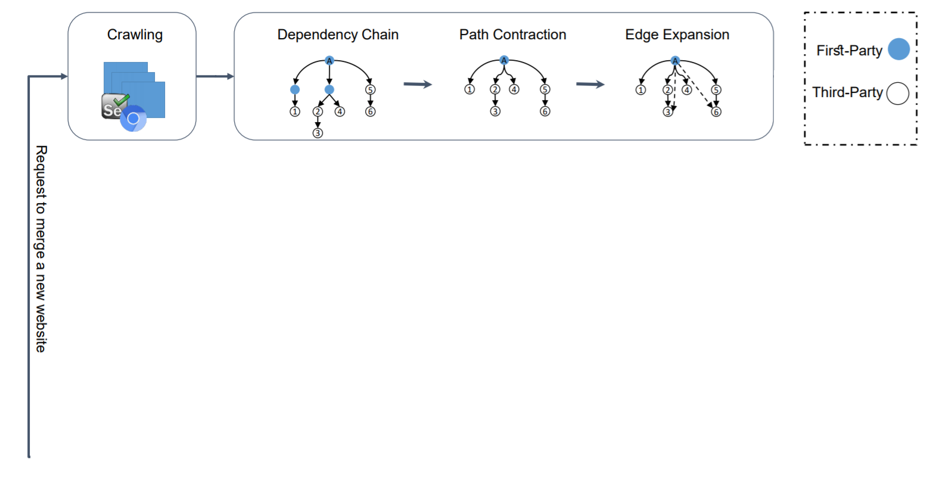
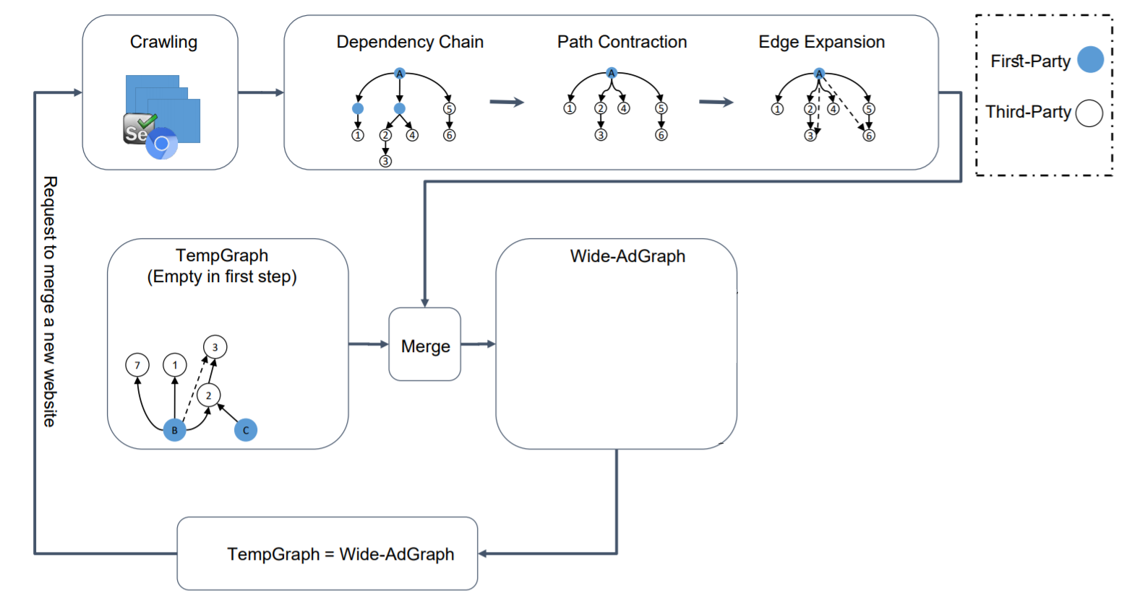
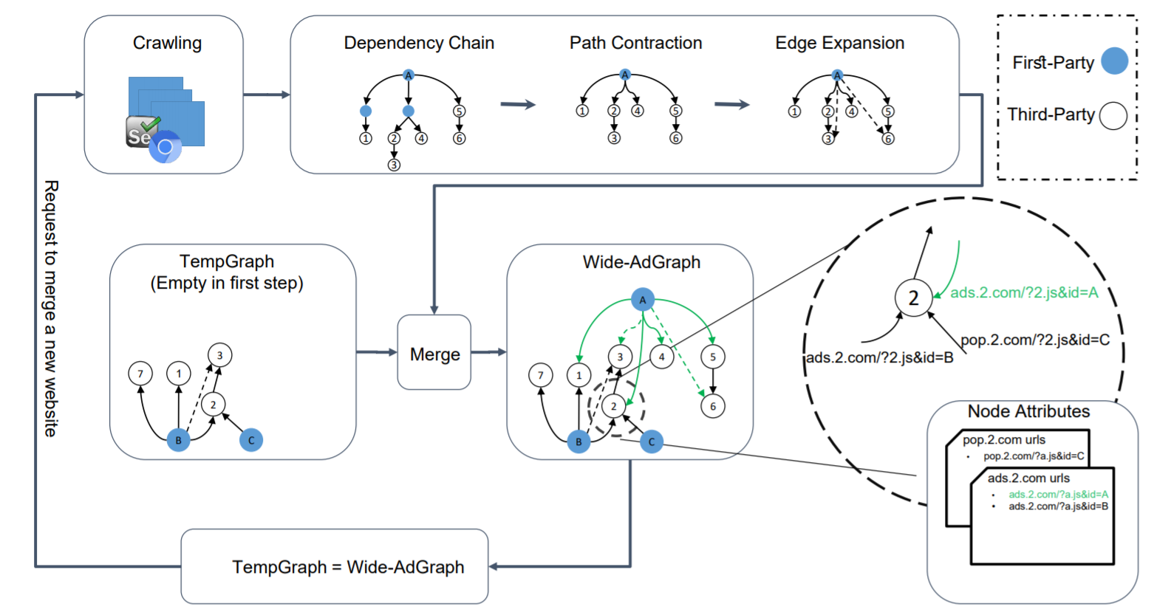
Wide-AdGraph

Slide 8
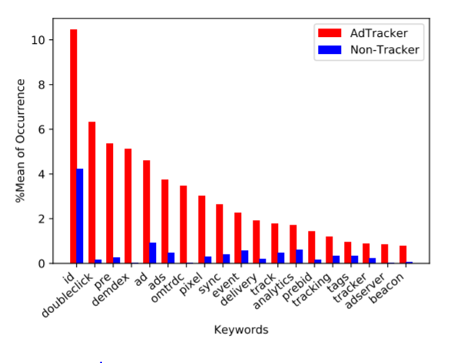
Feature Extraction
Extract two type of features
Context and Structural
Content Features
Engineered features
URL lengths
the number of times of repetition of special keys ("&", "=" or "?)
Keywords
TF-IDF

Slide 9
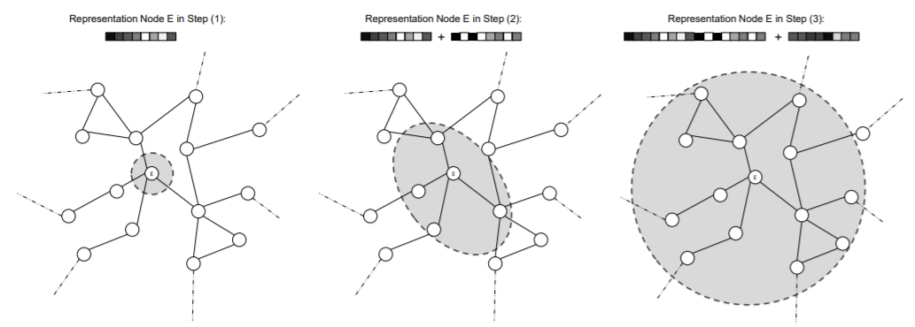
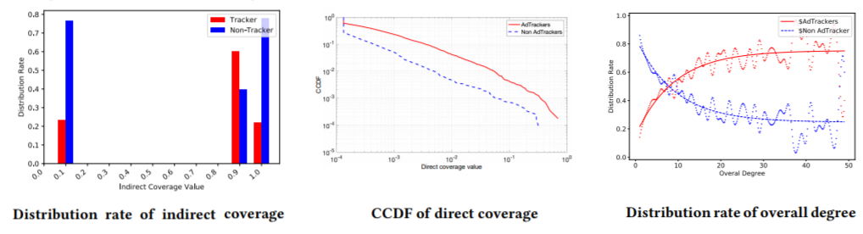
Feature Extraction (contd.)
Structural Features
Refex algorithm
Initialized Features
In-degree, out-degree, overall degree
ego interconnectivity, ego out-degree
direct and indirect coverage

Slide 10
Machine Learning
Ground Truth
Filter Lists
Easy List, Easy Privacy, Squid Blacklist, Fanboy’s Social Blocking List and Fanboy’s Annoyance List
Random forest
10-fold cross validation to choose hyper parameters
80% train – 20% test

Slide 11
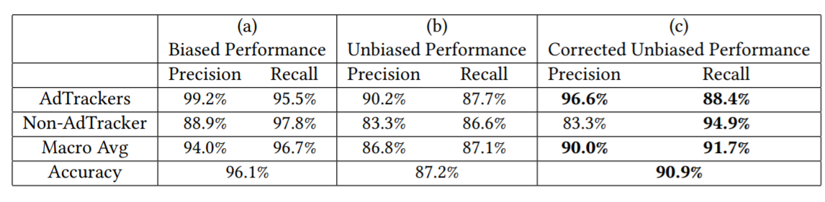
Evaluation

Slide 12
Key Takeaways
Propose wide dependency chain graph (Wide-AdGraph)
Shed lights on the ecosystem of AdTrackers
Use Machine Learning to automate detecting AdTrackers

