Slide 1


BACnet & Lighting in 2020
The Lighting Applications working group was formed in 2001 to improve BACnet's use as a native network lighting control protocol.
Since then, new BACnet objects, services, properties, and other standard values have been added to the BACnet standard to support lighting control.

Slide 2
Object Reliability Property
New standard values were added to Reliability property of objects:
TRIPPED
  The end device, such as an actuator, is not responding to commands, prevented by a tripped condition or by being mechanically held open.
LAMP_FAILURE
  Indicates that the lamp has failed in a physical lighting device.
COMMUNICATION_FAILURE
  Proper operation of the object is dependent on communication with a remote sensor or device and communication with the remote sensor or device has been lost.

Slide 3
Lighting Output Object
Present_Value in Percent of Normalized Range
  0.0%=Off
  1.0-100% =On
  -1.0 = Warn
  -2.0 = Warn Relinquish
  -3.0 = Warn Off
Lighting_Command for dimming control
  operation, target level, ramp rate, fade time, step, priority
  Operations include:
    fade-to, ramp-to
    step-up, step-down, step-off
    warn, warn-relinquish, warn-off
    stop
Internal dimming engine drives Tracking_Value
Internal Egress_Time timer for automatic relinquish
Low and High trim to clamp the Present_Value

Slide 4
Binary Lighting Output Object
Present_Value is Enumerated for lighting control
  Off
  On
  Warn
  Warn-relinquish
  Warn-off
  Stop
  + vendor specific if needed
Internal Egress_Time timer for automatic relinquish
Strike and Hour counting properties
Power property
Optional event notification parameters

Slide 5
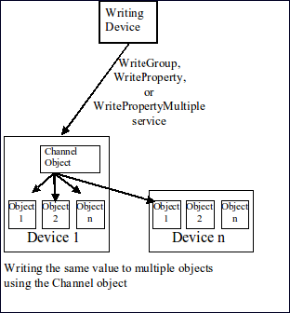
Channel Object
Present_Value is Channel Value (pseudo Commandable)
  similar to Any - primatives
  includes Lighting Command
Propagated value to List of Object Property References
  Object Property Reference can be another device
  Execution Delay + Inhibit
  Channel Number
  Group membership
Defined data coercion

Slide 6
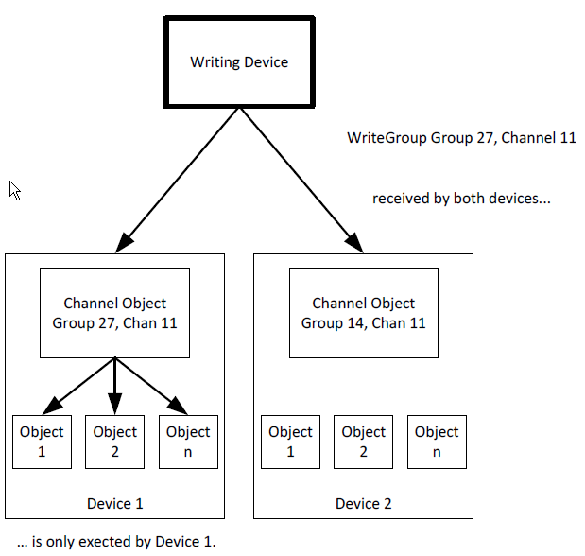
WriteGroup Service
Broadcast Write to Channel Objects in a Single Group
Group number is meant to limit
  0=reserved
  1=min
  4,294,967,295=max
Priority - used if not specified
Change List - Tuples
  Channel Number = property of Channel object 1-65535
  Overriding Priority - specific priority if needed
  Value - may be coerced if not exact datatype
Inhibit Delay - if allowed by Channel object

Slide 7
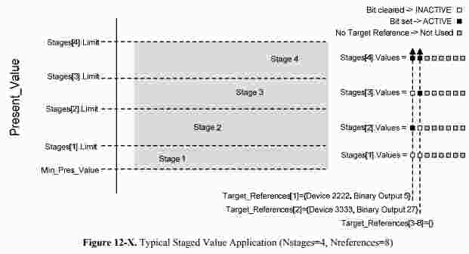
Staging object
The Staging object type provides a way for BACnet devices to map analog values onto multiple Binary
Value, Binary Output, or Binary Lighting Output objects.

Slide 8
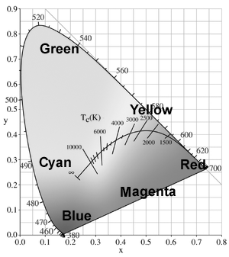
Color object
The Color object type provides a way for BACnet devices to interact with X,Y color, directly or with control commands:
None
Fade To
Stop
Override

Slide 9
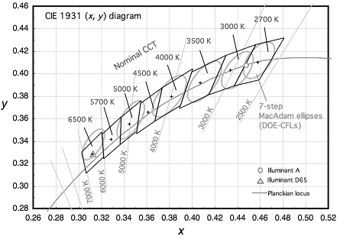
Color Temperature object
The Color Temperature object type provides a way for BACnet devices to interact with closest coordinated color temperature (CCT), directly or with control commands:
None
Fade To
Stop
Override

Slide 10
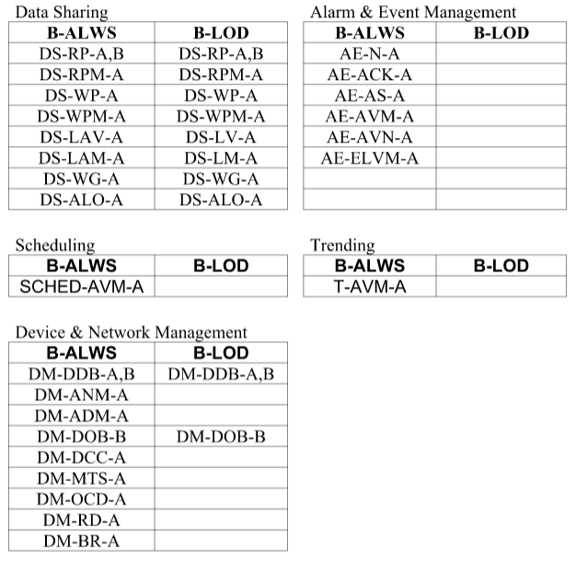
Lighting BIBBs
With the addition of the Lighting object types and new services, lighting specific BIBBs and device profiles were defined.
Lighting Operator Interfaces.
  This family is composed of B-XAWS, B-ALWS, and B-LOD.
Lighting Control Stations.
  This family is composed of B-ALCS and B-LCS.
Lighting Controllers.
  This family is composed of B-LS and B-LD.

