Slide 1
Basics of BACnet
History of BACnet
BACnet Architecture
Routers
Gateways
Objects
Properties
Services
2015
Notes:
This presentation provides an overview of the history, scope, and features of the BACnet protocol.

Slide 2
Why a Standard Protocol?
Interoperability
Competitive system expansion
End "lock in" fear
Integrating building services requires communication standards
Reduce training cost by using a single operator interface
Enable development of new technology

Slide 3
Why a Standard Protocol?
Share data among different vendor's systems for a more sensible and integrated approach to facilities management
Access all systems from a common interface to permit common graphics, event and alarm enunciation, and data logging

Slide 4
History of BACnet
Committee began in June, 1987
Consensus using working groups
ASHRAE/ANSI standard 135-1995
ISO 16484-5 in 2003
Design Goals
  Interoperability
  Efficiency
  Flexibility
  Extensibility
  Reliability
  Stability
  Simplicity
Notes:
The development of the BACnet protocol began in June, 1987, in Nashville, Tennessee, at the inaugural meeting of the Standard Project Committee (SPC). H. Michael Newman, the first chairman of the committee, presided over the meeting. The first meeting produced a list of desirable attributes of a good protocol, and what the BACnet protocol eventually became: Interoperability, Efficiency, Low Overhead, Highest Common Multiplier, Compatibility with other applications and networks, Layered OSI model Network, Flexibility, Extensibility, Cost Effective, Transmission Reliability, Apply to real-time processes, Maximum Simplicity, Allow priority schemes, Medium access fairness, and Stability under realistic loads.

Slide 5
BACnet Applications
HVAC Controls
Lighting Controls
Security (access control)
Fire detection/suppression systems
Smart Elevators
Fault detection and diagnostic systems

Slide 6
BACnet Architecture
BACnet Layers
OSI
BACnet Application Layer (APDU)
Application
BACnet Network Layer (NPDU)
Network
ISO 8802-2
MS/TP
PTP
BVLC
BVLC
LonTalk
ZigBee
Data Link
Ethernet
ARCNET
EIA-485
EIA-232
UDP/IP4
UDP/IP6
802.15.4
Physical
LAN options with BACnet
Pros? Cons?
Notes:
The BACnet Collapsed Architecture
BACnet is based on a four-layer collapsed architecture that corresponds to the physical, data link, network, and application layers of the OSI model as shown in Figure 4-2. The application layer and a simple network layer are defined in the BACnet standard. BACnet provides five options that correspond to the OSI data link and physical layers. Option 1 is the logical link control (LLC) protocol defined by ISO 8802-2 Type 1, combined with the ISO 8802-3 medium access control (MAC) and physical layer protocol. ISO 8802-2 Type 1 provides unacknowledged connectionless service only. ISO 8802-3 is the international standard version of the well-known "Ethernet" protocol. Option 2 is the ISO 8802-2 Type 1 protocol combined with ARCNET (ATA/ANSI 878.1). Option 3 is a Master-Slave/Token-Passing (MS/TP) protocol designed specifically for building automation and control devices as part of the BACnet standard. The MS/TP protocol provides an interface to the network layer that looks like the ISO 8802-2 Type 1 protocol and controls access to an EIA-485 physical layer. Option 4, the Point-To-Point protocol, provides mechanisms for hardwired or dial-up serial, asynchronous communication. Option 5 is the LonTalk protocol. Collectively these options provide a master/slave MAC, deterministic token-passing MAC, high-speed contention MAC, dial-up access, star and bus topologies, and a choice of twisted-pair, coax, or fiber optic media. The details of these options are described in Clauses 7 through 11.
A four-layer collapsed architecture was chosen after careful consideration of the particular features and requirements of BAC networks, including a constraint that protocol overhead needed to be as small as possible. The reasoning behind the selection of the physical, data link, network, and application layers for inclusion in the BACnet architecture is outlined in this subclause.

Slide 7
LAN: PTP
Only choice for modem
Special design for point to point applications
Accommodates modern modem standards (V.32bis, V.42)
Point to point only
Limited speed (9.6K to 56Kbps)

Slide 8
LAN: LonTalk
Variety of media (UTP, coax, RF, IR, fiber)
Scalable speed (32K to 1.25Mbps)
Non-deterministic
Distance limitations
Sole source chip
Special development tools
Application size limited
Very few BACnet vendors using LonTalk

Slide 9
LAN: ARCNET
Pros
Cons
ANSI Standard
Deterministic response
Scalable speed
Variety of media (UTP, coax, fiber)
Very fast (156k-7.5Mbps)
No special development tools
High performance for medium cost
Sole source chip
Too costly for low end unitary controllers
Distance limitations for some media
Very few BACnet vendors using ARCNET

Slide 10
LAN: BACnet MS/TP
ANSI standard
Low cost
Can be implemented in a single chip microcontroller
Deterministic response
Long distance (1500 m)
Single media (EIA-485)
Limited speed (9.6K to 115Kbps)

Slide 11
LAN: Ethernet
Pros
Cons
International standard
Already in most buildings
Variety of media (UTP, fiber, wireless)
Very fast (10/100/1000 or more Mbps)
Easy to interface to PCs
No special development tools
Power included (PoE)
High cost
Distance limitations
non-deterministic

Slide 12
LAN: BACnet/IP
International standard
Already in most buildings
Variety of media (UTP, fiber, wireless)
Very fast (10/100/1000 or more Mbps)
Easy to interface to PCs
No special development tools
Power included (PoE)
High cost
Distance limitations
Non-deterministic
Additional software stack required (UDP/IP)

Slide 13
LAN: BACnet/IPv6
International standard
New to BACnet (2015)
Variety of media (UTP, fiber, wireless)
Standard meshing and messaging built on standard wireless layer (IEEE 802.15.4)
Uses VMAC for address
Can use Ethernet, WiFi, 6lowPAN, 6loBAC
Additional software stack required (UDP/IPv6)

Slide 14
LAN: ZigBee
Low cost, low power wireless
Standard meshing and messaging built on standard wireless layer (IEEE 802.15.4)
Limited speeds
Limited broadcasting
Nodes may sleep

Slide 15
Internetworking
Required whenever two dissimilar LAN technologies need be coupled
Performance constraints (bandwidth)
Cost constraints
Isolate message traffic
Remote access
Utilize existing infrastructure
Connect multiple isolated applications

Slide 16
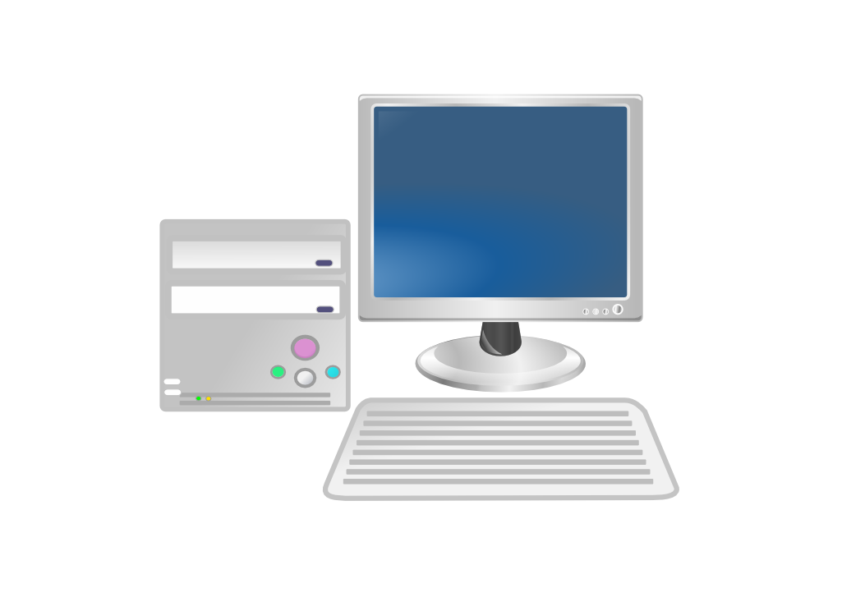
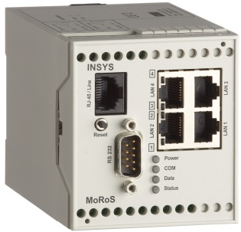
BACnet Routers
Start of Message
Ethernet
NPDU
APDU
Address and Length Information
Error Detection Checksum
BACnet Router
Data Remains Unchanged
Start of Message
NPDU
APDU
MS/TP
Address and Length Information
Error Detection Checksum
Notes:
THE NETWORK LAYER
The purpose of the BACnet network layer is to provide the means by which messages can be relayed from one BACnet network to another, regardless of the BACnet data link technology in use on that network. Whereas the data link layer provides the capability to address messages to a single device or broadcast them to all devices on the local network, the network layer allows messages to be directed to a single remote device, broadcast on a remote network, or broadcast globally to all devices on all networks. A BACnet Device is uniquely located by a network number and a MAC address.
Devices that interconnect two disparate BACnet LANs, e.g., ISO 8802-3 and ARCNET, and provide the relay function described in this clause are called "BACnet routers." Devices that interconnect two disparate BACnet networks through a point-to-point (PTP) connection (see Clause 10) are also BACnet routers. BACnet routers build and maintain their routing tables automatically using the network layer protocol messages defined in this clause. Network layer protocol messages facilitate both the auto-configuration of routers and the flow of messages to, and between, routers. BACnet routing capability may be implemented in stand-alone devices or, alternatively, in devices that carry out other building automation and control functions.

Slide 17
BACnet Routers
Network 2
Network 1
Network 3
Network 4
DMAC=04
DNET=4
DADR=08
DMAC=05
DNET=4
DADR=08
DMAC=08
SNET=1
SADR=05
Port 1
MAC 04
Port 2
MAC 04
Port 3
MAC 07
Port 1
MAC 05
Port 2
MAC 07
Device
MAC 05
Device
MAC 08
Device
MAC 08
Router 1
Router 2
Routing Table
Routing Table
Net
Send To
Net
Send To
1
2
3
4
Attached, port 1
Attached, port 2
Attached, port 3
Net 3, MAC 5
1
2
3
4
Net 3, MAC 7
Net 3, MAC 7
Attached, port 1
Attached, port 2
Notes:
Network Layer Protocol Messages
Clause 6.4 describes the format and purpose of the ten BACnet network layer protocol messages. These messages provide the basis for router auto-configuration, router table maintenance, and network layer congestion control.
Who-Is-Router-To-Network
This message is indicated by a Message Type of X'00' optionally followed by a 2-octet network number. Who-Is-Router-To-Network is used by both routing and non-routing nodes to ascertain the next router to a specific destination network or, in the case of routers, as an aid in building an up-to-date routing table. See Figure 6-5.
I-Am-Router-To-Network
This message is indicated by a Message Type of X'01' followed by one or more 2-octet network numbers. It is used to indicate the network numbers of the networks accessible through the router generating the message. It shall always be transmitted with a broadcast MAC address.
I-Could-Be-Router-To-Network
This message is used to respond to a Who-Is-Router-To-Network message containing a specific 2-octet network number when the responding half-router has the capability of establishing a PTP connection that can be used to reach the desired network but this PTP connection is not currently established.

Slide 18
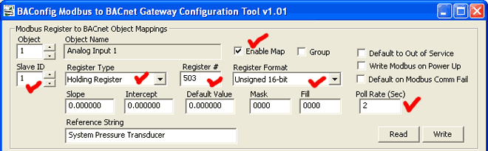
BACnet Gateway
Ethernet
NPDU
APDU
BACnet Gateway
Gateway Configuration tool from Control Solutions, Inc
Modbus RTU
Modbus RTU Packet

Slide 19

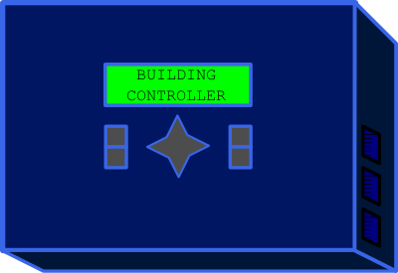
BACnet Objects
Objects represent physical inputs, outputs, and software processes.
IF level > 50 THEN
.
.
.
Notes:
MODELING CONTROL DEVICES AS A COLLECTION OF OBJECTS
The data structures used in a device to store information are a local matter. In order to exchange that information with another device using this protocol, there must be a "network-visible" representation of the information that is standardized. An object-oriented approach has been adopted to provide this network-visible representation. This clause defines a set of standard object types. These object types define an abstract data structure that provides a framework for building the application layer services. The application layer services are designed, in part, to access and manipulate the properties of these standard object types. Mapping the effect of these services to the real data structures used in the device is a local matter. The number of instances of a particular object type that a device will support is also a local matter.
All objects are referenced by their Object_Identifier property. Each object within a single BACnet Device shall have a unique value for the Object_Identifier property. When combined with the system-wide unique Object_Identifier of the BACnet Device, this provides a mechanism for referencing every object in the control system network. No object shall have an Object_Identifier with an instance number of 4194303. Object properties that contain BACnetObjectIdentifiers may use 4194303 to indicate that the property is not initialized.

Slide 20
BACnet Objects
Objects are evaluated and controlled by their properties
Property Name, Value
Object_Name
"Lighting Area 1"
Object_Type
BINARY_OUTPUT
Present_Value
Active
Status_Flags
Normal, In-Service
Out_Of_Service
False
Inactive_Text
"Off"
Active_Text
"On"
Notes:
All objects in BACnet have properties that are used for information exchange. Some properties are read-only. Some properties are writable.
The graphic shows an example of a Binary Output object controlling a lighting load. It shows a few properties and their values that might be in this object. Usually there are more properties in the object.
This object has a name ("Lighting Area 1") and an object type (BINARY_OUTPUT). The Present_Value property indicates the the value at this moment. The Status_Flags tell us if this object is functioning normally. The Out_Of_Service indicates that the Present_Value is coupled to the physical output.
The Active_Text and Inactive_Text are values the help tell an operator the state of the present value.

Slide 21
BACnet Objects
accumulator
binary-output
file
multi-state-output
trend-log
analog-input
binary-value
group
multi-state-value
load-control
analog-output
calendar
life-safety-point
notification-class
structured-view
analog-value
command
life-safety-zone
program
access-door
averaging
device
loop
pulse-converter
binary-input
access-credential
event-enrollment
multi-state-input
schedule
event-log
access-zone
access-rights
access-point
access-user
credential-data-input
characterstring-value
bitstring-value
trend-log-multiple
global-group
characterstring-value
date-pattern-value
date-value
datetime-pattern-value
datetime-value
integer-value
large-analog-value
octetstring-value
positive-integer-value
time-pattern-value
time-value
channel
staged-value
timer-value
lighting-output
binary-lighting-output
notification-forwarder
alert-enrollment
network-port
elevator
Notes:
Although there are thousands of potentially useful object types in a building control system, BACnet defines a minimal number of Standard Object Types in detail. A BACnet standard object is an object whose behavior, in terms of the properties it provides and what they do, is defined in the BACnet standard.
BACnet devices are only required to implement a Device object. Other objects can be included as needed. BACnet has also defined a way for vendors to define their own non-standard objects.

Slide 22
BACnet Objects
Required and Optional Properties
Object_Name
"Lighting Area 1"
Object_Type
BINARY_OUTPUT
Required
Present_Value
Active
Status_Flags
Normal, In-Service
Out_Of_Service
False
Inactive_Text
"Off"
Optional
Active_Text
"On"
Other properties...
Notes:
Each standard object contains a set of Required properties, and a set of Optional properties. Required properties must be implemented.
The image above shows some required and optional properties of a Binary Output object.
BACnet has defined a way for vendors to define their own non-standard properties for use in standard objects. Any number of non-standard properties can be defined with whatever behavior the vendor chooses.

Slide 23
Binary Output Object
Property Identifier
Property Datatype
Conformance Code
Conformance Codes:
R required, readable
W required, writable
O optional
Object_Identifier
Object_Name
Object_Type
Present_Value
Description
Device_Type
Status_Flags
Event_State
Reliability
Out_Of_Service
Polarity
Inactive_Text
Active_Text
Change_Of_State_Time
Change_Of_State_Count
Time_Of_State_Count_Reset
Elapsed_Active_Time
Time_Of_Active_Time_Reset
Minimum_Off_Time
Minimum_On_Time
Priority_Array
Relinquish_Default
Time_Delay
Notification_Class
Feedback_Value
Event_Enable
Acked_Transitions
Notify_Type
Event_Time_Stamps
Profile_Name
BACnetObjectIdentifier
CharacterString
BACnetObjectType
BACnetBinaryPV
CharacterString
CharacterString
BACnetStatusFlags
BACnetEventState
BACnetReliability
BOOLEAN
BACnetPolarity
CharacterString
CharacterString
BACnetDateTime
Unsigned
BACnetDateTime
Unsigned32
BACnetDateTime
Unsigned32
Unsigned32
BACnetPriorityArray
BACnetBinaryPV
Unsigned
Unsigned
BACnetBinaryPV
BACnetEventTransitionBits
BACnetEventTransitionBits
BACnetNotifyType
BACnetARRAY[3] of BACnetTimeStamp
CharacterString
R
R
R
W
O
O
R
R
O
R
R
O¹
O¹
O²
O²
O²
O³
O³
O
O
R
R
O⁴
O⁴
O⁴
O⁴
O⁴
O⁴
O⁴
O
Out_Of_Service decouples the physical output from the Present_Value.
Properties required because Present_Value is commandable
Properties required for intrinsic reporting
Notes:
At the beginning of each standard object type specification that follows is a summary of the properties of the object type. The summary includes the property identifier, the datatype of the property, and one of the following : O, R, W
where O indicates that the property is optional,
R indicates that the property is required to be present and readable using BACnet services,
W indicates that the property is required to be present, readable,
and writable using BACnet services.
When a property is designated as required or R, this shall mean that the property is required to be present in all BACnet standard objects of that type. When a property is designated as optional or O, this shall mean that the property is not required to be present in all standard BACnet objects of that type. The value of R or O properties may be examined through the use of one or more of the ReadProperty services defined in this standard. Such R or O properties may also be writable at the implementor's option unless specifically prohibited in the text describing that particular standard object's property. When a property is designated as writable or W, this shall mean that the property is required to be present in all BACnet standard objects of that type and that the value of the property can be changed through the use of one or more of the WriteProperty services defined in this standard. The value of W properties may be examined through the use of one or more of the ReadProperty services defined in this standard. An O property, if present in a particular object, is not required to be writable unless specifically identified as such in the text describing that particular standard object's property.
In some devices, property values may be stored internally in a different form than indicated by the property datatype. For example, real numbers may be stored internally as integers. This may result in the situation where a property value is changed by one of the WriteProperty services but a subsequent read returns a slightly different value. This behavior is acceptable as long as a "best effort" is made to store the written value specified.

Slide 24
Object Identifiers
1st octet
2nd octet
3rd octet
4th octet
Object instances can range from 0 to 4194303, but 4194303 is reserved for unconfigured devices.
10 bit Object Type
22 bit Object Instance
analog-input (0),
analog-output (1),
analog-value (2),
binary-input (3),
binary-output (4),
binary-value (5),
calendar (6),
command (7),
device (8),
event-enrollment (9),
file (10),
group (11),
loop (12),
multi-state-input (13),
multi-state-output (14),
notification-class (15),
program (16),
schedule (17),
...
Object types can be any of the BACnet standard types, or non-standard types from 128 to 1023
Notes:
A BACnet Object Identifier value shall consist of two components:
(1) A 10-bit object type, representing the BACnetObjectType of the object, with bit 9 the most significant bit and bit 0 the least significant. For objects defined in this standard, the value for this field shall be determined by the BACnetObjectType enumeration in Clause 21.
(2) A 22-bit object instance number, with bit 21 the most significant bit and bit 0 the least significant.
A "BACnetDevice" is any device, real or virtual, that supports digital communication using the BACnet protocol. Each BACnet Device contains exactly one Device object, as defined in 12.11. A BACnet Device is uniquely located by an NSAP, which consists of a network number and a MAC address.
Device object identifiers are unique "internetwork wide." If this is not the case, the Who-Is service will produce ambiguous results.

Slide 25
Property Identifiers
accepted-modes (175),
acked-transitions (0),
ack-required (1),
action (2),
action-text (3),
active-text (4),
active-vt-sessions (5),
active-cov-subscriptions (152),
adjust-value (176),
alarm-value (6),
alarm-values (7),
all (8),
all-writes-successful (9),
apdu-segment-timeout (10),
apdu-timeout (11),
application-software-version (12),
archive (13),
attempted-samples (124),
auto-slave-discovery (169),
average-value (125),
backup-failure-timeout (153),
bias (14),
buffer-size (126),
change-of-state-count (15),
change-of-state-time (16),
client-cov-increment (127),
configuration-files (154),
controlled-variable-reference (19),
controlled-variable-units (20),
controlled-variable-value (21),
count (177),
count-before-change (178),
count-change-time (179),
cov-increment (22),
cov-period (180),
cov-resubscription-interval (128),
database-revision (155),
date-list (23),
daylight-savings-status (24),
deadband (25),
derivative-constant (26),
derivative-constant-units (27),
description (28),
description-of-halt (29),
device-address-binding (30),
device-type (31),
direct-reading (156),
effective-period (32),
elapsed-active-time (33),
error-limit (34),
event-enable (35),
event-state (36),
...
Property identifiers are specified for each standard object.
Non-standard property identifiers in the range of 512 to 4194303 allows each vendor to define their own properties.

Slide 26
BACnet Services
Service == Message
Services allow Devices to do something
Must implement at least ReadProperty

Slide 27
BACnet Confirmed Services
Confirmed == Unicast, Acknowledged
AcknowledgeAlarm
AtomicWriteFile
WritePropertyMultiple
COV-Notification
AddListElement
PrivateTransfer
EventNotification
RemoveListElement
TextMessage
GetAlarmSummary
CreateObject
ReinitializeDevice
GetEnrollmentSummary
DeleteObject
VTOpen
SubscribeCOV
ReadProperty
VTClose
SubscribeCOVProperty
ReadPropertyMultiple
VTData
LifeSafetyOperation
ReadRange
Authenticate
AtomicReadFile
WriteProperty
ReqestKey
ReadPropertyConditional
DeviceCommunicationControl

Slide 28
BACnet Unconfirmed Services
Unconfirmed == Broadcast (usually)
I-Am
TextMessage
I-Have
TimeSynchronization
COV-Notification
WhoHas
EventNotification
WhoIs
PrivateTransfer
UTC TimeSynchronization
WriteGroup

