Slide 1
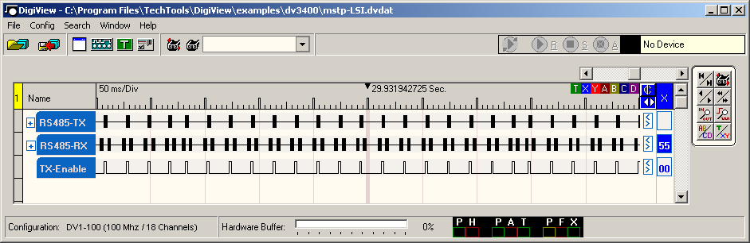
BACnet MS/TP
Physical and Electrical considerations
Packet structure
Receive Frame State Machine
Slave and Master Node State Machine
Design issues (timing, buffering, MAC address)

Slide 2
BACnet MS/TP EIA-485
Baud Rates: 9600, 19200, 38400, 57600, 76800
Parity: no
Start Bits: 1
Stop Bits: 1
Least Significant Bit First (same as EIA-232)
Uses standard UART
Notes:
This may not be the ideal circuit for EIA-485. There has been much debate in the BACnet MS/TP working group about it.

Slide 3
MS/TP Packet Structure
0x55
Preamble
2 octets
0xFF
Frame Type
1 octet
Destination Address
1 octet
Source Address
1 octet
Length
2 octets, most significant octet first
Header CRC
1 octet
Data
(present if Length is non-zero) Length octets
Data CRC
(present if Length is non-zero) 2 octets
0xFF
pad
(optional) at most, 1 octet

Slide 4
Receive Frame State Machine

Slide 5
Master Node State Machine

Slide 6
Slave Node State Machine

Slide 7
MS/TP Timing
Token
T_{frame_abort}
_{< 60 bit times}
Token
Token
55
FF
00
72
0A
00
00
A9
55
FF
00
03
72
00
00
95
55
FF
00
A0
03
00
00
04
T_{usage_timeout}
_{< 20ms}
T_{turnaround}
_{> 40 bit times}
T_{postdrive}
_{< 15 bit times}

Slide 8
MS/TP Timing
Poll For Master
Token
55
FF
01
07
03
00
00
6D
55
FF
00
0A
03
00
00
04
T_{usage_timeout}
_{< 20ms}
BACnet Data Expecting Reply
Token
55
FF
05
89
0A
00
12
12
01
04
02
05
53
07
C4
02
80
00
01
0E
31
00
62
FF
EF
0F
41
2D
55
FF
00
72
0A
00
00
A9
T_{reply_timeout}
_{< 255ms}

Slide 9
BACnet Data Expecting Reply
May use Reply Postponed
Practical use only in RTOS or queued data
Single buffer, single thread, just reply
Buffer, queue - match packet signature

Slide 10
MS/TP MAC Address
Master Node MAC 0-127 (0x00 - 0x7F)
Slave Node MAC 0-254 (0x00-0xFE)
Broadcast 255 (0xFF)
DIP switch, dials, LCD
Non-volatile, same after power cycle or reset
Proposed Auto Addressing (DHCP, ZeroConfig)

