Slide 1

BACnet Network Tools
Protocol Analyzer
Stimulus and Testing
Installation Tools

Slide 2
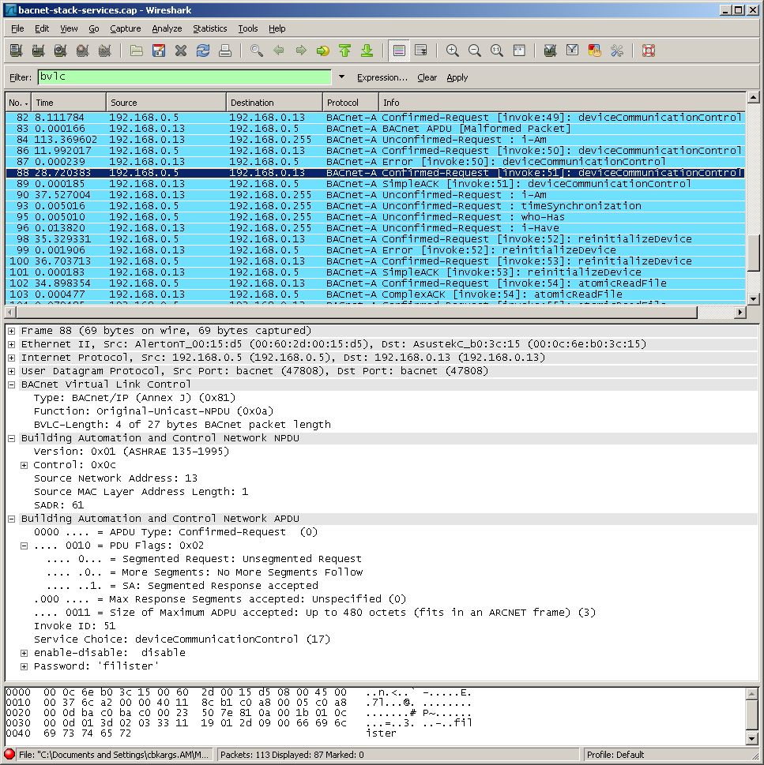
Protocol Analyzer
VTS - BACnet Visual Test Shell (free!)
BACtrace
BAS-O-Matic
Wireshark (free!)
DigiView
Oscilloscope

Slide 3
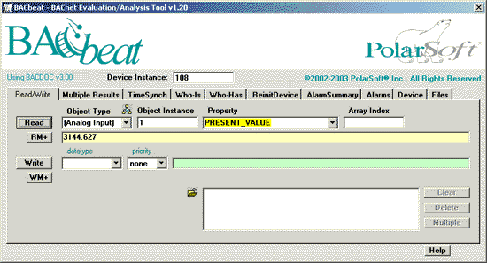
Stimulus and Testing
VTS (free!), BITS
BACnet Stack at SourceForge tools (free!)
BACnet Explorer
BACbeat

Slide 4
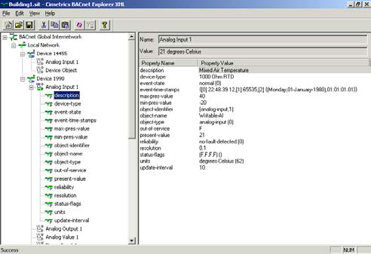
BACnet Installation Tools
BACbeat
BACnet Explorer
BAS Workstation

