Slide 1


BACnet & Lighting in 2023
Challenges in 1998 when developing a native BACnet networked lighting control system:
Blink Warn
Fade or Step to Level
Group or Zone Actions
Automatic Timeouts (CA - Title 24)
Scenes and Preset Levels
Dawn / Dusk Schedules
The Lighting Applications working group was formed in 2001 to improve BACnet's use as a native network lighting control protocol.
Since then, new BACnet objects, services, properties, and other standard values have been added to the BACnet standard to support lighting control.

Slide 2
Object Reliability Property
New standard values were added to Reliability property of objects:
TRIPPED
  The end device, such as an actuator, is not responding to commands, prevented by a tripped condition or by being mechanically held open.
LAMP_FAILURE
  Indicates that the lamp has failed in a physical lighting device.
COMMUNICATION_FAILURE
  Proper operation of the object is dependent on communication with a remote sensor or device and communication with the remote sensor or device has been lost.

Slide 3
Output Object Interface_Value Property
HOA (Hand Off Auto) switches are common in control equipment, and permit a local override of output values. Assuming the HOA control cannot be "trumped" by the controller, there is nothing the controller can do to change the value of the output. There is no other process that can change the value of its output. However, the actual output value is of interest (especially to workstations), but are not reportable via a standard mechanism in BACnet, assuming the value of the HOA switch is known by the controller.
Interface_Value
  This read-only property indicates the value, in engineering units, of the physical output. If the BACnet device is not capable of knowing the value of the physical output, then the value of this property shall be NULL.

Slide 4
Lighting Output Object
Present_Value in Percent of Normalized Range
  0.0%=Off
  1.0-100% =On
  -1.0 = Warn
  -2.0 = Warn Relinquish
  -3.0 = Warn Off
Lighting_Command for dimming control
  operation, target level, ramp rate, fade time, step, priority
  Operations include:
    fade-to, ramp-to, stop
    step-up, step-down, step-off
    warn, warn-relinquish, warn-off
    restore-on, default-on
    toggle, toggle-restore, toggle-default
Internal dimming engine drives Tracking_Value
Internal Egress_Time timer for automatic relinquish
Low and High trim to clamp the Present_Value
  -4.0 = Restore On
  -5.0 = Default On
  -6.0 = Toggle Restore
  -7.0 = Toggle Default

Slide 5
Binary Lighting Output Object
Present_Value is Enumerated for lighting control
  Off
  On
  Warn
  Warn-relinquish
  Warn-off
  Stop
  + vendor specific if needed
Internal Egress_Time timer for automatic relinquish
Strike and Hour counting properties
Power property
Optional event notification parameters

Slide 6
Channel Object
Writing Device
Present_Value is Channel Value (pseudo Commandable)
  similar to Any - primitives
  includes Lighting Command
Propagated value to List of Object Property References
  Object Property Reference can be another device
  Execution Delay + Inhibit
  Channel Number
  Group membership
Defined data coercion
WriteGroup service
WriteProperty service
WritePropertyMultiple service
Device 1
Channel Object
Object
1
Object
2
Object
n
Writing the same value to multiple objects using the Channel object
Device n
Object
1
Object
n

Slide 7
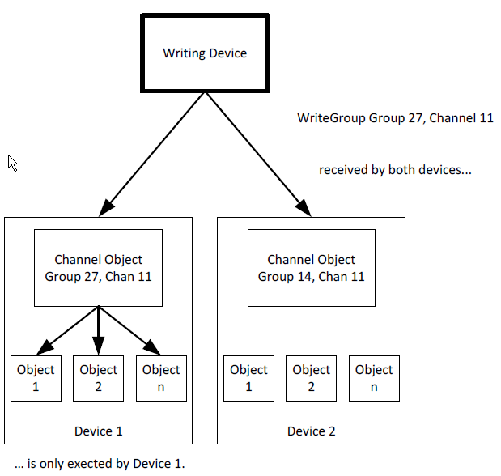
WriteGroup Service
Broadcast Write to Channel Objects in a Single Group
Group number is designed to limit
  0=reserved
  1=min
  4,294,967,295=max
Priority - used if not specified
Change List - Tuples
  Channel Number = property of Channel object 1-65535
  Overriding Priority - specific priority if needed
  Value - may be coerced if not exact datatype
Inhibit Delay - if allowed by Channel object

Slide 8
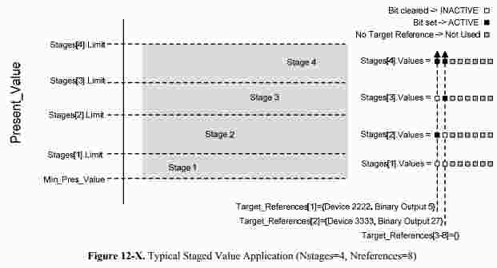
Staging object
The Staging object type provides a way for BACnet devices to map analog values onto multiple Binary
Value, Binary Output, or Binary Lighting Output objects. The Staging object can be used by 0-100% lighting commands that turn on individual fixtures to achieve step-lighting.

Slide 9
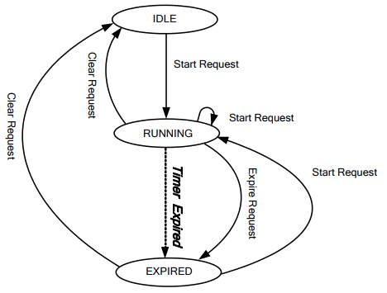
Timer object
Many building automation applications have timer functionality, which should be made network visible for
interoperable control, monitoring, and visualization.
A new object type Timer is added to allow timer functionality to be network visible. A new event algorithm
CHANGE_OF_TIMER is added to accommodate the event detection characteristics and notification needs of the
Timer object.

Slide 10
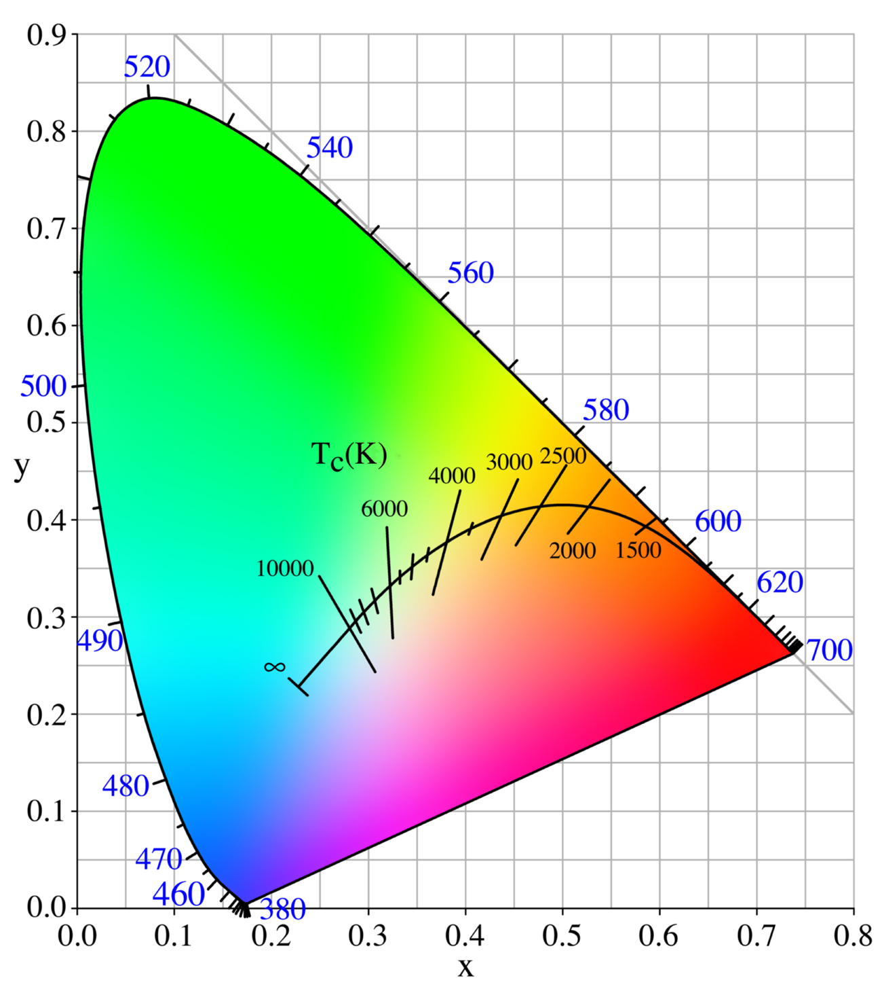
Color object
The Color object type provides a way for BACnet devices to interact with X,Y color, directly or with control commands:
None
Fade To
Stop
Override
The Color object is coupled with a Lighting Output object which provides the brightness value.

Slide 11
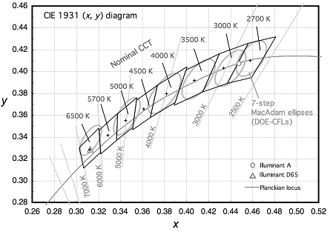
Color Temperature object
The Color Temperature object type provides a way for BACnet devices to interact with closest coordinated color temperature (CCT), directly or with control commands:
None
Fade To
Stop
Override
The Color Temperature object is coupled with a Lighting Output object which provides the brightness value.

Slide 12
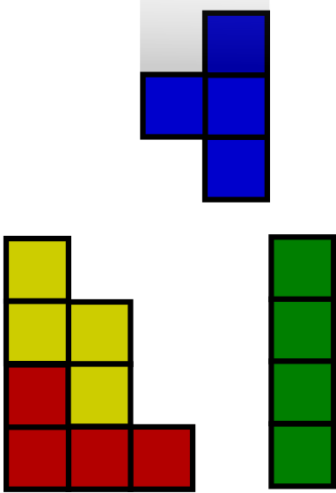
BACnet - BIBBs - Building Blocks
Annex K describes the BACnet Interoperability Building Blocks (BIBBs)
BIBBs used in PICS, standard Profiles
Example:
  K.1.2 BIBB
  Data Sharing-ReadProperty-B (DS-RP-B): The B device is a provider of data to device A.

Slide 13
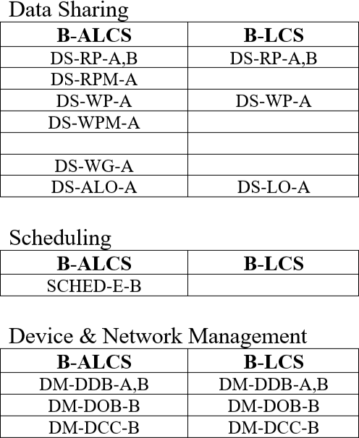
Lighting BIBBs
With the addition of the Lighting object types and new services, lighting specific BACnet Interoperability Building Blocks (BIBBs) and device profiles were defined.
Lighting Operator Devices and workstations.
  This family is composed of B-XAWS, B-ALWS, and B-LOD.
Lighting Control Stations.
  This family is composed of B-ALCS and B-LCS.
Lighting Supervisor (button/switch/sensor) and Lighting Device (lamp/ballast).
  This family is composed of B-LS and B-LD.

Slide 14
BACnet - Key Features
Multiple datalink to choose from (Ethernet, WiFi, IPv4, IPv6, IPv6/6LoPAN/802.15.4, EIA-485, etc).
Optional IT friendly interfaces (RESTful API, JSON responses, object tags) and Security (TLS/websocket)
Robust objects and services supporting Schedules, Events, Alarms, Audit Logs, Trending, Access Control, Life Safety, Elevators, and Files in addition to many value objects.
BACnet core interoperability between components is based on an object-oriented model. In this scheme, individual automation system devices can perform any type of function from data sharing to scheduling, from controlling light brightness and color fading to scenes, to integration between HVAC, security, fire and life safety, access control.
Each device, whether it is a controller or an endpoint, can participate in the BACnet network, and has its own identity.

Slide 15
BACnet Objects for Modeling a Device
accumulator
binary-output
file
multi-state-output
trend-log
analog-input
binary-value
group
multi-state-value
load-control
analog-output
calendar
life-safety-point
notification-class
structured-view
analog-value
command
life-safety-zone
program
trend-log-multiple
averaging
device
loop
pulse-converter
binary-input
credential-data-input
event-enrollment
multi-state-input
schedule
event-log
access-zone
access-rights
access-point
access-user
access-credential
characterstring-value
bitstring-value
access-door
global-group
characterstring-value
date-pattern-value
date-value
datetime-pattern-value
datetime-value
integer-value
large-analog-value
octetstring-value
positive-integer-value
time-pattern-value
time-value
channel
network-security
timer
lighting-output
binary-lighting-output
notification-forwarder
alert-enrollment
network-port
elevator-group
escalator
lift
staging
audit-log
audit-reporter
color
color-temperature

Slide 16
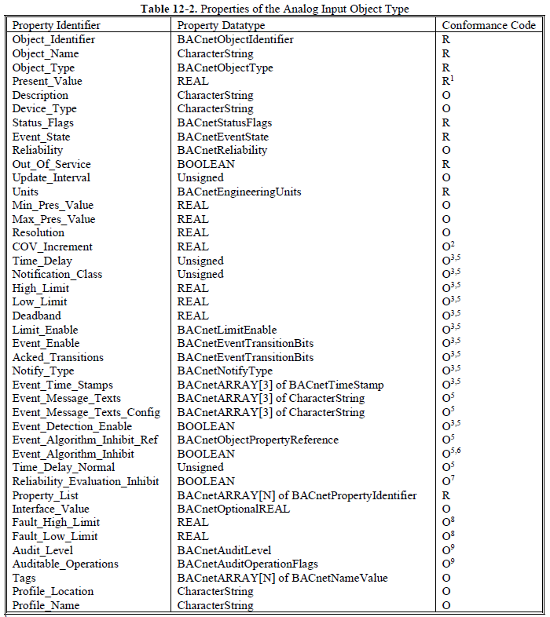
BACnet Object Property Values
For 'value' objects, additional property values assist the building or application integration to understand other related information of the 'value', such as Units, Status or Name and provide a vendor a rich palette from which to model their device features.

Slide 17
BACnet Confirmed Services
Confirmed == Unicast, Acknowledged
AcknowledgeAlarm
AtomicWriteFile
WritePropertyMultiple
COV-Notification
AddListElement
PrivateTransfer
EventNotification
RemoveListElement
TextMessage
GetAlarmSummary
CreateObject
ReinitializeDevice
GetEnrollmentSummary
DeleteObject
VTOpen
SubscribeCOV
ReadProperty
VTClose
SubscribeCOVProperty
ReadPropertyMultiple
VTData
LifeSafetyOperation
ReadRange
Authenticate
AtomicReadFile
WriteProperty
RequestKey
GetEventInformation
AuditLogQuery
ReadPropertyConditional
ConfirmedCOVNotificationMultiple
DeviceCommunicationControl
SubscribeCOVPropertyMultiple

Slide 18
BACnet Confirmed Services
Unconfirmed == Broadcast (usually)
I-Am
TextMessage
I-Have
TimeSynchronization
COV-Notification
WhoHas
EventNotification
WhoIs
PrivateTransfer
UTC-TimeSynchronization
WriteGroup
COV-NotificationMultiple
Who-Am-I
AuditNotification
You-Are

Slide 19
BACnet Application Layer
Design: BACnet object modeling for Lighting Control
Required
  Device object
  Network Port object
Lighting Specific Outputs
  Lighting Output object
  Binary Lighting Output object
  Staging object
  Color object
  Color Temperature object
Shades & Blinds
  Analog Output object
  Binary Output object
  Multi-state Output object
Sensors (light, motion, touch)
  Analog Input object
  Binary Input object
  Multi-state Input object
Demand Response/Shed
  Load Control object
  Averaging object
Grouping Lights
  Channel object
Daylight Harvesting
  Loop object
Area Timeout
  Timer object
Time of Day Scheduling
  Schedule object
  Calendar object
Configuration Parameters
  Analog Value object
  Binary Value object
  Multi-state Value object

Slide 20
BACnet Application Layer
Design: BACnet Network Communication
Object property services
  ReadProperty
  WriteProperty
  ReadPropertyMultiple
  WritePropertyMultiple
Control services
  WriteGroup
  WriteProperty
Device discovery and management services
  ReinitializeDevice
  DeviceCommunicationControl
  Who-Am-I
  You-Are
  Who-Is
  I-Am
Other object services
  AtomicReadFile
  AtomicWriteFile
  COVNotification
  SubscribeCOV
Other Device services
  TimeSynchronization
  UTCTimeSynchronization
Peer to Peer control is possible with any device!
Native BACnet vs Gateway
  Gateway adds latency
  Gateway restricts the BACnet service & object property model
  Gateway requires a translation from the downstream protocol

Slide 21
BACnet Application Layer
Design: Extensibility
Vendors can create their own services using Confirmed or Unconfirmed Private Transfer for services that BACnet hasn't standardized:
  Tunnel non-BACnet protocols
  Send Non-BACnet notifications or events
  Enable vendor specific features
Vendors can create their own objects with their own set of properties for objects that BACnet hasn't standardized:
  Only required to have object name, type, and instance properties
Vendors can add their own properties to BACnet standard objects
Many of the enumerations used in standard BACnet object property value and services are vendor extensible
BACnet Vendor ID is free to any entity

Slide 22










BACnet - Color & Lights & Sensors
Power Over Ethernet
Sensing devices use BACnet services to directly control other BACnet device objects, or to notify other BACnet building controllers
IEEE 802.3af-2003 PoE 15.4 W
IEEE 802.3at-2009 PoE+ 25.5 W
IEEE 802.3bt-2018 PoE++ 51 W
IEEE 802.3bt-2018 4PPoE 71.3 W
IEEE 802.3bu-2016 PoDL 50 W
There are IP migration transmission systems called ‘IP over any cable’ technology on the market today that allow installers/end-users to take advantage of extended PoE power & Ethernet distances using legacy cable.

Slide 23



BACnet Integration - Vivarium
Environmental controls
Lighting - A lighting system simulates the requirements of the animal and plant species, such as day/night regulator
Temperature - simulates conditions found in their natural habitat, including simulated day/night or seasonal periods
Humidity - simulates conditions found in their natural habitat, including simulated day/night or seasonal periods
Ventilation and openings - Access inside the vivarium is required for the purpose of maintenance, sometimes with the use of special lighting that won't disrupt experiments or the species inside

Slide 24

BACnet - Key Benefits
Worldwide standardized data communication for building automation
Independent of specific technologies and suppliers
Comprehensive solution for building control and automation networks
Compatibility with IT infrastructure and highly scalable solutions
Validation at independent testing laboratories and product certification
Continuously being maintained and upgraded while preserving current investments

