Slide 1

WQD 7003 Data Analytics:
Inference Statistical Analysis
CHAPTER 5 – STATISTICAL INFERENCE
Saw Shier Nee, Hema Subramaniam & Aznul Qalid Md Sabri
sawsn@um.edu.my , hema@um.edu.my, aznulqalid@um.edu.my
Dept. of AI, Fac. of Computer Science and IT, University of Malaya
Dept. of SE, Fac. of Computer Science and IT, Universiti Malaya

Slide 2

Outline
Types of variables
Hypothesis Testing
T-test
Chi Square Test

Slide 3
Learning Outcomes
At the end of this lecture, student will be able to:
To differentiate the different type of variables
To understand the concept of various statistical test
To identify the appropriate statistical test in different situations.
To interpret the statistical test results

Slide 4
Types of variable
Types of variables
Types of variable | Meaning
Numerical Variable | Value contains an numbers (continuous or discrete)
Categorical Variable | Contains categories instead of number
Continuous variable | Take an infinite number of real values in a given range
Discrete Variables | Take only finite number of real values in a given interval.
Dependent Variables | Output (Y)
Independent Variables | Input / Features (X)

Slide 5
Hypothesis Testing
Hypothesis Testing
Hypothesis: A claim / statement about a population parameters (µ, σ).
In inferential statistic, we study samples and use the results to generalize the populations.
Suppose we claim that: The average IQ of all undergraduate students in a University is 100.
Notes:
Then we collect data and test if is the hypothesis / claim is true.

Slide 6






Hypothesis Testing
Hypothesis Testing
Claim: The average IQ of all undergraduate students in a University is 100.
Two-tailed:
One-tailed:
One-tailed:
Null Hypothesis
Null Hypothesis
Null Hypothesis
Alternative Hypothesis
Alternative Hypothesis
Alternative Hypothesis
Notes:
If we want to test if the IQ is less than 100. Then our null hypothesis is opposite.

Slide 7
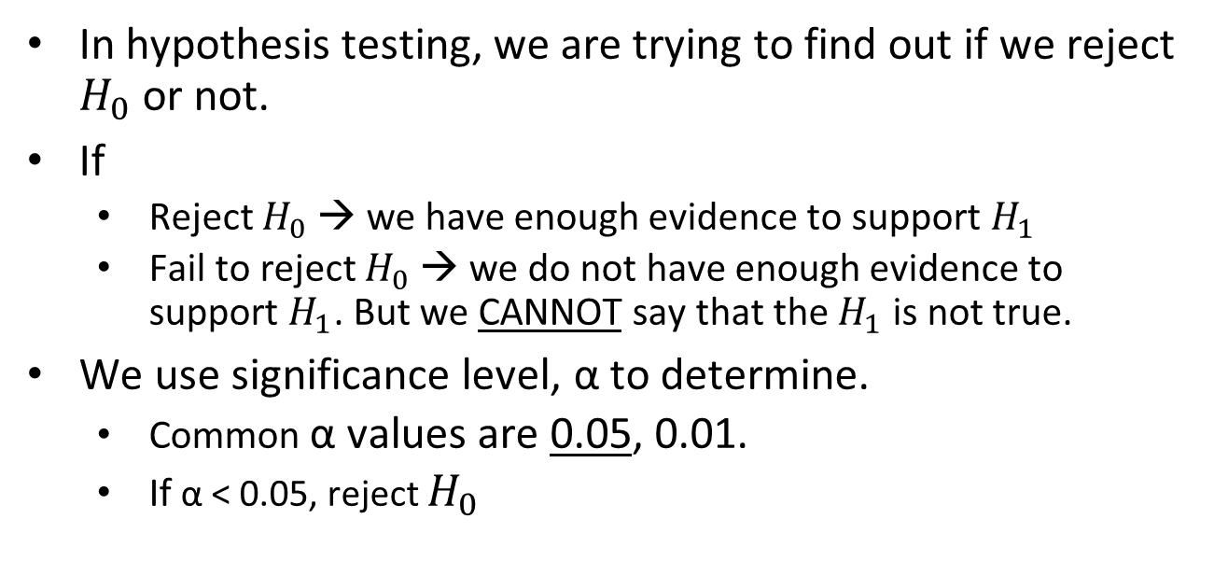
Hypothesis Testing
Hypothesis Testing
Notes:
If we want to test if the IQ is less than 100. Then our null hypothesis is opposite.

Slide 8






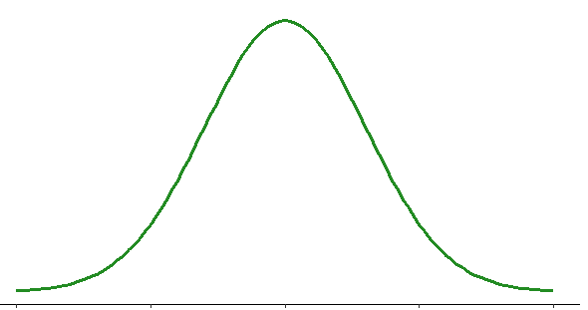



Hypothesis Testing
Hypothesis Testing
Two-tailed:
One-tailed:
One-tailed:
Null Hypothesis
Null Hypothesis
Null Hypothesis
Alternative Hypothesis
Alternative Hypothesis
Alternative Hypothesis
α/2
α/2
α
α

Slide 9
Hypothesis Testing
Hypothesis Testing
State the research question.
State the statistical hypothesis.
Determine significance value (alpha value)
Compute degree of freedom.
Set decision rule.
Calculate the test statistic.
Statistic results.
Statistic conclusion.

Slide 10
Statistical Test
Statistical Test
One-sample t-test
Numerical variables
T-test
Dependent t-test
Statistical Test
Categorical Variable
Chi-square test
Independent t-test

Slide 11
One sample t-test
T test: One sample t-test
Is a statistical hypothesis test to determine whether an unknown population mean is different from a specific value.
For example, this test is used to compare a list of values to a set standard.
The standard is usually chosen for its theoretical or practical importance.

Slide 12
One sample t-test: Concept
T test: One sample t-test
Compare the sample mean to the standard / population mean.

Slide 13
One sample t-test: Example
T test: One sample t-test
Average birth weight for white babies is 3,410 gram.
We want to compare the average birth weight of sample of black babies to this value
Average height of guys in Malaysia is 170cm.
We want to compare the average height of sample of Singaporean male to this value
Average IQ of UM students is 115.
We want to compare the average IQ of samples of students from UKM to this value.

Slide 14
Example
T test: One sample t-test
Intelligence tests are constructed such that the average score among adults is 100 points.
In this example, we take a small sample of undergraduate students at a University (N = 6) and try to determine if the average of intelligence scores for all students at the university is higher / lower / equal to 100.
In simple terms, are the university students smarter than average?

Slide 15
Example (con’t)
T test: One sample t-test
The scores obtained from the 6 students were as follows:
All of them score more than the average intelligence score.
Is this finding likely to hold true in repeated samples?
What if we drew 6 different people from the University?
A one-sample t-test will help answer this question.
 | X
Person 1 | 110
Person 2 | 118
Person 3 | 110
Person 4 | 122
Person 5 | 110
Person 6 | 150

Slide 16
Example (con’t)
T test: One sample t-test
Research Question:
On average, do the sample of undergraduates at a University have higher/lower/equal to average intelligence scores of 100?
Hypothesis
Null Hypothesis: IQ = 100
Alternative Hypothesis: IQ ≠ 100

Slide 17
Example (con’t)
T test: One sample t-test
Determine alpha value:
α = 0.05
Compute degree of freedom:
df = n – 1
n = number of samples
This determine the critical value.

Slide 18
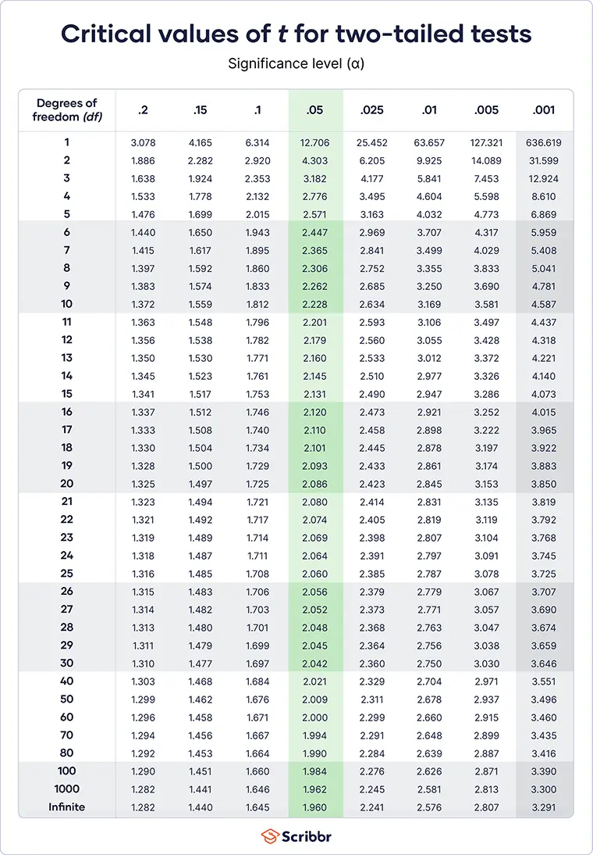


Example (con’t)
T test: One sample t-test
Set decision rule:
With α = 0.05, df = 5, two tailed test.
We obtained the critical value from t-statistics table.
-2.571
2.571
Notes:
Compute

Slide 19

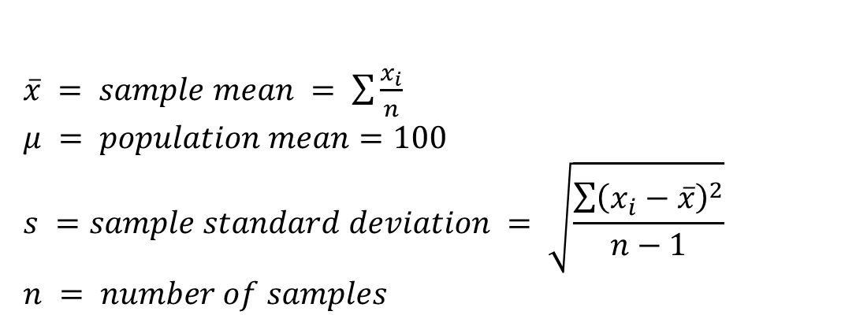
Example (con’t)
T test: One sample t-test
Notes:
Compute

Slide 20

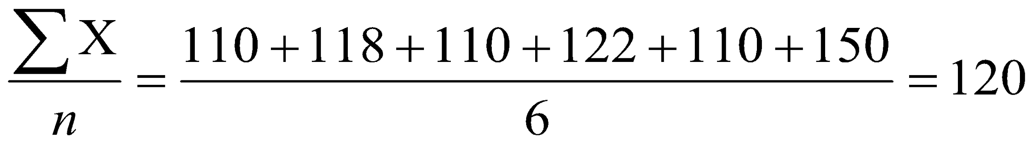
Example (con’t)
T test: One sample t-test
Sample mean:
=

Slide 21
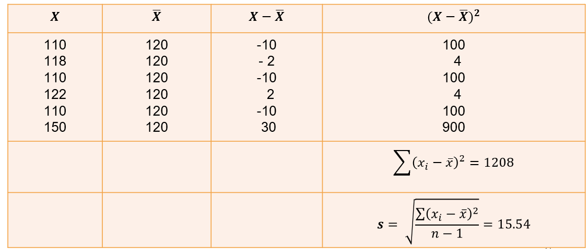
Example (con’t) – sample standard deviation
T test: One sample t-test

Slide 22
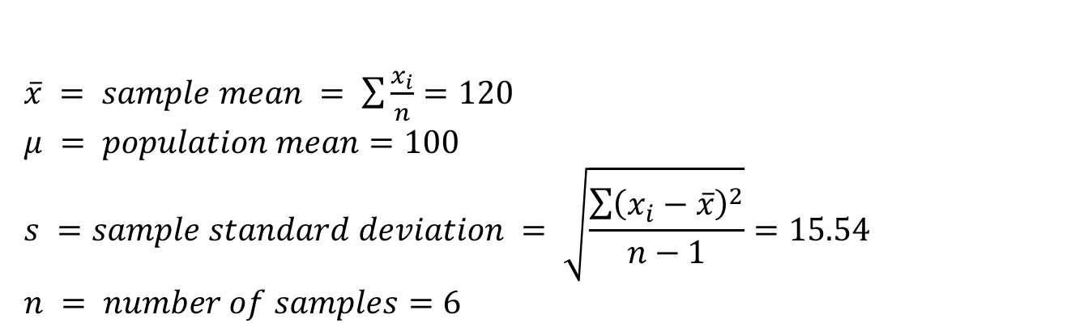
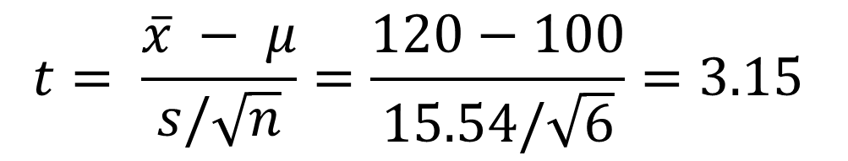
Example (con’t)
T test: One sample t-test
Compute t-statistic value:
Notes:
Compute

Slide 23


Example (con’t)
T test: One sample t-test
Stat Results:
t-statistic = 3.15, larger than t-critical value, falls into critical region. Reject Ho
Stat Conclusion:
There is sufficient evidence to conclude that sample of undergraduate at a University is significantly different from average intelligence score.
-2.571
2.571
3.15
Hypothesis
Null Hypothesis: IQ = 100
Alternative Hypothesis: IQ ≠ 100
Notes:
Compute

Slide 24
Statistical Inference
T test: One sample t-test
Notice that the conclusion makes an inference about the population of students from the University based on a small sample.
This is why we call this type of a test ‘statistical inference.’
We are inferring something about the population based on only a sample of members.
Notes:
Compute

Slide 25
Statistical Test
Statistical Test
One-sample t-test
Numerical variables
T-test
Dependent t-test
Statistical Test
Categorical Variable
Chi-square test
Independent t-test

Slide 26
Dependent t-test
T test: Dependent t-test
Is a statistical hypothesis test to compare the means of two variables for a single group.
For example, when you have two sets of scores from the same person in your sample,
Also called as paired-sample t-test

Slide 27
Dependent t-test: Example
T test: Dependent t-test
A training program assessment takes pretest and posttest scores from the same group of people
A paint durability study applies different types of paint to portions of the same wooden boards.
Check if there was a difference in smokers' daily cigarette consumption before and after a 6-week hypnotherapy programme.

Slide 28
Dependent t-test: Concept
T test: Dependent t-test
The way to handle two scores per person, or a matched pair, is to make difference scores.
For each person, or each pair, you subtract one score from the other.
Once you have a difference score for each person, or pair, in the study, you treat the study as if there were a single sample of scores (scores that in this situation happen to be difference scores).
Compare the difference score to see if is equal to zero.

Slide 29
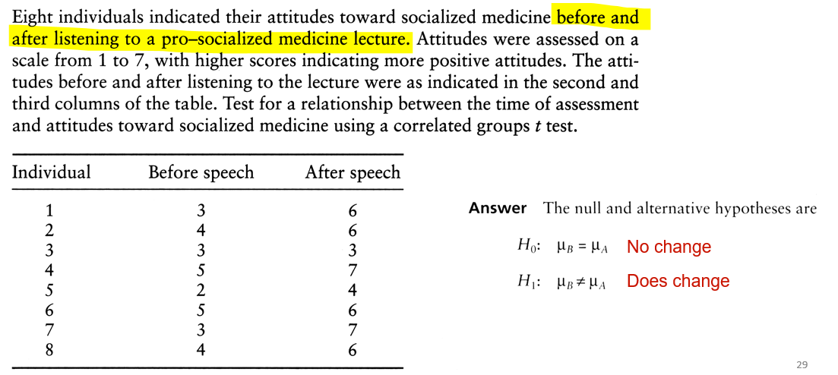
Example
T test: Dependent t-test

Slide 30
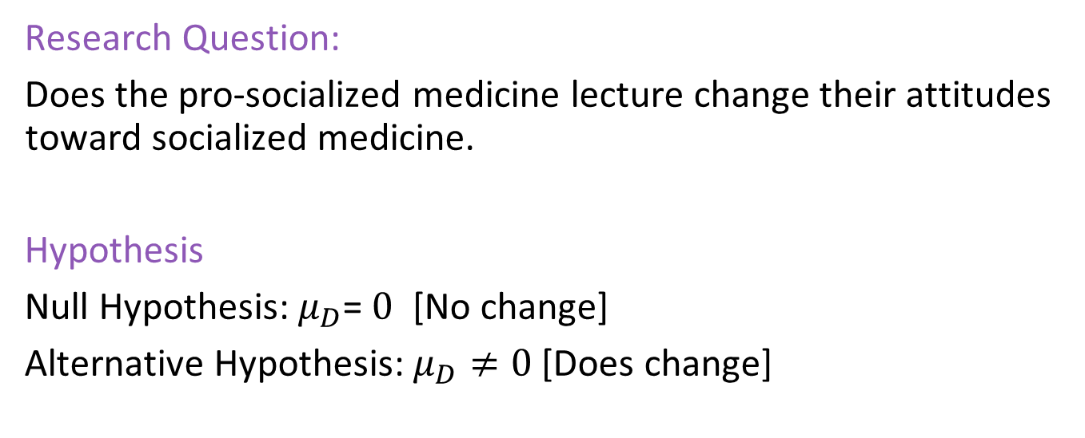
Example (con’t)
T test: Dependent t-test
Difference scores

Slide 31
Example (con’t)
T test: Dependent t-test
Determine alpha value:
α = 0.05
Compute degree of freedom:
df = n – 1
n = number of difference scores
This determine the critical value.

Slide 32
Example (con’t)
T test: Dependent t-test
Set decision rule:
With α = 0.05, df = 7, two tailed test.
We obtained the critical value from t-statistics table.
-2.365
2.365
Notes:
Compute

Slide 33
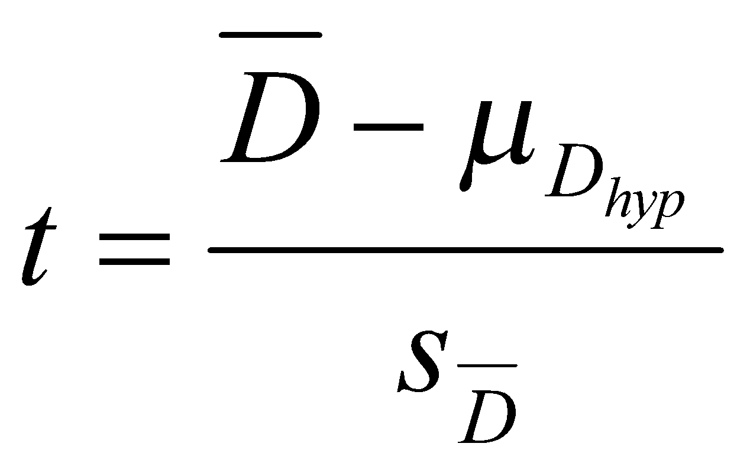
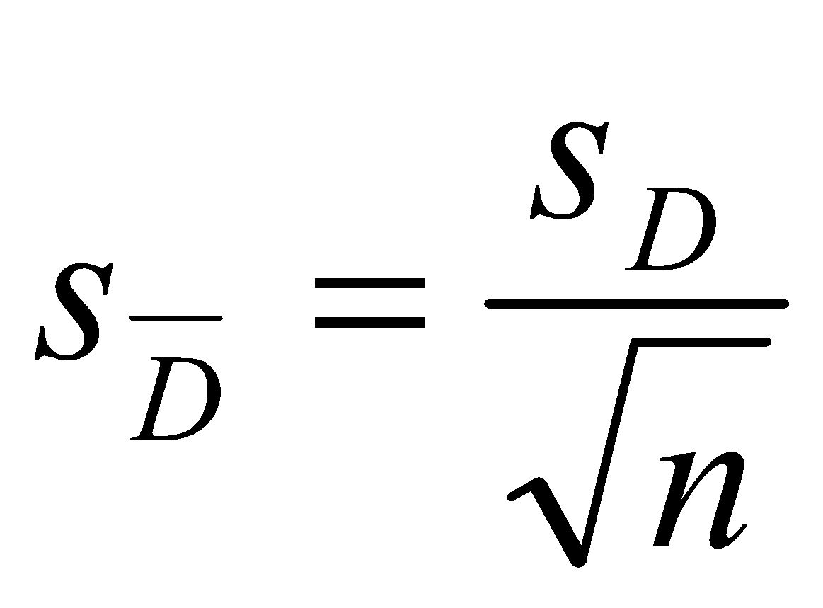
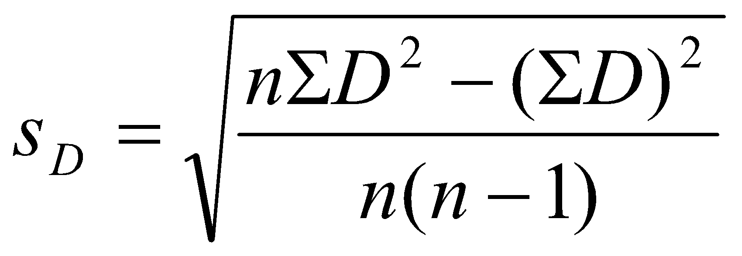
Example (con’t)
T test: Dependent t-test
Compute t-statistic value:
Mean Difference
Standard error of difference
Standard deviation of difference
Number of sample
Notes:
Compute

Slide 34
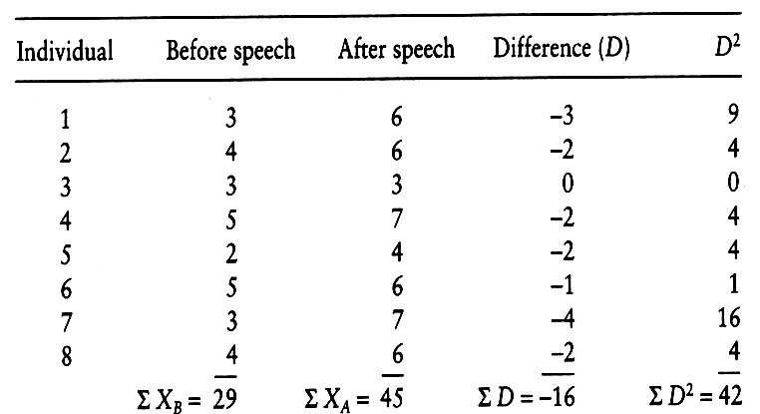
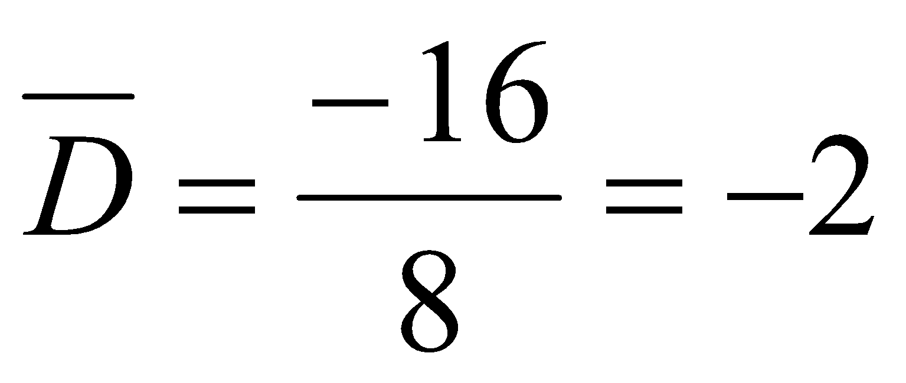
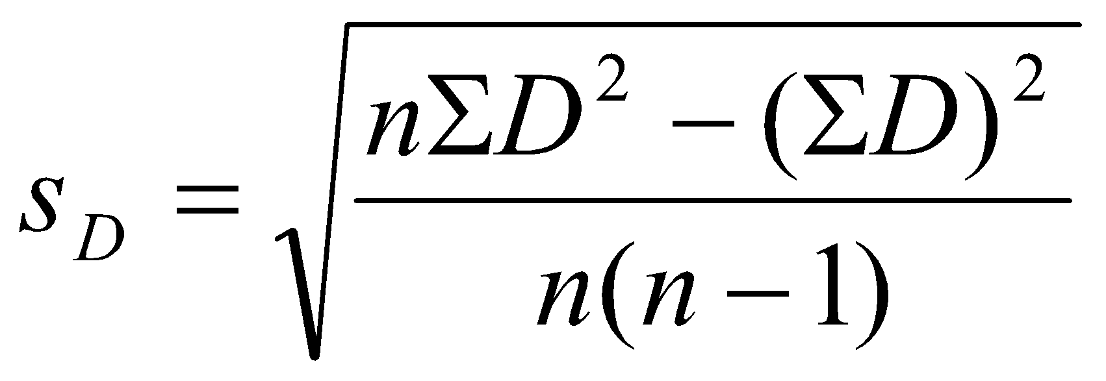
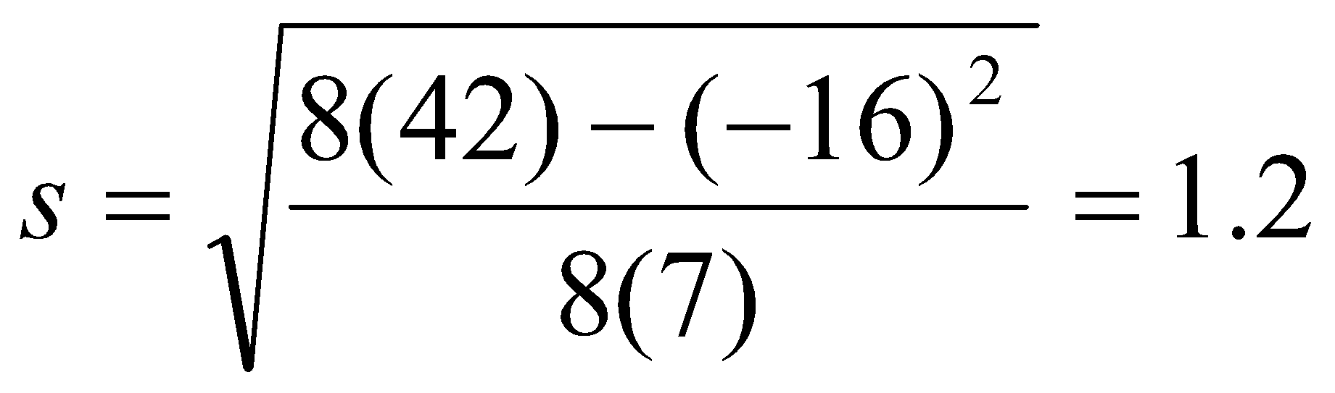
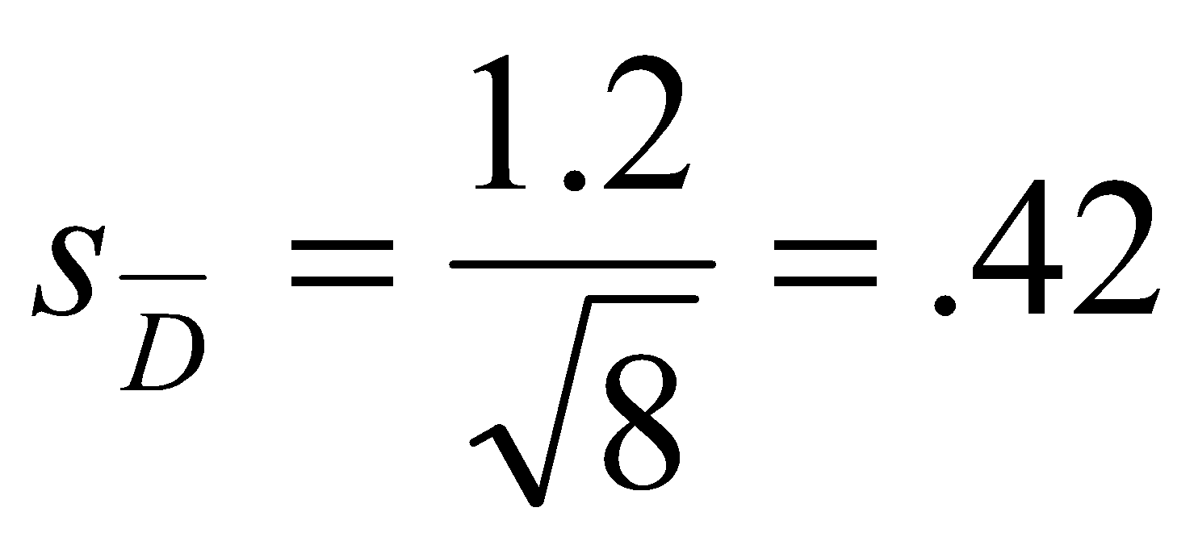
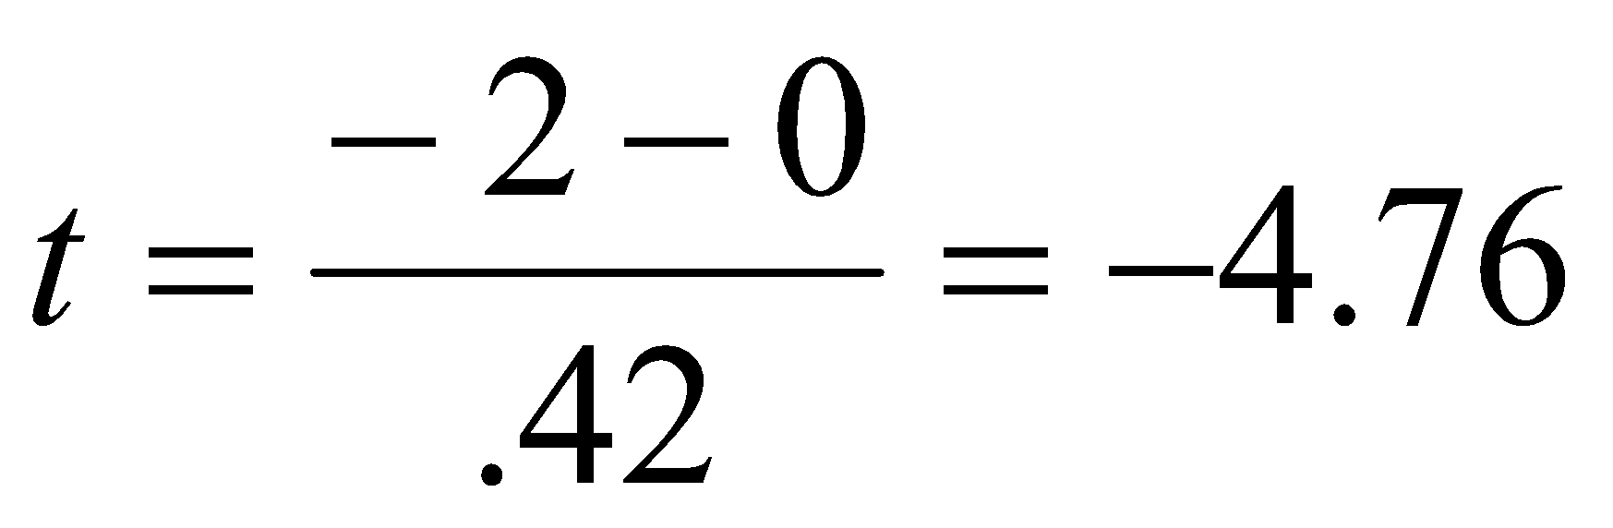
Example (con’t)
T test: Dependent t-test
Notes:
Compute

Slide 35

Example (con’t)
T test: Dependent t-test
Stat Results:
t-statistic = -4.76, smaller than t-critical value, falls into critical region. Reject Ho
Stat Conclusion:
There is sufficient evidence to conclude that individual's attitude toward socialized medicine changed after lecture.
-2.365
2.365
-4.76
Notes:
Compute

Slide 36
Statistical Test
Statistical Test
One-sample t-test
Numerical variables
T-test
Dependent t-test
Statistical Test
Categorical Variable
Chi-square test
Independent t-test

Slide 37
Independent t-test
T test: Independent t-test
Is a statistical hypothesis test to compare the means of TWO groups, or conditions.
Also known as two-sample t-test

Slide 38
Independent t-test: Example
T test: Independent t-test
Compare the income between men and women
Compare the housing price between Penang and Kuala Lumpur
Compare number of complains between Samsung phone and IPhone

Slide 39
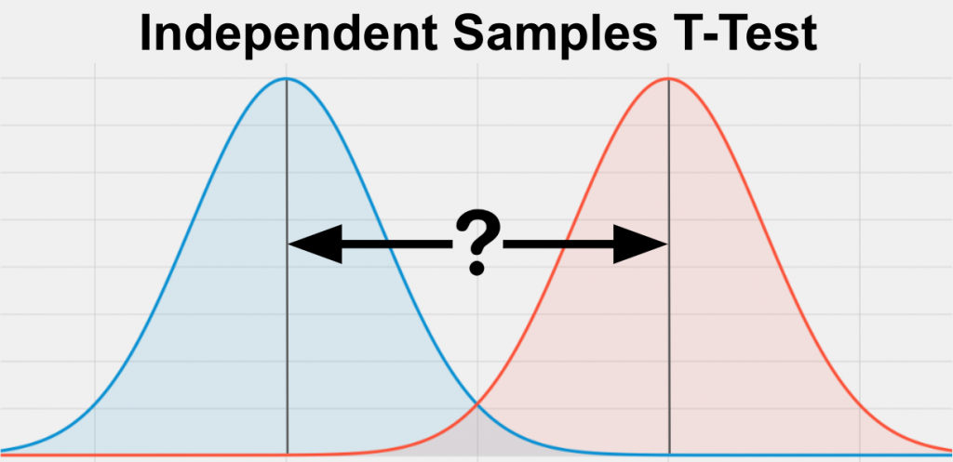
Independent t-test: Concept
T test: Independent t-test
Compare the sample mean between two groups.
Men’s income
Women’s income

Slide 40
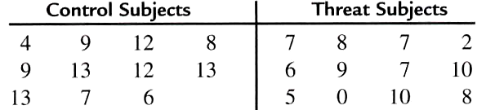
Example
T test: Independent t-test
Stereotype Threat.
To find out if stereotype threat threat affect individual’s performance.
Assessment marks
Subject does not experience stereotype threat
Subject experience stereotype threat

Slide 41

Example (con’t)
T test: Independent t-test
threat
control

Slide 42
Example (con’t)
T test: Independent t-test
Determine alpha value:
α = 0.05
Compute degree of freedom:
df = (n₁ – 1) + (n₂ – 1)
n = number of samples
This determine the critical value.
df = (n₁ – 1) + (n₂ – 1)
= (11-1) + (12-1)
= 21

Slide 43
Example (con’t)
T test: Independent t-test
Set decision rule:
With α = 0.05, df = 21, two tailed test.
We obtained the critical value from t-statistics table.
-2.08
2.08
Notes:
Compute

Slide 44
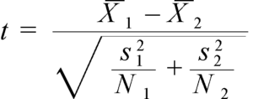
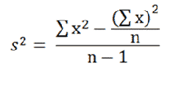

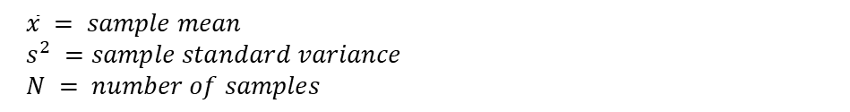
Example (con’t)
T test: Independent t-test
Compute t-statistic value:
Notes:
Compute

Slide 45
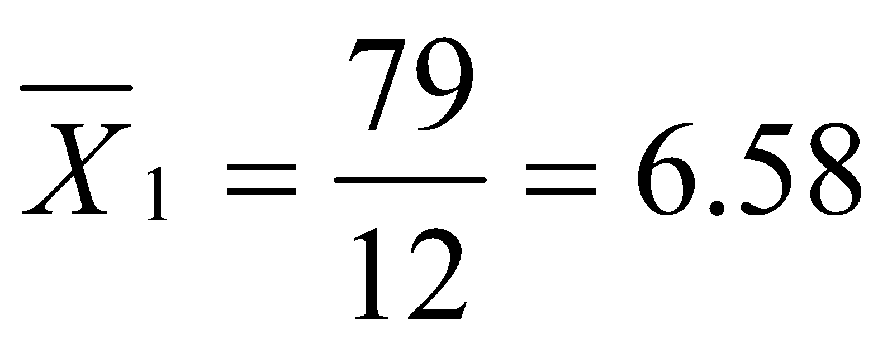
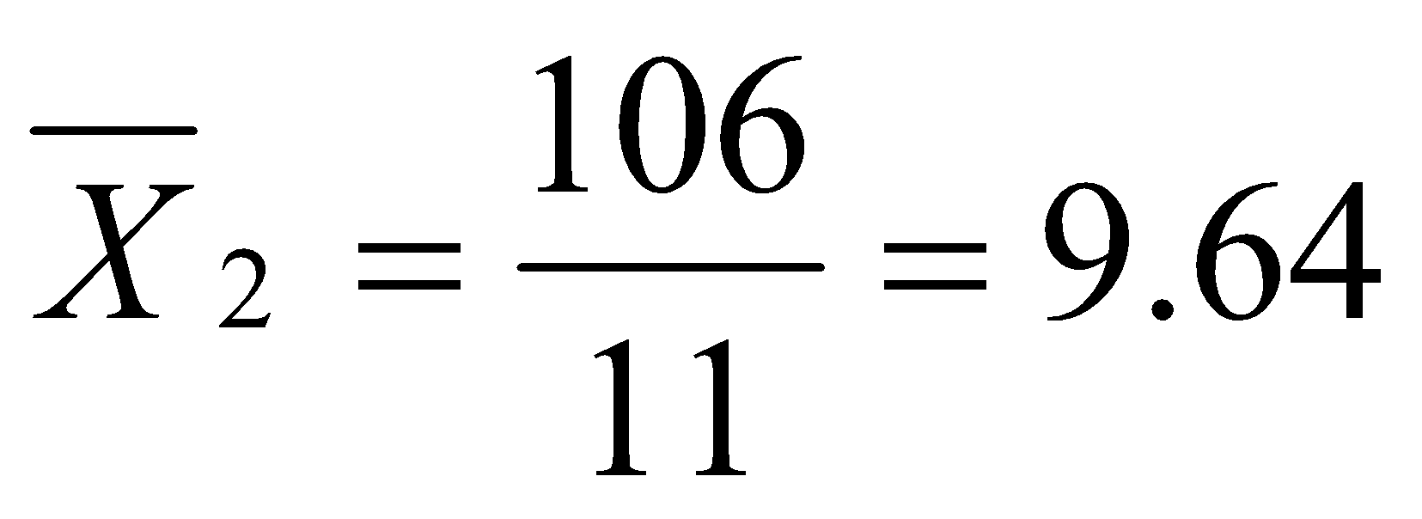
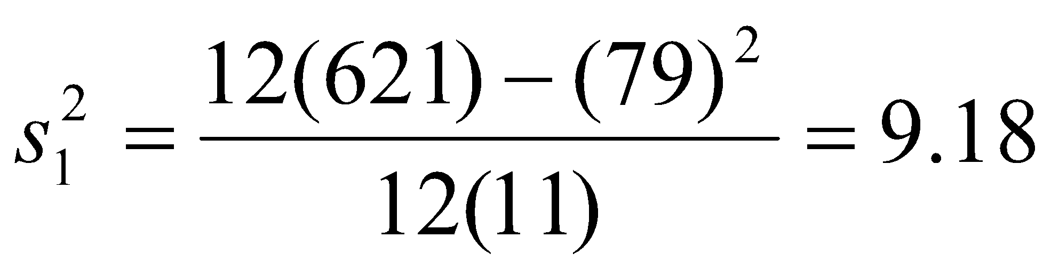
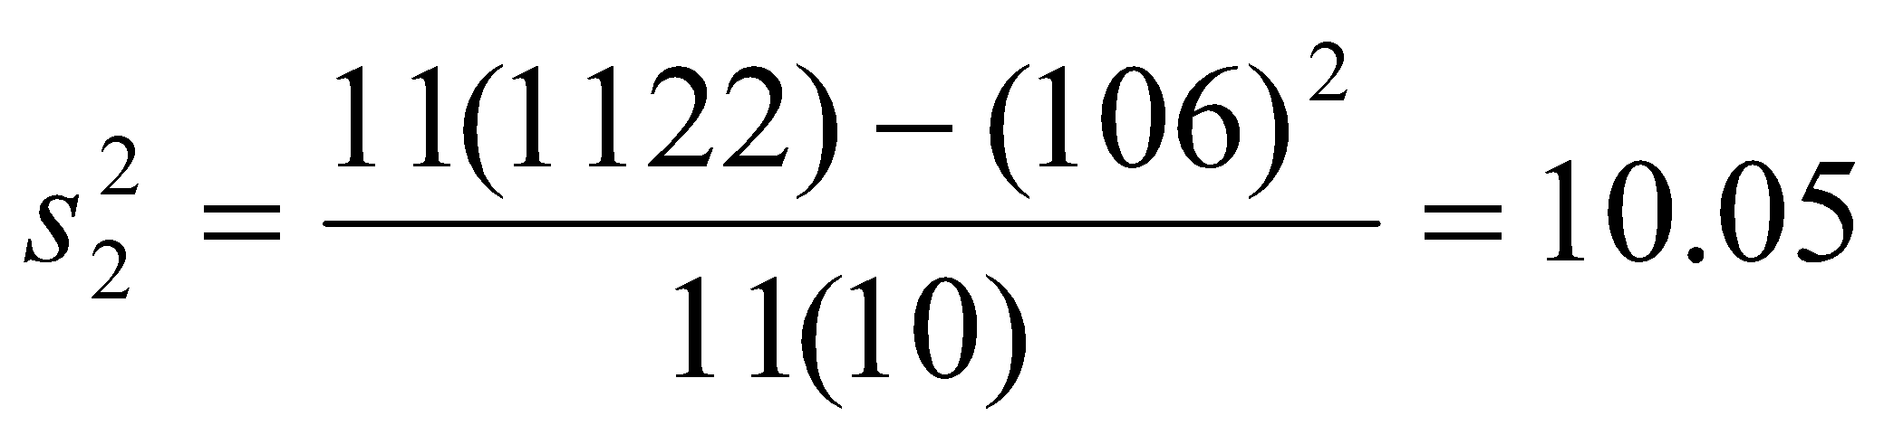
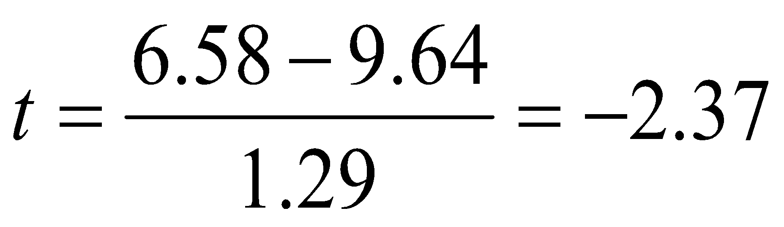
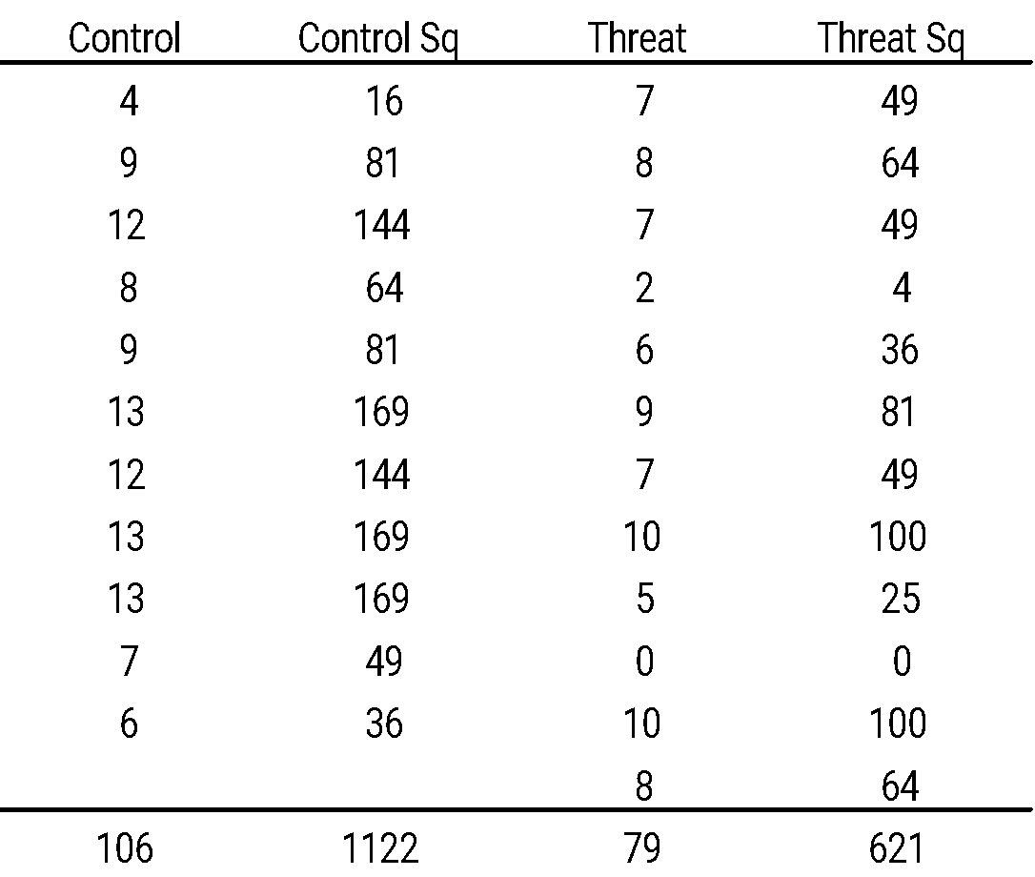
Example (con’t)
T test: Independent t-test
threat
control
n = 11
n = 12
Notes:
Compute

Slide 46

Example (con’t)
T test: Independent t-test
Stat Results:
t-statistic = -2.37, smaller than t-critical value, falls into critical region. Reject Ho
Stat Conclusion:
There is sufficient evidence to conclude that stereotype threat affects the performance of those individual to which it is applied.
-2.08
2.08
-2.37
Notes:
Compute

Slide 47
Statistical Test
Statistical Test
One-sample t-test
Numerical variables
T-test
Dependent t-test
Statistical Test
Categorical Variable
Chi-square test
Independent t-test

Slide 48
Chi-squared test
Chi-squared test
Is statistical hypothesis test
to determine whether there is a significant difference between the expected frequencies and the observed frequencies.
Or to determine if two categorical variables are independent

Slide 49
Chi-squared test: Example
Chi-squared test
Wish to know if attending class influence the students’ grades.
Wish to know if education level influence marital status
Wish to know if the number generated has uniform distribution.

Slide 50
Example 1
Chi-squared test
A gambler observes throws of a dice to determine if the dice is fair
After observing 48 throws, he has the following observations
Spots | Observed Frequency
1 | 8
2 | 7
3 | 2
4 | 14
5 | 10
6 | 7
Q: Is the dice fair?
How do we know? We compare the distribution with a uniform distribution and test it with chi-squared to see if the difference is significant

Slide 51
Example 1 (con’t)
Chi-squared test
Research Question:
Is the dice fair?
Hypothesis
Null Hypothesis: There is NO significant association between observed distribution and uniform distribution.
Alternative Hypothesis: There is a significant association between observed distribution and uniform distribution.

Slide 52
Example 1 (con’t)
Chi-squared test
Determine alpha value:
α = 0.05
Compute degree of freedom:
df = n-1
n = number of categories in our data
This determine the critical value.
df = 6-1 = 5

Slide 53
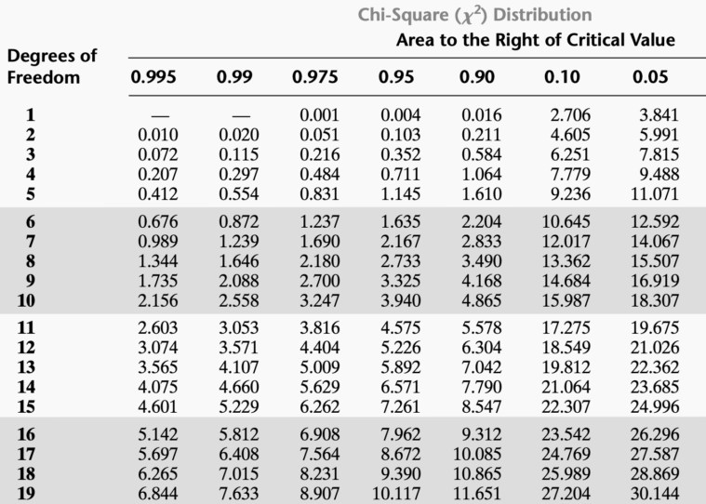


Example 1 (con’t)
Chi-squared test
Set decision rule:
With α = 0.05, df = 5, two tailed test.
We obtained the critical value from chi-squared distribution.
-11.071
11.071
If chi-square value > 11.071 or < -11.071, then reject Ho
Notes:
Compute

Slide 54
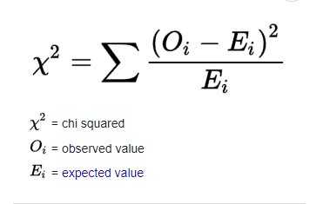
Example 1 (con’t)
Chi-squared test
Compute chi-squared value:
Notes:
Compute

Slide 55
Example 1 (con’t)
Chi-squared test
Compute chi-squared value:
Spots | Observed Frequency | Expected Frequency
1 | 8 | 8
2 | 7 | 8
3 | 2 | 8
4 | 14 | 8
5 | 10 | 8
6 | 7 | 8
Notes:
Compute

Slide 56
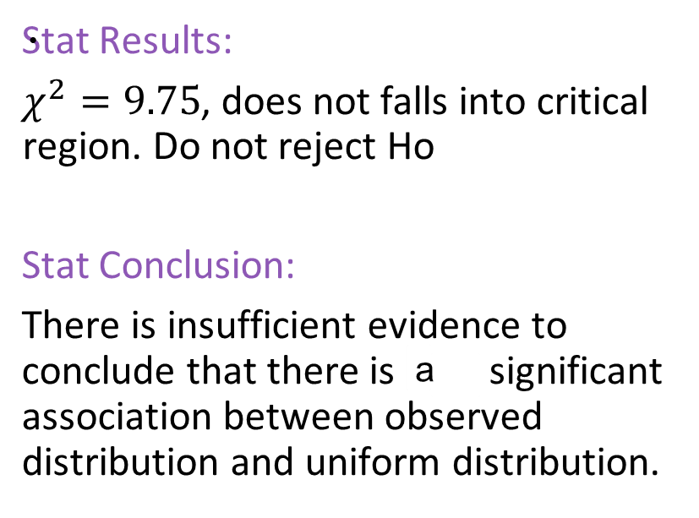
Example 1 (con’t)
Chi-squared test
11.071
-11.071
9.75
Notes:
Simpler term: Dice is not fair.

Slide 57
Example 2
Chi-squared test
We wish to know whether there is any relationship between inpatients and outpatients' distribution.
 | 18-24 | 25-34 | 35-44 | 45 and over
Inpatients | 230 | 415 | 330 | 181
Outpatients | 530 | 1198 | 888 | 391

Slide 58
Example 2 (con’t)
Chi-squared test
Research Question:
Does inpatients and outpatients' distribution independent to each other?
Hypothesis
Null Hypothesis: There is NO significant association between inpatient and outpatients.
Alternative Hypothesis: There is a significant association between inpatient and outpatients.

Slide 59
Example 2 (con’t)
Chi-squared test
Determine alpha value:
α = 0.05
Compute degree of freedom:
df = (n_column-1)(n_row-1)
n = number of categories in our data
This determine the critical value.
df = (4-1)(2-1) = 3

Slide 60
Example 2 (con’t)
Chi-squared test
Set decision rule:
With α = 0.05, df = 3, two tailed test.
We obtained the critical value from chi-squared distribution.
-7.815
7.815
If chi-square value > 7.815 or < -7.815, then reject Ho
Notes:
Compute

Slide 61
Example 2 (con’t)
Chi-squared test
Compute chi-squared value:
Notes:
Compute

Slide 62
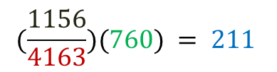
Example 2 (con’t)
Chi-squared test
Compute chi-squared value: Contingency table
Observed | 18-24 | 25-34 | 35-44 | 45 and over
Inpatients | 230 | 415 | 330 | 181
Outpatients | 530 | 1198 | 888 | 391
Total = 1156
Total = 3007
Total = 760
Total = 1613
Total = 1218
Total = 572
Grand total = 4163
Expected | 18-24 | 25-34 | 35-44 | 45 and over
Inpatients | 211
Outpatients
Notes:
Compute

Slide 63
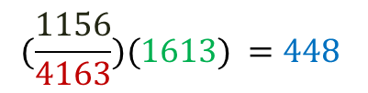
Example 2 (con’t)
Chi-squared test
Compute chi-squared value: Contingency table
Observed | 18-24 | 25-34 | 35-44 | 45 and over
Inpatients | 230 | 415 | 330 | 181
Outpatients | 530 | 1198 | 888 | 391
Total = 1156
Total = 3007
Total = 760
Total = 1613
Total = 1218
Total = 572
Grand total = 4163
Expected | 18-24 | 25-34 | 35-44 | 45 and over
Inpatients | 211 | 448
Outpatients
Notes:
Compute

Slide 64
Example 2 (con’t)
Chi-squared test
Compute chi-squared value: Contingency table
Observed | 18-24 | 25-34 | 35-44 | 45 and over
Inpatients | 230 | 415 | 330 | 181
Outpatients | 530 | 1198 | 888 | 391
Total = 1156
Total = 3007
Total = 760
Total = 1613
Total = 1218
Total = 572
Grand total = 4163
Expected | 18-24 | 25-34 | 35-44 | 45 and over
Inpatients | 211 | 448 | 338 | 159
Outpatients | 549 | 1165 | 880 | 413
Notes:
Compute

Slide 65
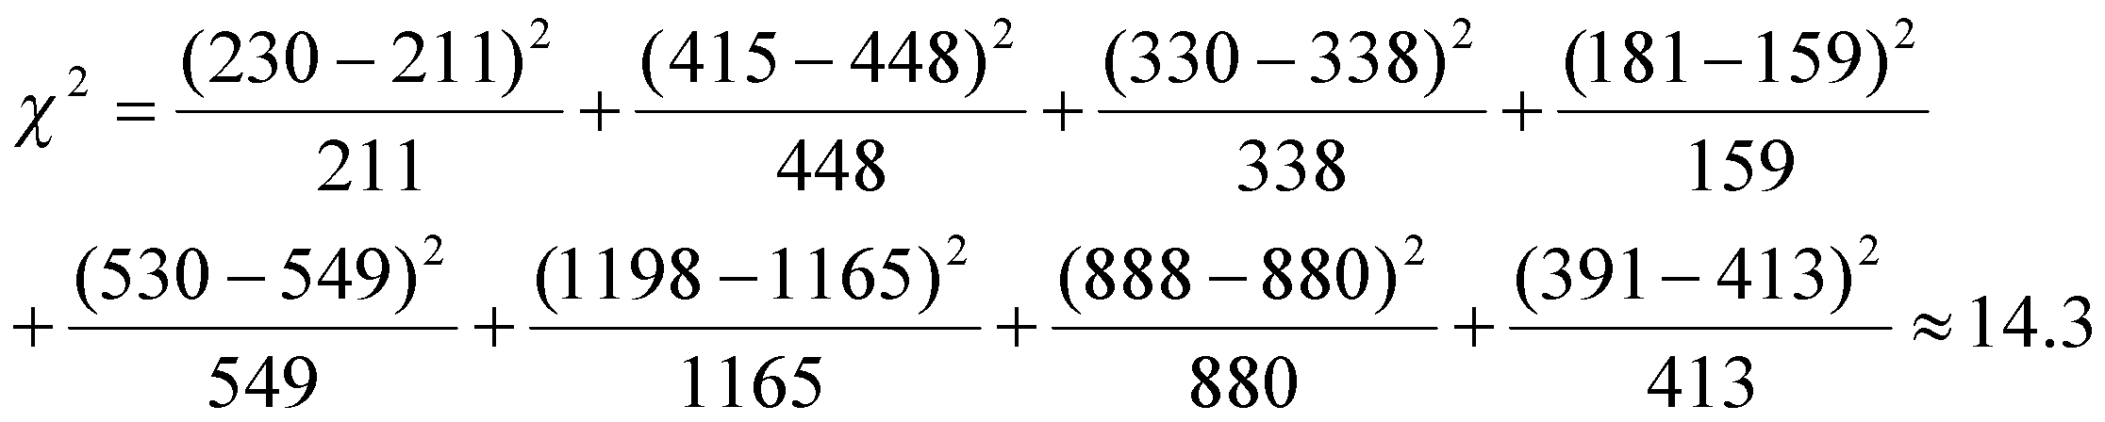
Example 2 (con’t)
Chi-squared test
Compute chi-squared value: Contingency table
Observed | 18-24 | 25-34 | 35-44 | 45 and over
Inpatients | 230 | 415 | 330 | 181
Outpatients | 530 | 1198 | 888 | 391
Expected | 18-24 | 25-34 | 35-44 | 45 and over
Inpatients | 211 | 448 | 338 | 159
Outpatients | 549 | 1165 | 880 | 413
Notes:
Compute

Slide 66
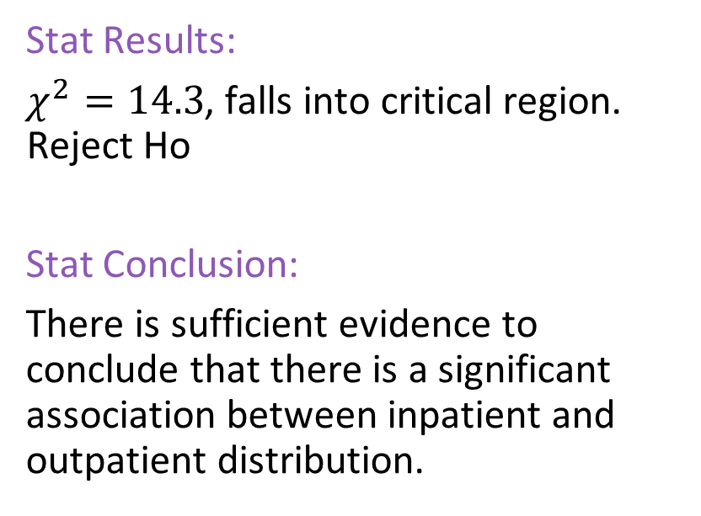
Example 2 (con’t)
Chi-squared test
7.815
-7.815
14.3
Hypothesis
Null Hypothesis: No association btw distributions / Independent
Alternative Hypothesis: There is an association btw distributions / Not independent
Notes:
Simpler term: Dice is not fair.

Slide 67
Statistical Test
Statistical Test
One-sample t-test
Numerical variables
T-test
Dependent t-test
Statistical Test
Categorical Variable
Chi-square test
Independent t-test

