Slide 1
WQD7004
Programming for Data Science
Chapter 3
Data Structure

Slide 2
Contents
Introduction
List
Matrix
Array
Data Frame
Factors

Slide 3
Introduction
Data structures are very important because these are the objects you will manipulate on a day-to-day basis in R.
R has many data structures. These include
  atomic vector
  list
  matrix
  array
  data frame
  factors

Slide 4
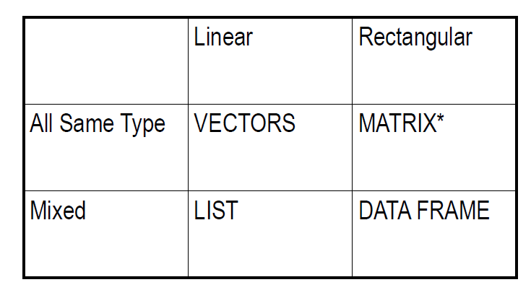
Introduction

Slide 5
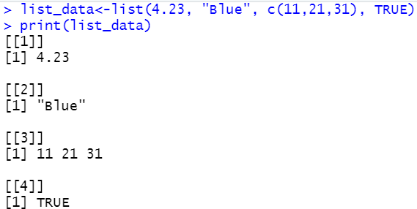
List
A list is an R-object which can contain many different types of elements inside, examples, vectors, functions and even another list inside it.

Slide 6
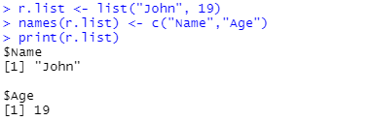
List
The names() function can be used to set the name of each element in the list.
  names(list_data) <- c("firstname", "secondname")
Integer, logical or character vectors can be used for indexing.
To display one of the element of list
  print(list_data[[2]]), print(list_data[["Age"]]), print(list_data$Age)

Slide 7
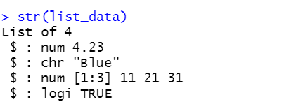
List
The length() function is used to find the length of the list.
The str() function is used to view the structure of the list.
unlist() function is used to convert list back to vector.

Slide 8
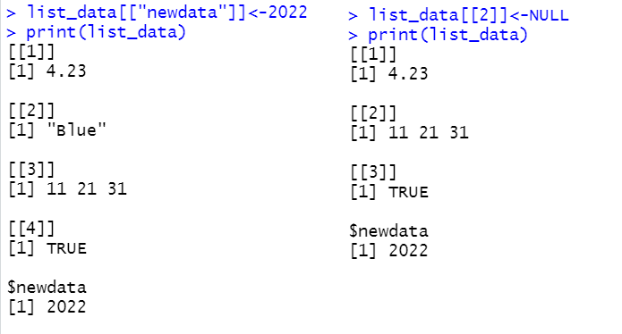
List
The $ operator can be used to refer to the list component
  print(list_data$newdata)
We can add a component by assigning a new name and we can delete a component by assigning NULL to it or using a negative index.

Slide 9
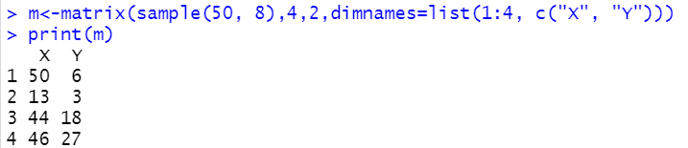
Matrix
A matrix is a two-dimensional rectangular data set.
The basic syntax for creating a matrix in R is matrix(data, nrow, ncol, byrow, dimnames)
By default, the data is populated to each column if byrow=TRUE is not specified.

Slide 10
Matrix
An element at the m^{th} row, n^{th} column of A can be accessed by the expression A[m, n]
  A[3,2] <- 100
Leaving columns field blank A[3,] will select entire row(third row), while leaving rows field blank A[,2] will select entire column (second column). Both return the result in a single row as vector.
If return the result as matrix, use A[ , 2, drop=FALSE]
Replace elements that are less than 3 with 0
  A[A<3]<-0

Slide 11
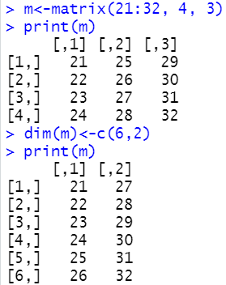
Matrix
Matrices can also be created directly from vectors by adding a dimension attribute using dim() function.

Slide 12
Matrix
rownames(), colnames(), dimnames() function can be used to set the name for the row and column.
nrow() returns the number of rows and and ncol() function the number of columns.
dim() function returns the number of rows and columns. It can change the dimension of matrix.
cbind() function is used to combine specified vector, matrix or data frame by columns.
rbind() function is used to combine specified vector, matrix or data frame by rows.

Slide 13
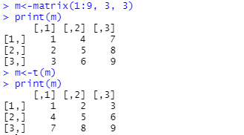
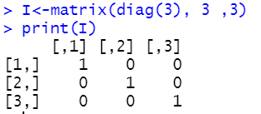
Matrix
t() function is used to transpose a matrix.
Identity matrix can be created using diag() function.

Slide 14
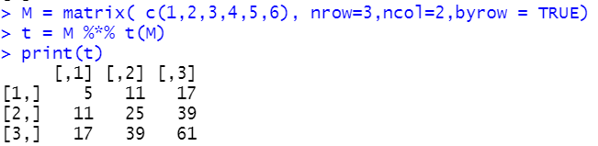
Matrix
%*%
  This operator is used to multiply a matrix.

Slide 15
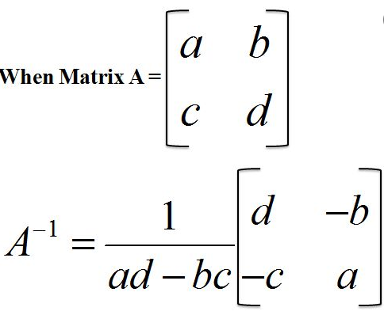
Matrix
Inverse of Matrix for a matrix A is denoted by A⁻¹.

Slide 16
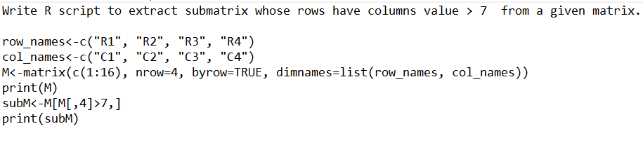
Matrix

Slide 17
Array
Array can be of any number of dimensions. An array is created using the array() function. It takes vectors as input and uses the values in the dim parameter to create an array.
Accessing and modifying array elements are like matrices.

Slide 18
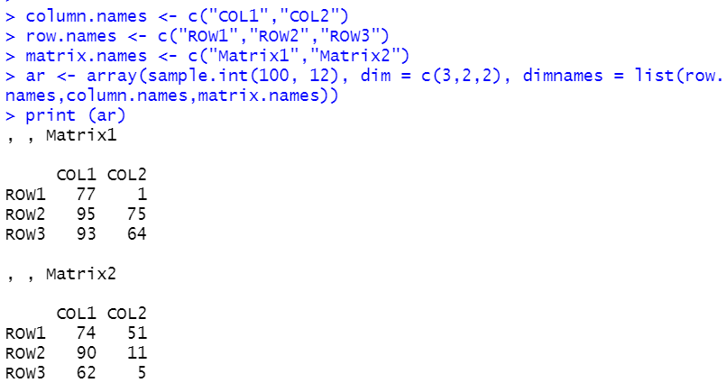
Array

Slide 19
Data Frame
Data frames are tabular data objects. Data is stored in the form of table. It consists a list of vectors of equal length.
Each column can contain different modes of data. The first column can be numeric while the second column can be character and third column can be logical.
Data Frames are created using the data.frame() function.
The characteristics of a data frame.
  The column names should be non-empty.
  The row names should be unique.
  Each column should contain same number of data items.

Slide 20
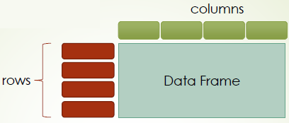
Data Frame

Slide 21
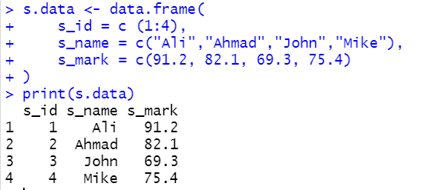
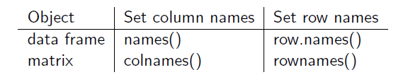
Data Frame

Slide 22
Data Frame
To add new column
  s.data$newcolumnname <- newcoldata
To display one of the item of data frame
  print(s.data[2,3]) #second row, third column
  print(s.data[2, "colname"])
  print(s.data[2,]) #second row
  print(s.data[,"colname"]) #by column name

Slide 23
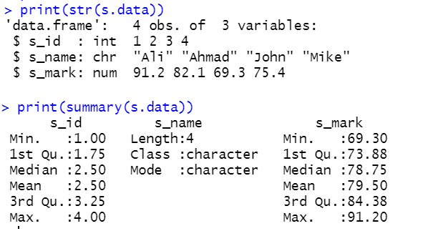
Data Frame
The structure of the data frame can be seen by using str() function.
The statistical summary and nature of the data can be obtained by applying summary() function.

Slide 24
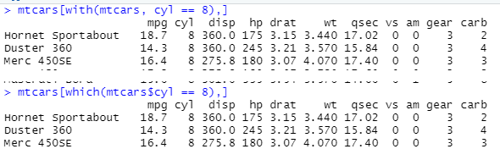
Data Frame
nrow() is used to return the number of rows in data frame and ncol() is used to return the number of columns in data frame.
Rows can be added to a data frame using the rbind() function and columns can be added using cbind().
The with() and which() functions can be used to access the elements within the data frame.

Slide 25
Data Frame
The subset( ) function is the easiest way to select variables and observations.
  newdata <- subset(mydata, age >= 60 | age <= 18,
  select=c(PID, Weight))
The order() function can sort vector, matrix, and data frame in ascending and descending order.
The merge() function merges two data frames by common columns or row names.

Slide 26
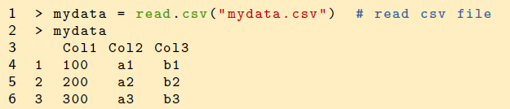

Data Frame
Data frames are usually created by reading in a dataset using the read.table() or read.csv().
Data frames can be converted to a matrix by calling data.matrix().

Slide 27
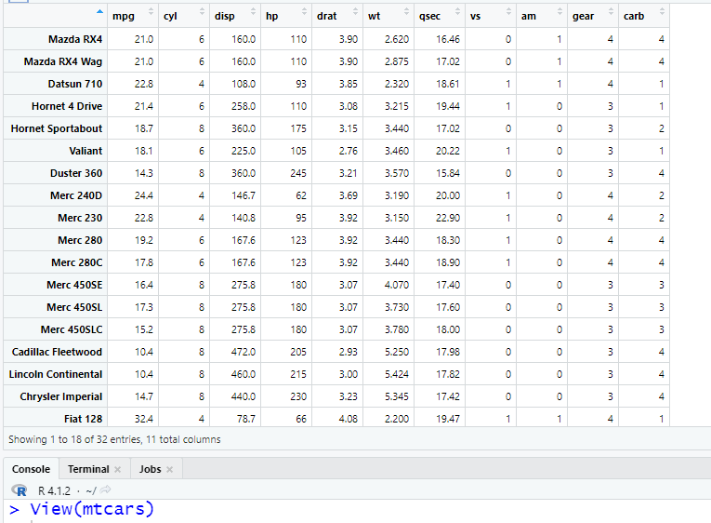
Data Frame
The View() function invokes a spreadsheet-style data viewer on a matrix or data frame.

Slide 28
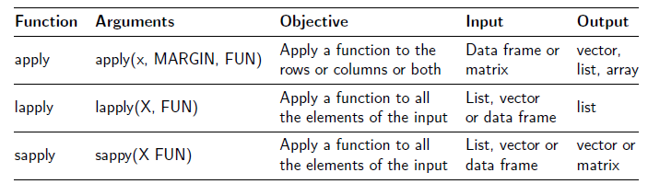
Data Frame
The apply() function is the most basic of all data structure.
The called function, FUN; can be any aggregating function, sub-setting function or vectorized function.
Margin=1 (row), Margin=2 (column)

Slide 29
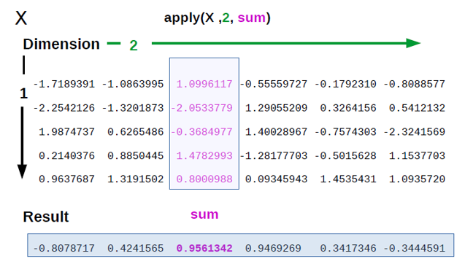
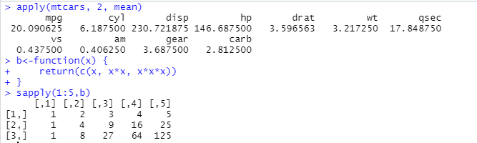
Data Frame

Slide 30
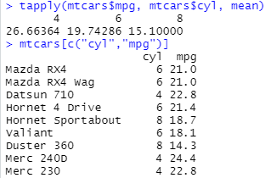
Data Frame
tapply() function lets you break a vector into pieces and then apply some function to each of the pieces.
In the code below, each of mpg in mtcars data is grouped by cylinder type and then mean() function is calculated.

Slide 31
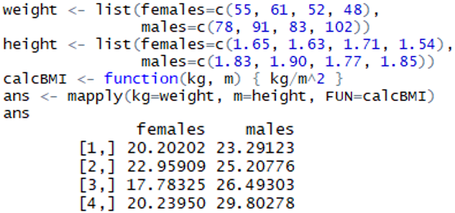
Data Frame
mapply() function is a multivariate version of sapply().
mapply applies a function to multiple list or multiple vector arguments.

Slide 32
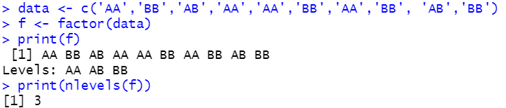
Factors
Factors are created using a vector. It stores the vector along with the distinct values of the elements in the vector as labels.
The labels are always character irrespective of whether it is numeric or character or logical type.
Factors are useful in statistical modeling.
Factors are created using the factor() function.
The nlevels() functions gives the count of levels. levels() displays the level.

Slide 33
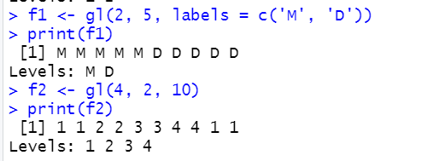
Factors
We can generate factor levels by using the gl() function. gl(n, k, labels=) or gl(n, k, length)

Slide 34
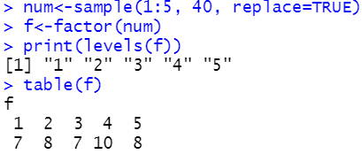
Factors
We cannot assign value outside of levels to the factors.
table()
  display the frequency table of each level

Slide 35


