Slide 1
WQD7004
Programming for Data Science
Chapter 4
Flow Control

Slide 2
Contents
Flow Control
Selection
Loop

Slide 3
Flow Control
Flow control is used to specify the order of the scripts to be executed.
Program can be written in three types of flow control namely the sequence, selection and repetition.
When the scripts are executed one after the other in order, it is called the sequence flow.
A selection flow chooses among alternative courses of action.
A Loop flow specifies that an action is to be repeated while some condition remains true.

Slide 4
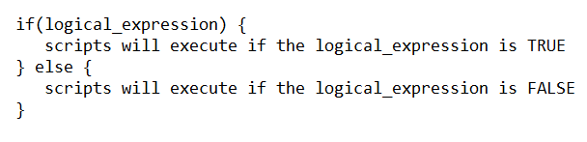
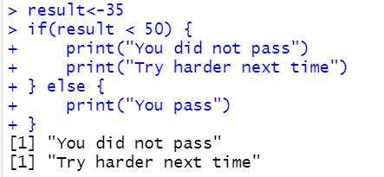
Selection
if is used to implement a decision. It consists of logical expression and body. If the logical expression is true, the body of the statement is executed.

Slide 5
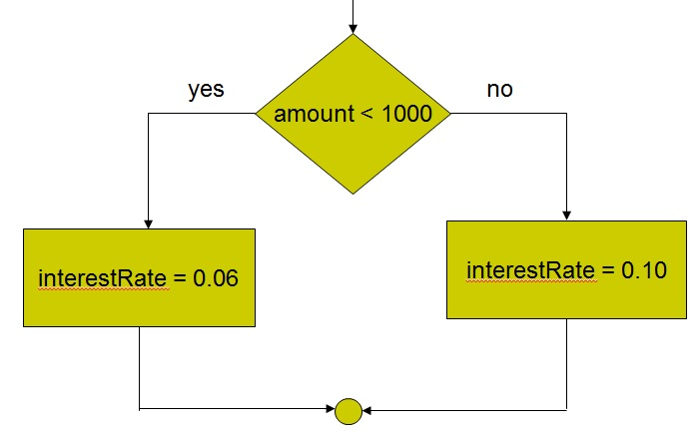
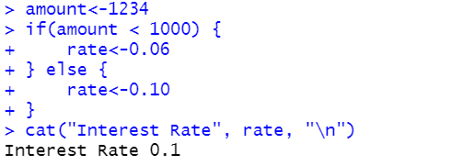
Selection

Slide 6
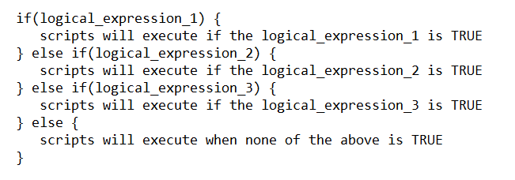
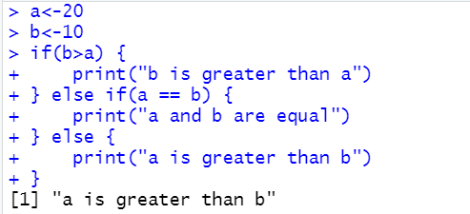
Selection
if else if else is very useful to test various conditions.

Slide 7

Selection
ifelse(logical_expression, x, y)
  The returned vector has element from x if the logical_expression is TRUE or from y if the logical_expression is FALSE.

Slide 8
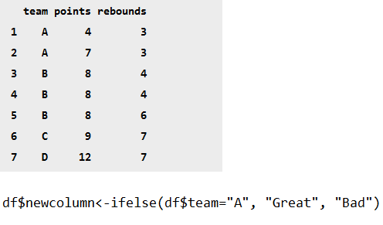
Selection

Slide 9
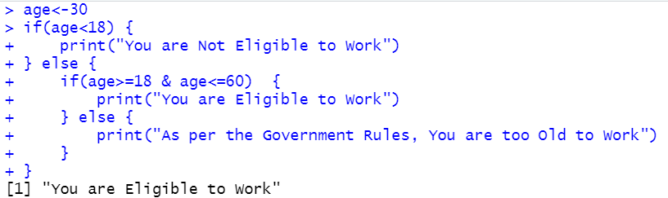
Selection
Nested if
  The if statement is inside another if statement.

Slide 10
Selection
A switch statement allows a variable to be matched against a list of values.
  switch(expression, case1, case2, case3, ....)
  switch("text-align", "margin-left" = "5px", "margin-right" = "5px", "text-align" = "right")
In the case of no match, the unnamed element is returned.
  switch("text-font", "margin-left" = "5px", "margin-right" = "5px", "text-align" = "right", "unknown")

Slide 11
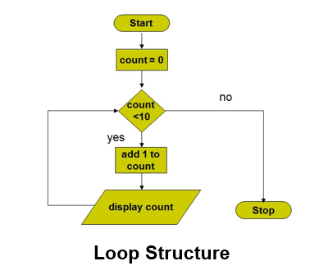
Loop
A loop statement allows us to execute a statement multiple times.

Slide 12
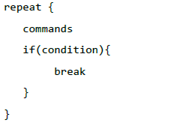
Loop
Repeat Loop
  executes a sequence of statements multiple times or iterate over a block of code multiple number of times.
  You can include the condition check in repeat loop to exit the loop. The break statement is used to terminate the loop.

Slide 13
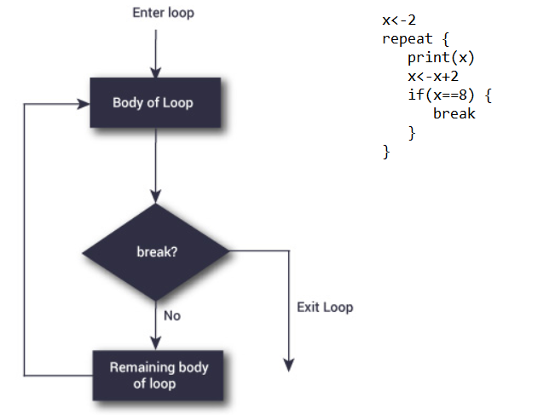
Loop

Slide 14
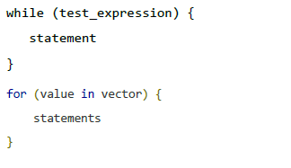
Loop
While Loop / For Loop
  repeats a statement or group of statements while a given condition is true.

Slide 15
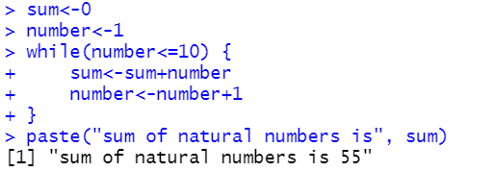
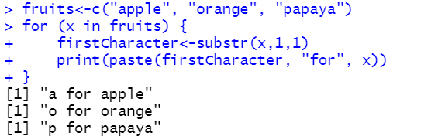
Loop

Slide 16
Loop
The next statement is useful when we want to skip the current iteration of a loop without terminating it.
R will skip further evaluation and starts next iteration of the loop.

Slide 17
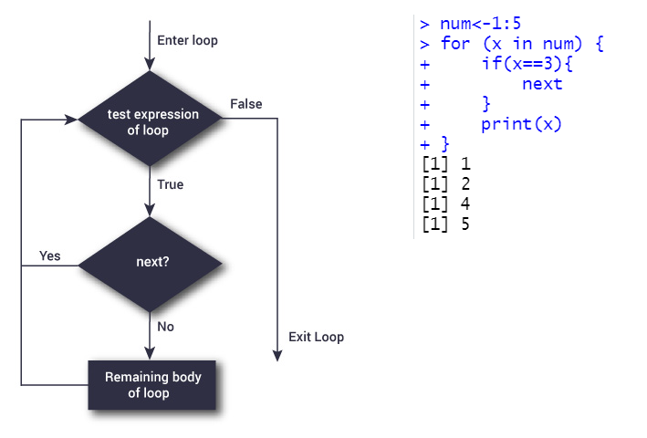
Loop

Slide 18
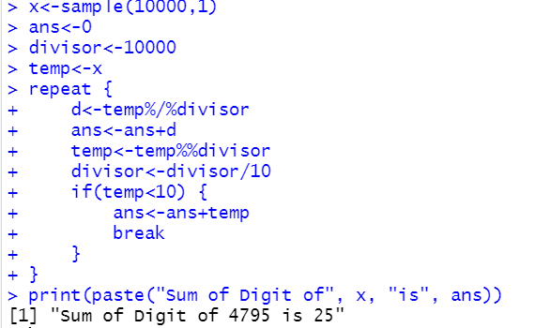
Loop
Find the sum of digit of a number (1 - 10000). Example, Sum of digit of 1234 = 10.

Slide 19
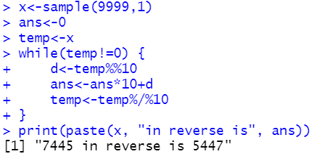
Loop
Reverse a number. 1234 in reverse is 4321.

Slide 20
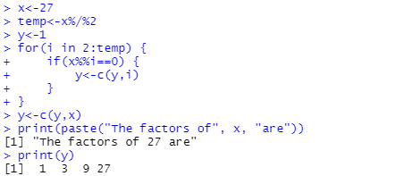
Loop
Find the factors of a number

Slide 21
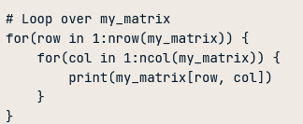
Loop
Using loops for matrices

Slide 22


