Slide 1
WQD7004
Programming for Data Science
Chapter 5
Function and File

Slide 2
Contents
Function
File
Writing Data to File
Reading Data from File

Slide 3

Function
A function is a set of statements organized together to perform a specific task. It allows us to reuse code.
R has many in-built functions, and the user can create their own functions.
A function may consist of arguments that are necessary for the function to accomplish the actions.
When calling the function, the values pass to it are assigned to argument variables.

Slide 4
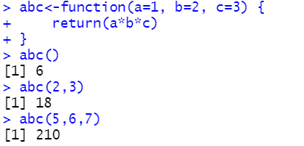
Function
A function can be interpreted as a closed box where inputs are entering and outputs are leaving.
We can define the value of the arguments (default value) in the function definition and call the function without supplying any argument to get the default result.
We use the return() functions to return a value immediately from a function.

Slide 5
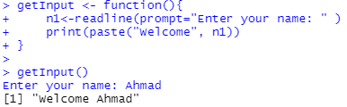
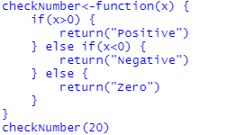
Function

Slide 6
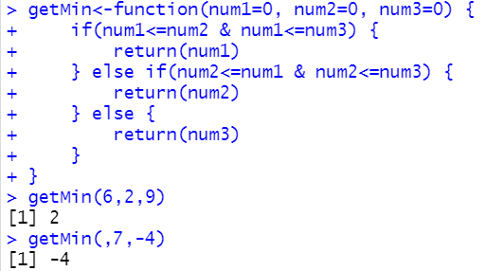
Function
Create a function that returns the minimum number from 3 numeric arguments

Slide 7
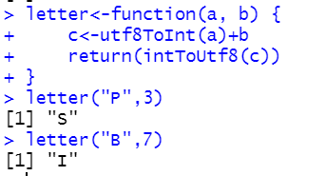
Function
Create a function that converts the letter to another letter based on the argument value.

Slide 8
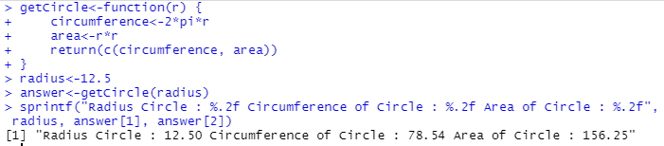
Function
Create a function that returns the area and the circumference of a circle given the argument is a radius.

Slide 9
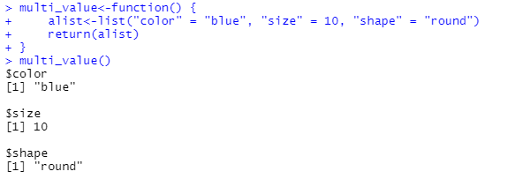
Function
The return() function can return only a single object. If we want to return multiple values with different data types in R, we can use a list to return it.

Slide 10
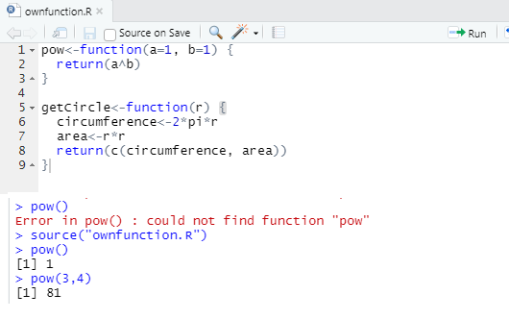
Function
We can create functions in R file. Whenever, we want to use the functions, we can use the source() function.

Slide 11
File
Files are used for permanent storage of large amounts of data.
R can be used to write data to the file and read data from the file.
The working directory is the directory used for reading data from file and writing data to the file.
  getwd()
  setwd()

Slide 12
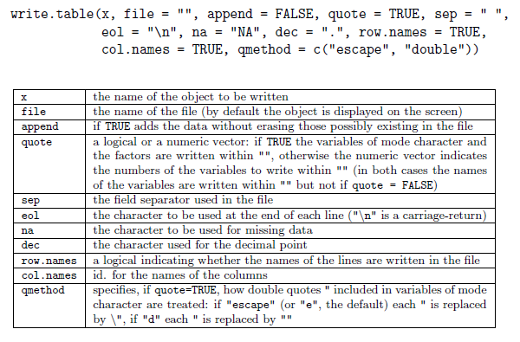
Writing Data to File
write.table and write.csv function are used to output the data frame in a file. It is useful to write data frame to a file as a grid of elements.
write.csv used comma "," as the field separator and write.csv2 used semicolon ";" as the field separator.

Slide 13
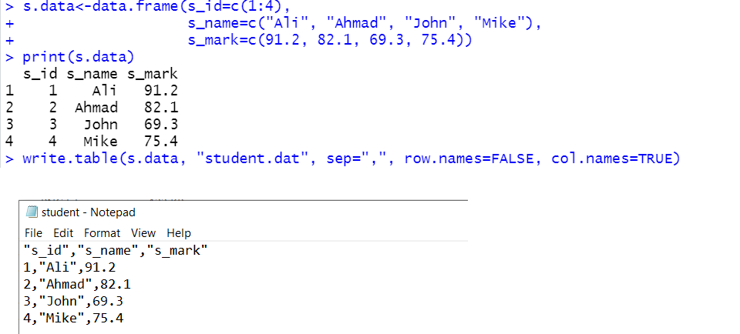
Writing Data to File

Slide 14
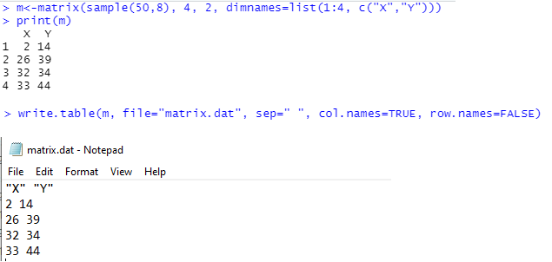
Writing Data to File

Slide 15
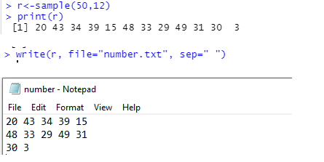
Writing Data to File
The write() function is used to write a vector in a specified number of columns into the file. If the number of columns is not specified, the default is 5.

Slide 16
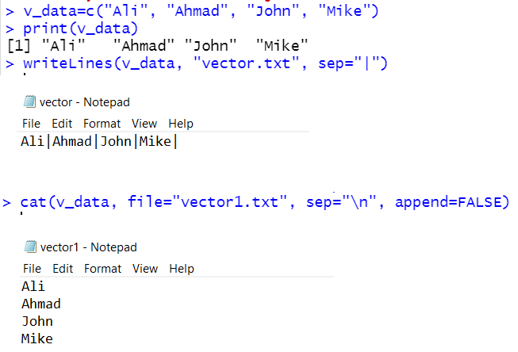
Writing Data to File
R vector objects can be written into a text file using the writeLines() function or cat() function.

Slide 17
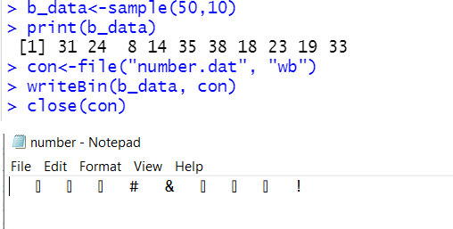
Writing Data to File
writeBin() is the function used to write data into binary file
  writeBin(object, con)
Binary file stores data in binary format. The data are stored in the sequence of bytes.

Slide 18
Writing Data to File
R has its own data file format using the .rds extension.
The .rds file is usually smaller than its text file counterpart and will therefore take up less storage space.
The .rds file will also preserve data types and classes such as factors and dates eliminating the need to redefine data types after loading the file.
The saveRDS() function is used to export a data object into the rds format.
  saveRDS(mtcars, "my_data.rds")

Slide 19
Writing Data to File
The R session (which includes all data objects) is saved in the Rdata file. The save() function can be used to save the entire R session.
  save(list=ls(), file="week1.Rdata")

Slide 20
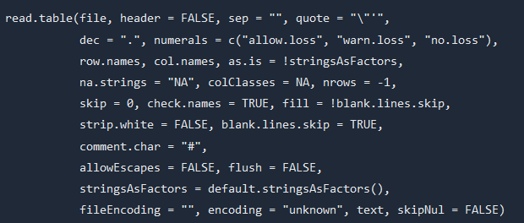
Reading Data from File
There are a few principal functions reading data into R:
  read.table and read.csv is used to read tabular data.
  The function will create a data frame.

Slide 21
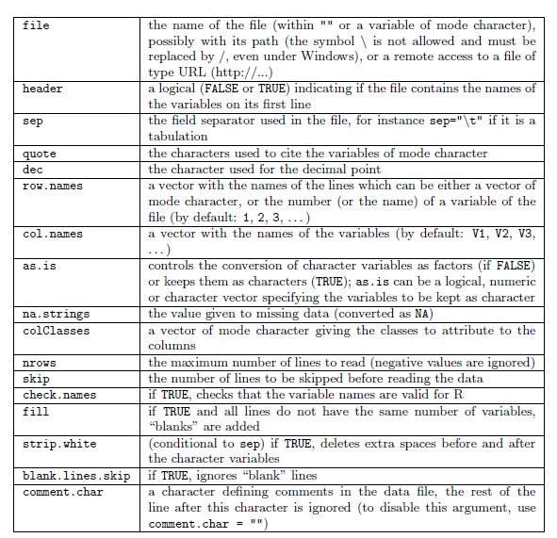
Reading Data from File

Slide 22
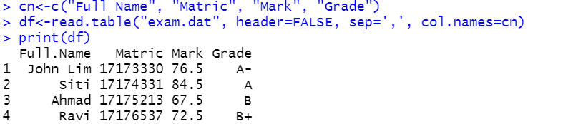
Reading Data from File
R will automatically
  Skip lines that begin with a #
  Determine the number of rows
  Determine type of variable in each column

Slide 23
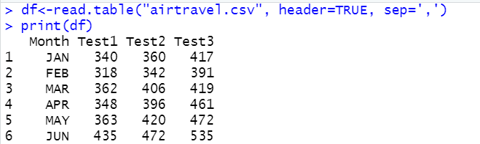
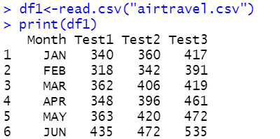
Reading Data from File

Slide 24
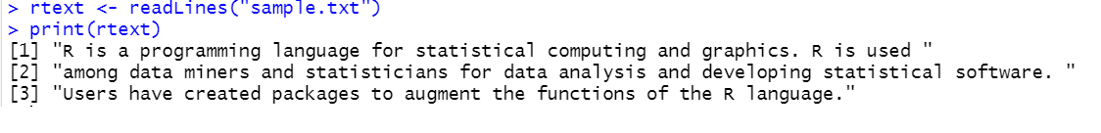
Reading Data from File
  readLines function is used to read lines of a text file.
  Text file is a file that contains sequence of characters. It is sometimes called ASCII files because the data are encoded using ASCII coding.
  readLines function can be used to read lines of webpages, since web pages are basically text files.
  file() function can be used to open file.
  read.delim() is used to read file with TAB separated.

Slide 25
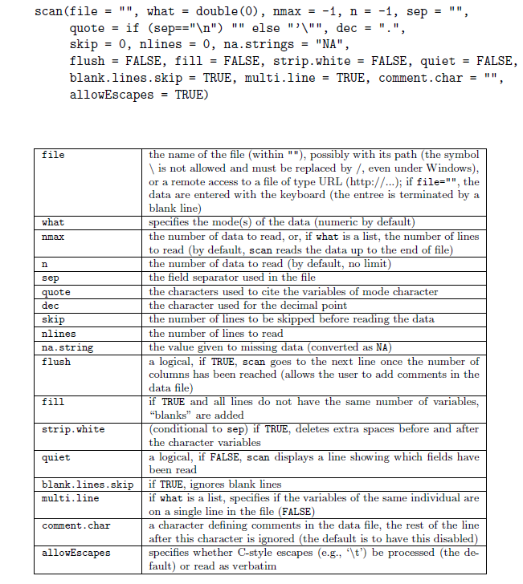
Reading Data from File
  scan() function can be used to read logical, integer, numeric, complex, character and raw data. It reads data into a vector or list.

Slide 26
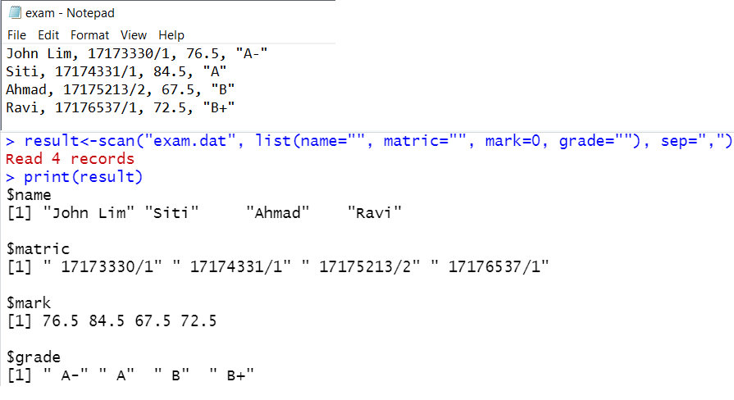
Reading Data from File

Slide 27
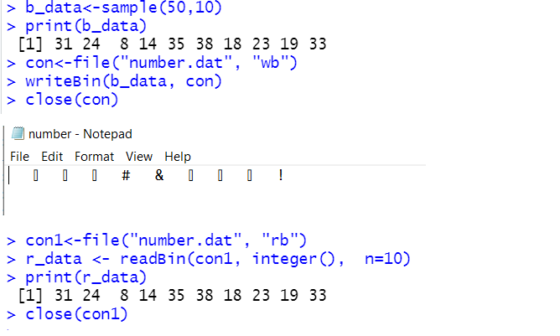
Reading Data from File
readBin() is used to read data from binary files
  readBin(con, what, n)
  what is used to specified the type of data and n is the number of bytes to read from the binary file.

Slide 28
Reading Data from File
serialize() function is used to convert individual R objects into a binary format that can be communicated across the connection.
The output of serialize() on an R object will be a raw vector coded in hexadecimal format.

Slide 29
Reading Data from File
The contents of rds file can be read using the readRDS() function.
  sdata<-readRDS("my_data.rds")
To load a previously saved R session type:
  load("week1.Rdata")

Slide 30


