Slide 1
WQD7004
Programming for Data Science
Chapter 6
Package (dplyr)

Slide 2
Contents
Introduction
dplyr
Tibble

Slide 3
Introduction
One of the great strengths of R is the ability to share R packages. R packages are a collection of functions, complied code and sample data.
An R package allows the user to attach the related softwares by a call to the library() function.
When we start the R console, only default packages are available by default. Other packages must be installed and the packages that are installed must be loaded explicitly.

Slide 4
Introduction
To install an R package
  install.packages("package names")
Once you have a package installed, you can make its contents available to use in your current R session.
  library(packagenames)

Slide 5
Introduction
Some of the useful package in R
  dplyr is mainly used for data manipulation.
  ggplot2 is the one of the best library for data visualization.
  data.table is the package that can handle a vast amount of data during data manipulation. It is mostly used for health care domains for genomic data and fields like business for predictive analytics.
  tidyr helps to create tidy data. (data cleaning)
  Shiny can be used to build the web application without requiring JavaScript.

Slide 6
Introduction
  knitr is the package mostly used for research. It is reproducible, used for report creation, and integrates with various types of code structures like LaTeX, HTML, Markdown, pdf, etc.
  caret package is a short form of Classification And Regression Training used for predictive modeling.

Slide 7
dplyr
dplyr is a grammar of data manipulation, providing a consistent set of verbs that help you solve the most common data manipulation challenges.
dplyr is used to work with data frames.
select() picks variables based on their names.
filter() picks cases based on their values.
arrange() changes the ordering of the rows.
mutate() adds new variables that are functions of existing variables.
summarise() reduces multiple values down to a single summary.

Slide 8
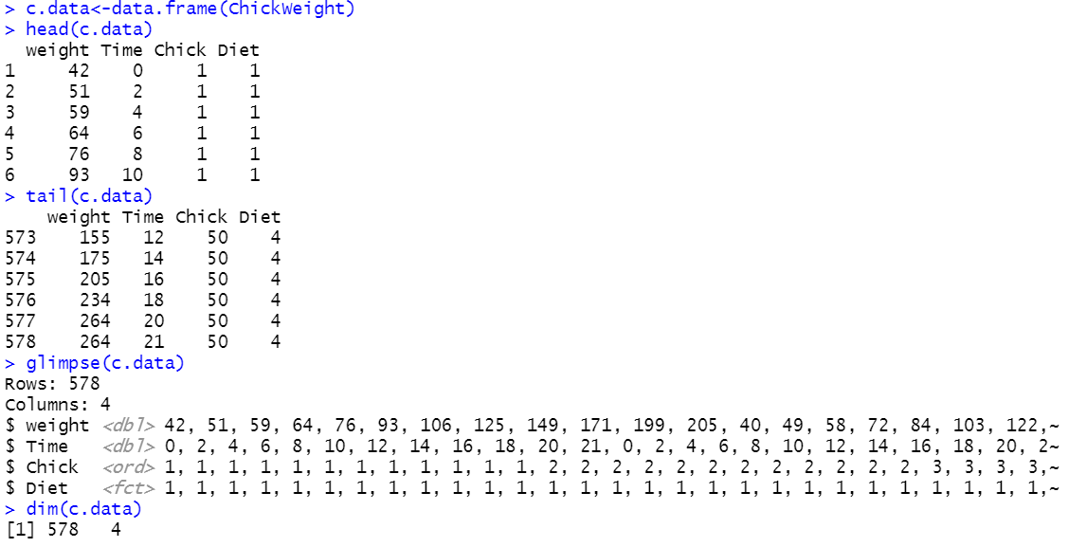
dplyr
glimpse() is used to view the structure of the dataset.
dim() returns the dimension of data frame.
head() obtains the first several rows of data frame and use tail() to obtain the last several rows.

Slide 9

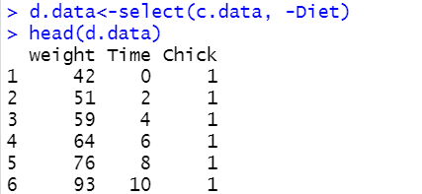
dplyr
select(data, columns)
  select only the columns required.

Slide 10
dplyr
dplyr has helper functions to help select a group of variables inside a select()
starts_with("x") every name that starts with "x"
ends_with("x") every name that ends with "x"
contains("x") every name that contains "x"
matches("x") every name that matches "x", where "x" can be a regular expression
num_range("x0", 1:5) the variable named x01, x02, x03, x04, x05

Slide 11
dplyr
select(data, columns)
  can use variable names as well as integer index
  select(mtcars, cyl:wt)
  select(mtcars, cyl:wt, -hp)
  select(mtcars, 1:4, -3)
  select (mtcars, starts_with("c"))
  select (mtcars, starts_with("c"), ends_with("t"))
  select (mtcars, starts_with("c") & ends_with("b"))

Slide 12
dplyr
filter(data, condition)
  return a subset of rows, multiple conditions can be applied.
  can use relational, logical operator and %in% inside filter()
    filter(mtcars, cyl == 8, qsec >16)
    filter(mtcars, (cyl == 8 | cyl == 6) & qsec >16)
  dim() is used to check the numbers of rows filtered
  filter(df, !is.na(x))
    choose only observations which value of x is not NA

Slide 13
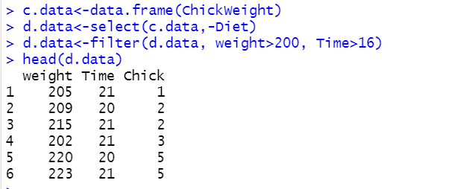
dplyr

Slide 14
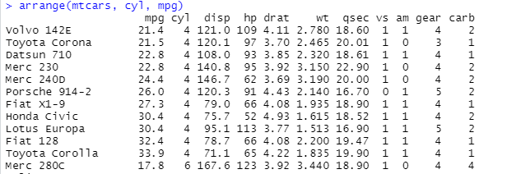
dplyr
arrange() can reorder one or many rows, according to any type of data
By default is ascending. To arrange in descending order, use desc().
  arrange(mtcars, cyl, mpg)
  arrange(mtcars, cyl, desc(mpg))

Slide 15
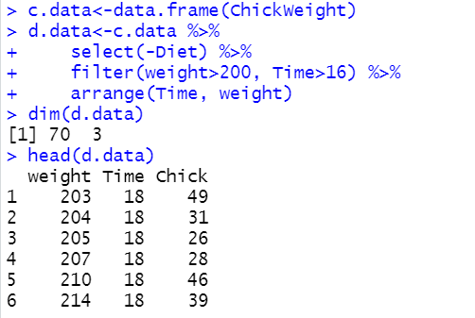
dplyr
pipe operator %>% is used to chain the process by taking the output of one function and inserting it into the next.
define the data frame used at the beginning and all the process will flow from it.

Slide 16
dplyr
mutate() adds new variables that are functions of existing variable
  mutate(data, newCol=func(columns))
  mutate(df, z=x+y)
  mutate(df, z=x+y, zz = z+v)
  can use the newly created variable

Slide 17
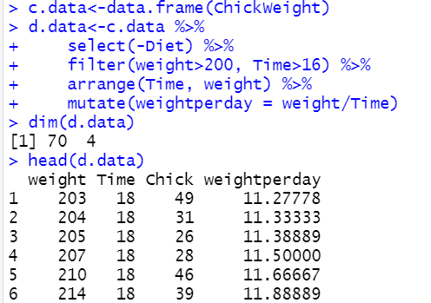
dplyr

Slide 18
dplyr
summarise() creates a new data frame.
It will have one (or more) rows for each combination of grouping variables; if there are no grouping variables, the output will have a single row summarising all observations in the input.
It will contain one column for each grouping variable and one column for each of the summary statistics that you have specified.
Can use any aggregating function that can take a vector of data and return a single number including
  min(), max(), mean(), median(), sd(), var()

Slide 19
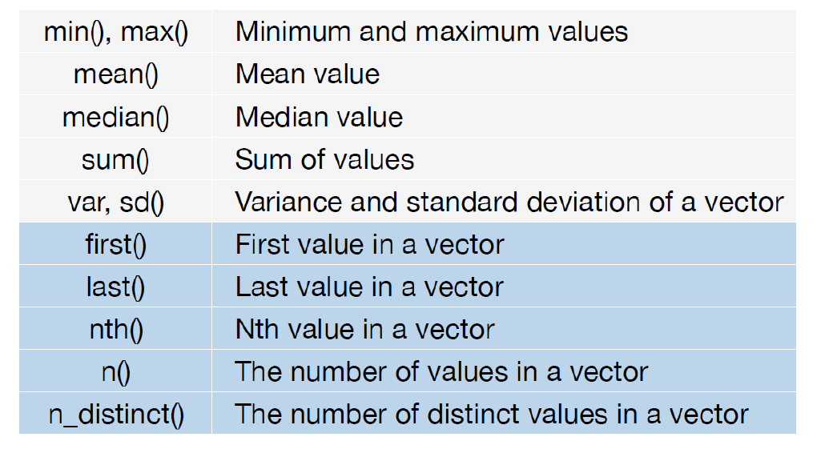
dplyr

Slide 20
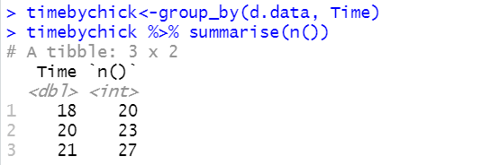
dplyr
  summarise(mtcars, n())
  summarise(mtcars, maxhp=max(hp))
  summarise(mtcars, maxhp=max(hp), meanqsec=mean(qsec))
group_by() create groups of data

Slide 21
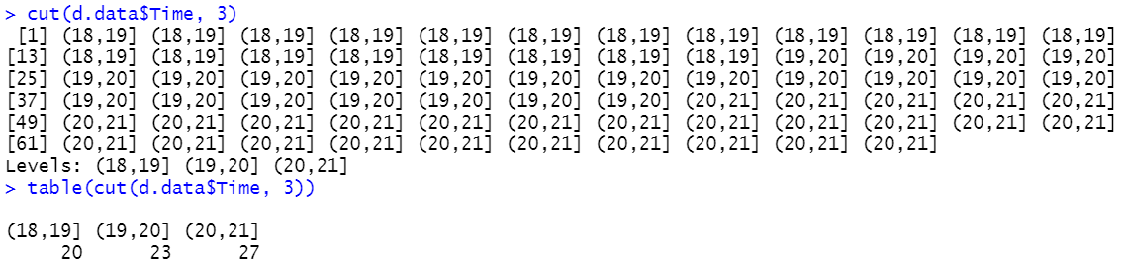
dplyr
cut() function is used to divide the range of data frame into intervals.
  cut(data,numberofgroups)

Slide 22
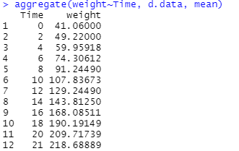
dplyr
the aggregate function is used to compute summary statistics for subsets of the data.
  aggregate(numeric_variable~grouping_variable, data, FUN)

Slide 23
Tibble
A tibble is a rectangular data table and a modern and simpler version of the data.frame construct in R.
As the tibble package (Müller & Wickham, 2020) is part of the core tidyverse.
Tibbles first appeared in the dplyr package and in the form of an R package tibble (v1.0) in 2016.
Tibbles are simpler data frames.
  tibbles do not change the types of input variables (e.g., strings are not converted to factors);
  tibbles do not change the names of input variables and do not use row names.

Slide 24
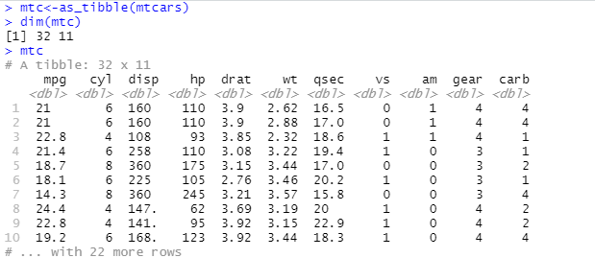
Tibble

Slide 25


