Slide 1
WQD7004
Programming for Data Science
Chapter 10
Machine Learning with R

Slide 2
Contents
Introduction
Methods
Confusion Matrix
caret

Slide 3
Introduction
Machine Learning basically automates the process of data analysis and makes data-informed predictions in real-time without any human intervention.
An application of artificial intelligence (AI) that provides systems the ability to learn and improve from experience without being explicitly programmed.
A data model is built automatically and further trained to make real-time predictions.
In machine learning, we build algorithms that take feature values (X) and train a model using known outcomes (Y) that is then used to predict outcomes when presented with features without known outcomes.

Slide 4
Introduction
Machine learning use cases
  Email categorization (spam, news, personal, others)
  Anomaly Detection (fraud detection)
  Optical character recognition
  Log file analysis
  Detect trends (number of cases present in systems)
  Image recognition (facial recognition)
  Predict stock price

Slide 5
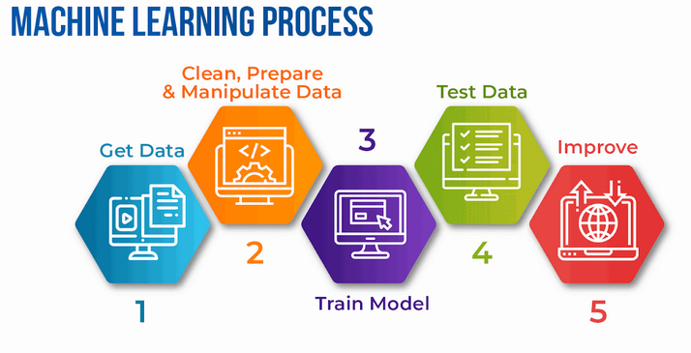
Introduction

Slide 6
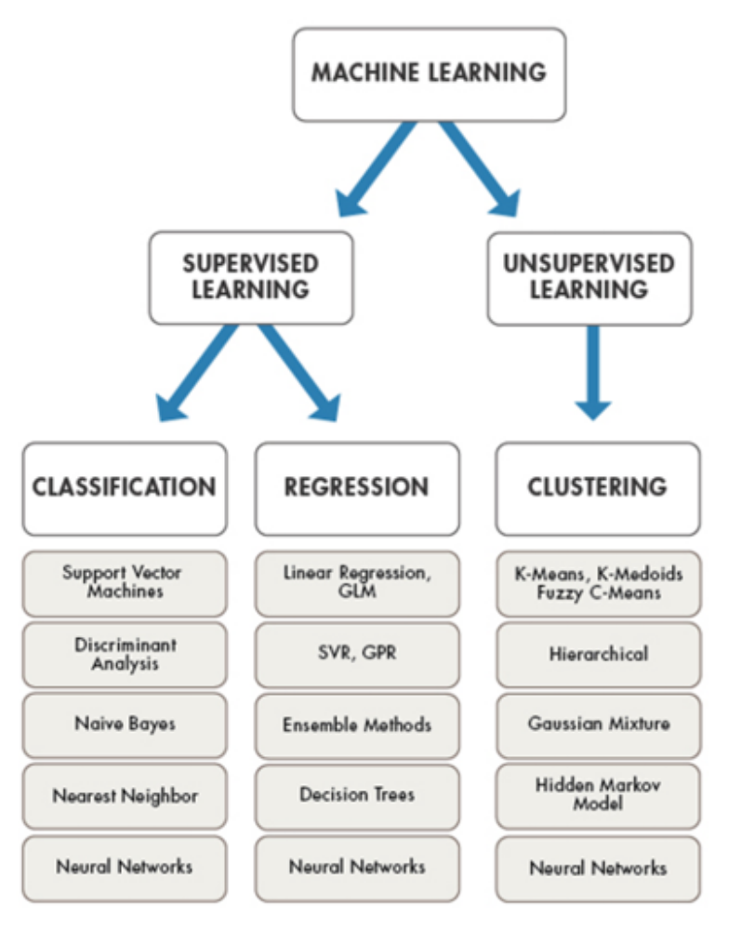
Methods

Slide 7
Methods
Supervised
  Apply what has been learned in the past to new data using labeled examples.
  Predicting future events.
  The system can provide targets for any new input after sufficient training.
  Regression
    predicts one set of numbers given another set of numbers.
  Classification
    identify which set of categories a new observation belong, based on a training set of data.

Slide 8
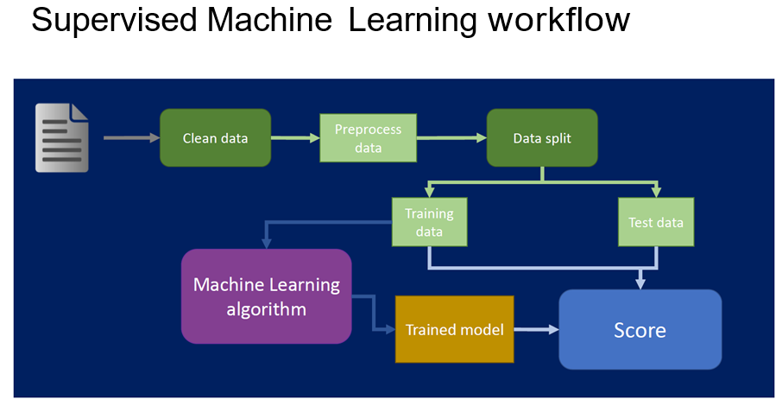
Methods

Slide 9
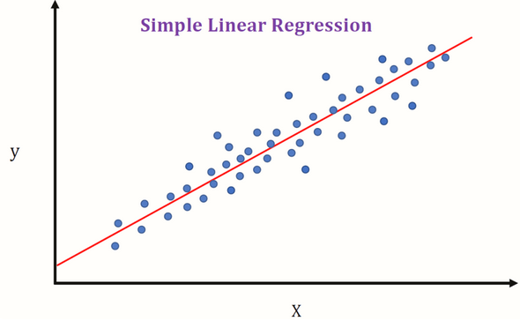
Methods
Regression
  Predict the value of y, given x

Slide 10
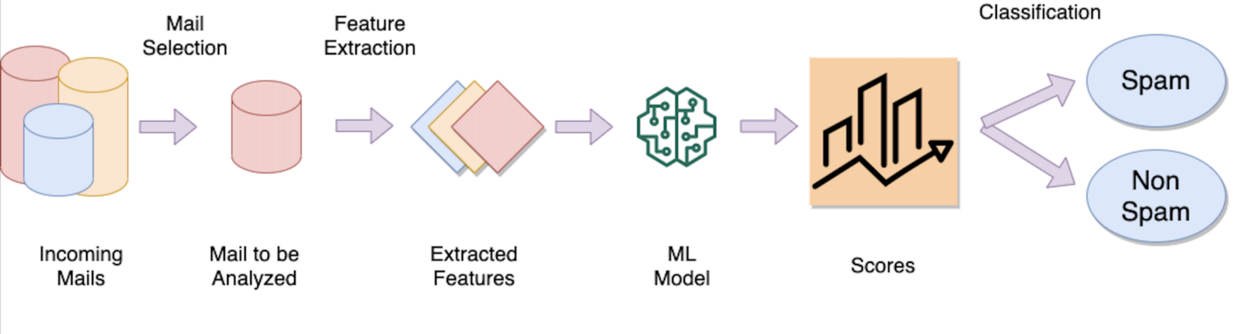
Methods
Classification
  Labelling an email as spam is a classification problem

Slide 11
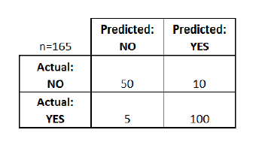
Confusion Matrix
A confusion matrix is a table that is often used to describe the performance of a classification model on a set of test data for which the true values are known.

Slide 12
Confusion Matrix
True positives (TP)
  We predicted yes and they do have the disease.
True negatives (TN)
  We predicted no and they don't have the disease.
False positives (FP)
  We predicted yes, but they don't actually have the disease. Type 1 error.
False negatives (FN)
  We predicted no, but they actually do have the disease. Type II error.

Slide 13
Confusion Matrix
Accuracy - (TP+TN)/total
Misclassification Rate - (FP+FN)/total
True Positive Rate - TP/actual yes
False Positive Rate - FP/actual no
True Negative Rate - TN/actual no
  (1- False Positive Rate )
  a test that always returns a negative test result will have a specificity of 100%
Precision - TP/predictedyes
Prevalence - actualyes/total
  How often does the yes condition occur in our sample?

Slide 14
Methods
Unsupervised
  When the information used to train is neither classified nor labeled.
  studies how systems can infer a function to describe a hidden structure from unlabeled data.
  Clustering
    The task of dividing the population or data points into several groups such that data points in the same groups are more similar to other data points in the same group than those in other groups.
    Similar data points are grouped together in the same cluster based on different definitions of similarity.

Slide 15
Methods
Semi-supervised
  They use both labeled and unlabeled data for training.
  Fall somewhere in between supervised and unsupervised learning.
  Improve learning accuracy.
Reinforcement
  Interacts with its environment by producing actions and discovers errors or rewards.
  Trial and error search and delayed reward are the most relevant characteristics of reinforcement learning.

Slide 16
caret
The caret package (short for Classification And REgression Training) is a set of functions that attempt to streamline the process for creating predictive models.
The package contains tools for:
  pre-processing
  feature selection
  data splitting
  model tuning using resampling
  variable importance estimation
  install.packages("caret")
  library(caret)

Slide 17
caret
Data Splitting
  Split data into training and test data subsets
  Split the iris dataset to an 80%/20% train/test and choose Species as the variable.
  split=0.80
  trainIndex<-createDataPartition(iris$Species, p=split, list=FALSE) # data in matrix if list=FALSE
  data_train<-iris[ trainIndex,]
  data_test<-iris[-trainIndex,]

Slide 18
caret
Train Model
  # train a naive bayes model
  install.packages("klaR")
  library(klaR)
  model1 <- NaiveBayes(Species~., data=data_train)
  # make predictions
  x_test <- data_test[,1:4]
  y_test <- data_test[,5]
  predictions <- predict(model1, x_test)
  confusionMatrix(predictions$class, y_test)

Slide 19
caret
Train Model
  # train a random forest model
  install.packages("randomForest")
  library(randomForest)
  model2 <- randomForest(Species~., data=data_train)
  # make predictions
  x_test <- data_test[,1:4]
  y_test <- data_test[,5]
  predictions <- predict(model2, x_test)
  confusionMatrix(predictions, y_test)

Slide 20
caret
Train Model
  # train a k-nearest neighbors (k-NN) model
  model3 <- train(Species~., data=data_train, method = "knn")
  # make predictions
  x_test <- data_test[,1:4]
  y_test <- data_test[,5]
  predictions <- predict(model3, x_test)
  confusionMatrix(predictions, y_test)

Slide 21
caret
Both overfitting and underfitting can lead to poor model performance. But by far the most common problem in applied machine learning is overfitting.
Overfitting happens when a model learns the detail and noise in the training data to the extent that it negatively impacts the performance of the model on new data. This means that the noise or random fluctuations in the training data is picked up and learned as concepts by the model.
Underfitting is a scenario in data science where a data model is unable to capture the relationship between the input and output variables accurately, generating a high error rate on both the training set and unseen data.

Slide 22
caret
To limit overfitting
  Use a resampling technique to estimate model accuracy. The most popular resampling technique is k-fold cross validation.
  Hold back a validation dataset. A validation dataset is simply a subset of your training data that you hold back from your machine learning algorithms until the very end of your project.

Slide 23
caret
k-fold cross validation
  It allows you to train and test your model k-times on different subsets of training data and build up an estimate of the performance of a machine learning model on unseen data.
  It works by randomly dividing the data into k groups, or folds, of approximately equal size. The model is trained on k-1 folds and tested on the remaining fold, and this process is repeated k times, with a different fold being used as the test set each time.
  The results from each test are then averaged to produce a final performance estimate.

Slide 24
caret
  One advantage of k-fold cross-validation is that it can provide a more robust estimate of model performance, since it uses all of the data for training and testing.
  This is particularly useful when the data are limited, as it can help to reduce the risk of overfitting.
# K fold
train_control <- trainControl(method="cv", number=10)
modelNB1 <- train(Species~., data=iris, trControl=train_control, method="nb")
# repeated K Fold
train_control <- trainControl(method="repeatedcv", number=10, repeats=3)
modelNB2 <- train(Species~., data=iris, trControl=train_control, method="nb")

Slide 25
caret
TrainData <- iris[,1:4]
TrainClasses <- iris[,5]
trctrl <- trainControl(method = "repeatedcv", number = 10, repeats = 3)
knn_fit <- train(TrainData, TrainClasses, method = "knn", trControl=trctrl, preProcess = c("center", "scale"), tuneLength = 10)
plot(knn_fit)
test_pred <- predict(knn_fit, newdata=iris)
confusionMatrix(test_pred, iris$Species)

Slide 26
caret
Leave-one-out cross-validation (LOOCV) is a special case of k-fold cross-validation, in which k is set to the number of observations in the data.
In LOOCV, the model is trained on all but one of the data points and tested on the remaining data point. This process is repeated k times, where k is the number of observations in the data, and the results are averaged to produce a final performance estimate.
# Leave one out CV
train_control <- trainControl(method="LOOCV")
modelNB3 <- train(Species~., data=iris, trControl=train_control, method="nb")

Slide 27
caret
bootstrapped k-fold cross-validation
  In this method, the data are first divided into k folds, and then the model is fit k times, with each fold used as a validation set in turn. For each fit, the data are also resampled with replacement from the training set to create additional training data.
# bootstrap
train_control <- trainControl(method="boot", number=100)
modelNB4 <- train(Species~., data=iris, trControl=train_control, method="nb")

Slide 28
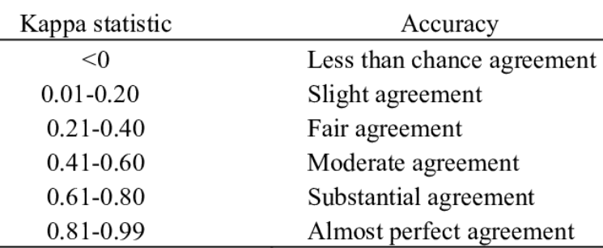
caret
Accuracy is the percentage of correctly classifies instances out of all instances. It is more useful on a binary classification than multi-class classification problems.
Kappa is like classification accuracy, and it is normalized at the baseline of random chance on your dataset. It is useful to use on problems that have an imbalance in the classes (e.g. 70-30 split for classes 0 and 1 and you can achieve 70% accuracy by predicting all instances are for class 0)

Slide 29
caret
Hold back a validation dataset.
  A validation set is a portion of the data that is set aside and not used during the model fitting process. Instead, it is used to evaluate the model's performance on unseen data.
  To hold back a validation set, you can split your data into three sets: a training set, a validation set, and a test set. The training set is used to fit the model, the validation set is used to tune the model's hyperparameters, and the test set is used to evaluate the final model's performance.

Slide 30
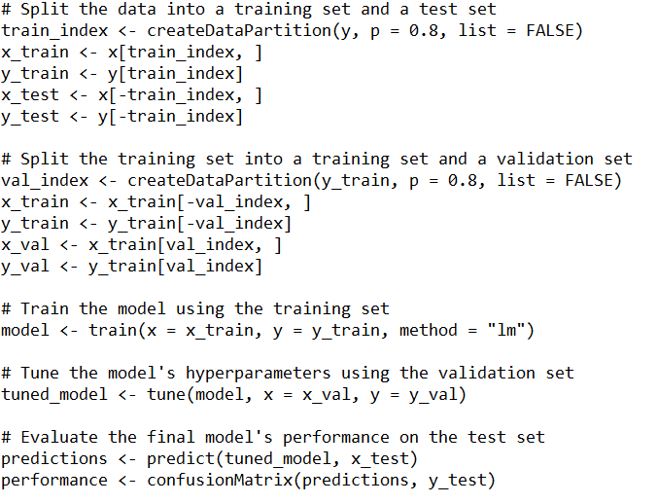
caret

Slide 31
caret
RMSE (Root Mean Squared Error) is the average deviation of the predictions from the observations. It is the measure of how well a regression line fits the data points. It is a standard way to measure the error of a model in predicting quantitative data.
A lower RMSE value indicates a better fit of the model to the data, since it means that the differences between the predicted and true values are smaller.
R Squared is called the coefficient of determination. It provides goodness of fit of a regression model. This is a value between 0 and 1 for no-fit and perfect fit respectively.

Slide 32
caret
Mean Absolute Error (MAE) is a measure of prediction error in machine learning. It is calculated as the average absolute difference between the predicted values and the true values. It is a commonly used metric in regression tasks.
fit1<-train(Employed~., data=longley, method="lm", metric="RMSE")
control <- trainControl(method="cv", number=5)
fit2 <- train(Employed~., data=longley, method="lm", metric="RMSE", trControl=control)
fit3<-train(mpg ~ ., data = mtcars, method = "lm", metric="Rsquared")

Slide 33
caret
ROC (receiver operating characteristic)
  An ROC curve is a graph showing the performance of a classification model at all classification thresholds.
  ROC metrics are only suitable for binary classification problems. It can be broken down into sensitivity and specificity.
  A curve that is close to the top-left corner of the plot represents a classifier with good performance (high true positive rates).
  A curve that is above the diagonal line represents a classifier that is better than a random classifier, while a curve that is below the diagonal line represents a classifier that is worse than a random classifier.

Slide 34
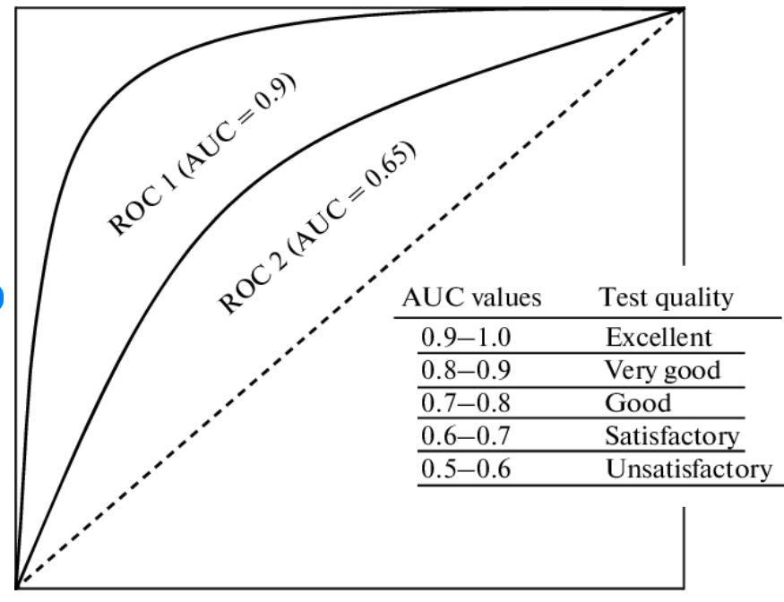
caret

Slide 35
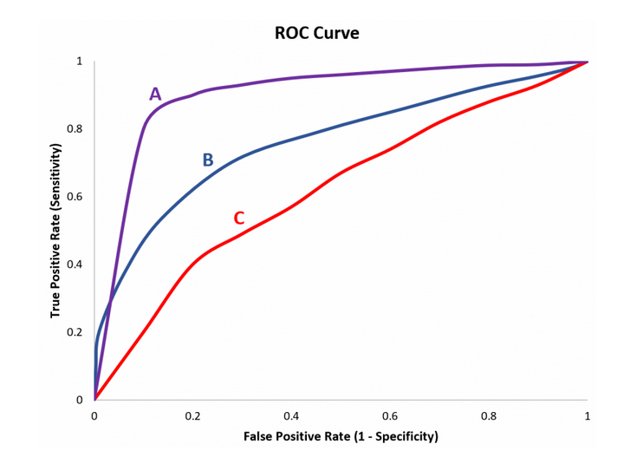
caret

Slide 36
caret
Sensitivity and specificity are statistical measures of the performance of a binary classification test
Sensitivity (true positive rate)
  the recall, or probability of detection in some fields measures the proportion of positives that are correctly identified as such (e.g. the percentage of sick people who are correctly identified as having the condition).
Specificity (1- False Positive Rate)
  measures the proportion of negatives that are correctly identified as such (e.g. the percentage of healthy people who are correctly identified as not having the condition).

Slide 37
caret
library(mlbench)
library(pls)
split<-0.80
data(Sonar)
trainIndex<-createDataPartition(Sonar$Class, p=split, list=F)
data_train<-Sonar[trainIndex,]
data_test<-Sonar[-trainIndex,]
ctrl <- trainControl(method = "repeatedcv", repeats = 3, classProbs = TRUE, summaryFunction = twoClassSummary)
# Partial Least Squares
plsFit <- train(Class~., data = data_train, method = "pls", preProc = c("center", "scale"), trControl = ctrl, metric = "ROC")
plsFit
ggplot(plsFit)

Slide 38


