Slide 1
WQD7004
Programming for Data Science
Chapter 8
Exploratory Data Analysis

Slide 2
Contents
Introduction
Data Exploration Techniques
Visualization
Visualization Techniques

Slide 3
Introduction
Exploratory data analysis (EDA) is used by data scientists to analyze and investigate data sets and summarize their main characteristics, often employing data visualization methods.
It helps determine how best to manipulate data sources to get the answers you need, making it easier for data scientists to discover patterns, spot anomalies, test a hypothesis, or check assumptions.
EDA provides a better understanding of data set variables and the relationships between them.
Summarizing the main characteristics of a data set based on size, patterns in the data or other attributes.

Slide 4
Introduction
Exploratory data analysis tools
  Clustering and dimension reduction techniques, which help create graphical displays of high-dimensional data containing many variables.
  Univariate visualization of each field in the raw dataset, with summary statistics.
  Bivariate visualizations and summary statistics that allow you to assess the relationship between each variable in the dataset and the target variable you’re looking at.
  Multivariate visualizations, for mapping and understanding interactions between different fields in the data.

Slide 5
Introduction
  K-means clustering is a clustering method in unsupervised learning where data points are assigned into K groups. Example, the number of clusters, based on the distance from each group’s centroid. The data points closest to a particular centroid will be clustered under the same category.
  Predictive models, such as linear regression, use statistics and data to predict outcomes.

Slide 6
Data Exploration Techniques
Summary Statistics
  The numbers that summarize properties of the data.
    Frequency
    Location
    Spread

Slide 7
Data Exploration Techniques
Frequency
  the percentage of time the value occurs in the data set.
  a representative population of people in terms of gender.
  Mode of an attribute is the most frequent attribute value.
  Percentile is a measure used in statistics indicating the value below which a given percentage of observations in a group of observations fall. For example, the 20th percentile is the value (or score) below which 20% of the observations may be found.

Slide 8
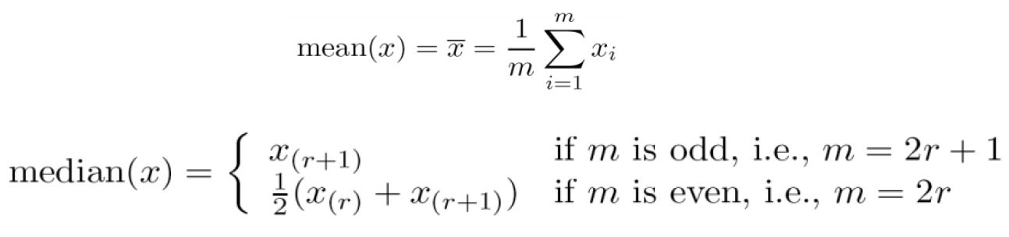
Data Exploration Techniques
Location
  The mean is the most common measure of the location of a set of points.
  However, the mean is very sensitive to outliers. Thus, the median is also commonly used.
  A trimmed mean can be used as well. It removes a small designated percentage of the largest and smallest values before calculating the mean.

Slide 9
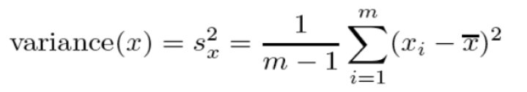
Data Exploration Techniques
Spread
  Range is the difference between the max and min
  The variance or standard deviation is the most common measure of the spread of a set of points. However, this is also sensitive to outliers.

Slide 10
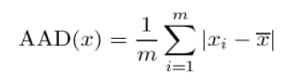

Data Exploration Techniques
The average absolute deviation (AAD) of a data set is the average of the absolute deviations from a central point.
The median absolute deviation (MAD) is used instead of the average deviation when the deviation value needs to be less affected by extreme values in the tail.

Slide 11
Visualization
Visualization is the conversion of data into a visual or tabular format so that the characteristics of the data and the relationships among data items or attributes can be analyzed or reported.
Visualization of data is one of the most powerful and appealing techniques for data exploration.
Humans can analyze large amounts of information that is presented visually
  Can detect general patterns and trends
  Can detect outliers and unusual patterns

Slide 12
Visualization
Representation
  The mapping of information to a visual format.
  Data objects, their attributes, and the relationships among data objects are translated into graphical elements such as points, lines, shapes, and colors.
  Their attribute values can be represented as the position of the points or the characteristics of the points, e.g., color, size, and shape
  If position is used, then the relationships of points, i.e., whether they form groups or a point is an outlier, is easily perceived.

Slide 13
Visualization
Arrangement
  Is the placement of visual elements within a display
  Can make a large difference in how easy it is to understand the data
Selection
  Is the elimination of certain objects and attributes.
  Selection may involve the choosing a subset of attributes.

Slide 14
Visualization
Base R Plot
  One of the most powerful functions of R is the ability to produce a wide range of graphics to quickly and easily visualize data.
  the plot() function can be used to create simple plots.
  plot(x, y, type)
    x and y
      the coordinates of points to plot
    type
      the type of graph to create

Slide 15
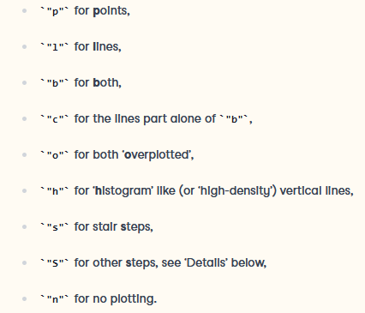
Visualization

Slide 16
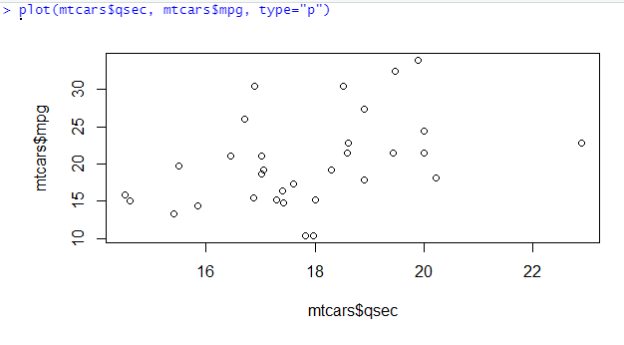
Visualization

Slide 17
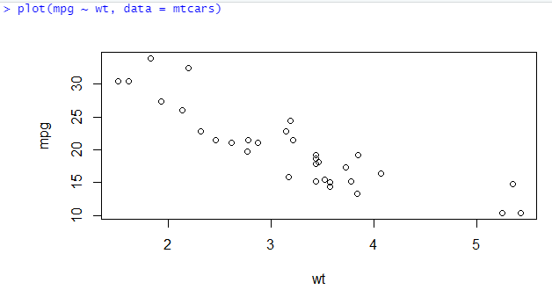
Visualization

Slide 18
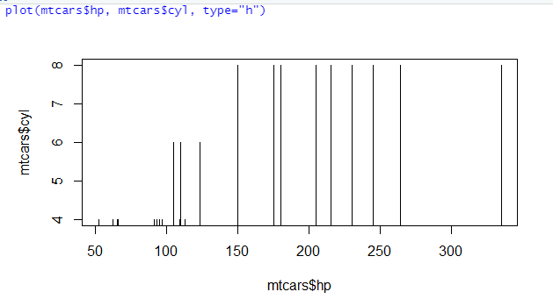
Visualization

Slide 19
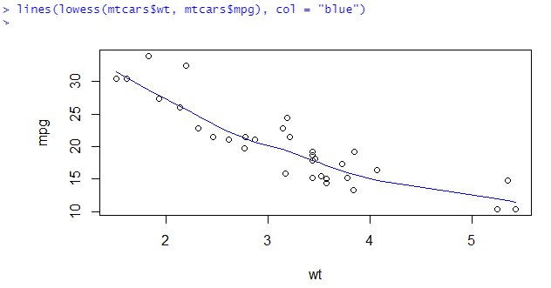
Visualization
LOWESS
  Locally Weighted Scatterplot Smoothing
  It is a method of regression analysis which creates a smooth line through a scatterplot.

Slide 20
Visualization
ggplot2 is a plotting package that provides helpful commands to create complex plots from data in a data frame.
  install.packages("ggplot2")
  library(ggplot2)
ggplot() function
  aesthetic mapping - aes()
  labels - labs()
  geom_point() or geom_histogram()

Slide 21
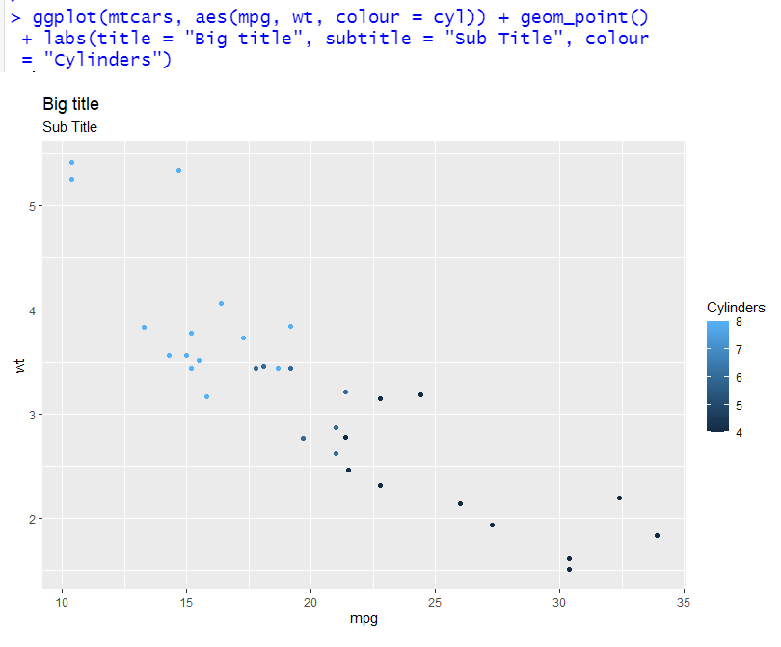
Visualization

Slide 22
Visualization Techniques
Line chart is a type of chart that displays information as a series of data points connected by straight line segments.
It also can connect a series of data points with a continuous line.

Slide 23
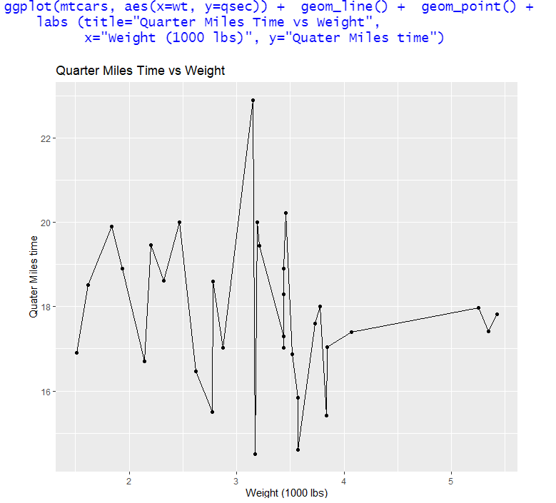
Visualization Techniques

Slide 24
Visualization Techniques
A bar chart or bar graph is a chart or graph that presents categorical data with rectangular bars with heights or lengths proportional to the values that they represent.
The bars can be plotted vertically or horizontally.

Slide 25
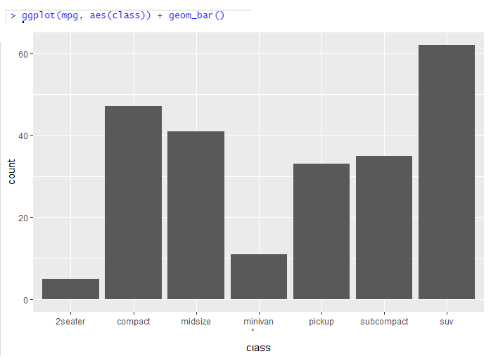
Visualization Techniques

Slide 26
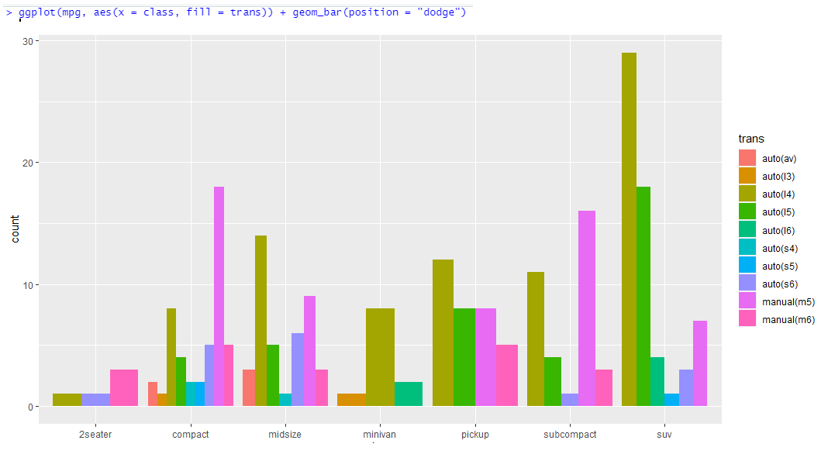
Visualization Techniques

Slide 27
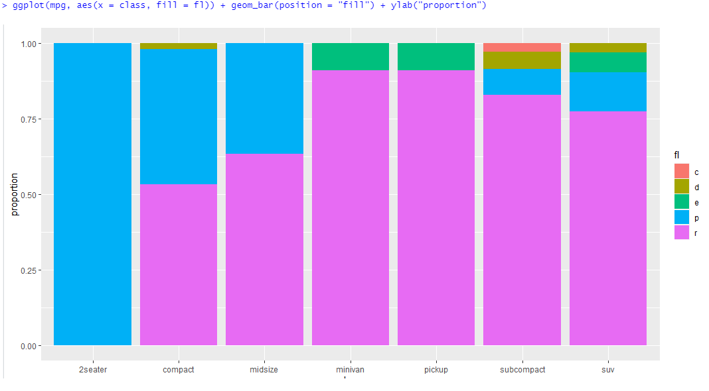
Visualization Techniques

Slide 28
Visualization Techniques
Histogram is a graphical representation that organizes a group of data points into user-specified ranges. It is used to summarize discrete or continuous data that are measured on an interval scale.
It shows the distribution of values of a single variable. It divides the values into bins and show a bar plot of the number of objects in each bin. The height of each bar indicates the number of objects.

Slide 29
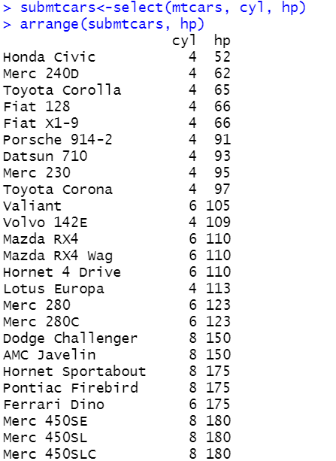
Visualization Techniques

Slide 30
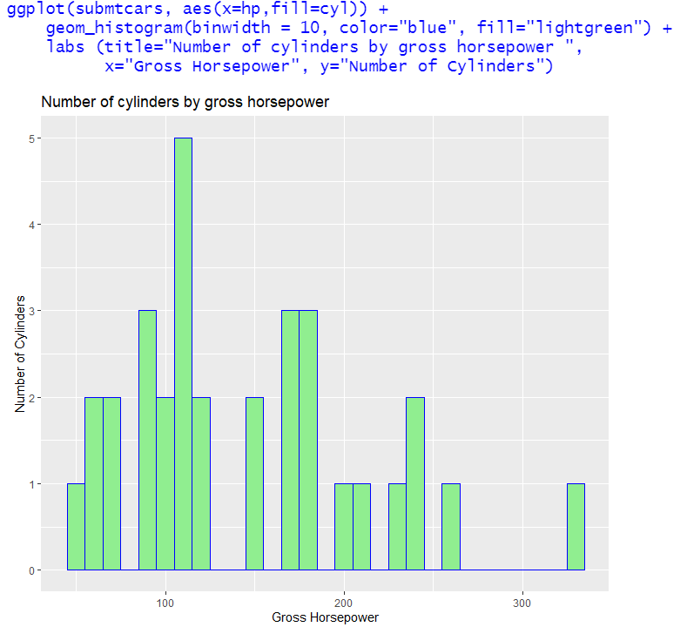
Visualization Techniques

Slide 31
Visualization Techniques
Scatter plot is a type of data visualization that shows the relationship between different variables.
It can be used to determine if there are patterns or correlations between two variables.
Essentially, each of these data points looks scattered around the graph.
Often additional attributes can be displayed by using the size, shape, and color of the markers that represent the objects.

Slide 32
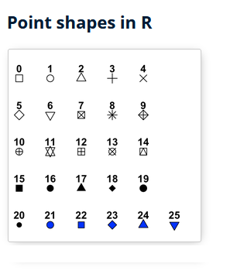
Visualization Techniques

Slide 33
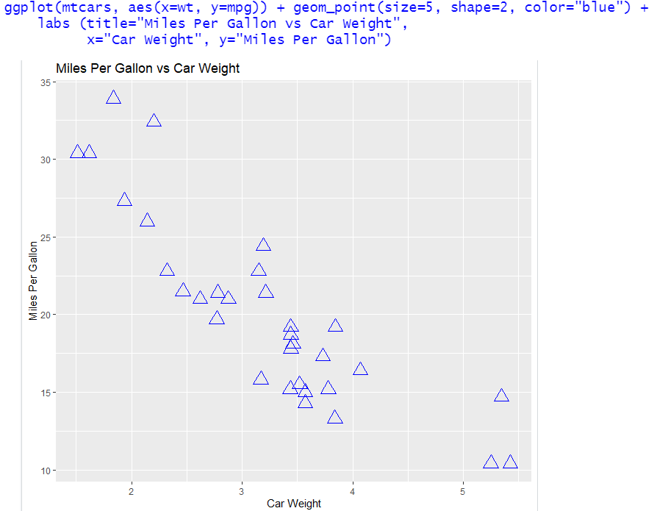
Visualization Techniques

Slide 34
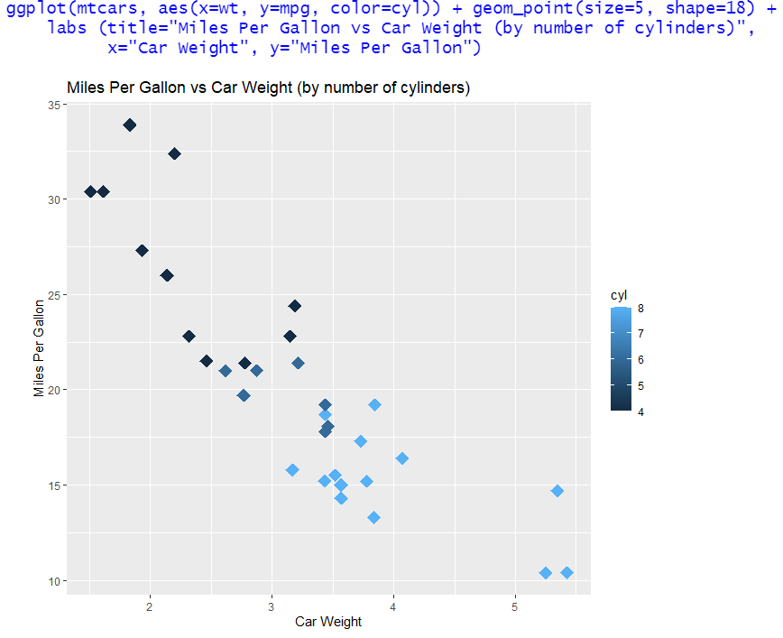
Visualization Techniques

Slide 35
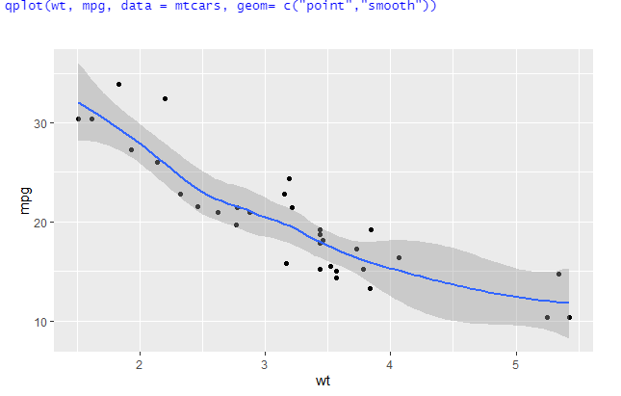
Visualization Techniques
qplot() in ggplot2 is very similar to the basic plot() function.

Slide 36
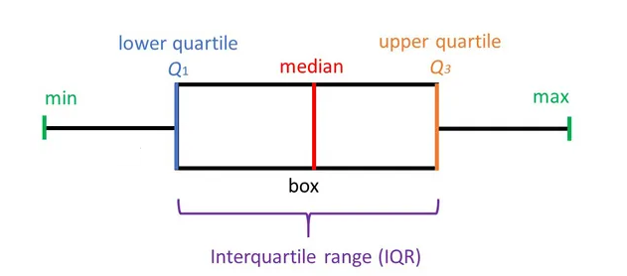
Visualization Techniques
Box plots is a type of chart often used in exploratory data analysis.
Box plots visually show the distribution of numerical data and skewness through displaying the percentiles and averages.
It shows the five-number summary of a set of data: including the minimum, first quartile, median, third quartile, and maximum score.

Slide 37
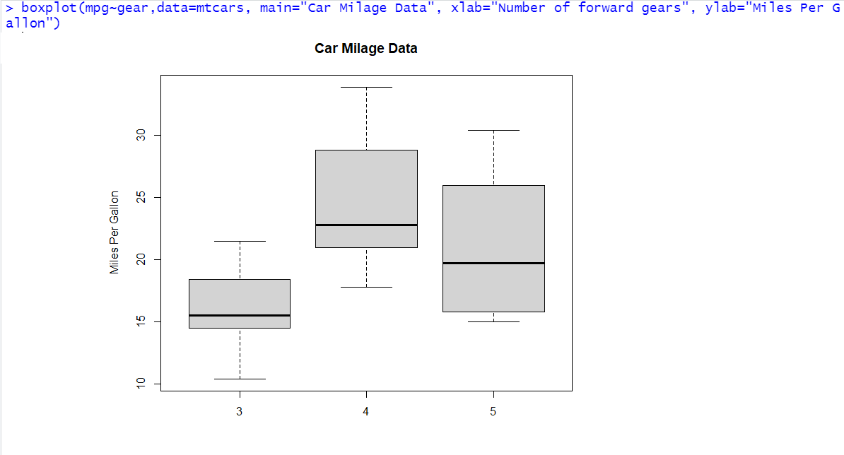
Visualization Techniques

Slide 38
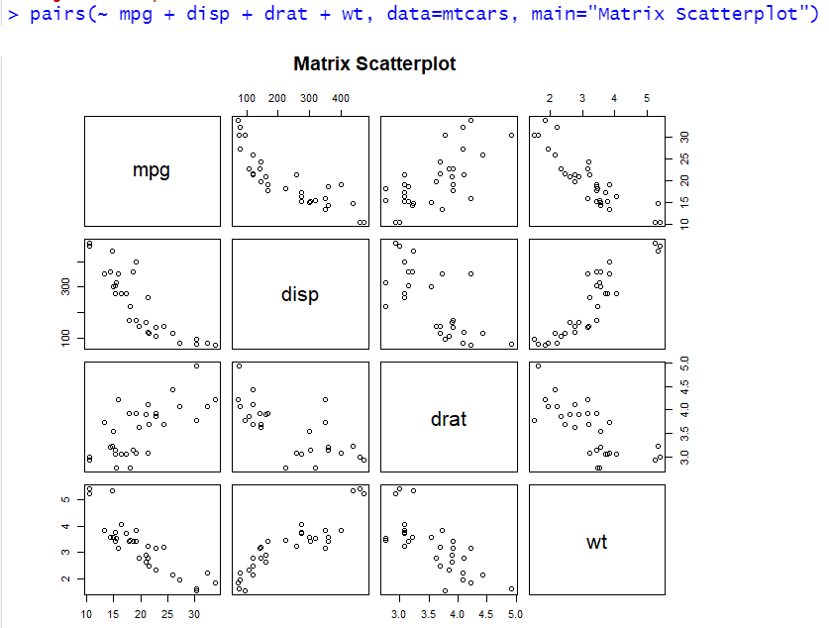
Visualization Techniques
A matrix plot is an array of scatterplots. It can plot the data matrix.
A matrix of plots is effective when you have many variables, and you would like to see relationships among pairs of variables.

Slide 39
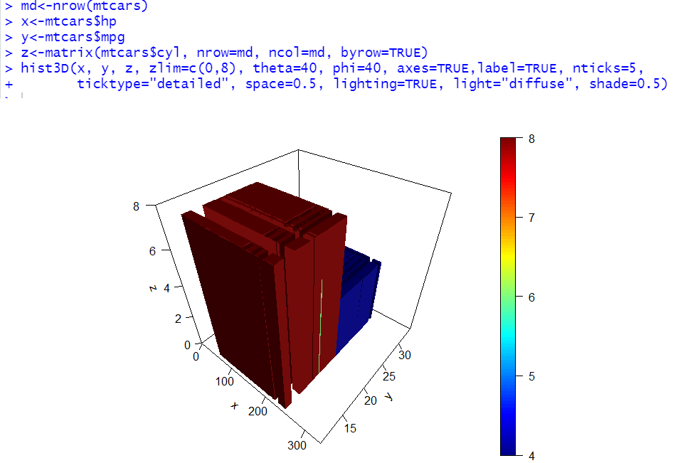
Visualization Techniques
plot3D is a package that used to plot multi-dimensional data
  install.packages("plot3D")
  library(plot3D)
  hist3D is used to plot 3D histogram

Slide 40
Visualization Techniques
Faceting is the process that split the chart window in several small parts (a grid), and display a similar chart in each section.
Each section usually shows the same graph for a specific group of the dataset. The result is usually called small multiple.

Slide 41
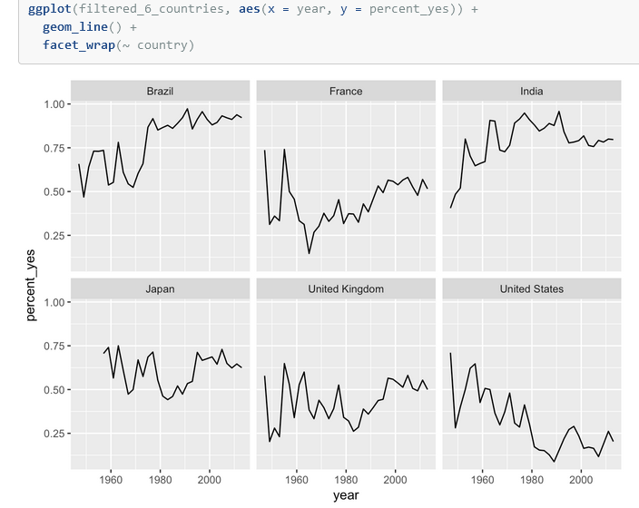
Visualization Techniques

Slide 42
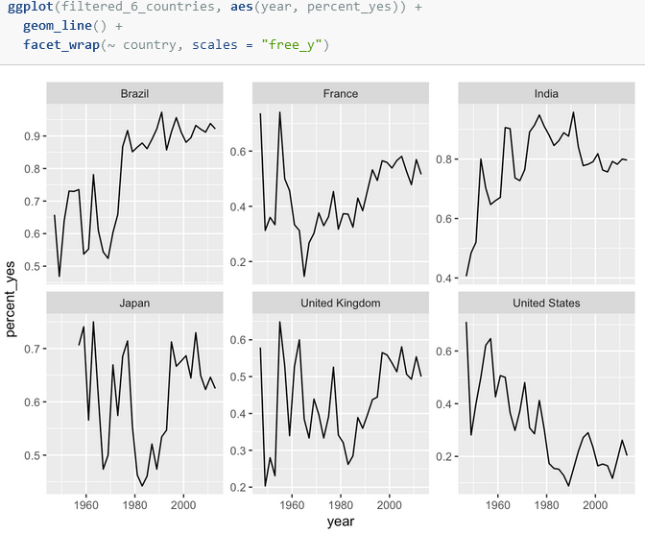
Visualization Techniques

Slide 43


