Slide 1
WQD7004
Programming for Data Science
Chapter 9
Statistics and Regression Modeling

Slide 2
Contents
Introduction
Descriptive Statistics
Statistical Measures
Inferential Statistics
Regression Model

Slide 3
Introduction
Statistics is a branch of applied mathematics that involves the collection, description, analysis, and inference of conclusions from quantitative data.
The outcome is to draw reliable conclusions about large groups and general events from the behavior and other observable characteristics of small samples.
These small samples represent a portion of the large group or a limited number of instances of a general phenomenon.
The two major areas of statistics are known as descriptive statistics, which describes the properties of sample and population data, and inferential statistics, which uses those properties to test hypotheses and draw conclusions.

Slide 4
Introduction
Statistics are used in virtually all scientific disciplines such as the physical and social sciences, as well as in business, the humanities, government, and manufacturing.
Statistics help to make decision based on data
  What are the numbers saying?
  Are there any trends in the data?
  Can we make predictions from the data?

Slide 5
Introduction
A population (N) is the entire group that you want to draw conclusions about. The population contains elements of anything you want to study, such as objects, events, organizations, countries, species, organisms, etc.
A sample (n) is the specific group that you will collect data from. The size of the sample is always less than the total size of the population.
If the sample size is large (n > 30), then the sample standard deviations can be used to estimate the population standard deviation.
If the sample size is small (n< 30), then the t distribution must be used.

Slide 6
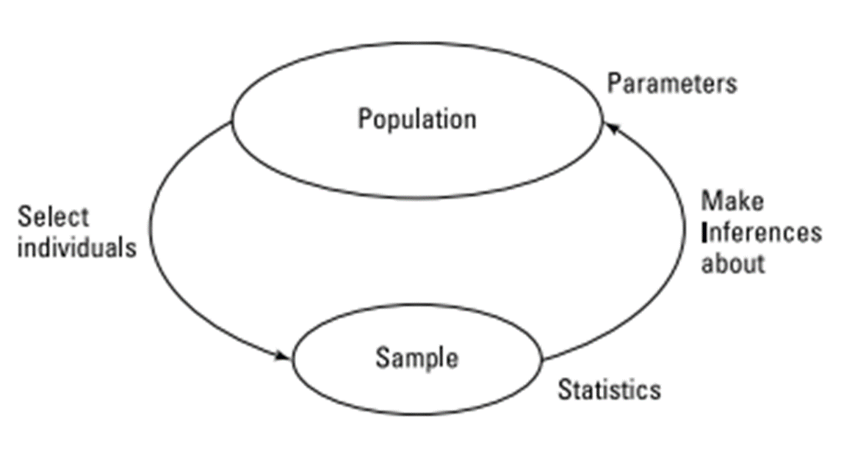
Introduction

Slide 7
Introduction
A variable can occur in any form, such as trait, factor or a statement that will constantly be changing according to the changes in the applied environment.
Such variables in statistics are broadly divided into four categories such as independent variables, dependent variables, categorical and continuous variables.
The independent variable is the one that is computed in research to view the impact of dependent variables. For example, a manager asks 100 employees to complete a project. He should know the capacity of the individual employee. He wants to know the reason behind smart guys and failure guys.

Slide 8
Introduction
Dependent variable or criterion variable has relied on the independent variable. Example, the project’s productivity or completion is the main criteria that are dependent on estimated time and IQ.
Categorical variables is a wide category of variable which is infinite and has no numerical data. These variables are called as qualitative variables or attribute variable. Such variables are further divided into nominal variables and ordinal variables.

Slide 9
Introduction
Nominal variable is a type of variable that is used to name, label or categorize particular attributes that are being measured. (name, email, designation)
Dichotomous variables are nominal variables which have only two categories or levels. (gender)
An ordinal variable is a type of measurement variable that takes values with an order or rank. (1. Satisfied 2. Indifferent 3. Dissatisfied )

Slide 10
Introduction
Continuous variables can take on an unlimited number of values between the lowest and highest points of measurement.
Continuous variables are also known as quantitative variables. It can be further categorized as either interval or ratio variables.
Interval variables are variables for which their central characteristic is that they can be measured along a continuum, and they have a numerical value (for example, temperature measured in degrees Celsius or Fahrenheit).

Slide 11
Introduction
Ratio variables are interval variables, but with the added condition that 0 (zero) of the measurement indicates that there is none of that variable.
Examples of ratio variables include height, mass, distance and many more. The name "ratio" reflects the fact that you can use the ratio of measurements.

Slide 12
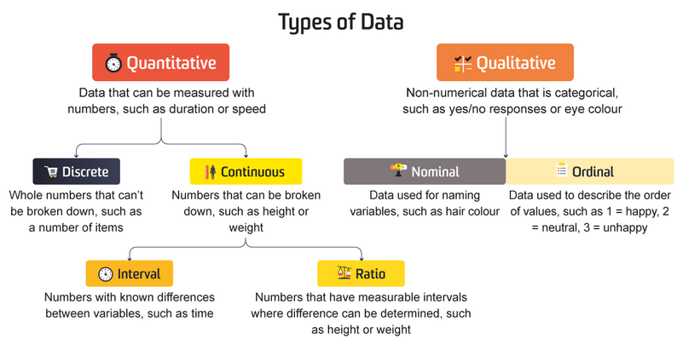
Introduction

Slide 13
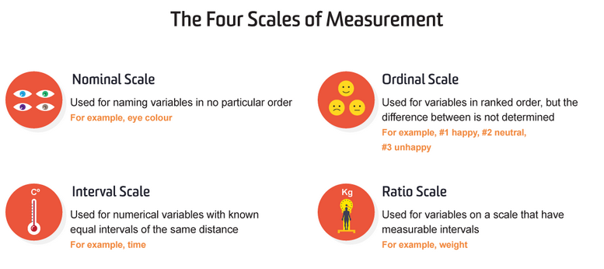
Introduction

Slide 14
Descriptive Statistics
Descriptive Statistics describes the properties of sample and population data.
It mostly focus on the central tendency, variability, and distribution of sample data.
Central tendency means the estimate of the characteristics, a typical element of a sample or population, and includes descriptive statistics such as mean, median, and mode.

Slide 15
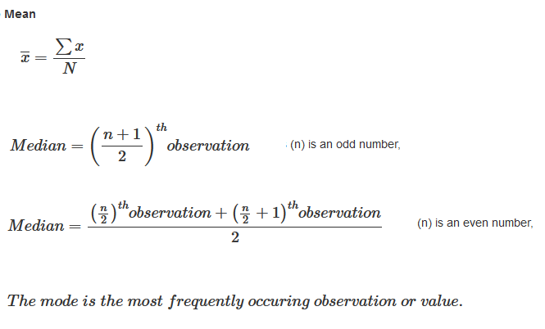
Descriptive Statistics

Slide 16
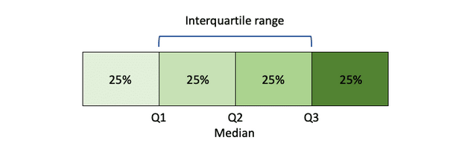
Descriptive Statistics
Variability refers to a set of statistics that show how much difference there is among the elements of a sample or population along the characteristics measured, and includes metrics such as range, variance, and standard deviation.
The larger the standard deviation means the larger the spread of values around the mean.
range = highest value - lowest value

Slide 17
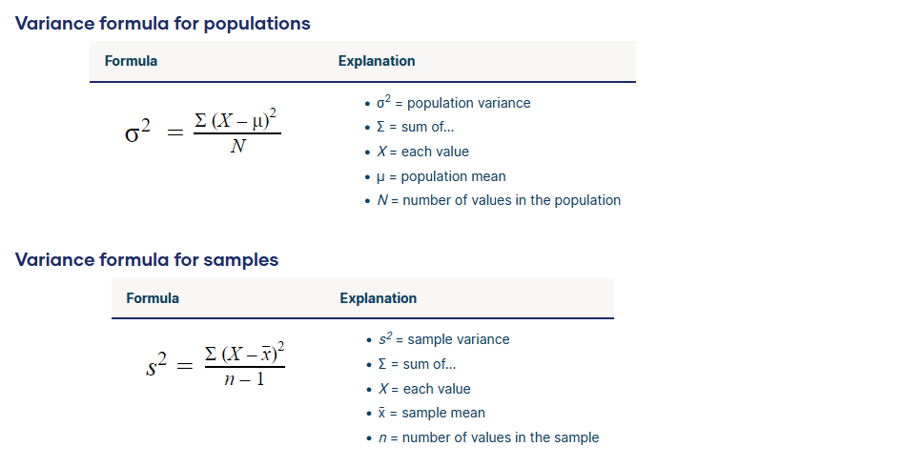
Descriptive Statistics

Slide 18
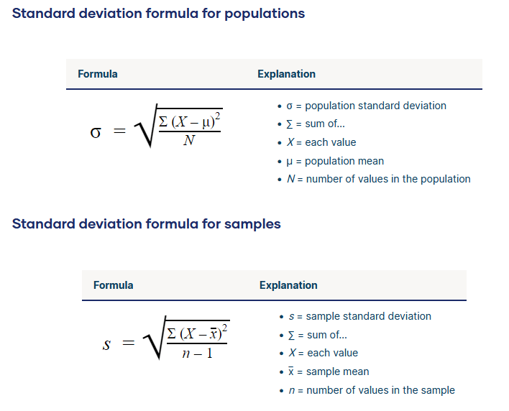
Descriptive Statistics

Slide 19
Descriptive Statistics
Distribution refers to the overall "shape" of the data, which can be depicted on a chart such as a histogram or dot plot, and includes properties such as the probability distribution function, skewness, and kurtosis.
A probability distribution is a statistical function that describes all the possible values and likelihoods that a random variable can take within a given range.
Skewness refers to a distortion or asymmetry that deviates from the symmetrical bell curve, or normal distribution, in a set of data. (left or right)
Kurtosis describe the degree to which scores cluster in the tails or the peak of a frequency distribution. The peak is the tallest part, and the tails are the ends of the distribution.

Slide 20
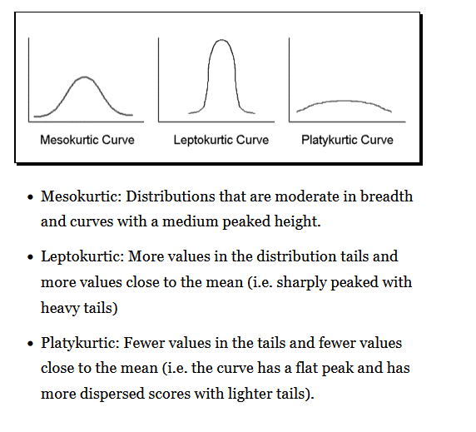
Descriptive Statistics

Slide 21
Statistical Measures
Descriptive statistics allow you to characterize your data based on its properties.
There are four major types of descriptive statistics:
  Measures of Frequency
  Measures of Central Tendency
  Measures of Dispersion or Variation (Spread)
  Measures of Position

Slide 22
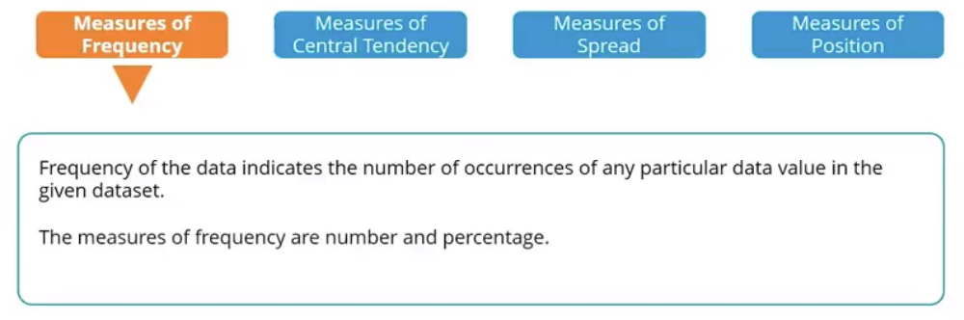
Statistical Measures
Show how often a response is given

Slide 23
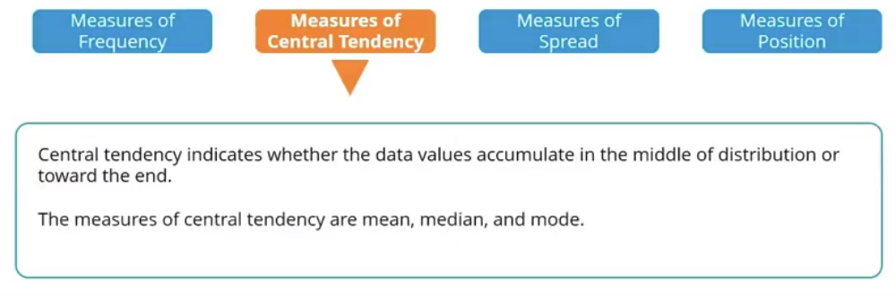
Statistical Measures
show how an average or most indicated response

Slide 24
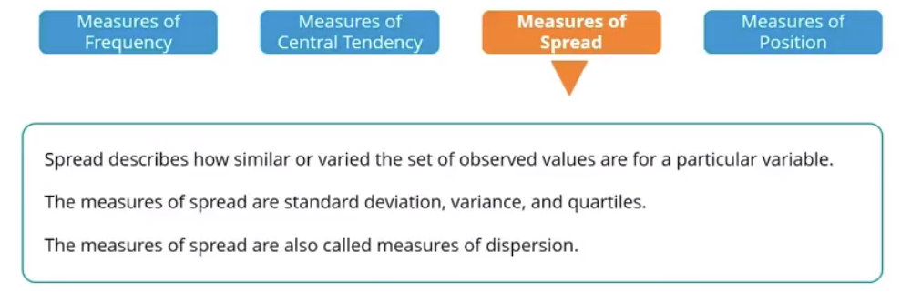
Statistical Measures
show how spread out the data are. It is helpful to know when your data are so spread out that it affects the mean

Slide 25
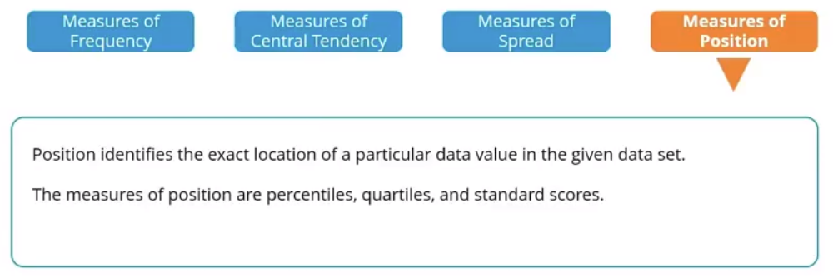
Statistical Measures
compare scores to a normalized score

Slide 26
Statistical Measures
Confidence interval refers to the probability that a population parameter will fall between a set of values for a certain proportion of times.
It measure the degree of uncertainty or certainty in a sampling method. They are most often constructed using confidence levels of 95% or 99%.
A researcher selects different samples randomly from the same population and computes a confidence interval for each sample to see how it may represent the true value of the population variable.
The resulting datasets are all different where some intervals include the true population parameter and others do not.

Slide 27
Statistical Measures
A 95% confidence interval means that if we were to take 100 different samples and compute a 95% confidence interval for each sample, then approximately 95 of the 100 confidence intervals will contain the true mean value (μ).
Z-score describes a value's relationship to the mean of a group of values. Z-score is measured in terms of standard deviations from the mean. If a Z-score is 0, it indicates that the data point's score is identical to the mean score.
The positive value of Z-scores indicating the score is above the mean and a negative score indicating it is below the mean.

Slide 28
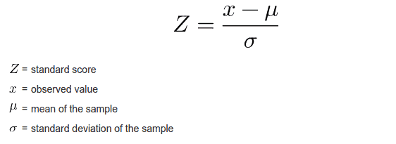
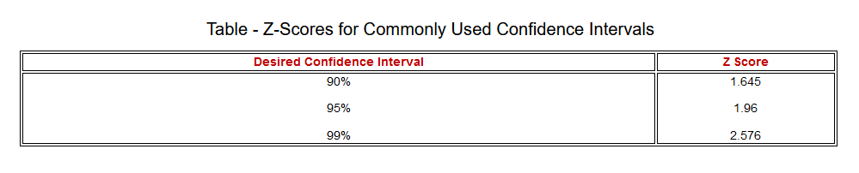
Statistical Measures

Slide 29
Inferential Statistics
Inferential statistics are used to develop a hypothesis from the data set. It would be impossible to get data from an entire population, so data scientists can use inferential statistics to extrapolate their results.
Using these statistics, they can make generalisations and predictions about a wider sample group, even if they haven’t surveyed them all.
With inferential statistics, it’s important to use random and unbiased sampling methods. If your sample isn’t representative of your population, then you can’t make valid statistical inferences.

Slide 30
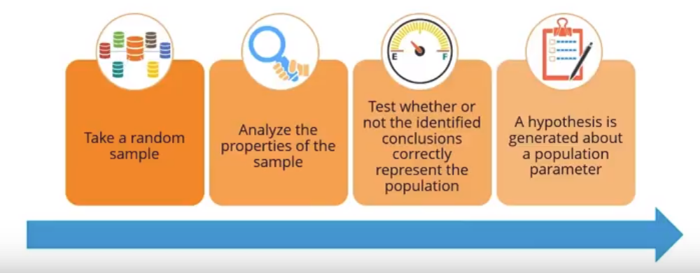
Inferential Statistics

Slide 31
Inferential Statistics
Hypothesis testing is an act in statistics whereby an analyst tests an assumption regarding a population parameter.
The first step is for the analyst to state the two hypotheses so that only one can be right.
The next step is to formulate an analysis plan, which outlines how the data will be evaluated.
The third step is to carry out the plan and physically analyze the sample data.
The fourth and final step is to analyze the results and either reject the null hypothesis, or state that the null hypothesis is plausible, given the data.

Slide 32
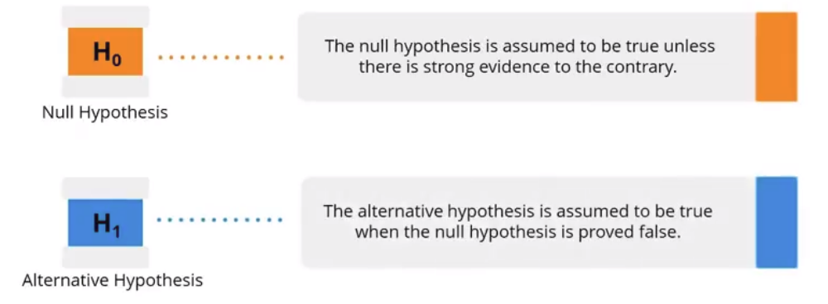
Inferential Statistics

Slide 33
Inferential Statistics
Example
  The wages of men and women are equal (Null)
  The wages between men and women are not equal
  The medicine is safe (Null)
  If proven that the medicine is unsafe, then the null hypothesis is rejected
Type I error
  When you REJECT the null hypothesis when the null hypothesis is TRUE (reject H0 and you shouldn’t)
Type II error
  When you ACCEPT the null hypothesis when it is FALSE. (don’t reject H0 and you should have)

Slide 34
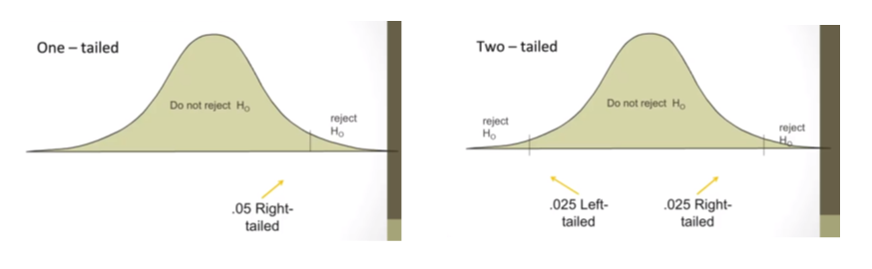
Inferential Statistics

Slide 35
Inferential Statistics
The alpha value is the threshold value that we measure p-values against. It tells us how extreme observed results must be in order to reject the null hypothesis of a significance test.
A p-value is the probability that the observed statistic occurred by chance alone, assuming that the null hypothesis is true.
p-value cannot be zero. If the p-value is less than or equal to alpha. In this case, we reject the null hypothesis. When this happens, we say that the result is statistically significant.
If the p-value is greater than alpha. In this case, we fail to reject the null hypothesis. When this happens, we say that the result is not statistically significant.

Slide 36
Inferential Statistics
Parametric tests are those statistical tests that assume the data approximately follows a normal distribution. It includes t-test and ANOVA.
A t-test is a type of inferential statistic used to determine if there is a significant difference between the means of two groups, which may be related in certain features.
It is mostly used when the data sets, like the data set recorded as the outcome from flipping a coin 100 times, would follow a normal distribution and may have unknown variances.
A t-test is used as a hypothesis testing tool, which allows testing of an assumption applicable to a population.

Slide 37
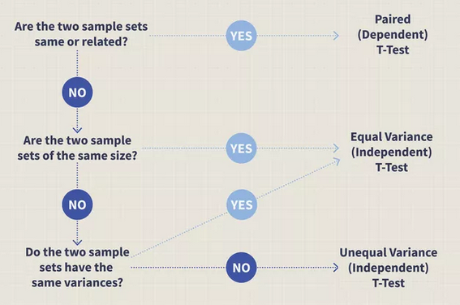
Inferential Statistics

Slide 38
Inferential Statistics
Analysis of variance (ANOVA) is an analysis tool used in statistics that splits an observed aggregate variability found inside a data set into two parts: systematic factors and random factors.
The systematic factors have a statistical influence on the given data set, while the random factors do not.
Analysts use the ANOVA test to determine the influence that independent variables have on the dependent variable in a regression study.

Slide 39
Inferential Statistics
Nonparametric tests are methods of statistical analysis that do not require a distribution to meet the required assumptions to be analyzed (chi-square).
A chi-square (χ2) statistic is designed to analyze group differences when the dependent variable is measured at a nominal level. It permits evaluation of both dichotomous independent variables, and of multiple group studies. It measures how a model compares to actual observed data.
Limitations include its sample size requirements, difficulty of interpretation when there are large numbers of categories (20 or more) in the independent or dependent variables.

Slide 40
Regression Model
A regression model provides a function that describes the relationship between one or more independent variables and a response, dependent, or target variable.
A regression analysis is the basis for many types of prediction and for determining the effects on target variables.
Type of regression
  Linear Regression
  Multiple Linear Regression
  Non-Linear Regression

Slide 41
Regression Model
Linear Regression
  A linear regression is a model where the relationship between inputs and outputs is a straight line. This is the easiest to conceptualize and even observe in the real world.
  Constant rate of increase of one variable with respect to another
  Examples
    Income and educational level
    Home sales and interest rates

Slide 42
Regression Model
Multiple Linear Regression
  Multiple regression indicates that there are more than one input variables that may affect the outcome, or target variable.
  By looking at both input variables, a clearer picture starts to emerge about what drives users to respond to a campaign and how to optimize email timing and frequency.
  While conceptualizing the model becomes more complex with more inputs, the relationship may continue to be linear.

Slide 43
Regression Model
Non-Linear Regression
  Nonlinear regression is a form of regression analysis in which data is fit to a model and then expressed as a mathematical function.
  The nonlinear regression relates the two variables in a nonlinear (curved) relationship.
  Nonlinear regression can show a prediction of population growth over time.

Slide 44
Regression Model
Correlation coefficient (r)
  Assesses whether 2 variables are linearly related to each other.
  Reflects the direction and the strength of the relation.
  cor() and cor.test() functions.
Types of Correlations
  When both variables are continuous: Pearson product-moment
  When both variables are nominal (categorical)
    Two categories for each variable: Phi
    Multiple categories for each variable: Kappa
  When both variables are ordinal: Spearman rank

Slide 45
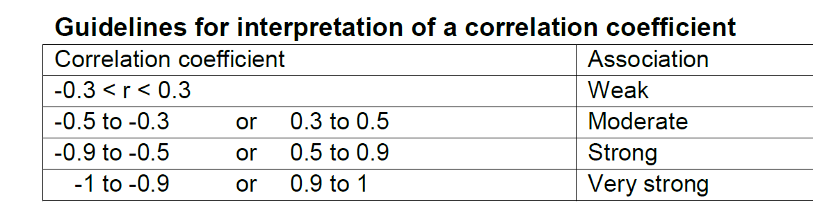
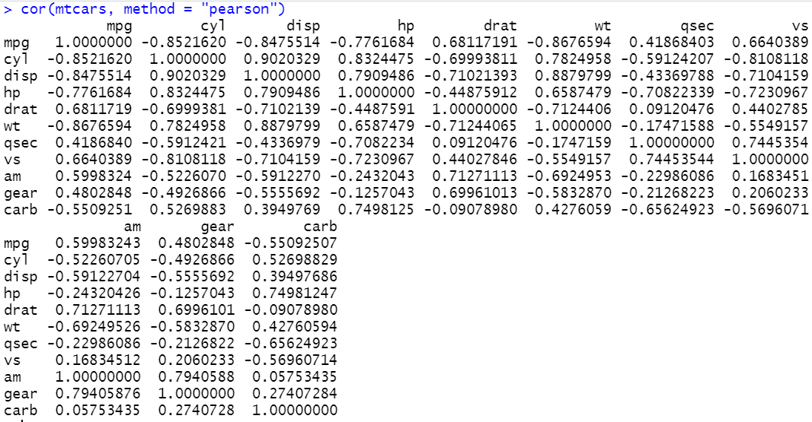
Regression Model

Slide 46
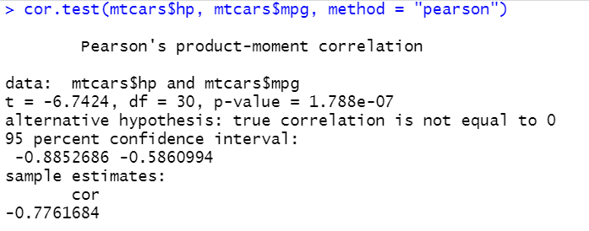
Regression Model
The correlation coefficient of -0.78 suggests a strong negative correlation between hp and mpg.
As the p value for the test is much smaller than 0.05 (p < 0.001), the null hypothesis (r = 0) is rejected.
-0.88 and -0.58 is the lower and upper limit of 95% confidence interval

Slide 47
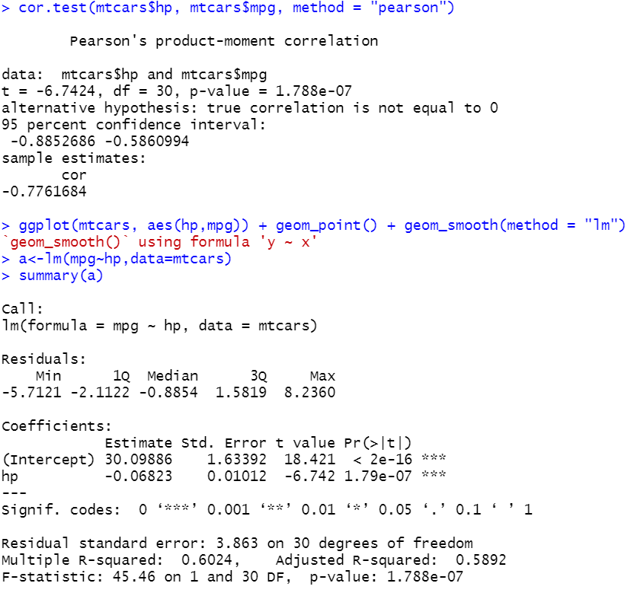
Regression Model

Slide 48
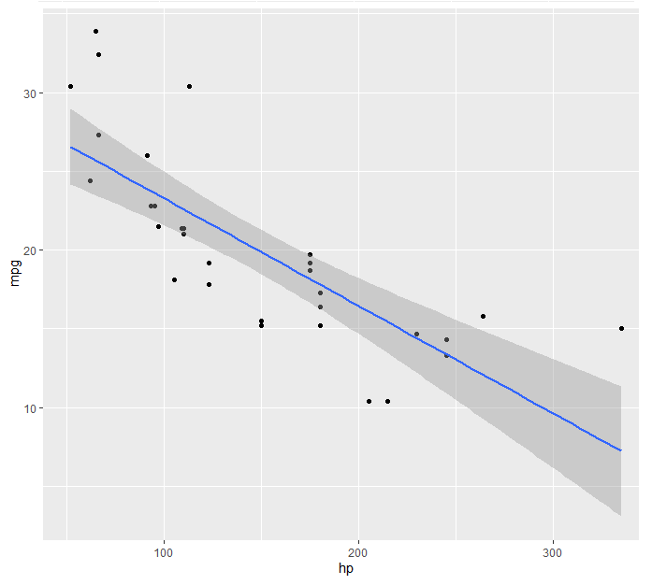
Regression Model
95% prediction interval of the mpg for the hp of 100 is between 15.2066 and 31.34547

Slide 49
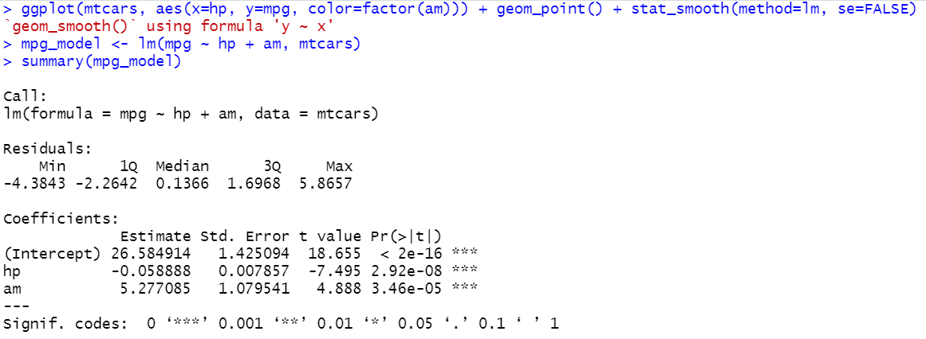
Regression Model
To examine the extent to which the gas mileage (mpg) is a function of both gross horsepower (hp) and transmission (am).
0 is automatic and 1 is manual.

Slide 50
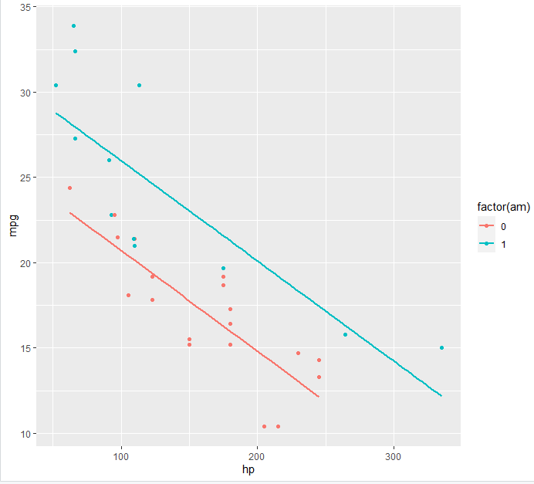
Regression Model

Slide 51


