Slide 1
WQD7004
Programming for Data Science
Chapter 2
Basics in R

Slide 2
Contents
Variable
Operator
Input
Output
Random Number

Slide 3
Variable
A variable is a storage location in the memory that has a type, name and value.
  A variable must be declared, specifying the variable's name and the type of information that will be held in it.
The name of the variable may contain letters, digits (0 – 9), the underscore (_) character, the period (.) character.
The name cannot begin with a digit or underscore.
The name cannot be reserved word
A variable begin with . is a hidden variable.
A meaningful name will make the program easy to understand.

Slide 4
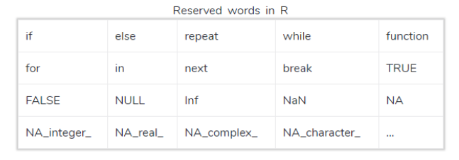
Variable

Slide 5
Variable
Data Type | Example | Script
Logical | TRUE, FALSE, T, F | status <- TRUE
Numeric | 31.2, 456 | num <- 12.65
Integer | 12L, 2022L | num1 <- 65L
Complex | 12 + 4i | num2 <- 32 - 3i
Character | "Z", "R Program" | str <- "Result"
Raw | "HI" is stored as 48 49 | b <-charToRaw("HI")
numeric constants preceded by 0x or 0X are interpreted as hexadecimal numbers.

Slide 6
Variable
class(variable) or typeof(variable) can be used to get the data type of the variable
ls() list down all the variables currently available in the workspace.
ls(all.names = TRUE) list down all the variables including the hidden variable.
Variables can be deleted by using the rm() function.

Slide 7
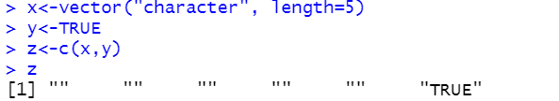
Variable
the c() function allows the different classes of R objects to get mixed together. Coercion occurs so that every element in the vector is of the same class.
Implicit coercion
  When R tries to find a way to represent all of the objects in the vector in a reasonable fashion.
  The coersion rule goes logical -> integer -> numeric -> complex -> character

Slide 8


Variable
Explicit coercion
  Objects can be explicitly coerced from one class to another. as() function can be used to coercing an object to a given class.
If R can't figure out how to coerce an object, the NA result is produced.

Slide 9
Variable
A NA value in R represents (not available). This can exist in any sort of numeric or character vectors. It is generally interpreted as missing values.
A NaN value in R represents (not a number), It is basically any numeric calculations with an undefined result. This exists only in vectors with numeric datatype.

Slide 10

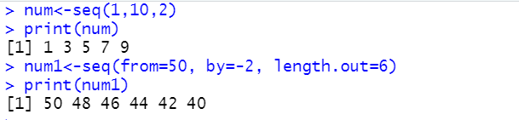
Variable
seq() function generate a sequence of number.
  seq(from, to, by, length.out)

Slide 11

Variable
rep() function replicates the values
  rep(x, times, length.out, each)
  length.out repeat the vector until it reaches the specified length

Slide 12

Variable
nchar() function is used to count the number of characters including spaces in a string.

Slide 13
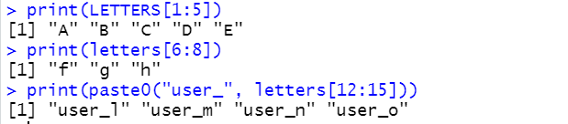
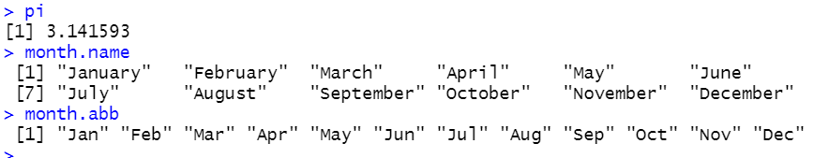
Variable
LETTERS can be used to create a sequential uppercase alphabet and letters can be used to create a sequential lowercase alphabet in R.
pi, month.name, month.abb (months abbrevations)

Slide 14
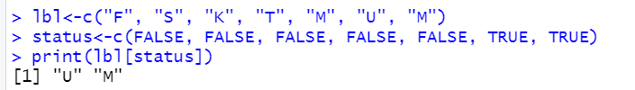
Variable
We can use logical vector for indexing. The position where the logical vector is TRUE is returned.

Slide 15

Operator
Assignment Operator
  It is used to assign value to the variable
  <-, =
  msg <- 'Welcome to Year'
  y <- 2022

Slide 16
Operator
Arithmetic Operator
  It is used to compute numeric results
  + (addition)
  - (subtraction)
  * (multiplication)
  / (division)
  %% (modulo or remainder)
  ^ (exponent)
  %/% (integer division)
  num <- 10 + 8
  num1 <- 10%%3

Slide 17
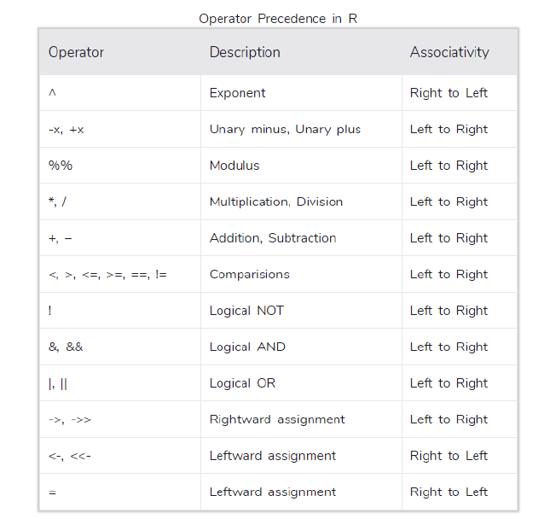
Operator

Slide 18
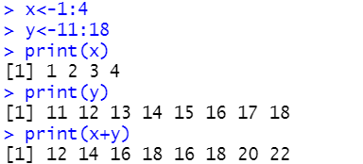
Operator
When adding 2 vectors with different number of elements, R loops the smaller vector as many times as necessary to add something to each element of the larger vector.

Slide 19
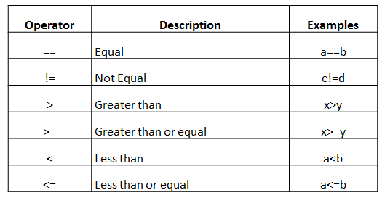

Operator
Relational Operator
  It is used to tests the relationship between two values.

Slide 20
Operator
Logical Operator
  It is used to create complex logical expression by merging multiple constraints/conditions
  Operators & and | perform element-wise operation.
  Operators && and || examines only the first element of the operands.
Operator | Description | Examples
& | TRUE & TRUE is TRUE, others FALSE) | a==b & c==d
| | FALSE | FALSE is FALSE, others TRUE) | c!=d | a<b
! | NOT (!FALSE is TRUE, !TRUE is FALSE) | !(x>y)

Slide 21
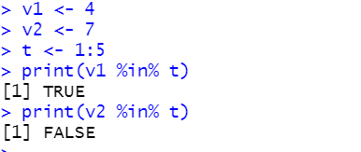

Operator
%in%
  This operator is used to identify if an element belongs to a vector.

Slide 22
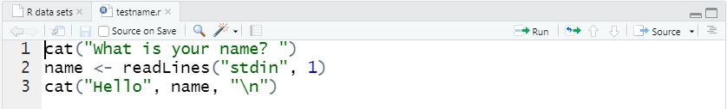

Input
We can use readLines("stdin", 1) function to take input from the user (terminal).
First save the script in R file. Then, run the R file from terminal.

Slide 23
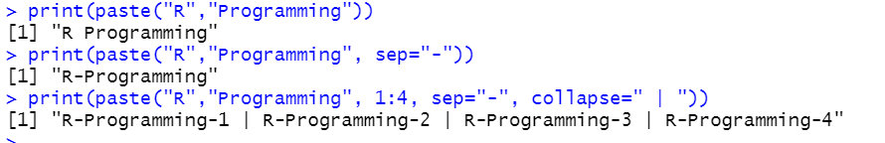
Output
print() function is used to display information of variable or dataset.
paste() function is used to concatenating strings. It can take any number of arguments to be combined.
  sep represents any separator between the arguments
  collapse is used to eliminate the space in between two strings.
paste0() function is used to concatenating strings without space.

Slide 24
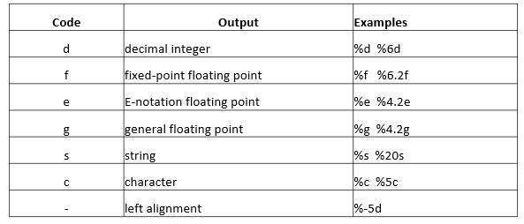
Output
cat() function is used to concatenating and display output.
  s_name = c("Ali","Ahmad","John","Mike")
  cat ("Students : ", s_name ,"\n")
sprintf() function is a C-style string formatting function.

Slide 25

Random Number
Random number is very useful in science, art, statistics, cryptography, gaming and etc.
sample(x, size, replace = FALSE, prob = NULL)
  either a vector of one or more elements from which to choose, or a positive integer.
  if the replace=FALSE, no duplication

Slide 26

Random Number
sample.int(n, size = x, replace = FALSE)
  an integer vector of length size with elements from 1:n

Slide 27
Random Number
The rnorm() function in R generates a random number using a normal(bell curve) distribution.
  rnorm(n, mean, sd)
    n: sample size
    mean: mean value (default value is zero)
    sd: standard deviation (default value is 1)
set.seed(seed)
  It is used to set the seed of R‘s random number generator, which is useful for creating simulations or random objects that can be reproduced.

Slide 28
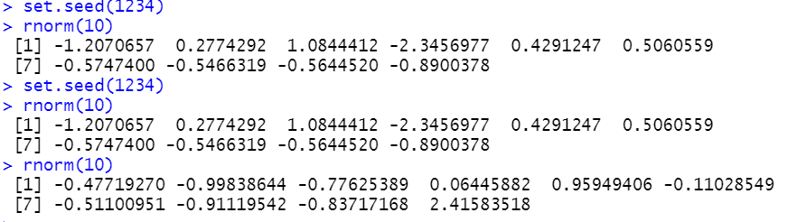
Random Number

Slide 29


