Slide 1


InnoV8
Website Design Proposal
Prepared by Group 10 | BlueFish Media Design
Web Design Assignment 1 (TSNI 2022)
Notes:
Good morning everyone. We are Group 10 from BlueFish Media Design, and today we present our website design proposal for InnoV8.
InnoV8 is a consultancy that provides motivational strategies and personal development services to corporations and charities.
Over the next slides we will walk through the client expectations, target audience, competitor analysis and our proposed design.

Slide 2
Agenda
01
Client Overview
Understanding the InnoV8 business and its consulting services
02
Client Expectations
Three things the InnoV8 website must achieve
03
Target Audience
Who the website serves and how the design appeals to them
04
Competition Analysis
Three competitor websites with strengths and weaknesses
05
Design Proposal
Color scheme, page layout, typography and the sample page
Notes:
Here is our agenda for today. We will start by introducing the InnoV8 client and their business.
Then we will present the three client expectations and the target audience for the website.
After that, we will share our analysis of three competitor websites, and finally present our complete design proposal including color, layout, typography and the sample page layout.

Slide 3
About InnoV8
The client and its business domain
InnoV8 specialises in motivational strategies and personal development consultancy. The firm helps corporations, companies and charity organisations improve employee motivation, leadership capability and overall team effectiveness.
01
Corporate and charity clients
Serving businesses and nonprofit organisations
02
Motivation and growth
Personal development and coaching services
03
Team effectiveness
Building stronger teams and workplaces
Notes:
First, let us introduce our client. InnoV8 is a consultancy that provides motivational strategies and personal development services.
They work with three types of clients: corporations, companies and charity organisations.
Their services focus on employee motivation, leadership growth and team effectiveness, which is the core of the website we designed.

Slide 4
Client Expectations
Three things the InnoV8 website must achieve
01
Credibility and trust
A polished, professional design that positions InnoV8 as a credible consultancy partner for corporate and charity clients.
02
Clear service showcase
Services presented clearly so corporate and charity visitors immediately understand what InnoV8 offers.
03
Lead generation
Strong calls-to-action and visible contact options that convert visitors into booked consultations.
Notes:
Now let us talk about the three expectations our client has for the website.
First, the website must build credibility and trust, so corporate and charity clients see InnoV8 as a professional consultancy.
Second, it must clearly showcase the services. And third, it must generate leads through clear calls-to-action that lead visitors to book a consultation.

Slide 5
Target Audience
Decision-makers in corporations, businesses and charity organisations
Age
30-55 years old, typical of managers, HR and L&D leaders.
Socioeconomic
Middle-to-high income professionals in management who hold training and consulting budgets and can authorise external services.
Gender
Both male and female decision-makers in management positions.
Interests
Leadership development, team building, employee engagement, organisational culture and personal growth.
Needs
Solving problems such as low employee motivation, weak teamwork, and limited leadership capability.
Notes:
Now let us look at who the website is designed for. The primary audience is decision-makers in corporations, small businesses and charity organisations.
They are typically aged 30 to 55, both male and female, in management or HR roles, with middle-to-high income and authority to spend on consulting.
They care about leadership, team building and employee engagement, and they need to solve problems like low motivation and weak teamwork.

Slide 6
Competition Analysis
Three competitor websites, assessed with the Web Design Best Practices Checklist
Competitor | Two Strengths | Two Weaknesses
FranklinCovey | Clear, consistent navigation Consistent branding and hierarchy | Content-dense homepage Heavy media slows loading
Dale Carnegie | Clear value proposition and CTA Localised regional content | Complex dropdown navigation Text-heavy pages reduce scanning
Gallup | Data-driven content builds trust Clear typography and white space | Vast site with dense pages Services hard to find
Notes:
We analysed three competitors in the consulting and training space: FranklinCovey, Dale Carnegie and Gallup.
For each site we noted two strengths and two weaknesses using the Web Design Best Practices Checklist.
Common weaknesses include dense pages and complex navigation. Our design avoids these problems with a clean layout and clear calls-to-action.

Slide 7
Color Scheme
Derived from the InnoV8 brand and logo
Primary Navy
Accent Blue
Highlight Teal
Light Background
Body Text
#093362
#216CE7
#20E0E0
#F4F7FB
#33415C
Deep navy conveys authority and professionalism, accent blue powers the calls-to-action, and teal adds a fresh, energetic highlight that reflects growth.
Notes:
Our color scheme is derived directly from the InnoV8 brand and logo.
Deep navy is the primary color, used for the header and main banner. Accent blue is reserved for call-to-action buttons, and the bright teal highlights numbers and key accents.
A light background and dark gray body text keep the pages readable, which matches the professional tone expected by corporate and charity clients.

Slide 8
Page Layout
Jello layout — fixed-width content, centered with fluid side margins
Header (full width)
Why Jello?
Content keeps a comfortable reading width on large screens.
Side margins grow with the viewport, so the page never looks stretched.
Matches the desktop-first design of our sample page.
Content
Fixed max width, centered
margin
margin
Notes:
For the page layout we chose the jello layout, as required by the assignment.
In a jello layout, the content area has a fixed maximum width and is centered, while the margins on both sides expand and contract with the screen size.
We implemented this with a maximum width of 900 pixels and margin auto centering, which keeps text readable and consistent across screen sizes.

Slide 9
Typography
Montserrat for headings, Inter for body text
01
Montserrat
InnoV8
Used for headings, titles and the logo wordmark. A geometric sans-serif with a strong, professional presence.
Website Design
Activating team potential and driving organisational growth — a sample of the Inter body text on screen.
02
Inter
Used for paragraphs, navigation links and small labels. Crisp, open and highly readable on screens.
Notes:
For typography we chose a two-font system.
Montserrat is used for all headings and the logo wordmark. It is a geometric sans-serif that gives the brand a strong, professional look.
Inter is used for paragraphs, navigation and labels. It is crisp and highly readable on screens, which keeps the content comfortable to read.

Slide 10
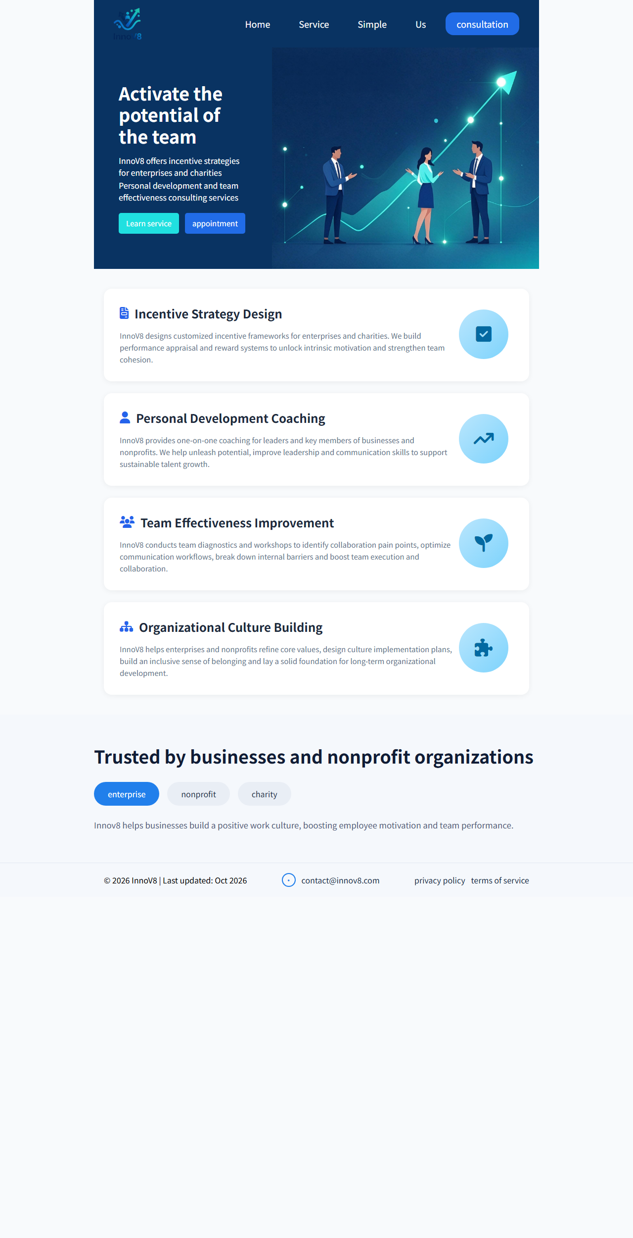
Sample Page Layout
The finished page
Our merged sample page combines the navy header and banner, four service cards, a trust section and a footer — all wrapped in a 900-pixel jello layout.
Website file
index.html + above.css + work.css
Delivered as a local file with this deck, tested in Google Chrome at 1280px width.
Notes:
This is the sample page layout we built for InnoV8. The screenshot shows the finished homepage rendered in Google Chrome.
On the left you can see the full page: the navy header and banner we designed, the four service cards, the trust section and the footer.
The website file index.html, together with its style sheets, is delivered with this deck and tested at a desktop width of 1280 pixels.

Slide 11

InnoV8
Thank You
Let's activate team potential together
Questions and feedback are welcome.
Group 10 | BlueFish Media Design | Web Design Assignment 1 (TSNI 2022)
Notes:
Thank you for listening. To sum up, we designed a professional, trustworthy website for InnoV8 that clearly showcases its consulting services and turns visitors into leads.
The design uses the InnoV8 brand colors, a jello layout and a clean two-font system.
We are happy to take any questions about the design decisions or the sample page itself.

