Slide 1
Unit testing in python
A trial lecture presented on 22 Oct 2021
By
Dr.rer.nat. Joseph Njeri
At Spiced Education GmbH
Berlin, Germany

Slide 2
Outline
Data science and software development
Code deployment
Why do unit testing?
Unittest python module
Backend framework: A simple temperature forecast example
Frontend and backend interaction
Live coding: Writing a unit test case and measuring coverage

Slide 3
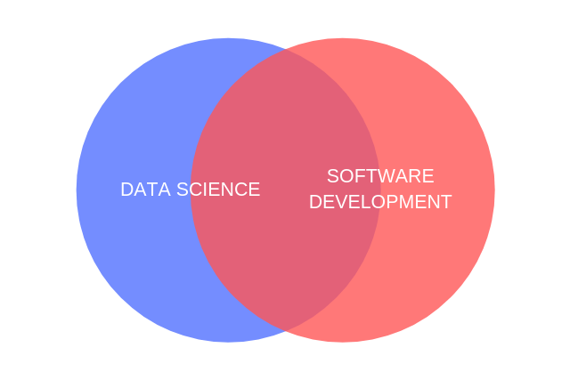
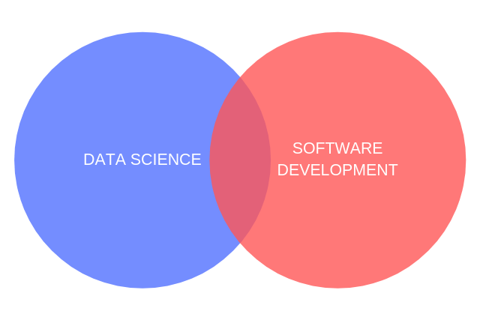
Data science and software development
Should a data scientist have software development skills?
a. How traditional data scientist think
b. How it should be

Slide 4
Your Code deployment process
Data scientist
Software developer
Machine
Learning
Model
Back-end
Application
Front-end
Application
Unit testing
Unit testing
A must before deployment
A must before deployment
An untested code is a recipe for chaos!

Slide 5
Unit testing: Why?
Test automation
Documentation
Reliability
Reusability
Code performance
Coverage
Code quality
Debugging

Slide 6
Python module unittest
TestCase:
  Can be used to create new test cases
  Has elegant methods for implementing unit tests
  Supports automated tests
Some useful TestCase methods:
  assertEqual
  assertTrue/assertFalse
  assertRaises

Slide 7

Example Application:
Simple Temperature forecast App
User Story
“As a user, I would want to compare hourly temperature forecasts on a given day for selected cities in Germany to decide which city to visit for vacation”

Slide 8
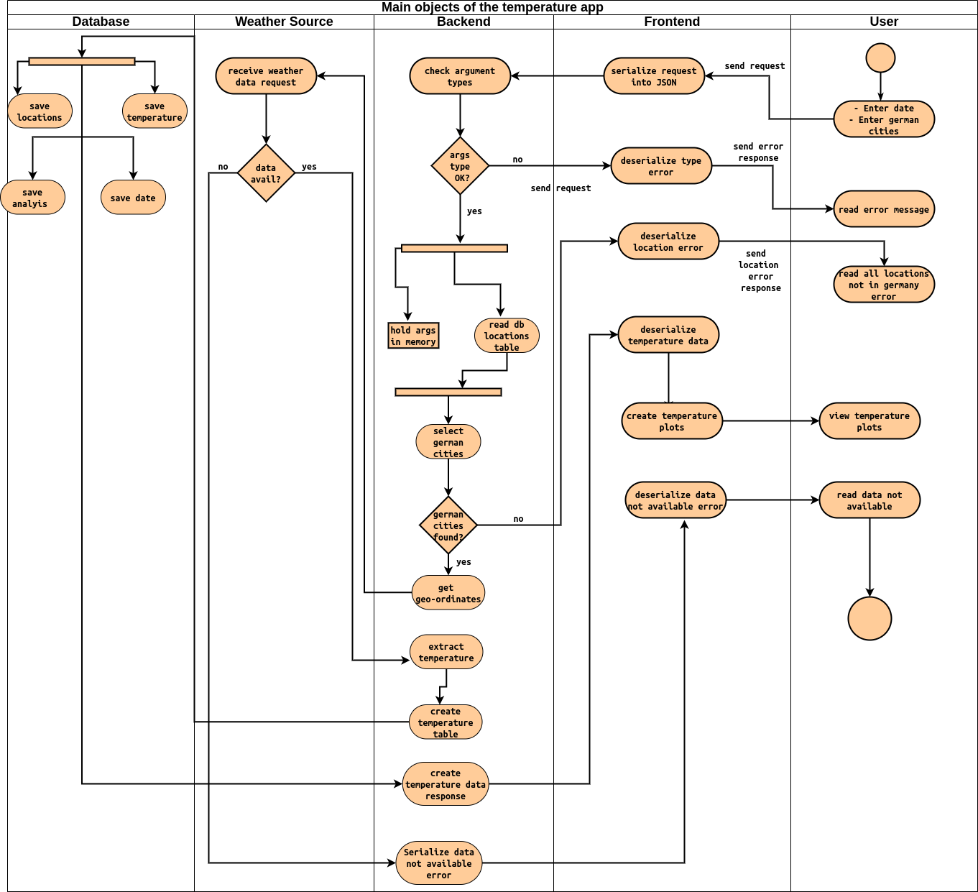
Flow chart of the application

Slide 9
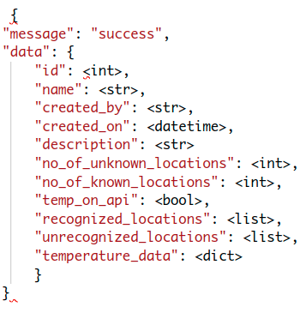
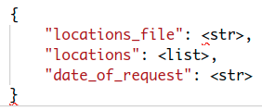

Frontend and Backend interaction
Show route Response (one object)
Put request from user:
Serialized to Json by frontend
Error message Response!
For Clarity:
Let’s use thunder-client in Vscode to simulate user input
and backend responses

Slide 10
Live Coding: Writing a unit test case
to test:
post
get
put routes on temperature API
Test argument types (instances)
Check test coverage
Run pylint to conform to the PEP-8 coding standard

