Slide 1

Third Eye for The Blind
(Ultrasonic Vibrator Glove)
TEAM PRESENTATION

Slide 2


Unfold our project
Summary
This Project Will Help blind people overcome the lack of visual sense, it uses audio and vibration signals to notify the user about upcoming hurdle. As the distance between the glove and the obstacle decreases, frequency of both audio and vibration signals increases.
It is also a great replacement to white cane (blind people's sticks).

Slide 3

1- Glove
2- Arduino Nano
3- Ultrasonic Sensor (Input)
4- Vibrator (Output)
5- Buzzer (Output)
6- Switch
tools

Slide 4
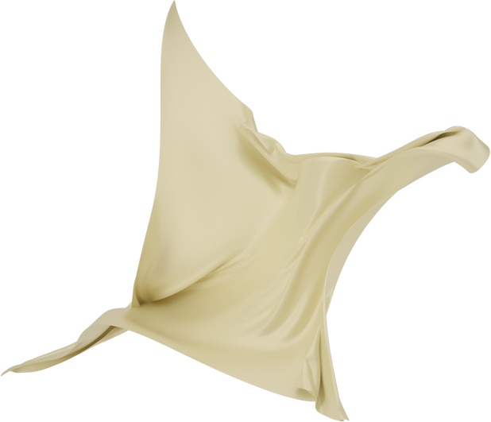
⦁ Less tiring than the white cane.
⦁ Easy to use.
⦁ Very efficient.
why ?
Distance
Vibrator
Buzzer
From 0 to 15 cm
From 15 cm to 50 cm
From 50 cm to 100 cm
Above 100 cm
Vibrating
Vibrating
Vibrating
no Vibrating
High Sound
Medium Sound
No Sound
No Sound

Slide 5
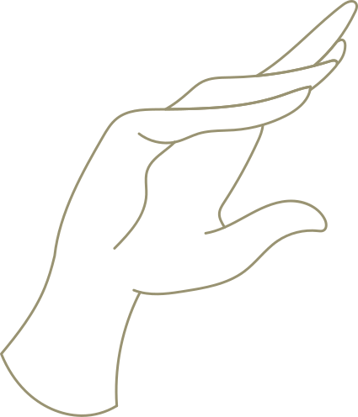
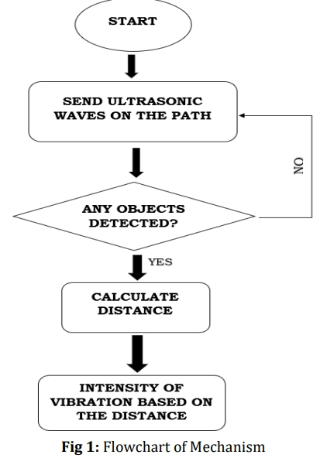
portfolio

Slide 6
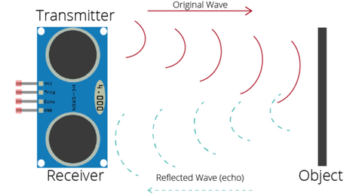
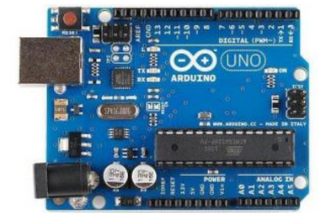
Ultrasonic Sensor
The ultrasonic sensor currently being used in this project has the ability to calculate the distance of any objects in their way with high accuracy. This sensor is most commonly used as it has less interference with the noise in the environment. The mechanism of the sensor is simple, it gives out an electronic burst and then calculates the time to hear back the echo. The echo pulse width is used to calculate the distance of the object or the obstacle. The Ultrasonic sensor used in HC-SR04
Hardware
Microcontroller
The Arduino UNO micro-controller board is the main processing unit of our design. This acts as a control system or central processing unit, which also stores all the algorithms in itself. All the inputs like ultrasonics sensors and outputs like vibrator, LED, alarm buzzer have to be interfaced with the unit, making it the most important part of the system.

Slide 7


We consider a quick and dependable algorithm to determine the position of the left hand taking into consideration only the x-acceleration. The algorithm is designed on the popular Zero Velocity Update approach, adopted in pedestrian dead reckoning. The peaks are separated using fixed threshold, while noise is regarded as a bias and estimated when the hand is still. In this work we introduce the Zero Update algorithm.
Algorithm

Slide 8
