Slide 1
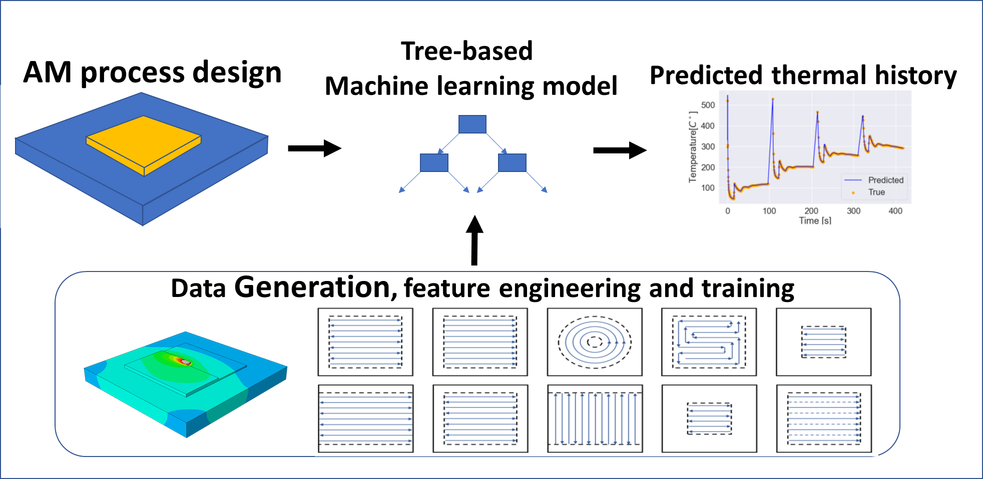

Slide 2
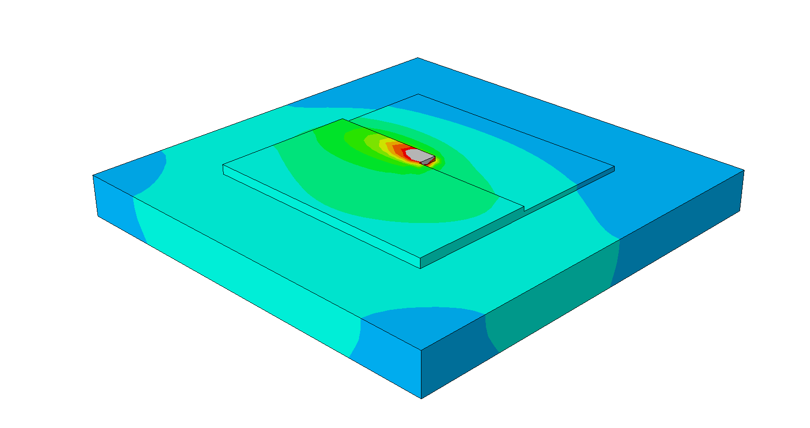
Tree-based
Machine learning model
AM process design
Predicted thermal history
Data Generation, feature engineering and training

Slide 3
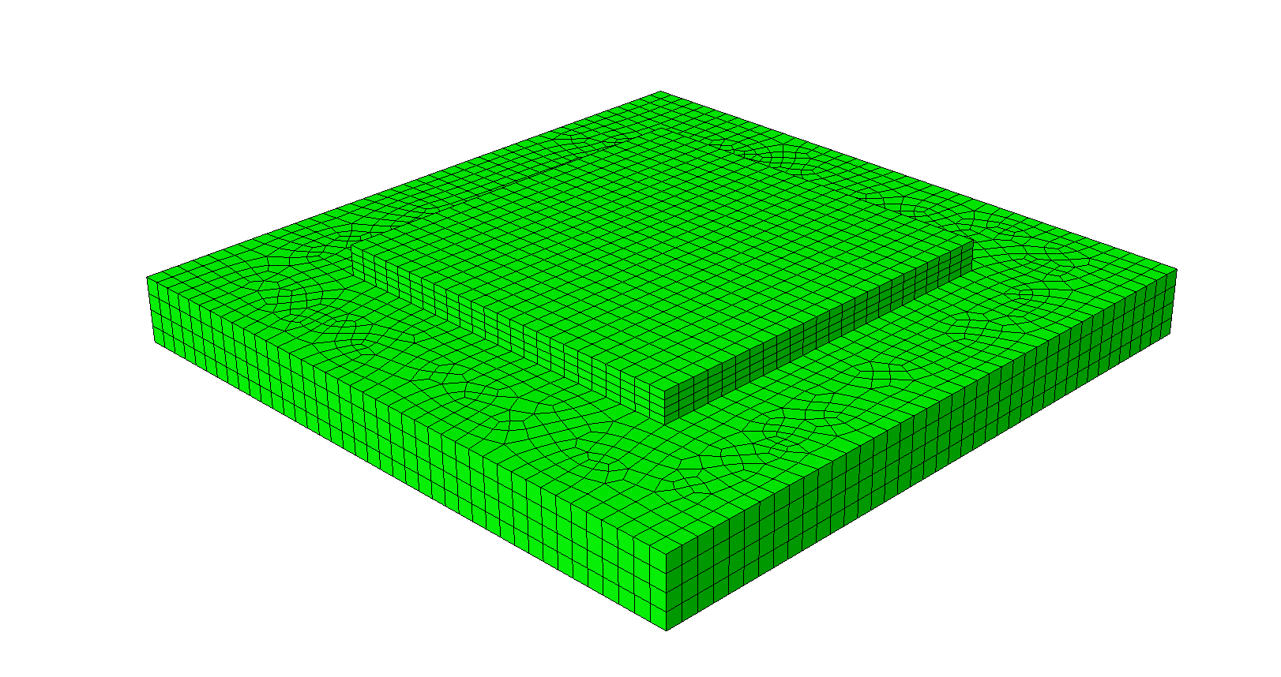
ML - Machine Learning
AM -Additive Manufacturing
FEA – Finite Element Analysis
AM model to predict thermal fields
Tree-based ML model
Predicted thermal field of AM model
Data from existing FEA to train ML model

Slide 4
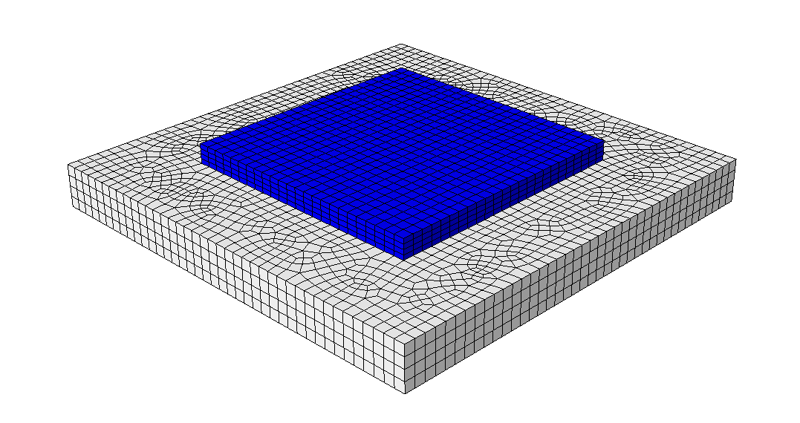
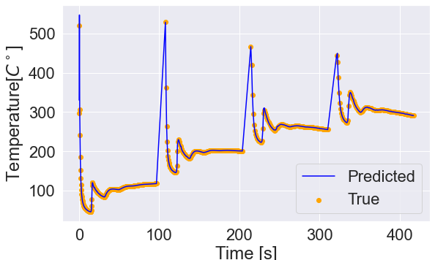
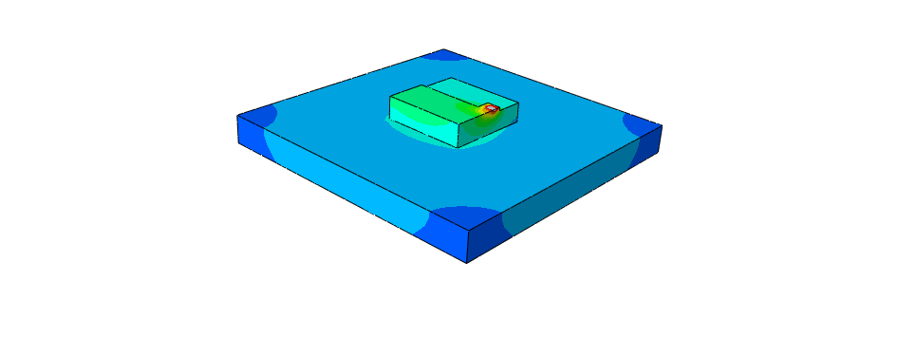
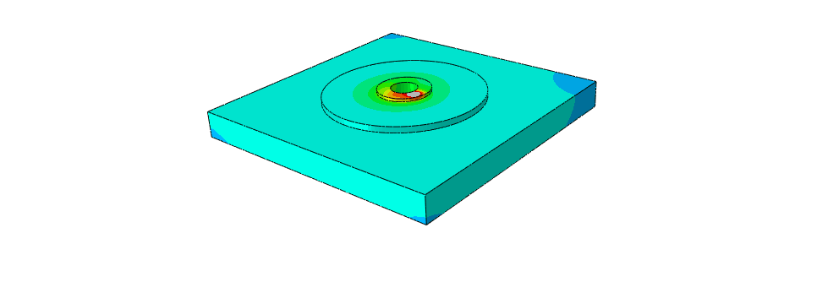
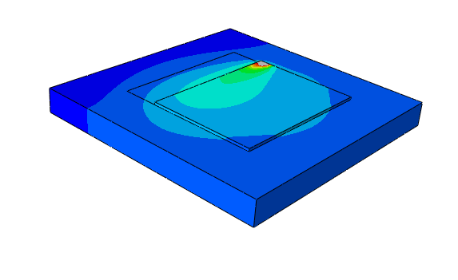
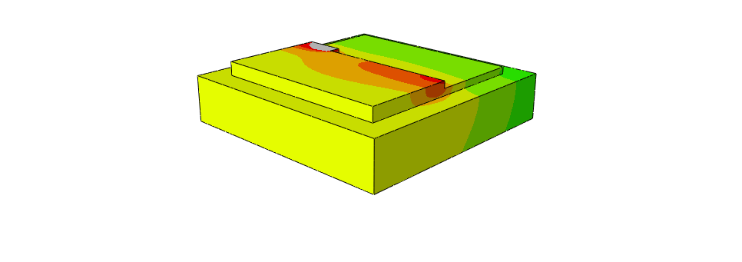
Physics-based ML model
AM process design
Predicted thermal history
Training of ML model
Data from existing FEA with various model characteristics

