Slide 1
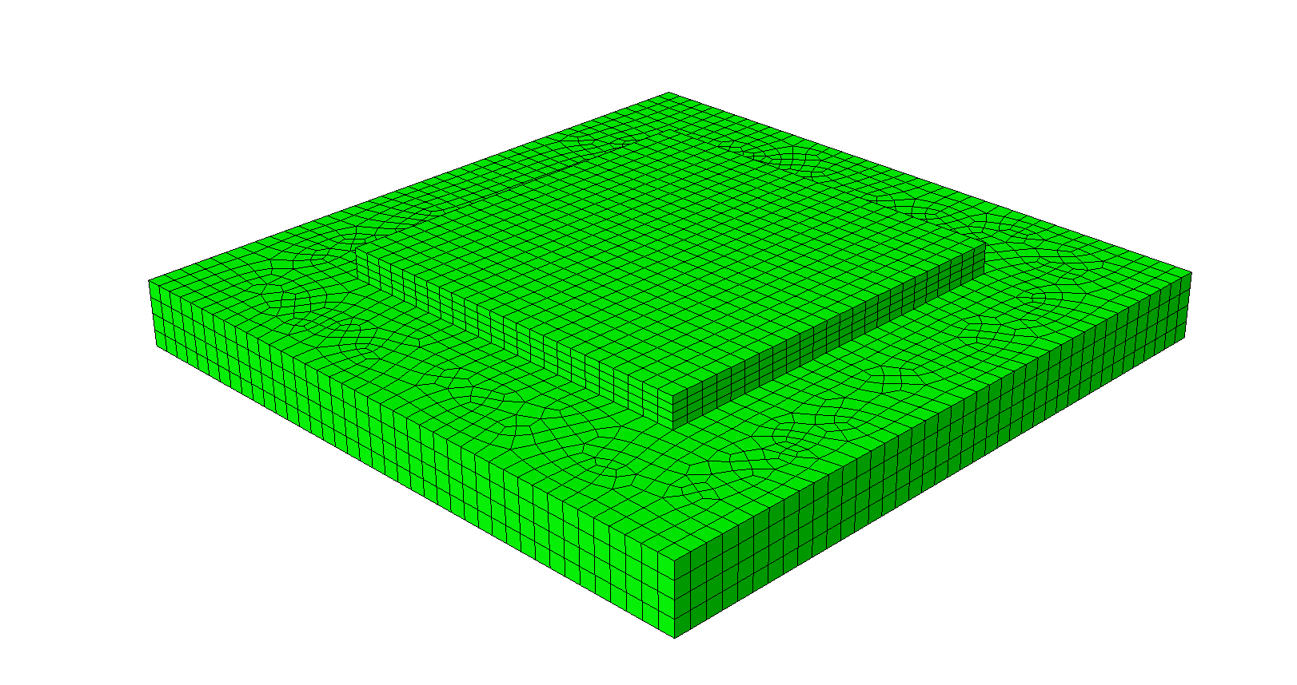
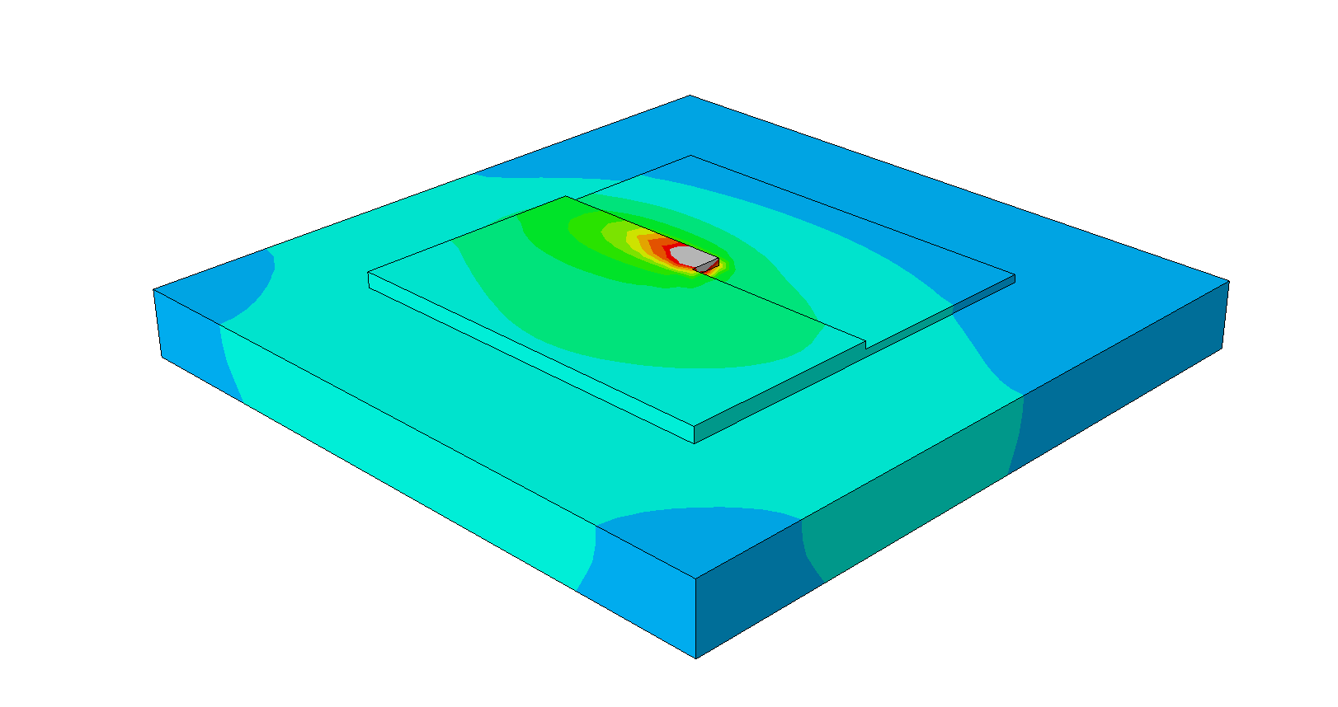
ML - Machine Learning
AM -Additive Manufacturing
FEA – Finite Element Analysis
AM model to predict thermal fields
Tree-based ML model
Predicted thermal field of AM model
Data from existing FEA to train ML model

Slide 2
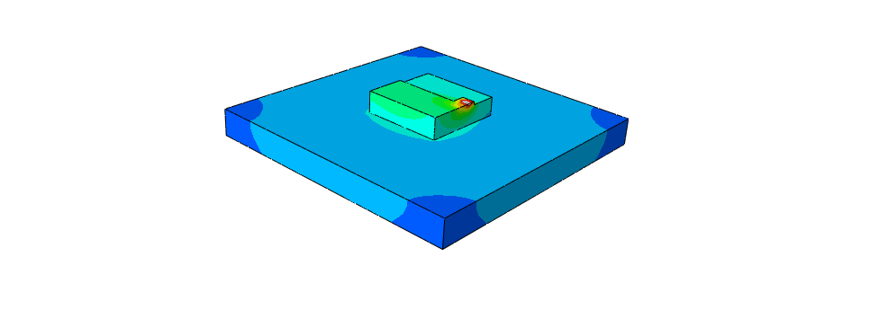
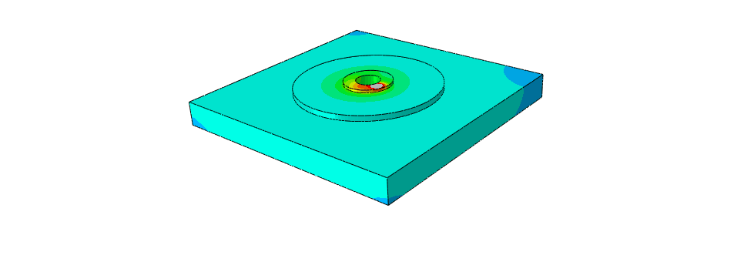
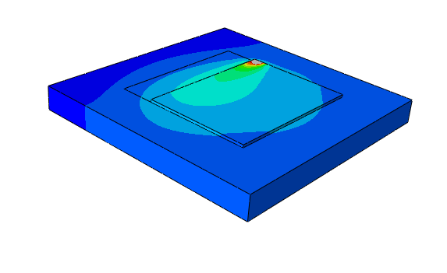
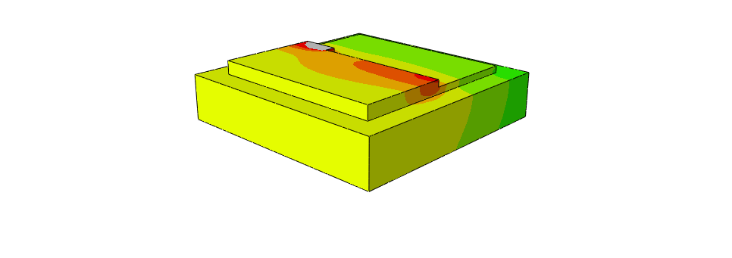
ML - Machine Learning
AM -Additive Manufacturing
FEA – Finite Element Analysis
AM model to predict thermal fields
Tree-based ML model
Predicted thermal field of AM model
Data from existing FEA to train ML model

Slide 3
ML - Machine Learning
AM -Additive Manufacturing
FEA – Finite Element Analysis
AM model to predict thermal fields
Tree-based ML model
Predicted thermal field of AM model
Data from existing FEA to train ML model

