Slide 1
Soukouratou Karim Souleymane
Web Tech Summer 2025 Final Exams

Slide 2
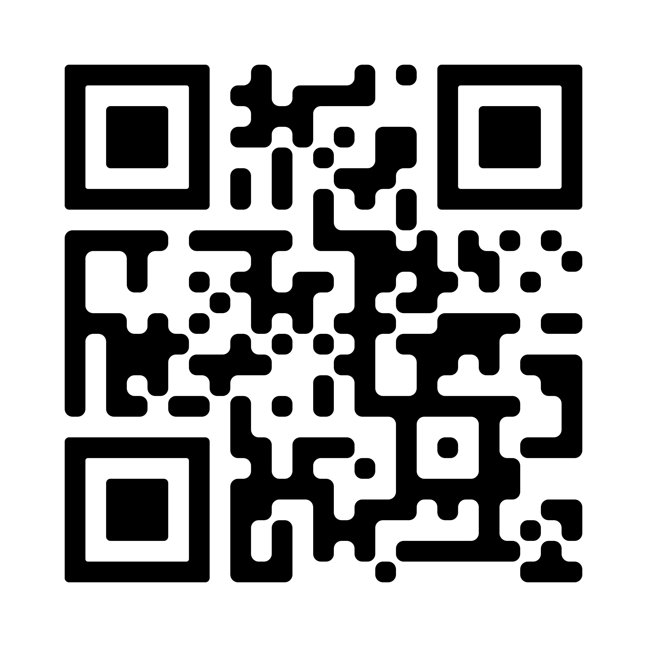
Soukouratou is developing a secure, data-driven web platform for ANAB Niger to digitize the student stipend process in Niger. The system eliminates the need for students to visit offices physically by providing remote bank verification and automated payment tracking.
IMPORTANT LINK:
Website : http://169.239.251.102:341/~soukouratou.souleymane/FinalProject/
Demo video: https://drive.google.com/file/d/10li2OZ5sApYlqtOsBD9yNtg5hdEWL_b4/view?usp=sharing
Gitub repository: https://github.com/karim-Souleymane-Soukouratou/FinalProject.git
E-Bourse is a digital platform designed to automate the management and disbursement of student scholarships and stipends. It represents the ANAB Niger transition from a paper-based, physical office system to a modern, data-driven financial portal.

Slide 3
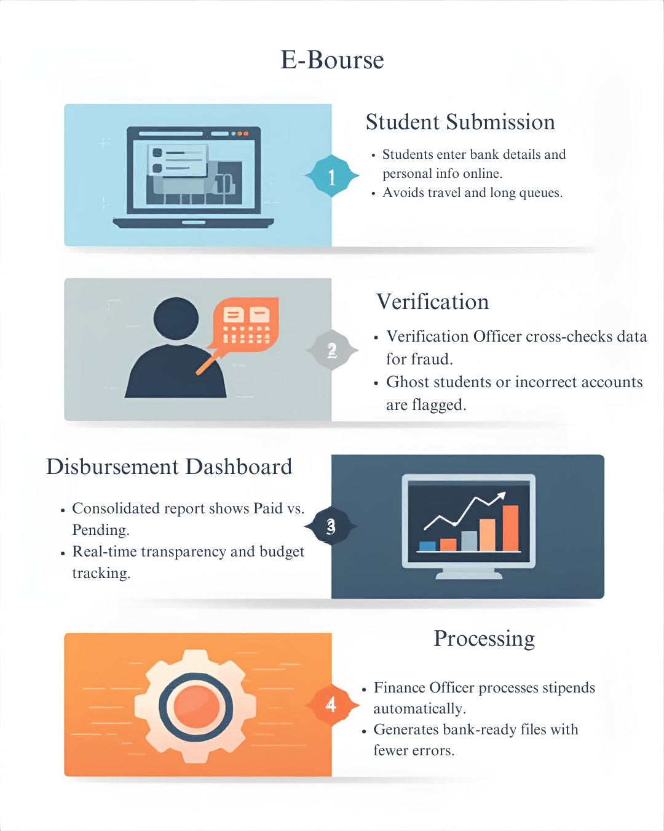
E-Bourse
ddd
The website is used by students, finance officers, and verification officers.
Students are high school or university scholars in Niger or abroad, while finance officers are professionals in accounting or public administration.
Verification officers are ANAB staff responsible for compliance and fraud prevention.
The website solves the problem of inefficient, manual, and centralised scholarship management.
It reduces the need for students to travel to Niamey, minimises payment delays and human errors, and helps ANAB prevent fraud by digitising verification and payment processes.
Before this website, students had to go and queue up to get it. Additionally, because they distribute the stipends late, some students have already returned to their home region. Therefore, when planning for them, they must return; otherwise, they will not receive it.
PERSONA(s) who are the people involved in using the website and what are their background
PROBLEM:What is the problem the website will solve
PAYOFF: What is a simple drawn screen that is illustrative of something the website shows that helps solve the problem. It is likely a report or some results of data entered by the participants. This is the most important square
FINISH: Why are the users better off with the website than before.

Slide 4
User / Customer
The website will be used by the Agence Nigérienne des Allocations et des Bourses (ANAB), a public institution under Niger’s Ministry of Higher Education. ANAB’s purpose is to manage and distribute scholarships and financial aid to Nigeriens students studying locally and abroad. The website replaces manual, in-person processes with a digital service that enhances efficiency, transparency, and accessibility.
The platform serves
Students: who activate their account, register bank details, and track payments online.
ANAB staff: register students, insert them in the database, verify student information, manage payments, and oversee the system.

Slide 5
Main Functions of the Website
1. Remote Bank Detail Submission
Students securely upload their information and account numbers via their personal portal. No more travelling to the ANAB office to hand in a physical form to receive the stipend.
2. Digital Verification Queue
Admins use a dashboard to review, approve, or reject bank details in real-time. Replaces the manual, paper-based verification process at the front desk with a fast, digital approval workflow.
3. Automated Payment Batching (Payment Run)
The system automatically identifies all verified students and generates a single disbursement file for the bank. Eliminates the slow, manual creation of payment lists, reducing human error and speeding up stipend delivery.
4. Real-time Status Tracking
Students can log in to check if their payment is "Pending," "Scheduled," or "Paid.“ Stops students from visiting the office just to ask about the status of their money.

Slide 6
Security
Password Protection: My website hashes all passwords with Bcrypt, so if a password is wrong or stolen, a hacker cannot see the real password.
Access Control: Only verified users with the correct role (Student or Admin) can access their pages; if you’re not authorized, the system redirects you, preventing access to others’ data.
SQL Injection Prevention: All user input is separated from SQL commands using prepared statements, so a hacker cannot type commands to view or delete student records.
Session & Token Security: Password resets and sessions use unique, expiring tokens, ensuring that hackers cannot reuse old links or hijack logged-in accounts

Slide 7
Architecture
Tier | What it Does | Technologies | Why
Presentation Tier | User interface (web pages) | HTML, CSS, JavaScript | Displays data and handles user interaction
Application Tier | Business logic and security | PHP | Processes requests and rules. Who Can access what
Data Tier | Stores data | MySQL | Secure and reliable data storage

