Slide 1
Q&A ML Presentation

Slide 2

Q1. how did we load the dataset ?
Answer: We used read_csv to load the dataset

Slide 3
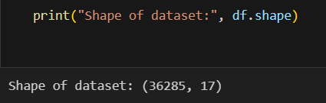
Q2. How many rows and columns are there?
Answer: We used df.shape to get the dataset dimensions.

Slide 4

Q3. What are the given columns?
Answer: We used df.columns.tolist() to preview the data.

Slide 5

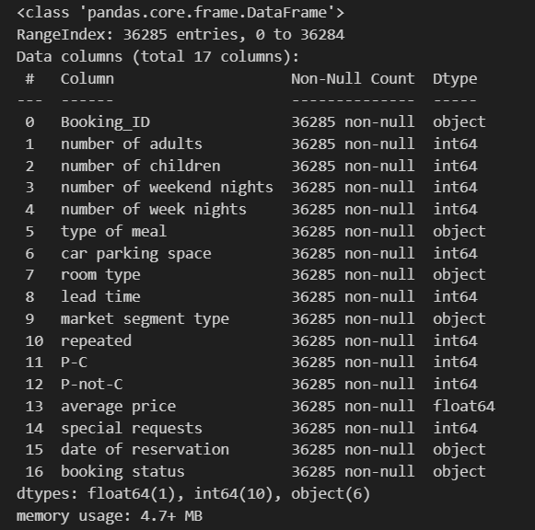
Q4. what are the given datatypes ?
We used df.info() to see the data types.

Slide 6
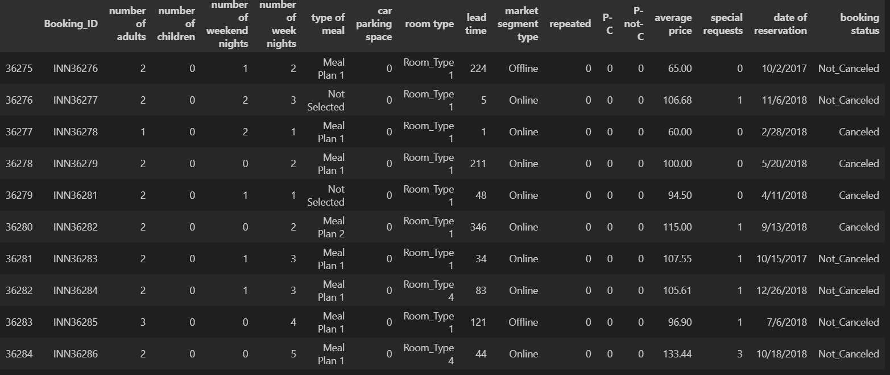


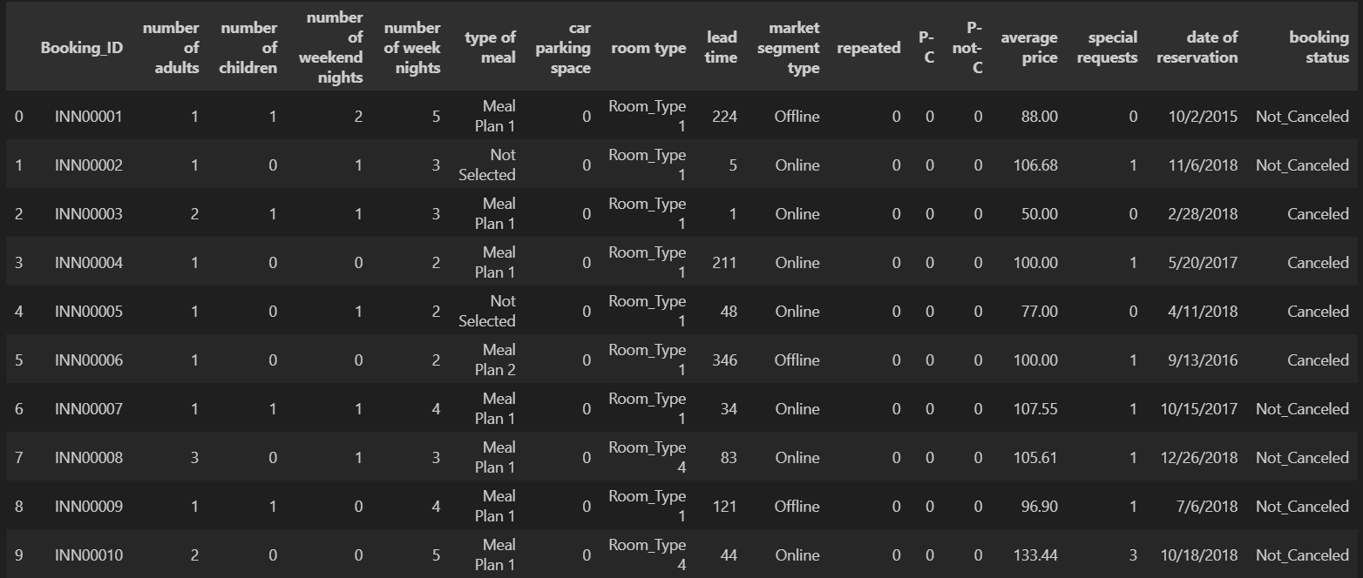
Q5.How to show the first and last five columns ?
Answer: by using df.head() and df.tail() .

Slide 7


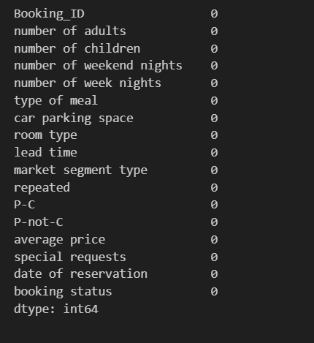
Q6. Are there missing values?
Answer: We checked df.isna().sum() to count missing values.

Slide 8


Q7. How to check for duplicates
Answer: by using df.duplicated().sum() to count the sum of duplicates.

Slide 9

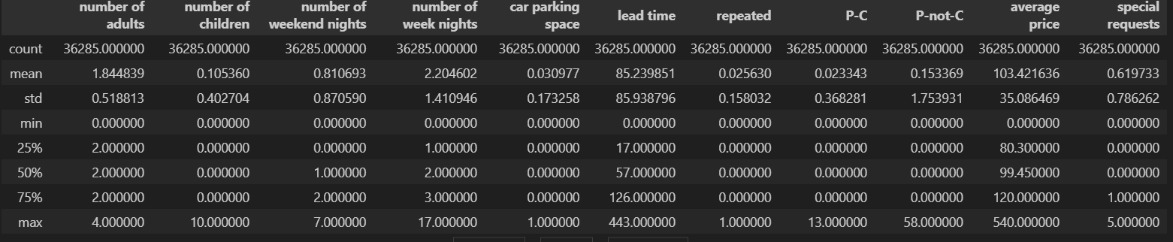
Q8. What basic statistics describe the data?
Answer: We ran df.describe() to summarize numeric columns.

Slide 10
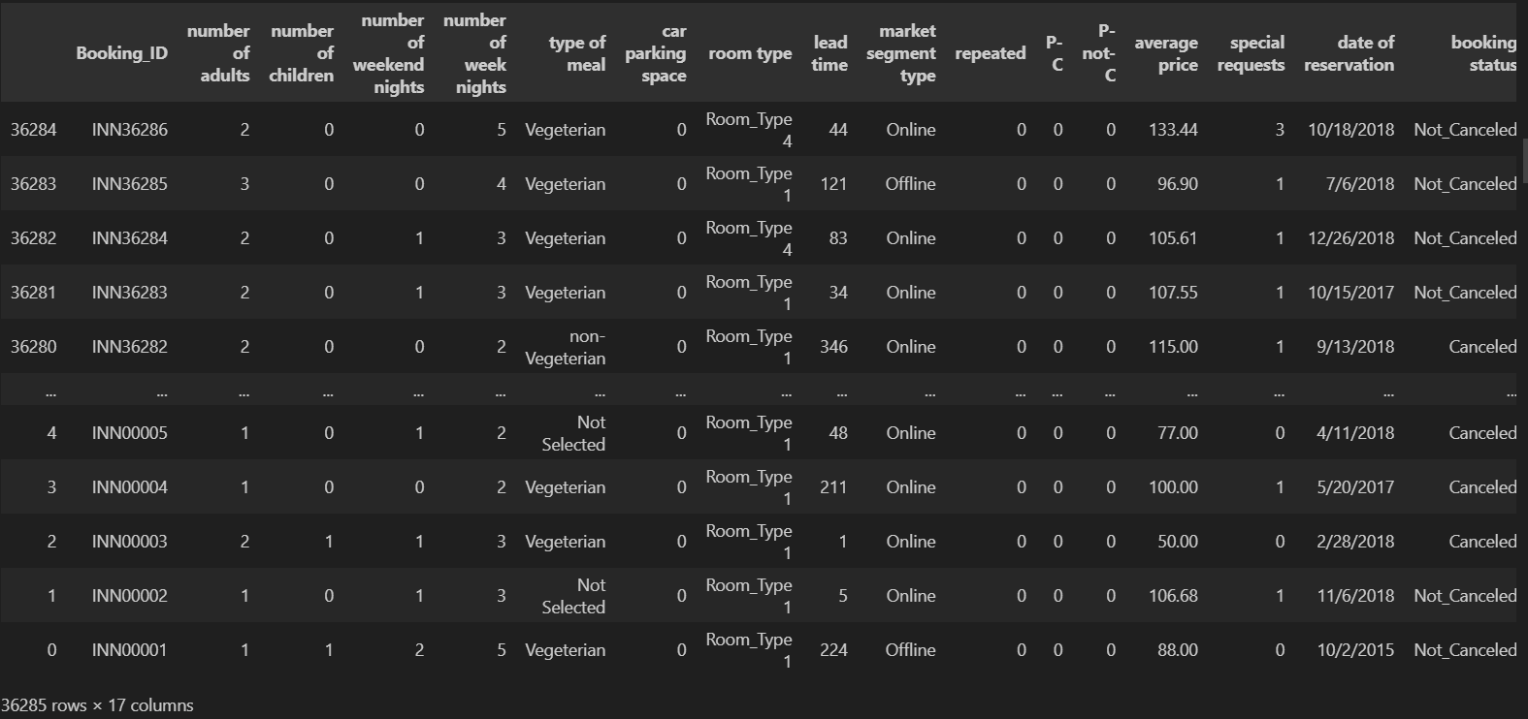

Q9. How to sort Descendingly ?
Answer: using df.sort_index(ascending=false).

Slide 11
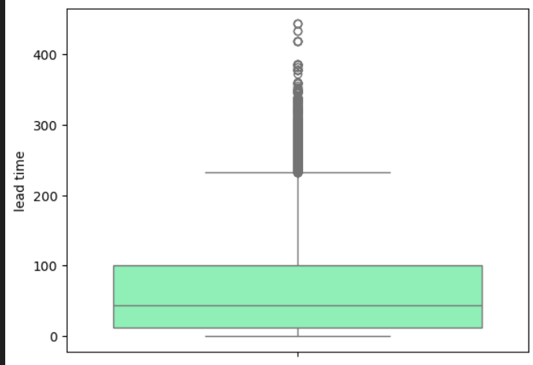
Q10. How to check for the most concentrated areas ?
Answer: using sns.boxplot().

Slide 12
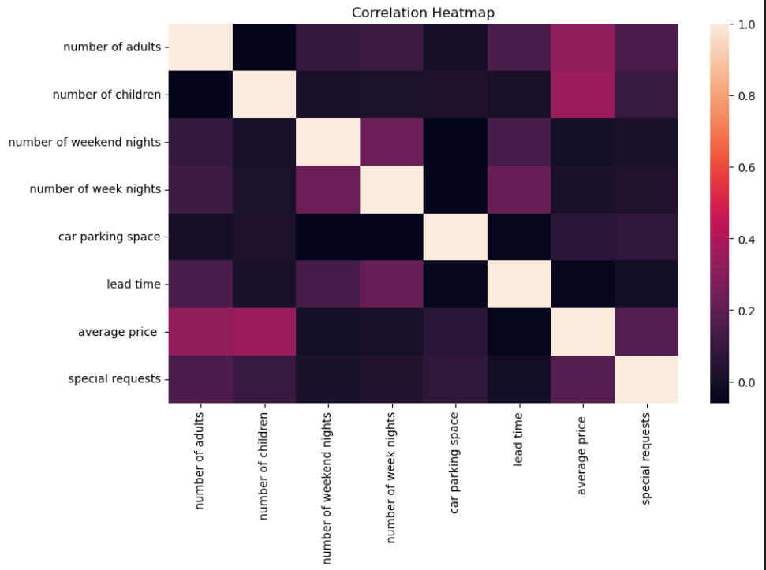
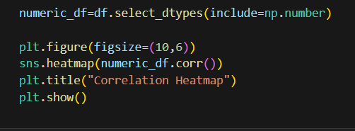
Q11. How to plot a heatmap ?
Answer: using sns.heatmap() but we must select the numeric datatypes first.

Slide 13
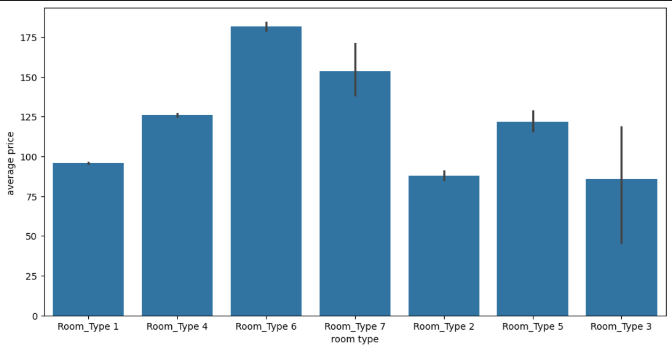

Q12. What simple visualization did we generate?
Answer: We plotted a quick chart using sns.barplot() to visualize a key relationship.

Slide 14
Thank you

