Slide 1

Intro to JavaScript

Slide 2

SUMMARY
1
What is JavaScript?
2
How to import JavaScript?
3
JavaScript Data Types
4
Booleans : Truthy vs Falsy
5
JavaScript Operators
6
JavaScript special characters
7
JavaScript Conditionals
8
JavaScript Loops

Slide 3
What is JavaScript?

Slide 4

JavaScript is a very powerful client-side scripting language developed by Brendan Eich in 1995.
JavaScript is used mainly for making a webpage more lively and interactive for the user.
Being a scripting language, JavaScript cannot run on its own. The browser is responsible for running JavaScript code.
JavaScript is also being used widely in game and Mobile application development.

Slide 5
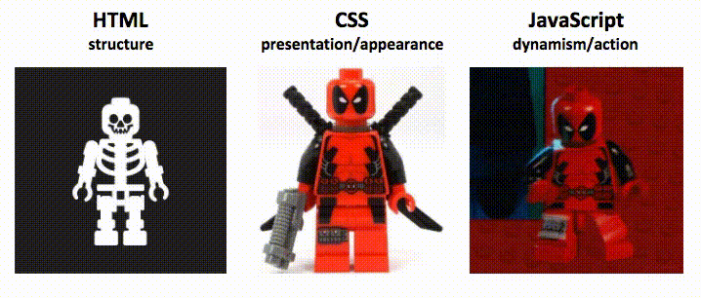
Notes:
Javascript yrod la page dynamique

Slide 6
How to import JavaScript?

Slide 7
Internal Javascript
Javascript code between two <Script> </Script> tags.
<script>
document.getElementById("demo").onclick = function(){
alert("Hello")};
</script>
External Javascript
Javascript code placed in a file separate from the HTML code
<script src=“index.js" type="text/javascript"></script>
Notes:
Both this methods can be put in the head and body section of a html page, but preferably we should put them before closing the body tag Because if we put them before ya7dhrou 9bal matetrandar la page mte3na donc yexecuti el code 3la 7aja mezelet mafamech
Famma defer lel lien externe w famma 'DOMContentLoaded’ lel lien interne

Slide 8
JavaScript Data Types
Notes:
It is the easiest yet most important language in web development.

Slide 9
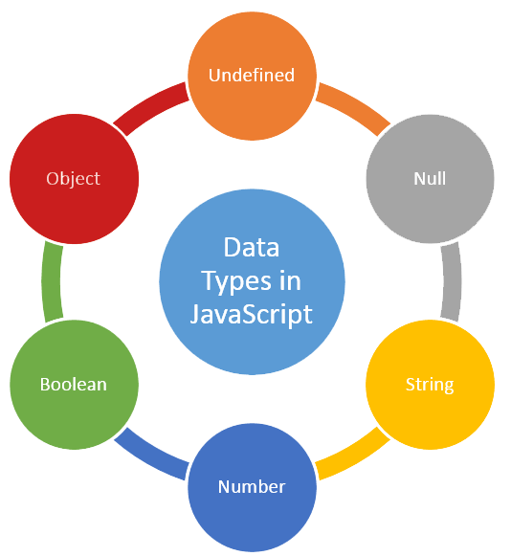
undefined
Arrays [1,2,”hi”]
Functions
Objects
{ name: ‘Salah’,
Age: ‘25’ }
null
Complex
property
value
Simple / Primitive
“hello”
“true”
“éhg&-éf ”
‘23’
`javascript`
true
false
1
0.2563
Notes:
Try in console typeof

Slide 10
Booleans : Truthy vs Falsy

Slide 11
There are SIX falsy values in JavaScript:
false
undefined
null
Everything else is truthy!!
0
‘’ (empty string)
NaN

Slide 12
JavaScript Operators

Slide 13
ARITHMETIC OPERATORS
Arithmetic operators are used to perform mathematic operations between numbers or strings.
+ | - | * | / | % | ++ | -- | **

Slide 14
EQUALITY OPERATORS
= assigns a value to a variable
== compares the value of the variables
=== compares the value and type of the variables
!= compares the inequality based on value
!== compares the inequality based on value and type
Notes:
SHOW THE NAVBAR, the text and the skills in both pages

Slide 15
LOGICAL OPERATORS
X && Y
X || Y
Returns first value if falsy
Returns first value if truthy
Notes:
SHOW THE NAVBAR, the text and the skills in both pages

Slide 16
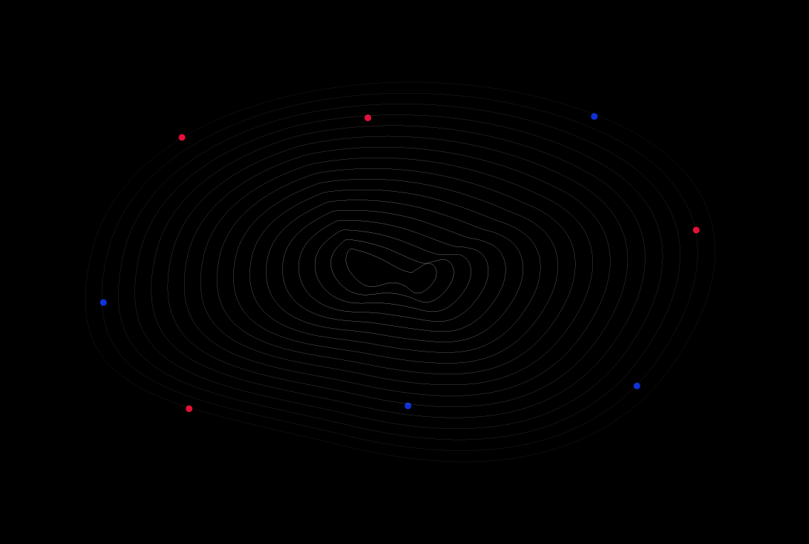
Thank You

