Slide 1
MY VISION & MY MISSION
Presented by:
KARIM EL-BAWAB

Slide 2


Slide 3

Introduction

Slide 4
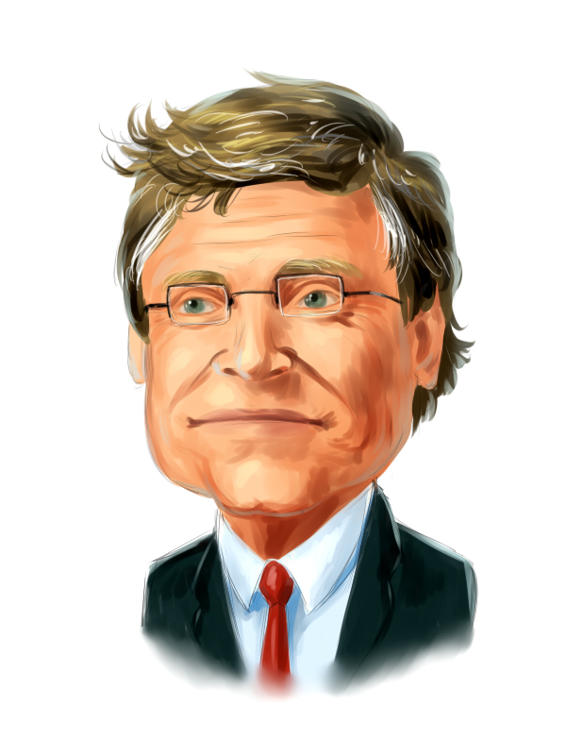

Slide 5
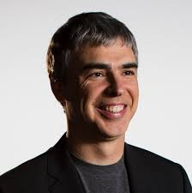

Slide 6
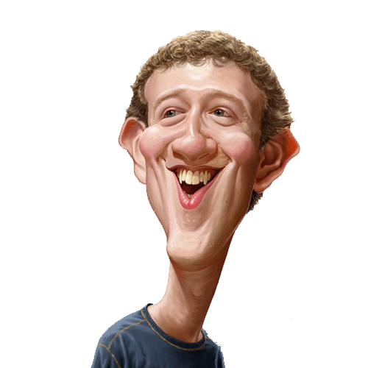

Slide 7
Google
Facebook
Microsoft

Slide 8
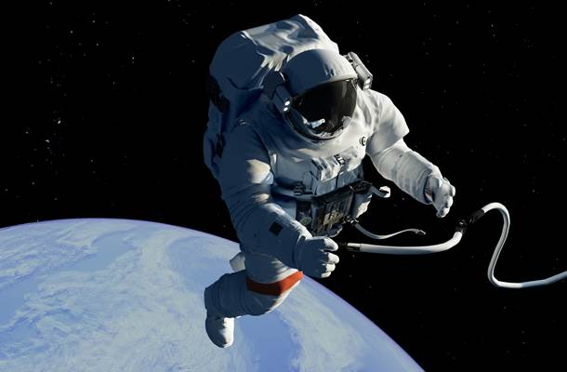



Slide 9
Why Wonderlearn ?

Slide 10
THANK YOU

