Slide 1
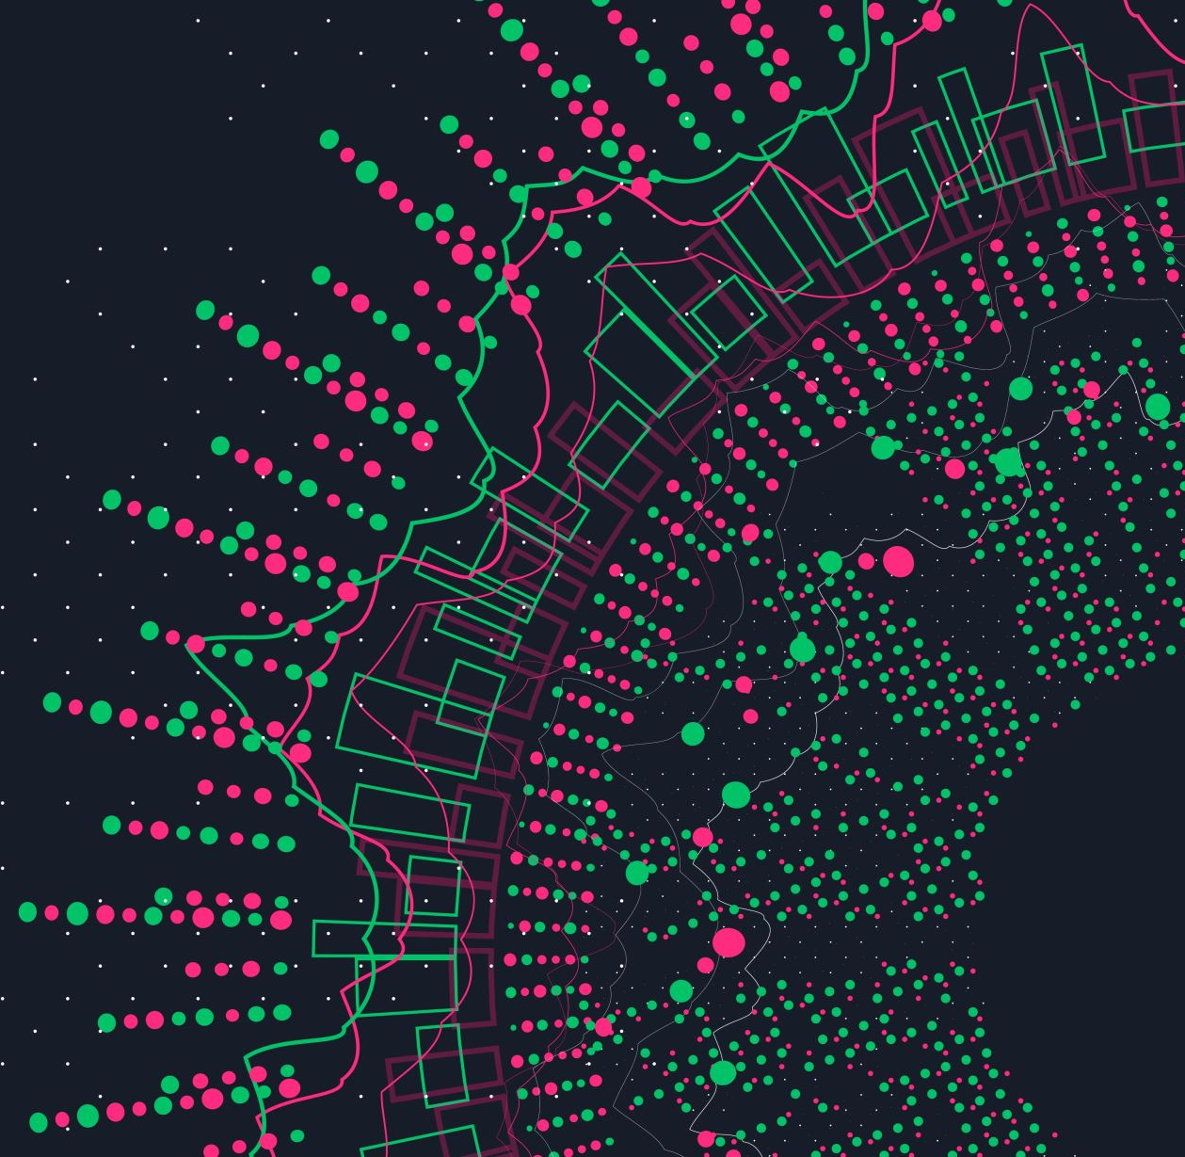
Maze Solver Agent
Mohamed Elsayed

Slide 2

Introduction
The goal of this project is to develop an AI agent able to solve a maze game. In order to do it, I implemented a searching algorithm. This approach consists in giving the system a fully defined problem (all states, available action in each state , cost, goal ).

Slide 3
Requirement
This project requires Python 3.6 installed
To run the game, execute in the “maze game” folder: maze.py

Slide 4

PA
Precepts : the position of robot.
Actions : move the robot up, down, left, and right.

Slide 5

PEAS
Performance measure: reach the goal with shortest path
Environment: maze board.
Actuators: left , right, up and down.
Sensors: position of the robot.

Slide 6
Agent
Agent type : Goal based agent.
Environment type: static , fully observable, deterministic, sequential , discrete, single agent .
Search strategy : uninformed search (breadth first search).

Slide 7
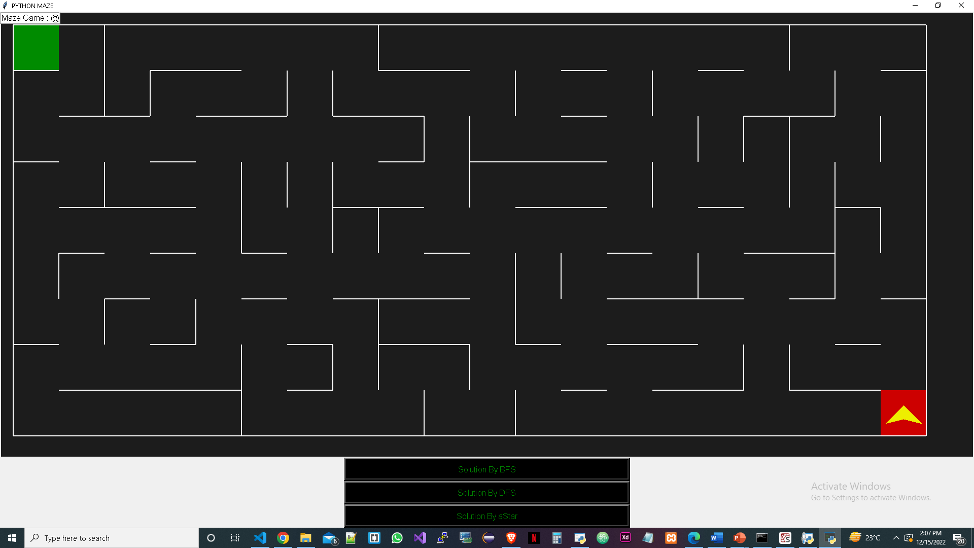
screenshots

Slide 8
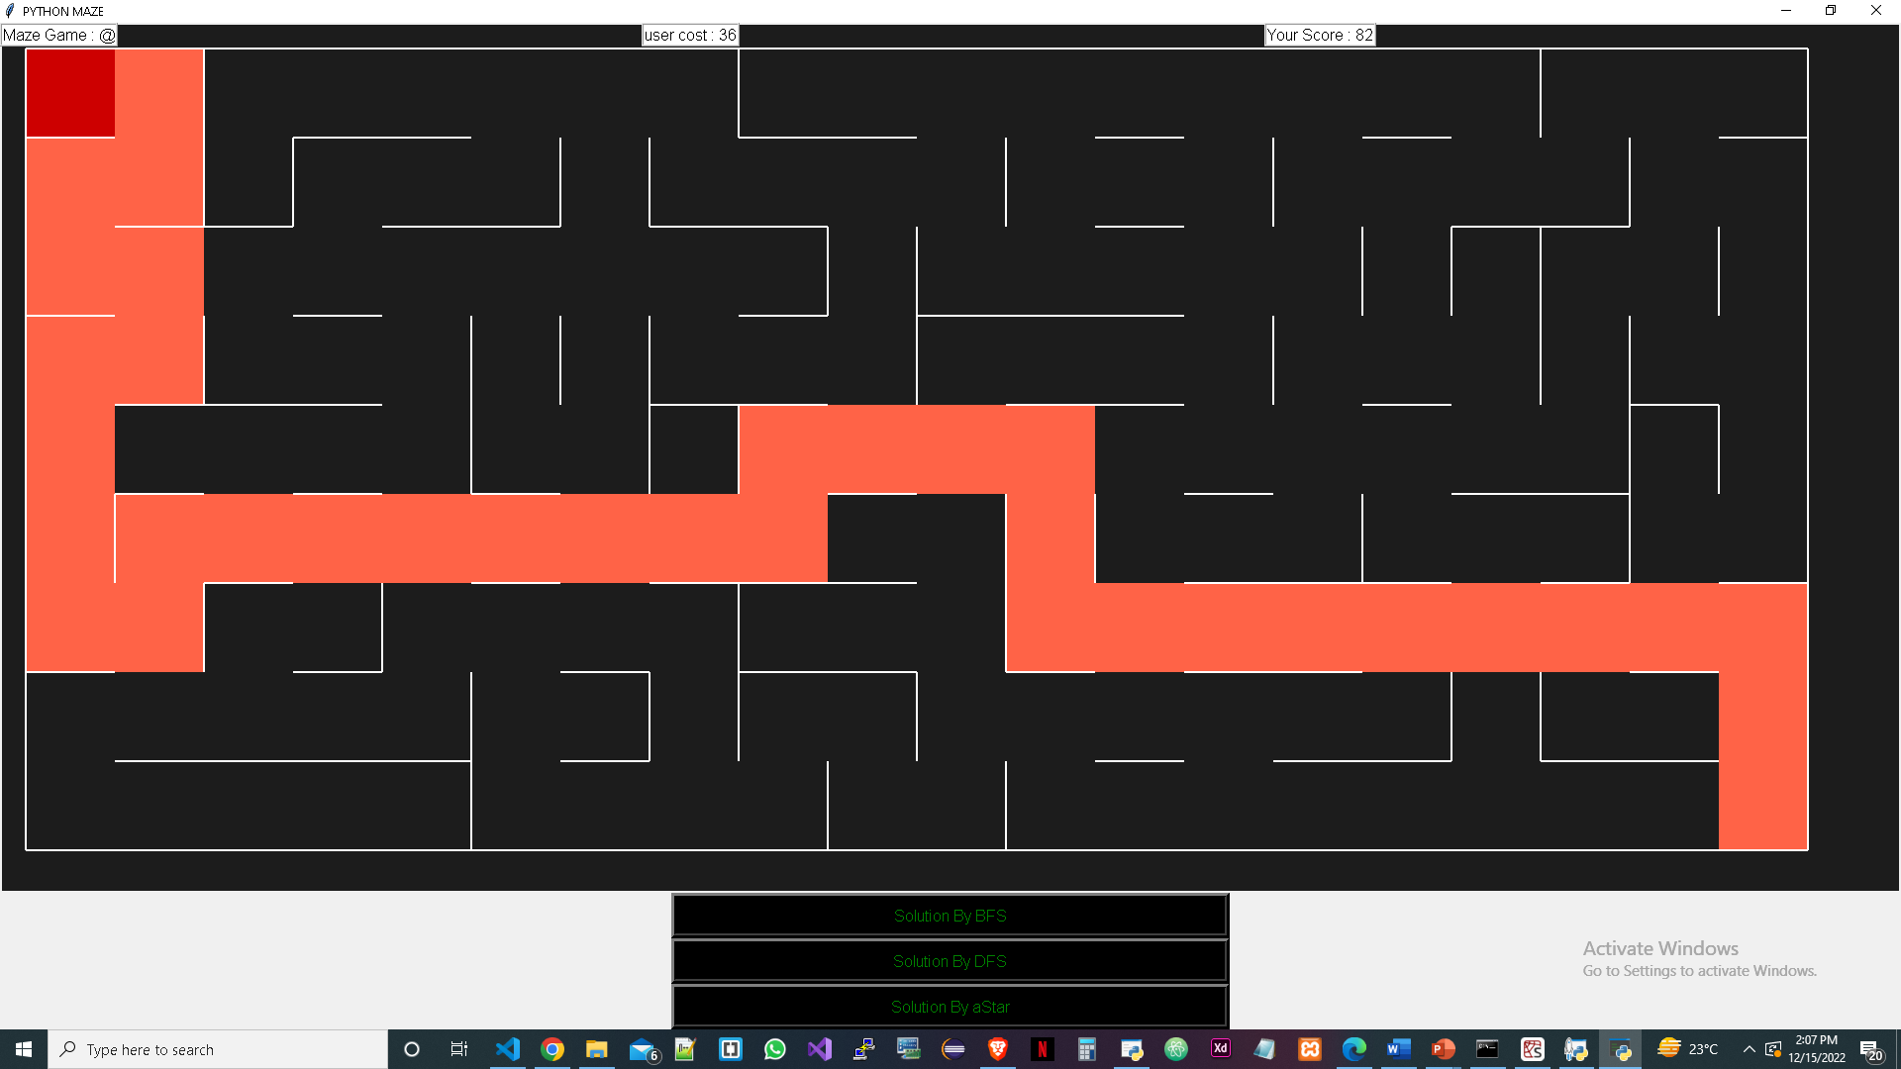
User Solution by arrow

Slide 9
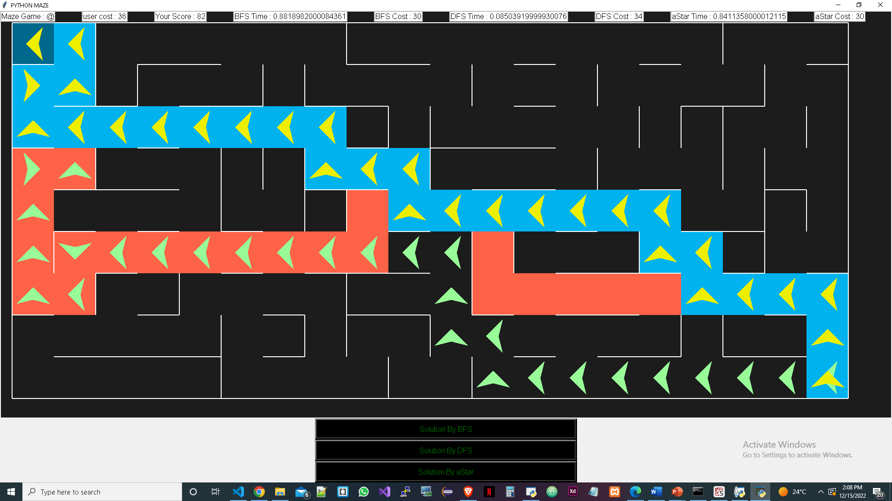
After all searching type solution

