Slide 1
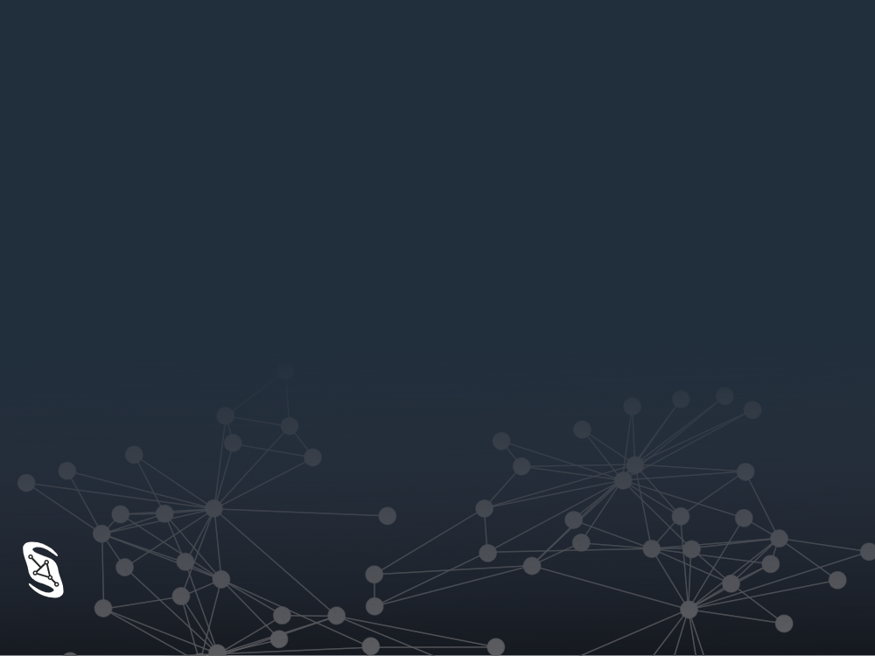
Nebula
Enabling AI for Healthcare with Federated Analytics
Sideral
AI Action Summit Hackathon AI for One Health
February 16th, 2025

Slide 2
Introduction
AI

Slide 3

Introduction
Data
AI

Slide 4
Introduction
Data Access
Data AI

Slide 5
Introduction
AI needs better access to data!

Slide 6
Healthcare Data in France
Nationwide statistics ?
encourage collaboration
ensure data coherence
link with other fields
protect security and privacy

Slide 7
Our Approach
in-house algorithms
P2P and adapters
centralized and decentralized deduplication
standardized data formats
enable building novel standards

Slide 8
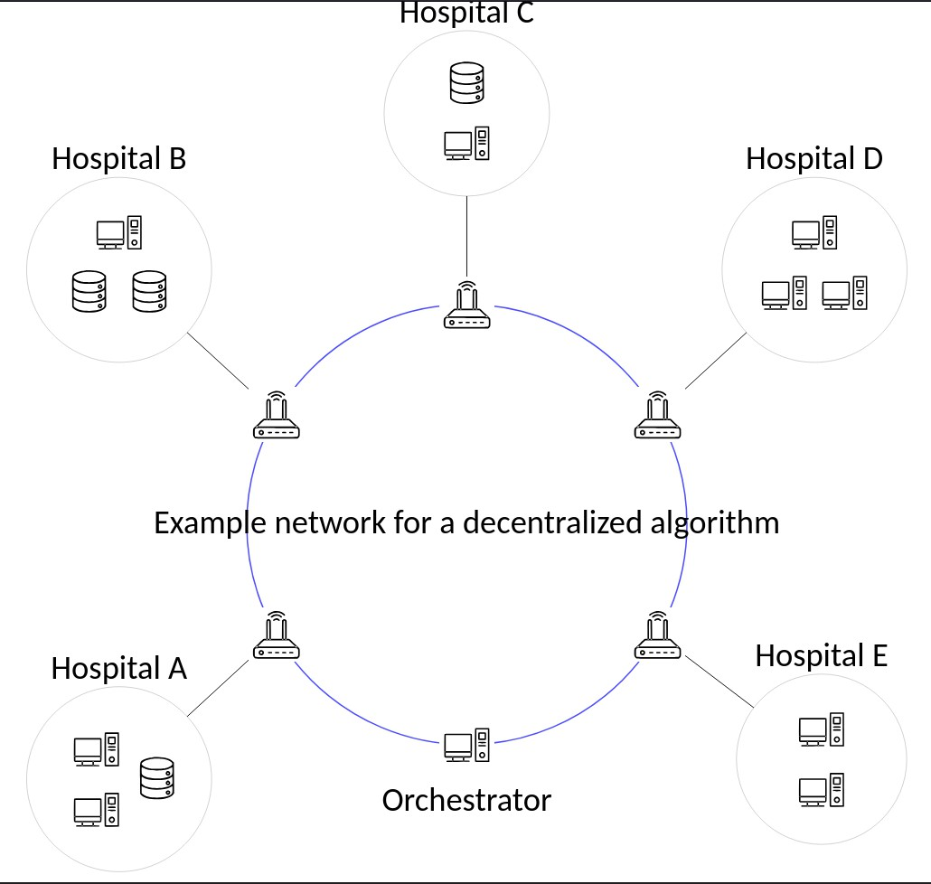
Example algorithm: histogram aggregation

Slide 9
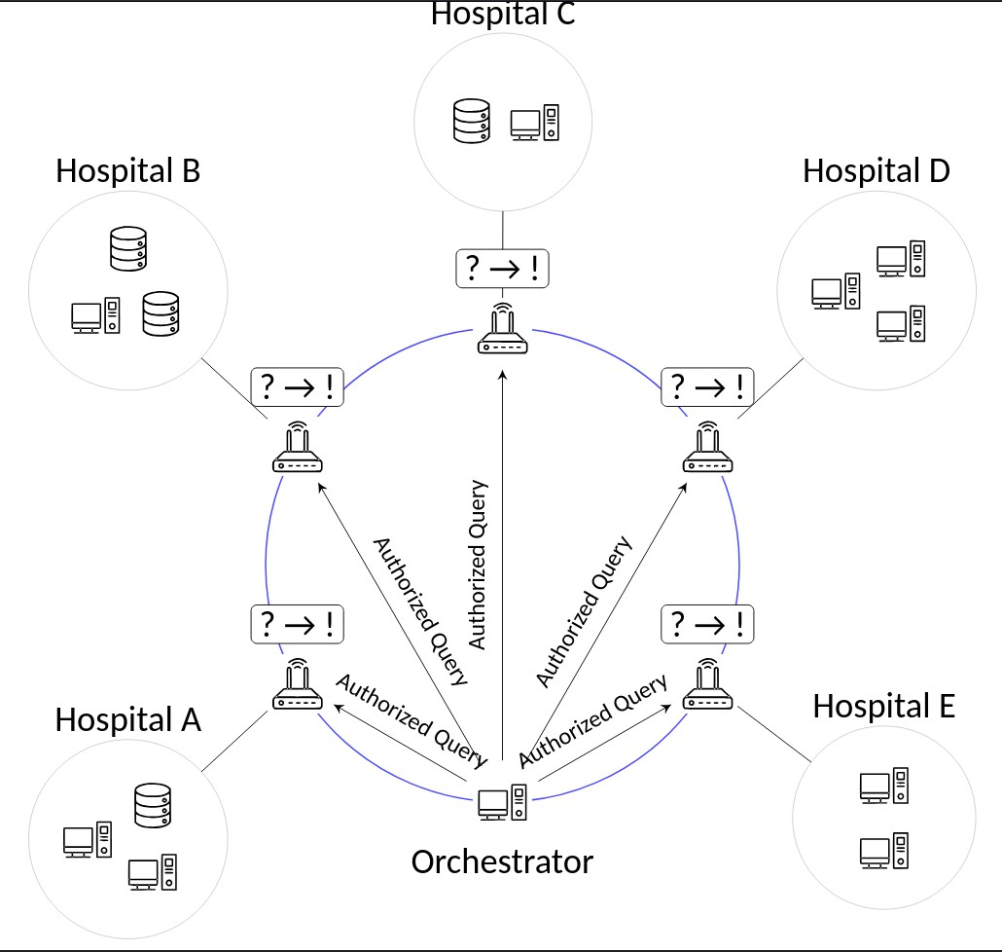
Example algorithm: histogram aggregation

Slide 10
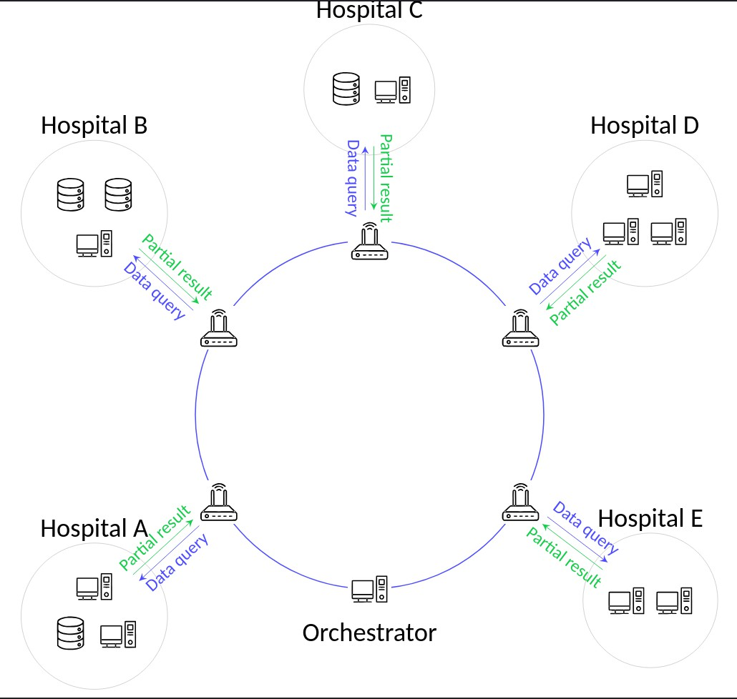
Example algorithm: histogram aggregation

Slide 11
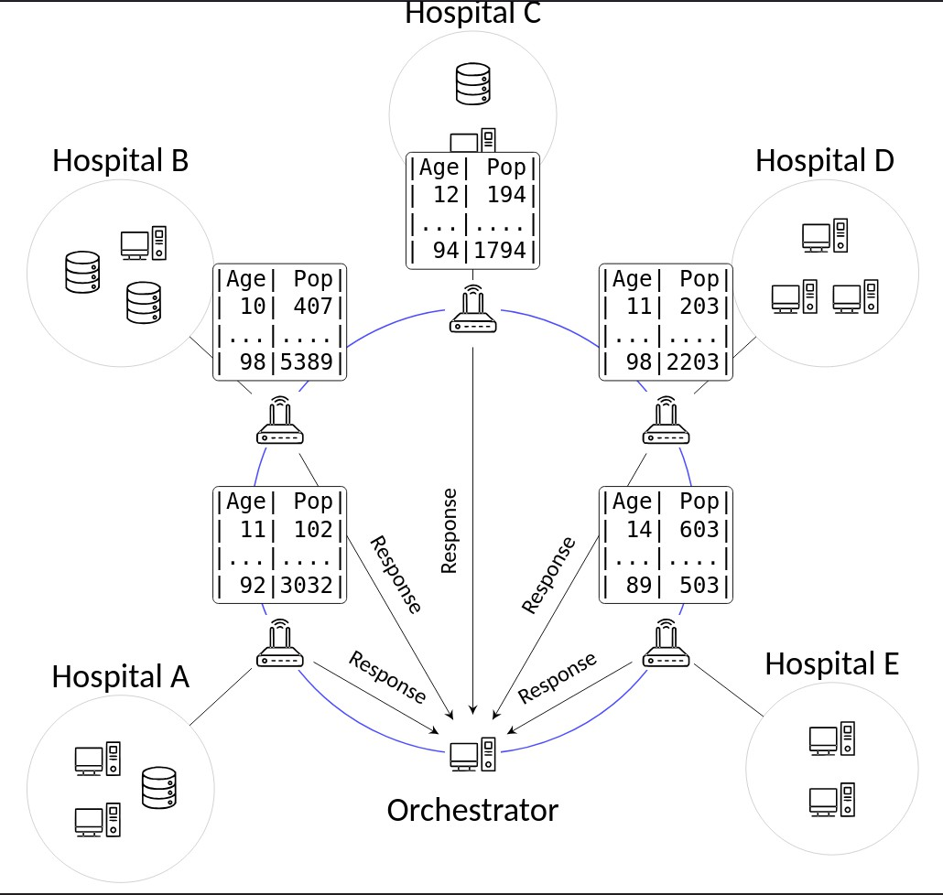
Example algorithm: histogram aggregation

Slide 12
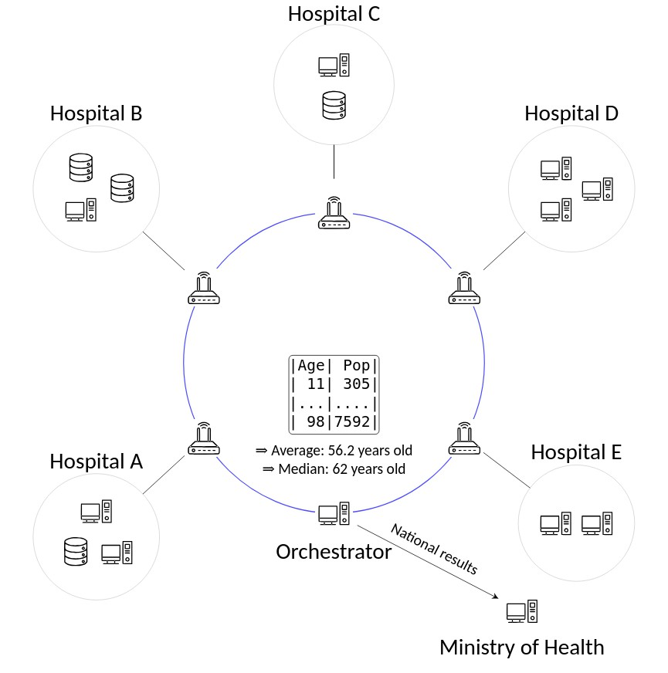
Example algorithm: histogram aggregation

Slide 13
Our solution
Nebula
A P2P cloud infrastructure platform for building federations

Slide 14
Our solution
Nebula enables:
massive interoperability
secure data collaboration
federated datasets

Slide 15
Our solution
Demo time!

Slide 16
Reach and strong points
no PII transit
extensible in scope
public-private partnerships
sovereign system AND international collaboration
facilitate data access
CNIL-approved

Slide 17
Conclusion
Thanks for listening ! Any questions ?

