Slide 1
GRADUATION PROJECT · 2025
Automated Explainable AI
for Loan Default Prediction
From raw credit data to a transparent, deployed underwriting system —
powered by LightGBM · SHAP · LIME · FastAPI · Flask
Karim Abdelmonem
Ezzeldeen · Mohamed A. · Mohamed H. · Mostafa
Live Demo
depi-loan-default-xai-frontend
.onrender.com
Repository
github.com/karimabdelmonem/
automated-explainable-ai-system

Slide 2
01 · OVERVIEW
One system, from data to decision
The Problem
The Data
Banks reject/accept loans with black-box models.
Regulators and applicants demand explanations.
255K+ real loan records · 18 features · 11.6% default rate · 7.7:1 class imbalance.
The Model
The Explanation
LightGBM tuned + threshold-optimised.
ROC-AUC 0.743 · F1 0.85 at operating point.
SHAP (global + local) & LIME wired into every prediction — live in the browser.

Slide 3
02 · PROBLEM
Why explainability is non-negotiable
A loan model that says just "denied" is a legal risk, a reputational risk, and a data-quality blind spot.
255,347
11.6%
7.7 : 1
Loan applications
Default rate
Class imbalance
Goal: build an accurate default-risk model AND surface WHY every decision was made — globally and per-applicant.

Slide 4
03 · DATASET
The raw material
Schema (18 features + target)
Source
Numeric
Age · Income · LoanAmount · CreditScore · MonthsEmployed · NumCreditLines · InterestRate · LoanTerm · DTIRatio
Kaggle · nikhil1e9/loan-default
255,347 rows · 18 columns
Zero missing values · zero duplicates
Ordinal
Education (HS → PhD)
Nominal
EmploymentType · MaritalStatus · LoanPurpose
Signal quality
Binary
HasMortgage · HasDependents · HasCoSigner
Strongest raw correlations with default:
• Age (−0.17) • InterestRate (+0.13)
• CreditScore (−0.20) • DTIRatio (+0.09)
Raw signal is weak — feature engineering does the heavy lifting.
Target
Default (0 / 1)

Slide 5
04 · CLEANING
Preprocessing pipeline
01
02
03
04
Drop ID
Binary encode
Duplicates & NaN
Outliers
LoanID has no predictive value
Yes/No → 1/0 on 3 columns
0 missing · 0 duplicates confirmed
Isolation Forest ∩ LOF — high-confidence only
05
06
07
08
Log-transform
Encode categoricals
Split 70 / 15 / 15
SMOTETomek + Scale
Income, LoanAmount (skewness ≈ 2.0)
Education ordinal · rest one-hot
Stratified · test set touched once
Train only — no leakage

Slide 6
05 · FEATURE ENGINEERING
Composite risk signals
Raw features have weak signal (max |corr| ≈ 0.20). Engineered ratios capture the interaction of risk drivers.
Feature
Formula
Meaning
loan_to_income
LoanAmount / Income
Affordability
employment_ratio
MonthsEmp / (Age×12)
Job stability × age
monthly_payment_est
LoanAmt × Rate / (Term×12)
Estimated burden
payment_to_income
monthly_pay / (Inc/12)
Real pressure
debt_burden_score
DTI × InterestRate
Combined stress
risk_score
0.4·(1−CS) + 0.35·DTI + 0.25·Rate
Composite signal
high_risk_flag
DTI>0.45 AND CS<600
Double-risk pattern
is_very_high_risk
CS<580 AND DTI>0.4 AND Rate>15
Triple-risk flag
creditscore_band
cut(CS, [300,580,670,740,850])
Non-linear tiers

Slide 7
06 · EDA
What the data actually says
88.4 / 11.6
Class split — moderate imbalance
300–850
CreditScore is the top raw predictor
Skew ≈ 2.0
Income & LoanAmount are heavy-tailed
0 nulls
Dataset arrived clean — rare luxury
Key EDA takeaway
Univariate distributions are healthy but no single feature separates defaulters from non-defaulters cleanly. This confirms that a non-linear model (LightGBM) with engineered interaction features is the right approach — a linear model bottoms out around ROC-AUC 0.68.

Slide 8
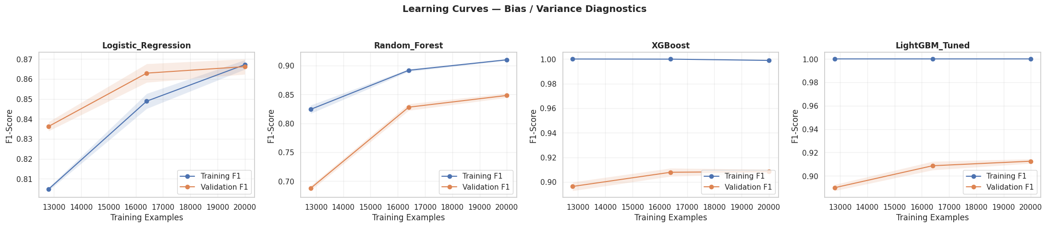
07 · DIAGNOSTICS
Learning curves & bias/variance
Reading the curves
• Tree models converge fast — plateau after ~40% of data
• Small train/val gap → no severe overfit
• LightGBM & XGBoost dominate the linear baseline early
• Deep MLP needs SMOTE + longer patience to catch up

Slide 9
08 · MODELS
Ten trained · three families
Linear baseline
Tree-based (imbalance-aware)
Deep learning
• Logistic Regression
• Random Forest
• XGBoost (scale_pos_weight)
• LightGBM (class_weight)
• Tabular MLP (baseline)
• Optimised MLP 512→256→128→64
Tuned & re-sampled
Ensemble
• LightGBM_Tuned (RandomizedSearchCV)
• LightGBM_ValEarlyStop
• LightGBM_SMOTE
• Soft-voting: LGBM + XGB + MLP

Slide 10
09 · LEADERBOARD
Final results, F1-optimal threshold
Model
Threshold
Accuracy
F1
ROC-AUC
Tabular_DL_Optimized
0.2283
0.8019
0.8217
0.7413
Tabular_DL
0.2606
0.7886
0.8134
0.7424
LightGBM
0.2082
0.7858
0.8113
0.7428
LightGBM_Tuned
0.1865
0.7838
0.8096
0.7332
LightGBM_SMOTE
0.1865
0.7838
0.8096
0.7332
XGBoost
0.2073
0.7747
0.8038
0.7394
Ensemble_Soft_Voting
0.2595
0.7711
0.8011
0.7346
LightGBM_ValEarlyStop
0.1811
0.7670
0.7991
0.7385
Logistic_Regression
0.3662
0.7683
0.7961
0.6801
Random_Forest
0.3645
0.7345
0.7751
0.7138
★ LightGBM chosen as production model — best ROC-AUC (0.7428), competitive F1, fast inference, native SHAP support.

Slide 11
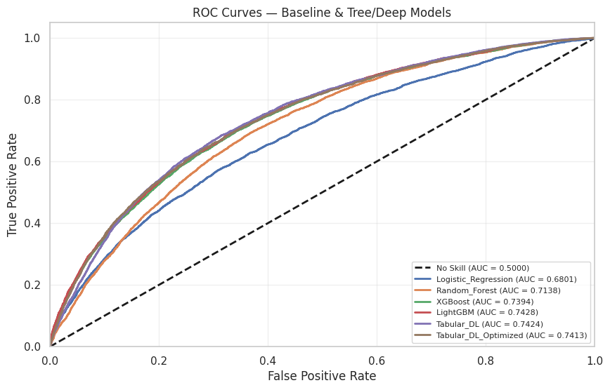
10 · EVALUATION
ROC curves — all baselines
Why ROC-AUC?
Class imbalance breaks accuracy — a naive model scores 88%.
ROC-AUC measures rank quality independent of the threshold — the honest way to compare defaulter-detection ability.
LightGBM AUC 0.743
XGBoost AUC 0.739
Logistic AUC 0.680

Slide 12
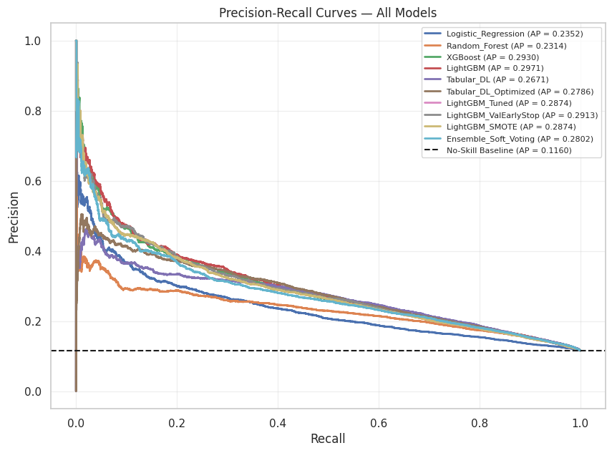
11 · EVALUATION
Precision–Recall — minority class
PR beats ROC here
At 11.6% positive rate, Precision–Recall exposes the real trade-off cost banks pay:
• High recall → catches defaulters, but rejects good customers
• High precision → clean approvals, but misses risk
The operating threshold is chosen ON the validation set — never on test.

Slide 13
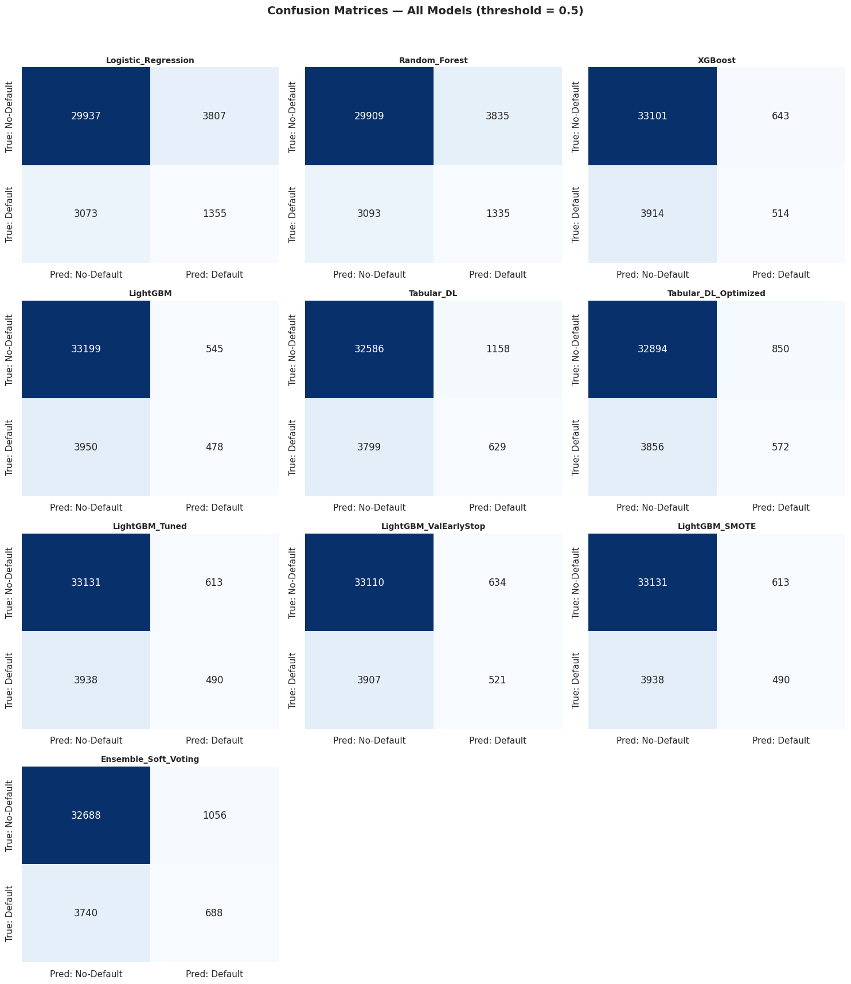
12 · EVALUATION
Confusion matrices · all models

Slide 14
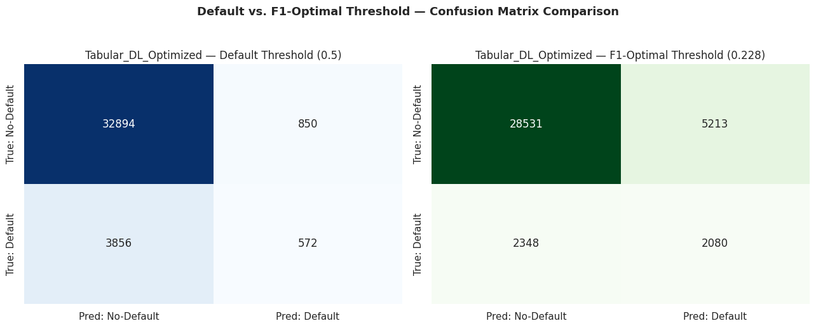
13 · THRESHOLD
F1-optimal threshold shifts everything
Why not 0.5?
With 11.6% positives, the default 0.5 cut-off is far too conservative.
Sweeping the threshold and maximising F1 on validation gives:
LightGBM → 0.208
Tabular DL → 0.228
Logistic → 0.366
Recall for defaulters jumps from ~15% → ~50%, at the cost of some false alarms — the right trade for a bank.

Slide 15
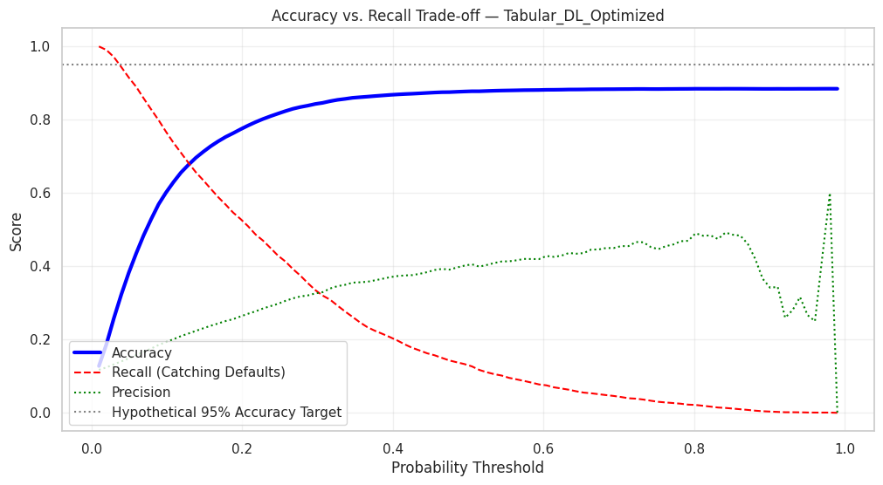
14 · TRADE-OFF
Accuracy vs recall — pick a business point

Slide 16
15 · MODEL CHOICE
Why LightGBM won
1
Highest ROC-AUC
2
Fast inference
3
SHAP-native
0.7428 — best rank quality across the leaderboard
< 15 ms per prediction — fits FastAPI request budget
TreeExplainer runs in O(TLD²) — real-time explanations
4
Handles imbalance
5
Small artifact
6
Interpretable ceiling
class_weight='balanced' beats naive SMOTE-only
Model < 5 MB — cheap to deploy on Render free tier
Tree structure lets analysts audit splits by hand

Slide 17
16 · XAI
Explanation pipeline
Input
Preprocess
Predict
Explain
Render
18 raw applicant fields
via web form
Same scaler +
feature engineering
LightGBM
probability + class
SHAP TreeExplainer
+ LIME tabular
Interactive dashboard
+ AI credit officer
Every prediction returns four artefacts: probability, decision, SHAP contributions (JSON), LIME explanation (HTML/JSON). The frontend renders all four in a single request-response cycle.

Slide 18
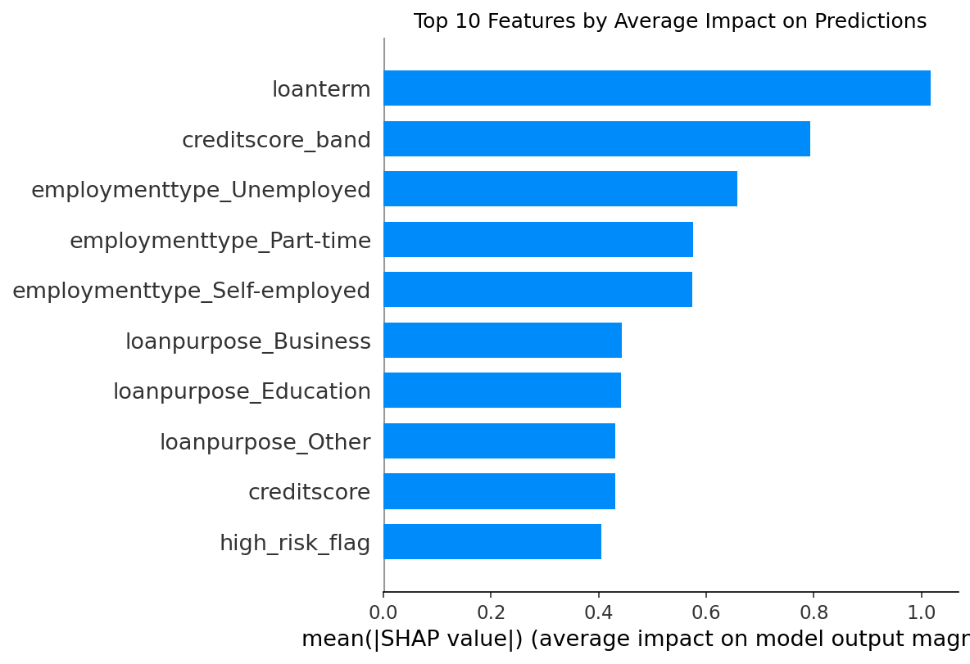
17 · SHAP · GLOBAL
Feature importance — what drives risk overall
Top drivers
The engineered features dominate.
• risk_score
• debt_burden_score
• payment_to_income
• InterestRate
• CreditScore
Validates the feature-engineering hypothesis: composite signals beat raw fields.

Slide 19
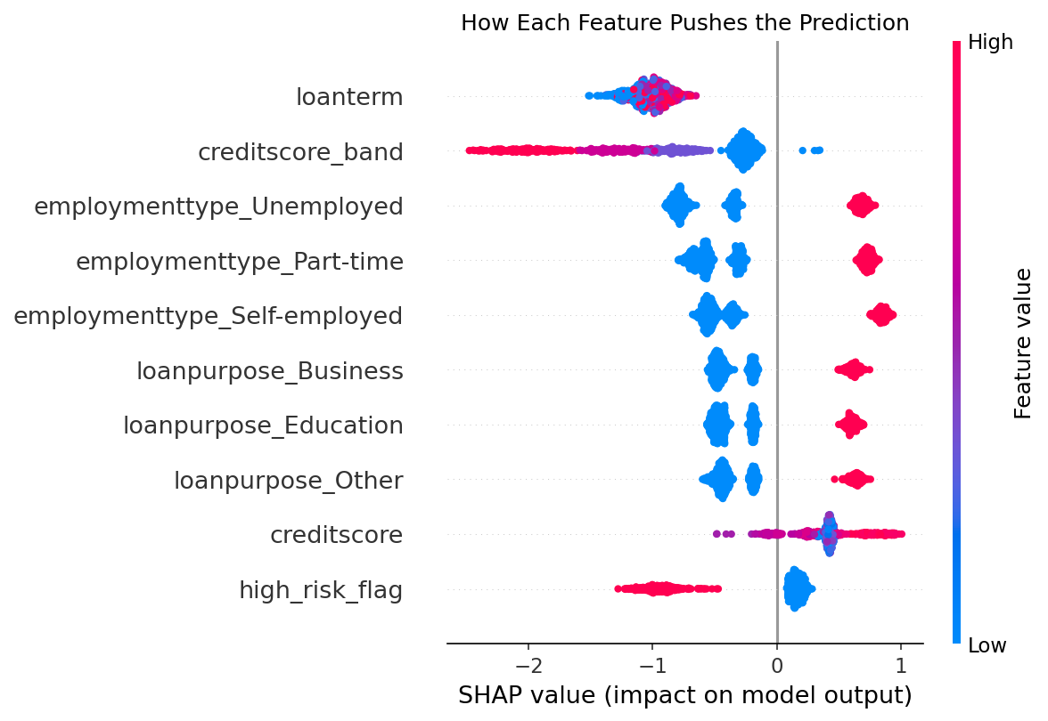
18 · SHAP · BEESWARM
Directionality of each feature
Reading the swarm
• Each dot = one applicant
• X-axis = SHAP value (impact on default probability)
• Color = raw feature value (red high, blue low)
High risk_score (red, right) → strong push toward default.
High CreditScore (red, left) → protective.
The model's reasoning matches domain intuition.

Slide 20
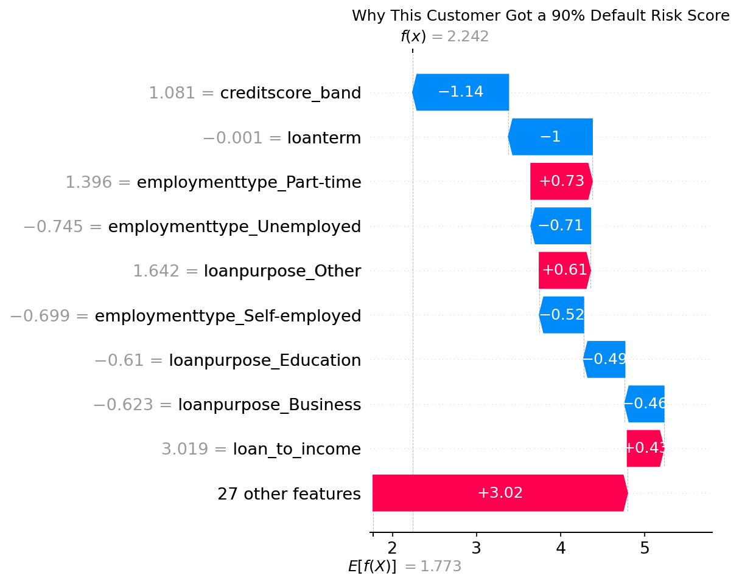
19 · SHAP · LOCAL
One applicant, decomposed
Waterfall = audit trail
Base value E[f(x)] + contributions = final prediction.
Every bar is a legally defensible reason for the decision — the exact quantity a regulator or an applicant can ask for.
This panel is embedded in the live app, per prediction.

Slide 21
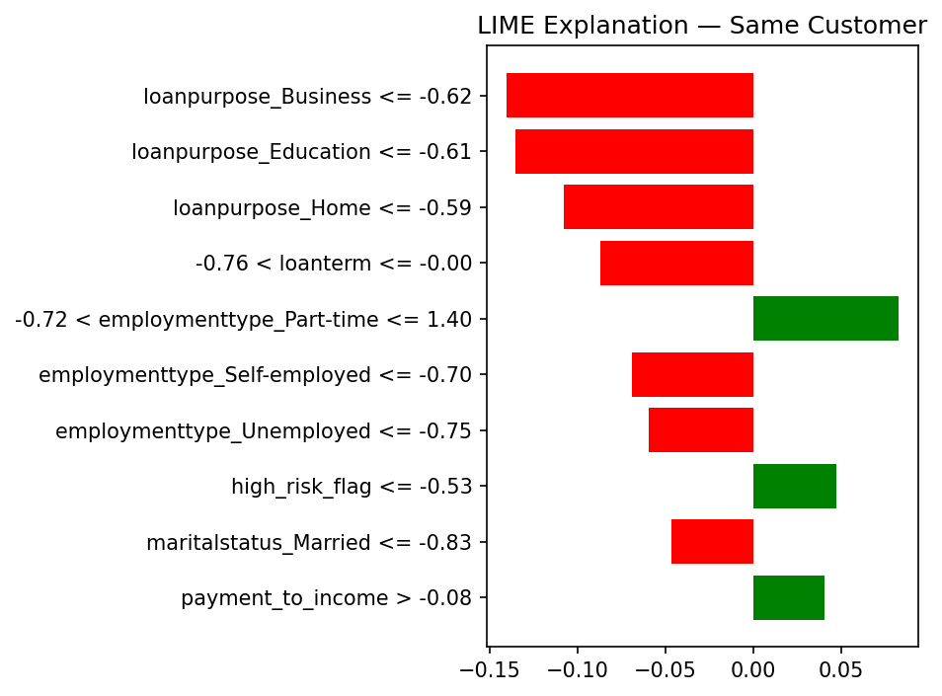
20 · LIME
Local surrogate — a second opinion
Why both?
SHAP: exact, additive, expensive.
LIME: fast, approximate, model-agnostic.
Agreement between the two increases confidence.
Both run at request time; the frontend flags disagreement so analysts can dig in.

Slide 22
21 · WORKFLOW
End-to-end request path
1
User submits form
18 fields · /result POST
2
Flask serialises payload
JSON → FastAPI /predict
3
Backend rebuilds features
Same scaler.pkl · engineered cols
4
LightGBM.predict_proba
probability + class @ tuned threshold
5
XAI engine
SHAP + LIME on the fly
6
Dashboard renders
Score · charts · AI credit officer

Slide 23
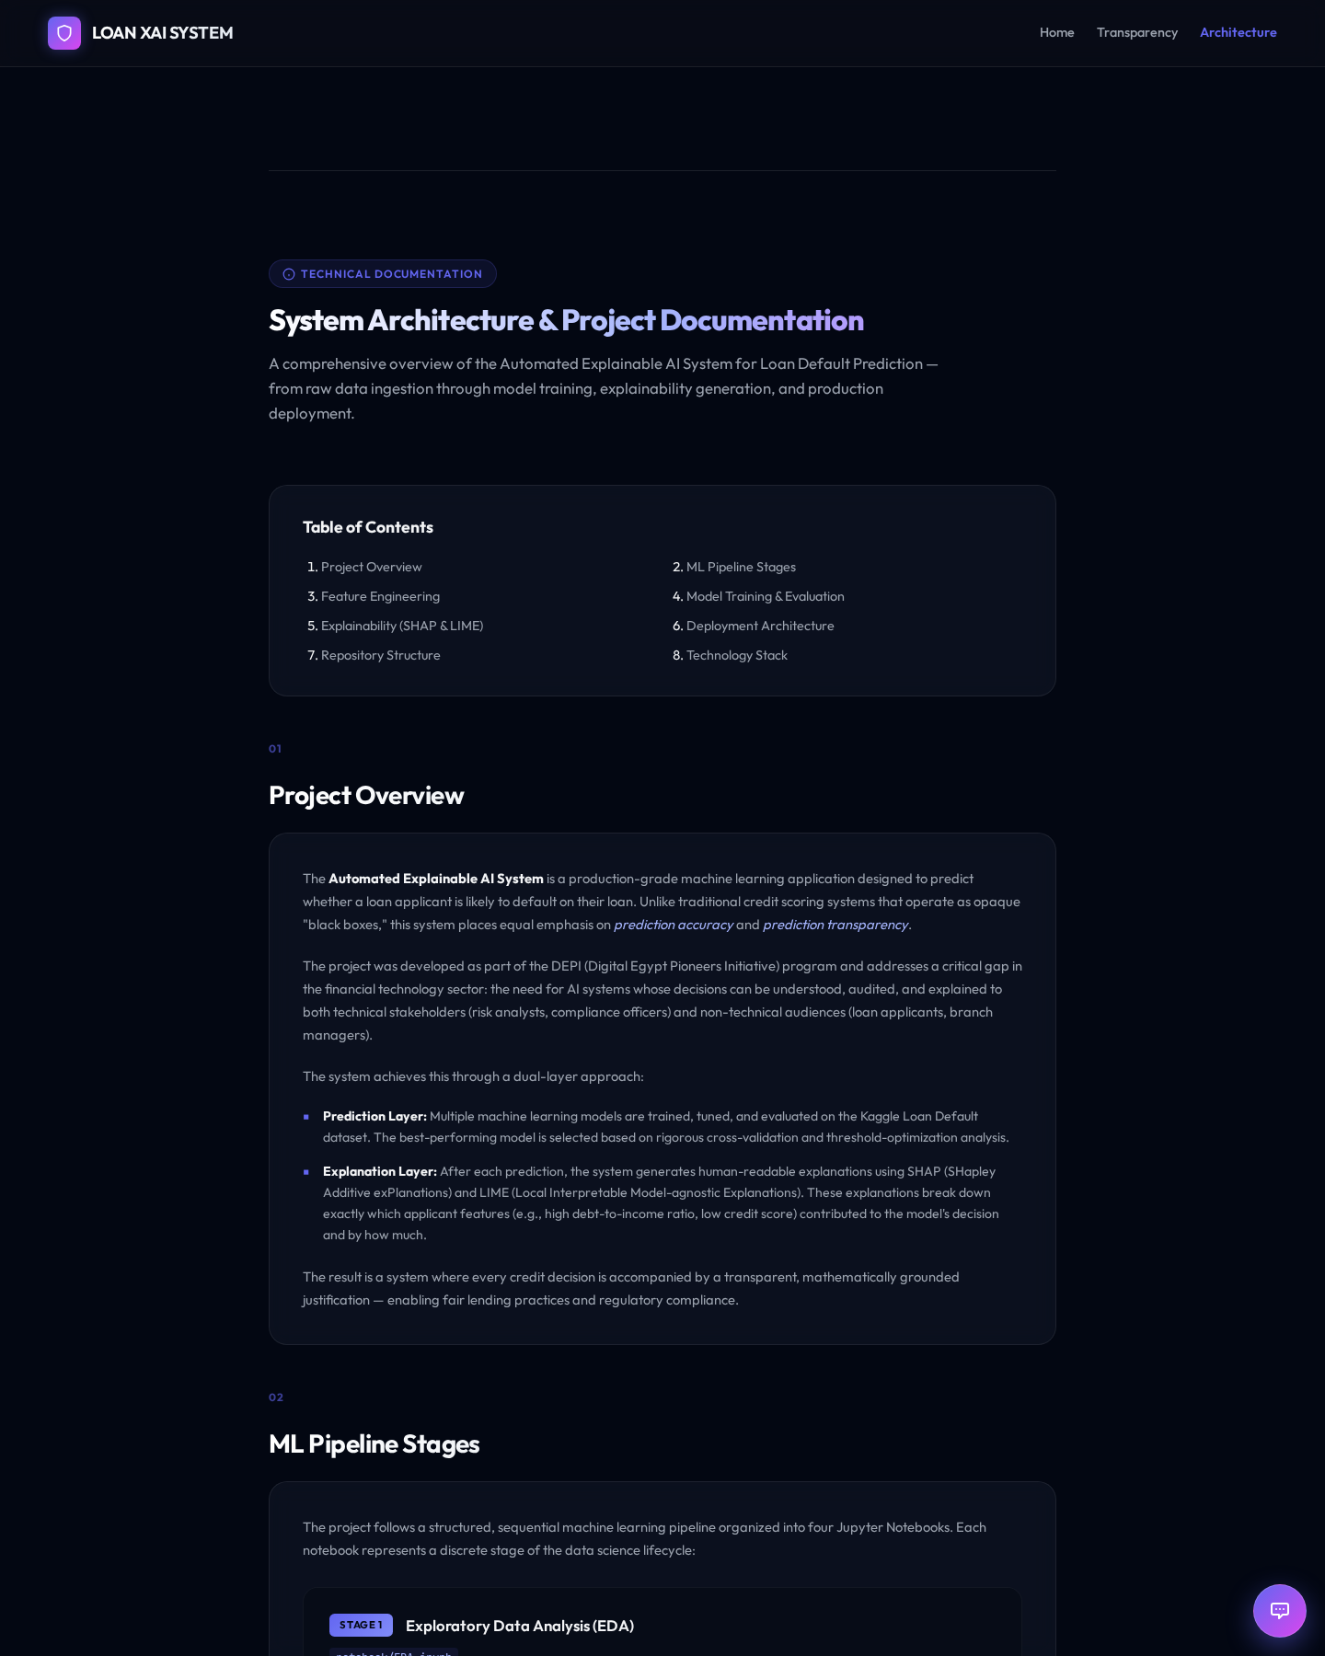
22 · SYSTEM
Website architecture
Stack
Frontend Flask · Jinja · vanilla JS Backend FastAPI · Pydantic Model LightGBM · joblib XAI SHAP · LIME Auth Supabase REST LLM Gemini (credit officer) Deploy Docker · Render

Slide 24


23 · WEBSITE
Landing page — the pitch

Slide 25


24 · WEBSITE
Landing — features & team

Slide 26
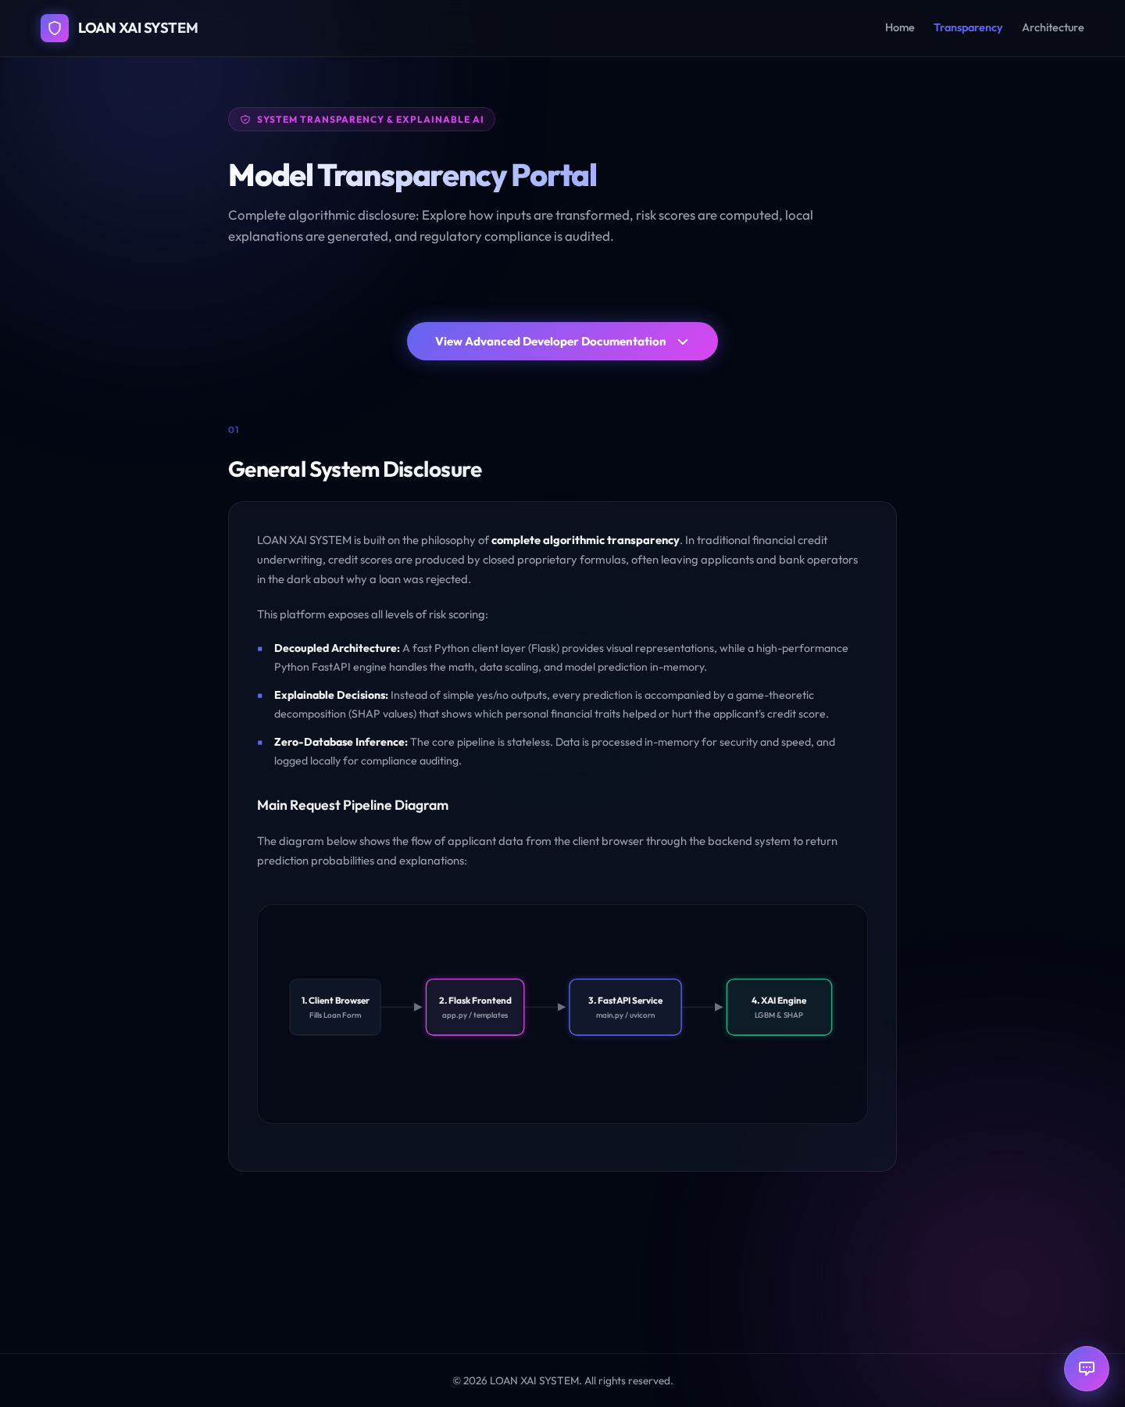
25 · WEBSITE
Transparency page — the model card
What lives here
• Model version & training date
• Global feature importance
• Data-source disclosure
• Known limitations
• Fairness notes
Giving auditors what they need before they ask.

Slide 27
26 · STACK
Technical architecture
Presentation
API layer
ML core
• Flask 3.0
• Jinja2 templates
• Vanilla JS + Chart.js
• FastAPI + Uvicorn
• Pydantic schemas
• Async request handling
• LightGBM (joblib)
• scikit-learn scaler
• 12 engineered features
Explainability
Data & auth
Infra
• shap.TreeExplainer
• lime.LimeTabularExplainer
• Reference dataset cached
• Kaggle raw CSV
• Parquet processed splits
• Supabase user auth
• Docker (frontend + backend)
• Render web services
• Gemini API for the credit officer

Slide 28
27 · CHALLENGES
What the notebooks don't show
Severe class imbalance
Weak raw signal
88 / 12 split — naive accuracy is deceiving. Solved with SMOTETomek + class_weight + threshold tuning.
Best single-feature correlation was 0.20. Fixed with 11 engineered interaction features.
SHAP latency
Cold-start on free tier
LIME on 5K background samples was too slow. Cached a 500-row reference set — sub-second explanations.
Render dyno sleep + backend spin-up. Added keep-alive pinger every 10 min.
Threshold ≠ 0.5
End-to-end reproducibility
Chose F1-optimal per model on validation; test set never touched during selection.
scaler.pkl + feature_names.pkl shipped in the API image → identical preprocessing prod & train.

Slide 29
28 · FUTURE
Where this goes next
→
Counterfactual explanations
→
Bias & fairness audit
→
Drift monitoring
"What would flip your decision?" — DiCE / actionable recourse
Demographic parity, equal opportunity across protected groups
Population-stability + prediction-drift alerts in production
→
Live retraining loop
→
Multi-language UI
→
PDF audit reports
Feedback from actual repayment outcomes → weekly model refresh
Arabic-first credit officer already built — expand full UI translation
One-click regulator-ready explanation packet per applicant

Slide 30
29 · RESULTS
Numbers that matter
0.743
0.81
50%
ROC-AUC
F1-score
Recall on defaulters
LightGBM on held-out test
at F1-optimal threshold
vs. ~15% at threshold 0.5
10
11
< 15 ms
Models compared
Engineered features
Prediction latency
linear · trees · deep · ensemble
top drivers in SHAP importance
end-to-end, SHAP + LIME cached

Slide 31
Thank you.
Questions welcome.
Try the live demo
depi-loan-default-xai-frontend.onrender.com
Explore the code
github.com/karimabdelmonem/automated-explainable-ai-system

