Slide 1
Kariman Ibrahem
EXECUTIVE BRIEFING
Customer Attrition:
Why We're Losing Customers
and Where to Act
A business lens on 10,127 customer journeys
Prepared for executive review

Slide 2
EXECUTIVE SUMMARY
1 in 6 customers walked out the door
A look at who left, what they took with them, and what we can do now
10,127
1,627
16.1%
$13.2M
Customers reviewed
Customers lost in the period
Overall attrition rate
Credit lines that walked with them
WHAT THE DATA IS TELLING US
• $5.0M of annual card spend now sits with a competitor (11% of our total).
• Customers on a single product churned 2.5x more than multi-product customers.
• Platinum cardholders churned at 25%, our highest-tier — and highest risk — segment.
• Four months of silence is the tipping point: churn nearly doubles after month 3.
• Three focused plays can meaningfully bend the curve — detailed on slide 12.
Customer Attrition Executive Briefing
1

Slide 3
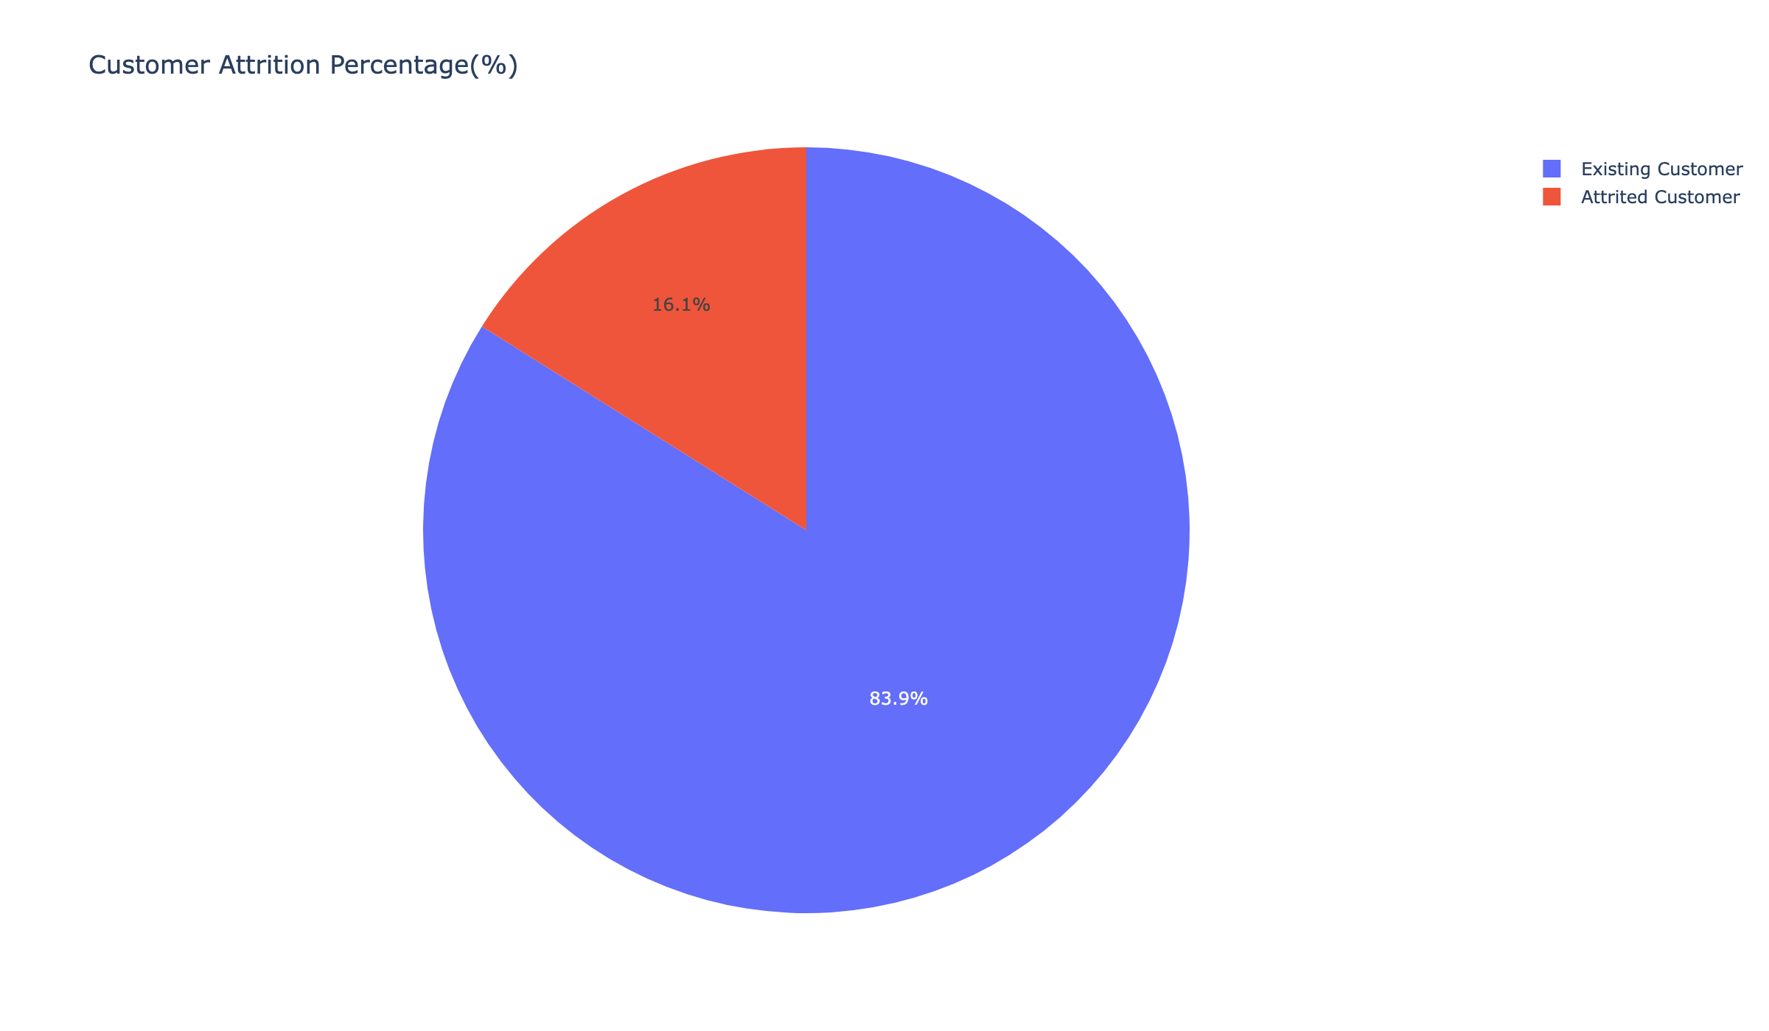
CHURN AT A GLANCE
8 of 10 customers stay — but we're still losing a small city every year
THE STORY
Imagine a mid-sized branch filling up every year with customers ready to close their accounts. That's what 16% attrition looks like at our scale — 1,627 customers and roughly $13 million in credit lines walking away.
The good news: most customers are still with us. The opportunity: the reasons they leave are visible in the data, and many are within our control.
THE TAKEAWAY
We don't have a mass-churn problem. We have a pattern problem — and patterns are fixable.
Customer Attrition Executive Briefing
2

Slide 4
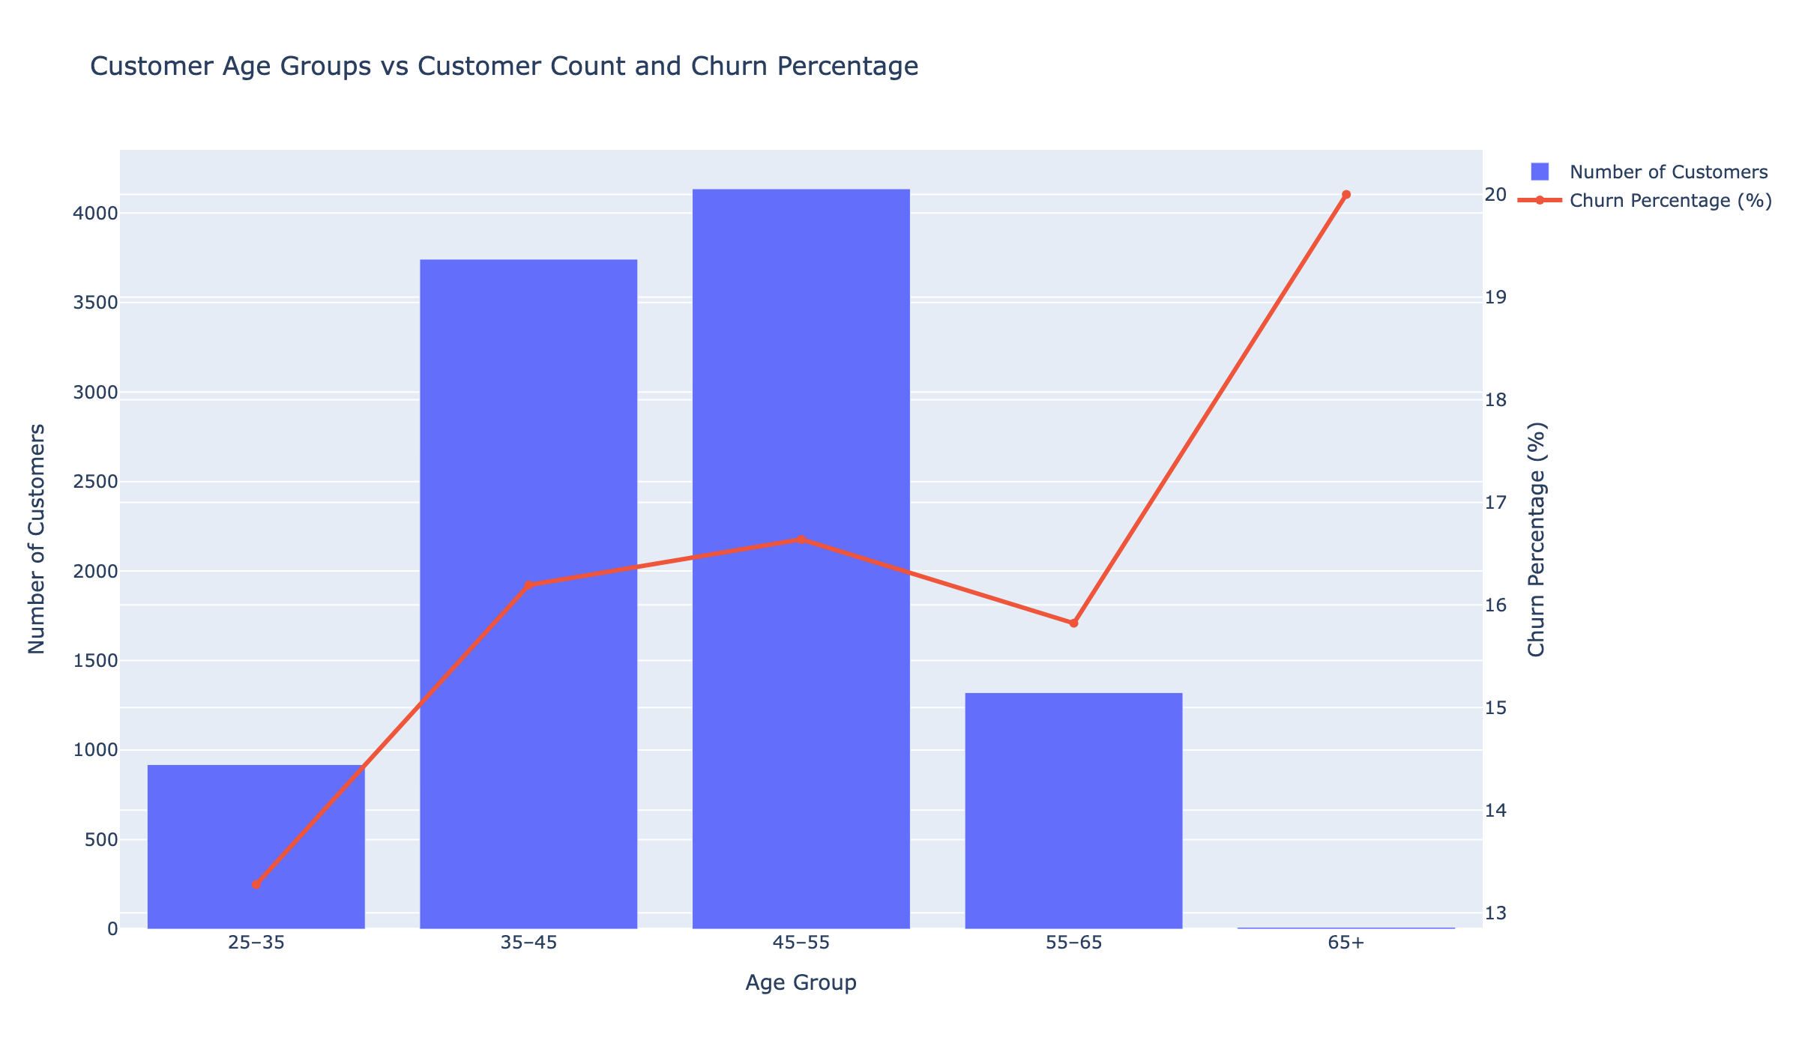
WHO LEAVES: AGE
Younger customers leave the most; we earn loyalty as they grow with us
WHAT IT MEANS
• Under 35: churn runs highest — these customers are still shopping around.
• 55-64: our stickiest working-age group.
• 65+: churn drops to about 10% — long-tenured customers rarely leave.
THE TAKEAWAY
Early-life customers are a retention priority. Every year they stay, they stay longer.
Customer Attrition Executive Briefing
3

Slide 5
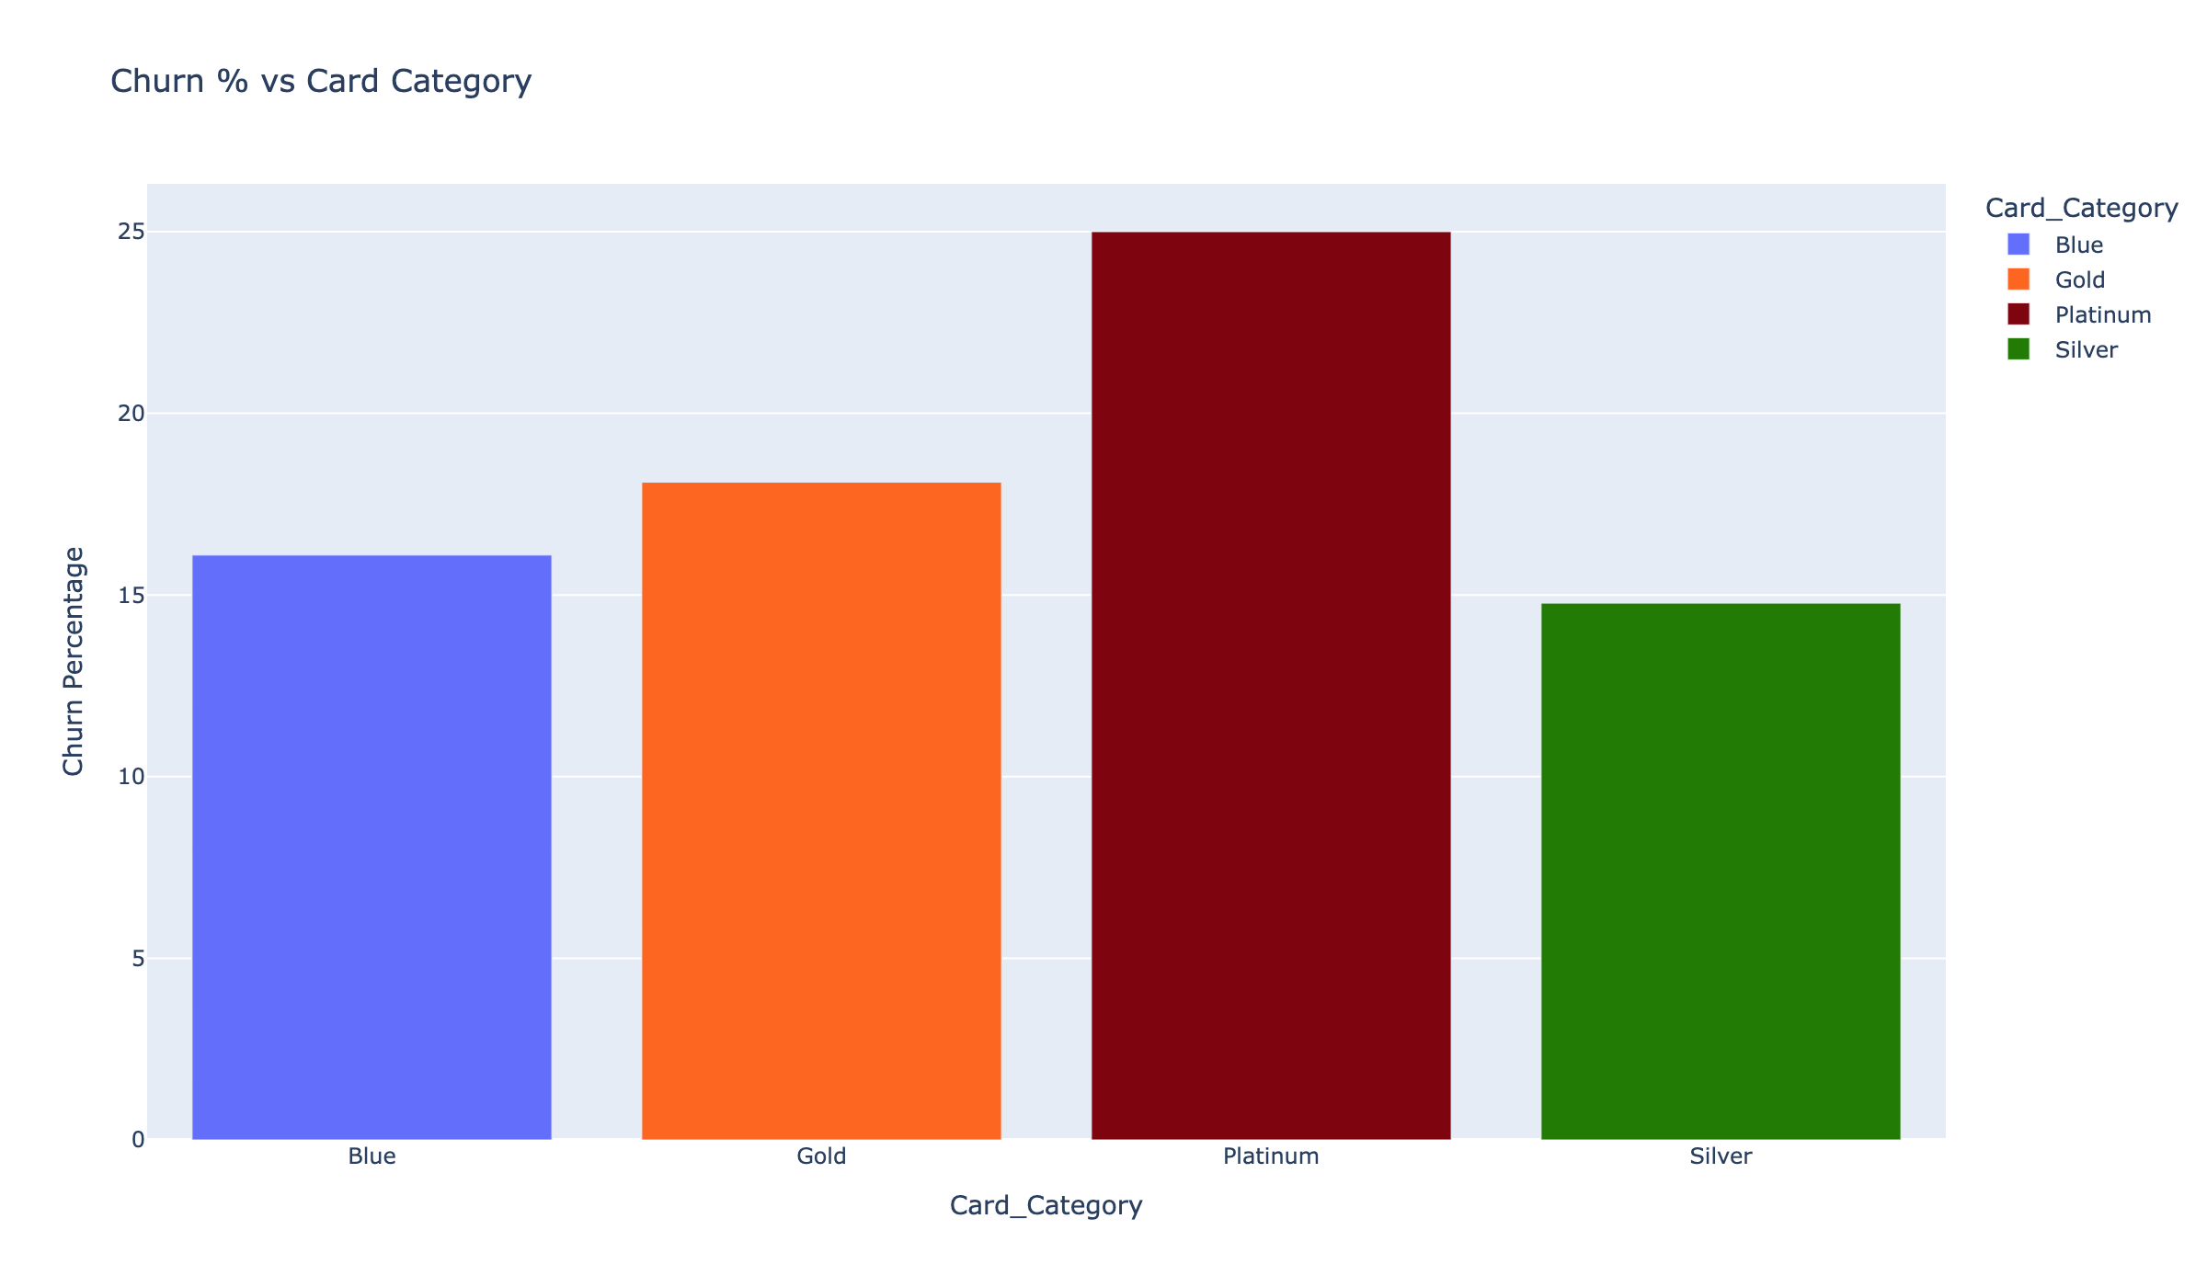
THE PREMIUM PARADOX
Our highest-tier customers churn the most
BY CARD CATEGORY
Platinum: 25.0% churn
Gold: 18.1% churn
Blue: 16.1% churn
Silver: 14.8% churn
A quarter of Platinum customers — the ones we invest the most in — are walking. The premium experience isn't delivering premium.
THE TAKEAWAY
Platinum isn't a loyalty segment today — it's a flight-risk segment.
Customer Attrition Executive Briefing
4

Slide 6
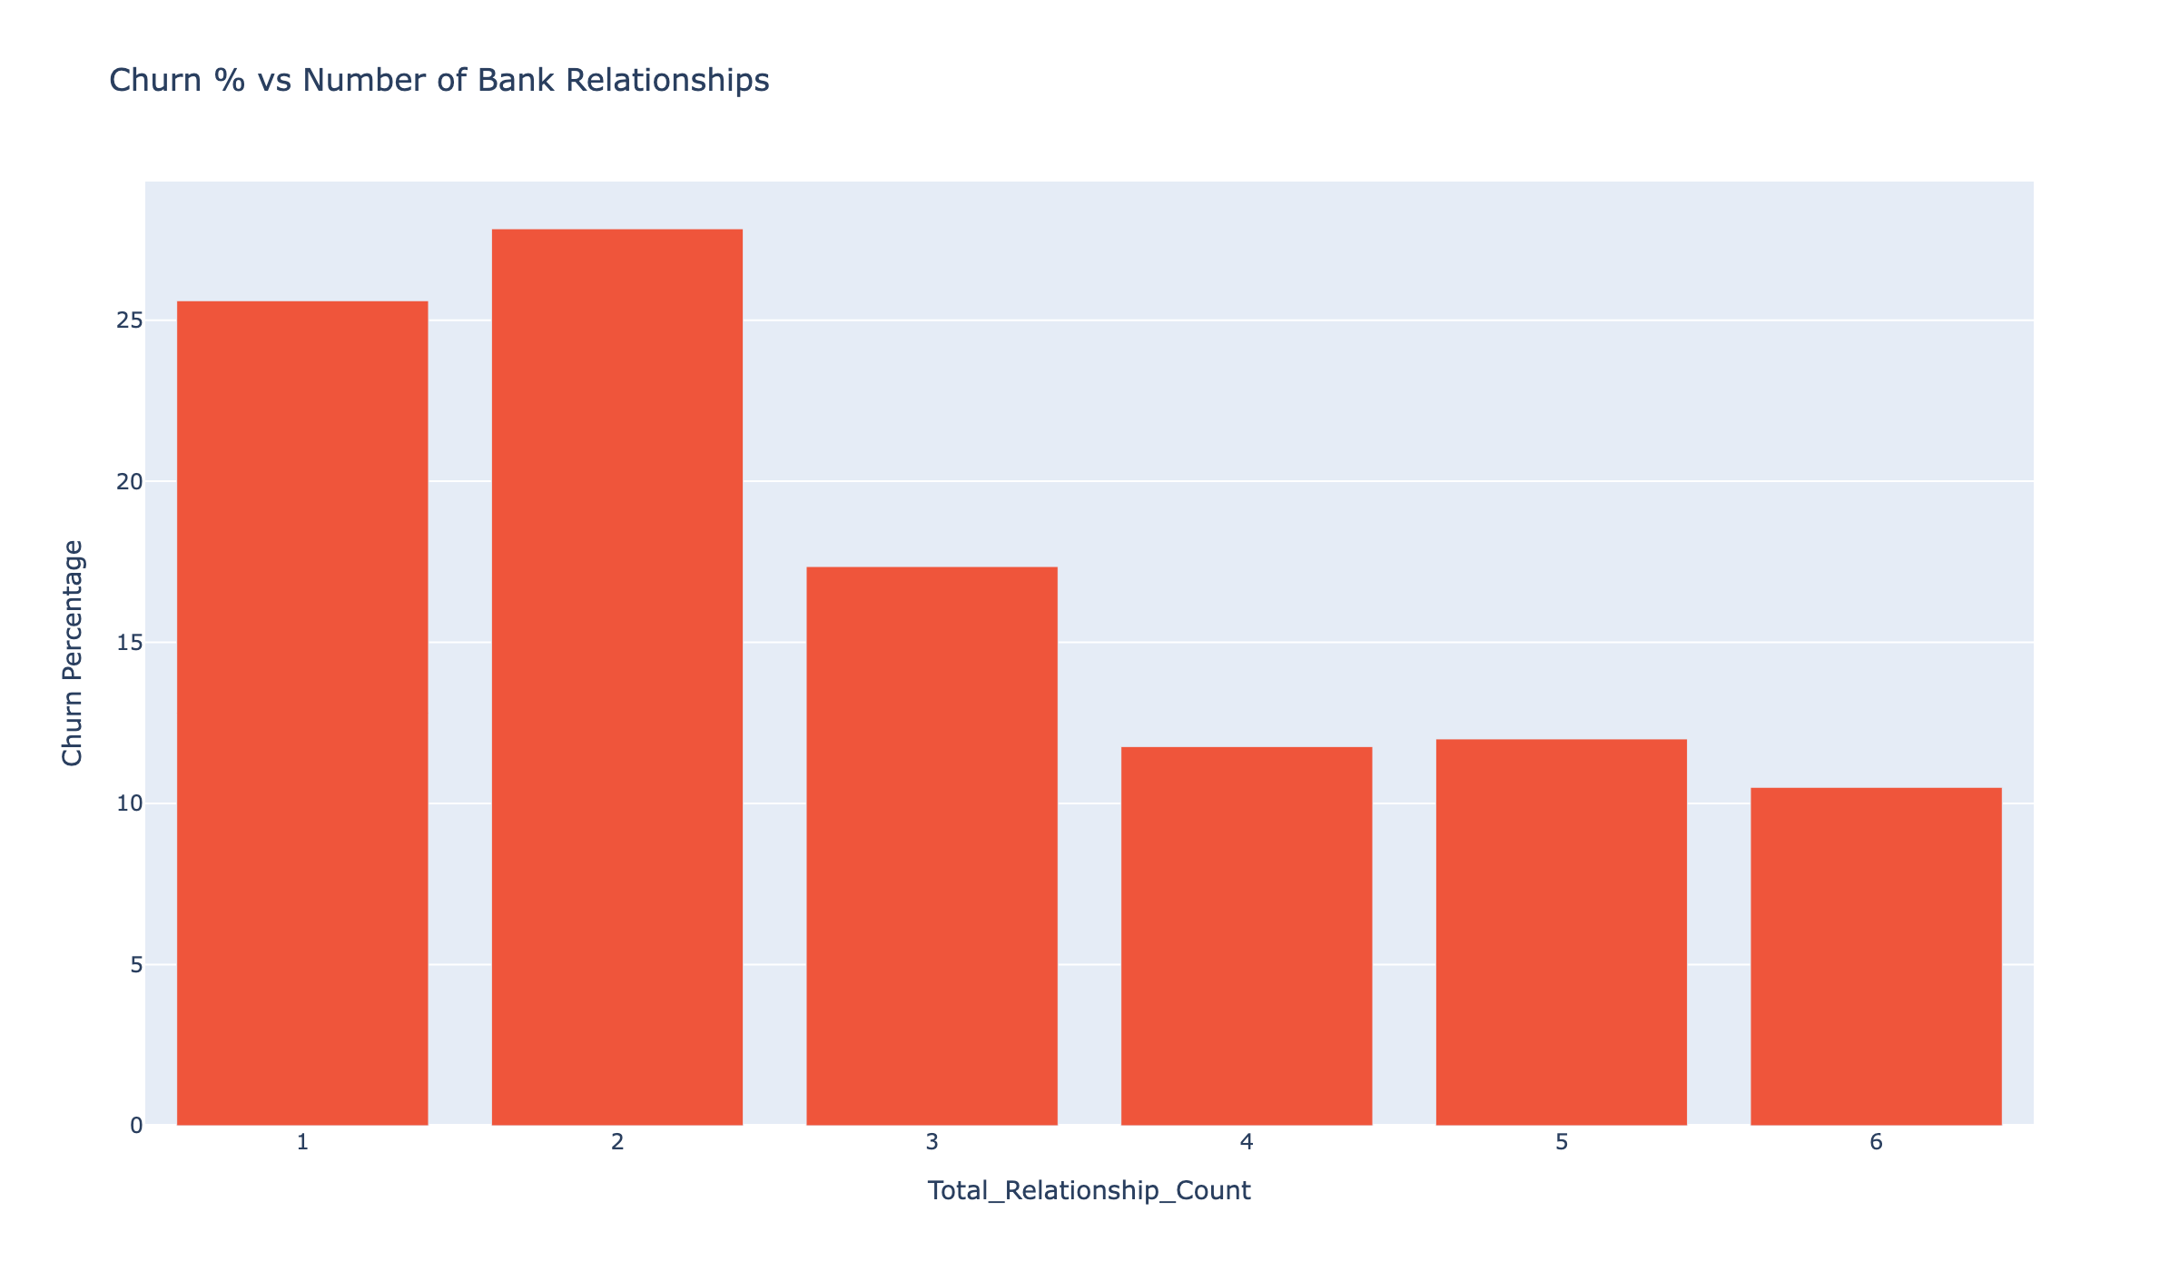
PRODUCT DEPTH
The more we serve them, the more they stay
BY NUMBER OF PRODUCTS HELD
1 product: 26% churn
2 products: 28% churn
3 products: 17% churn
4 products: 12% churn
5 products: 12% churn
6 products: 11% churn
THE TAKEAWAY
Cross-sell is not just a revenue play. Adding a second product cuts churn nearly in half.
Customer Attrition Executive Briefing
5

Slide 7
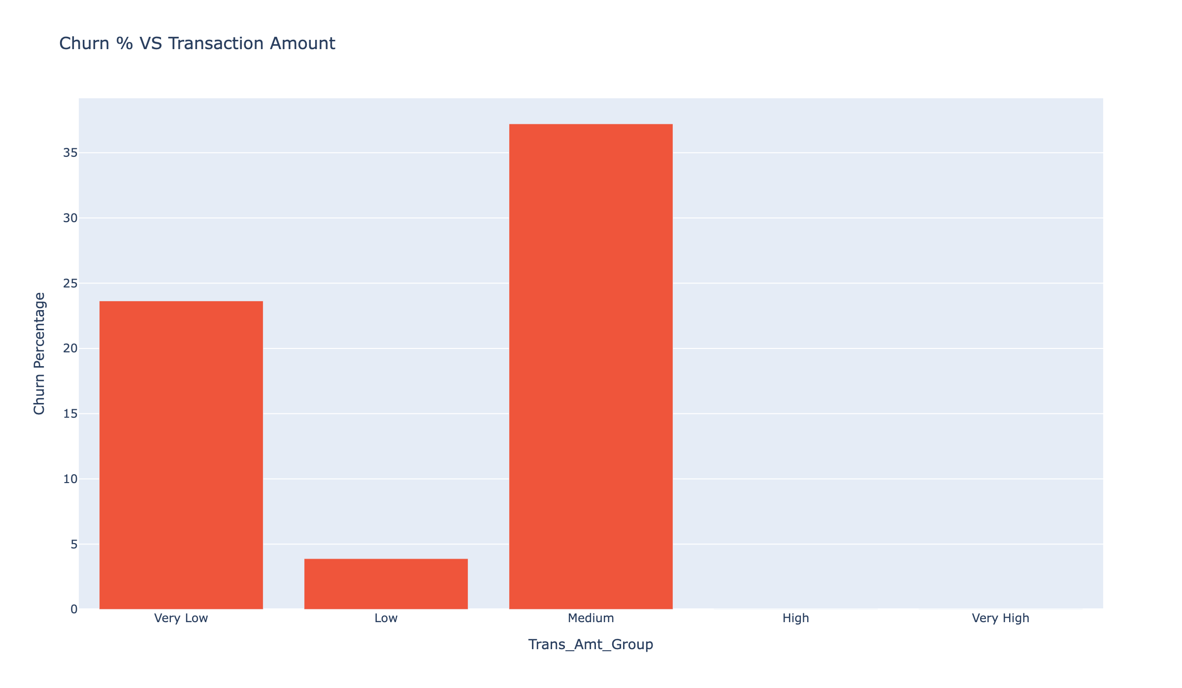
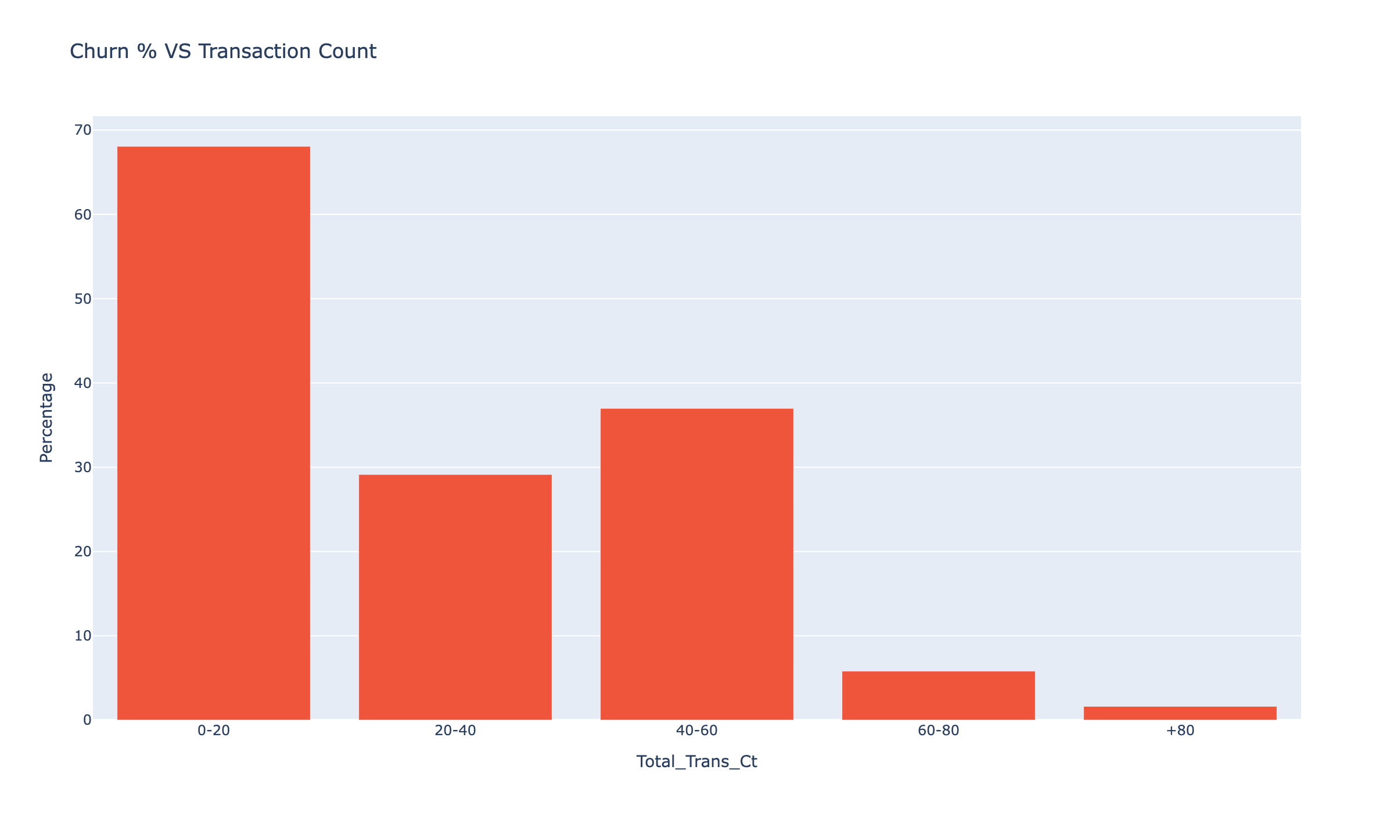
SPENDING ENGAGEMENT
The quiet middle is where we bleed
THE TAKEAWAY
Customers in the mid transaction band churn the most. Low spend is a warning light, not a comfort.
Customer Attrition Executive Briefing
6

Slide 8
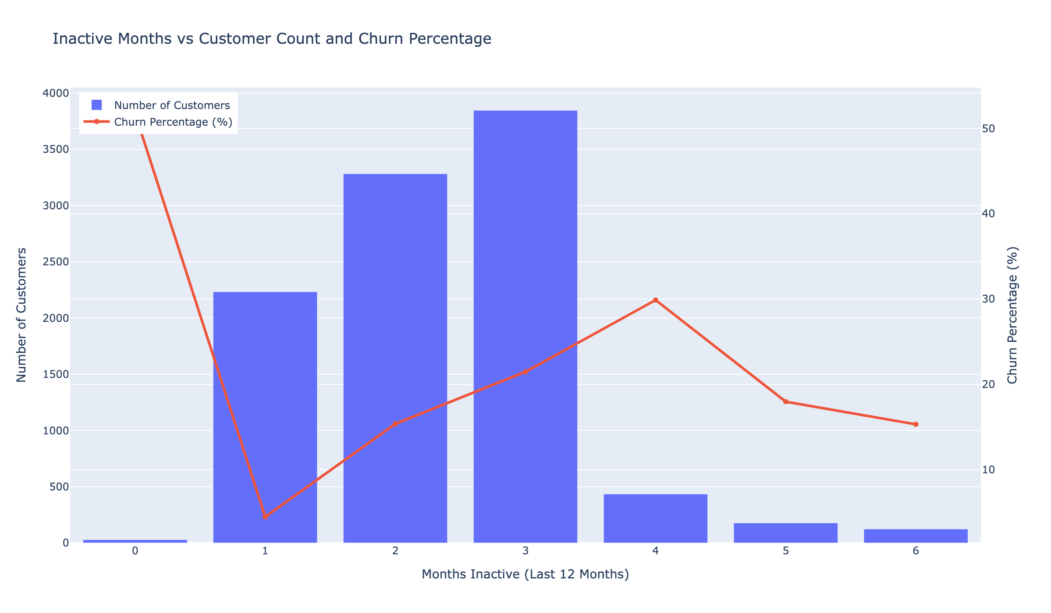
THE EARLIEST WARNING SIGN
4 months of silence is the tipping point
INACTIVITY VS. CHURN
1 month quiet: 4.5% churn
2 months quiet: 15% churn
3 months quiet: 22% churn
4 months quiet: 30% churn
5 months quiet: 18% churn
6 months quiet: 15% churn
Once a customer goes 4 months without using their card, the odds of losing them nearly double.
THE TAKEAWAY
An automatic check-in at the 3-month quiet mark is the single easiest retention lever we have.
Customer Attrition Executive Briefing
7

Slide 9
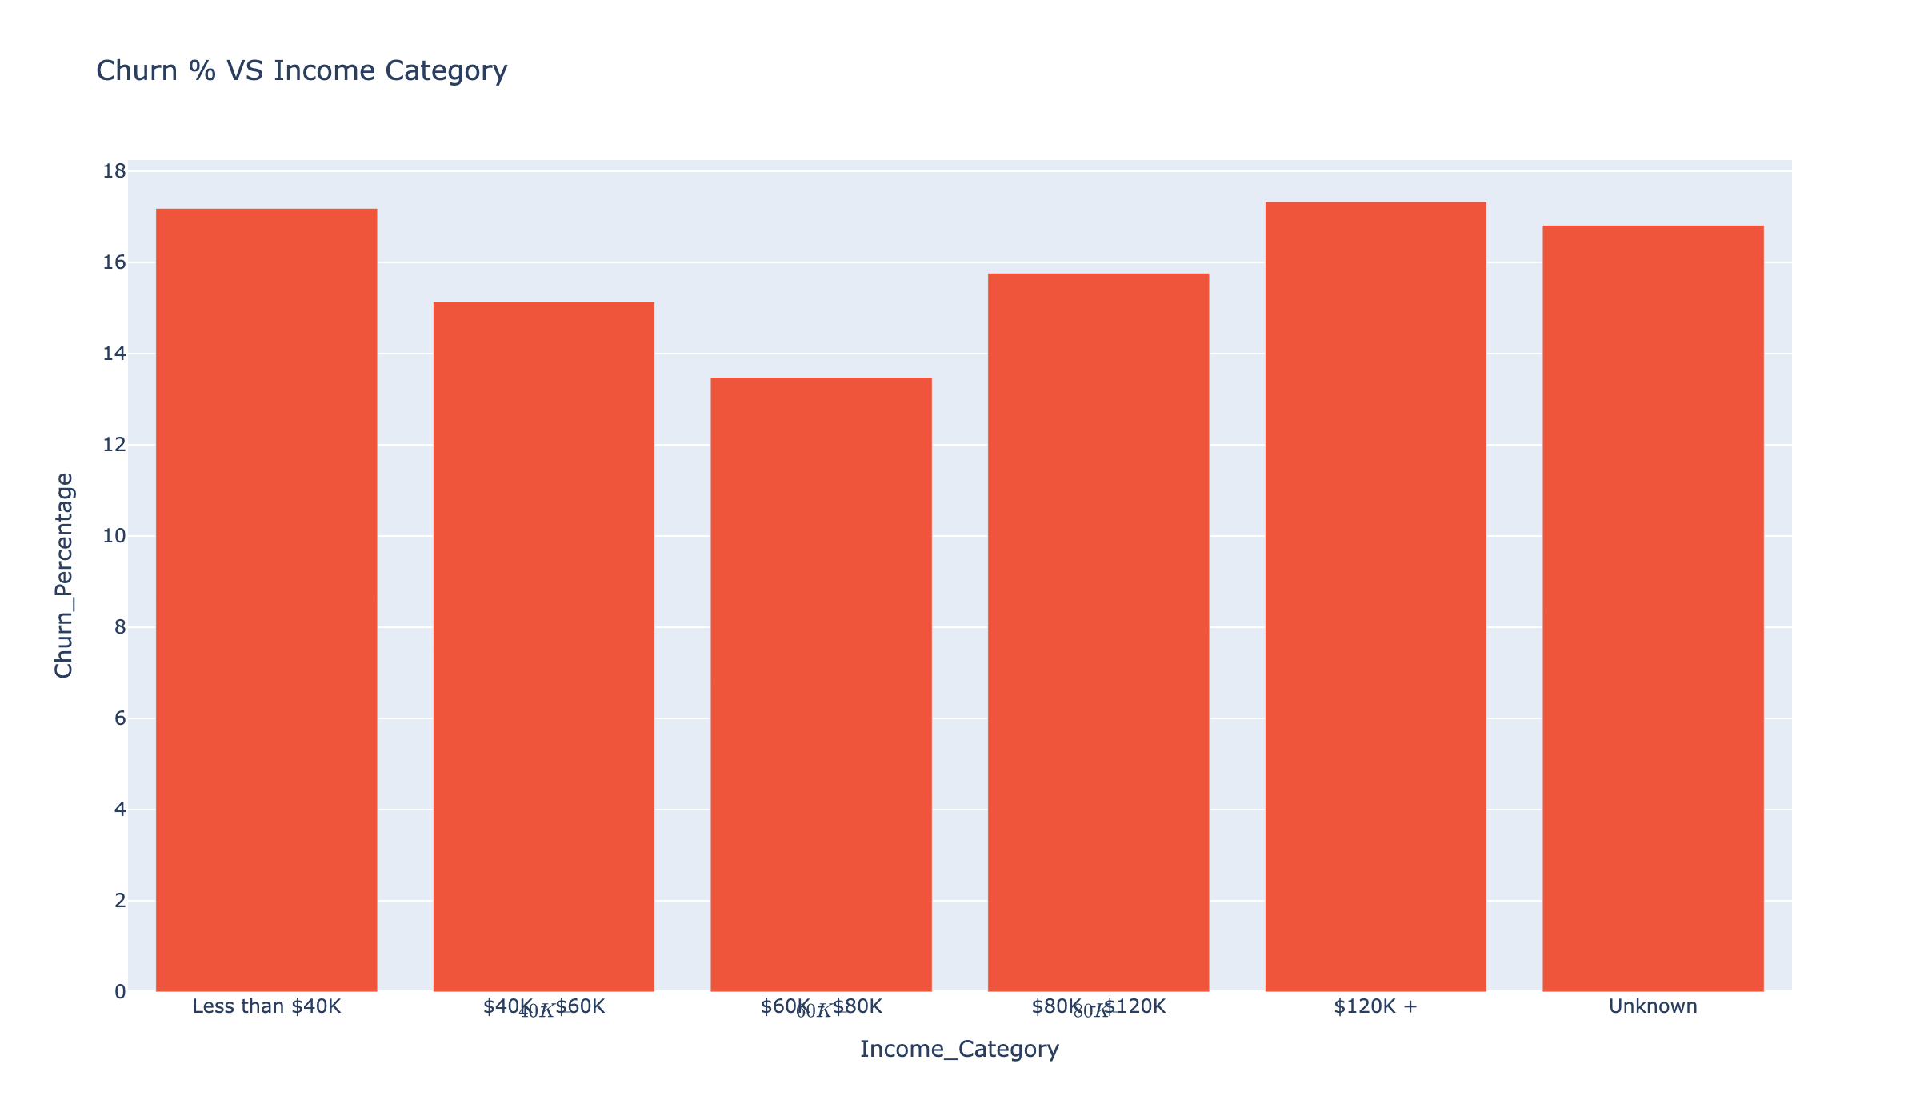
INCOME ISN'T THE DRIVER — ENGAGEMENT IS
Churn is similar across income bands; how we serve matters more than paycheck
CHURN BY INCOME
Less than $40K: 17.2%
$40K - $60K: 15.1%
$60K - $80K: 13.5%
$80K - $120K: 15.8%
$120K +: 17.3%
THE TAKEAWAY
Don't build retention around income tiers. Build it around product depth and engagement signals.
Customer Attrition Executive Briefing
8

Slide 10
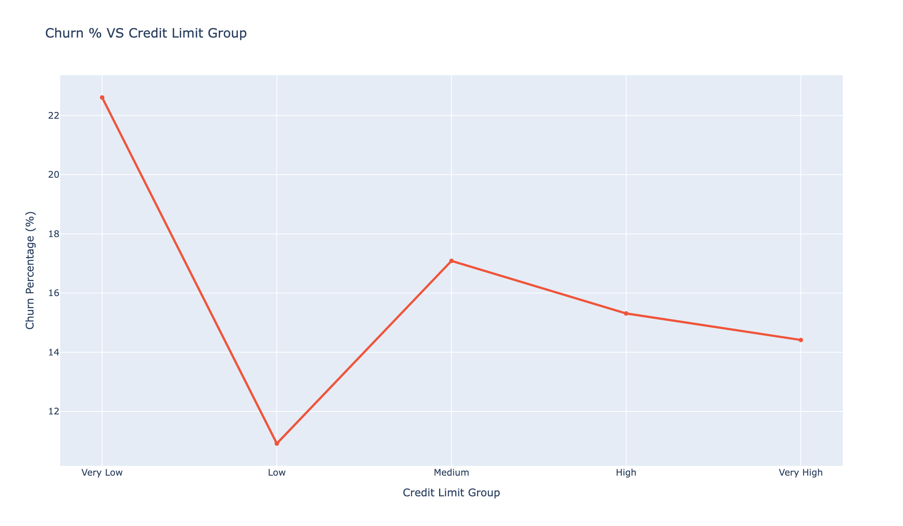
WHAT WALKS WITH THEM
Every lost customer takes an $8,136 credit line on average
$8,136
Avg credit line per lost customer
$13.2M
Total credit exposure lost
Revolving balance lost
$1.1M
THE TAKEAWAY
Retention isn't only a CX metric. It's a balance-sheet metric.
Customer Attrition Executive Briefing
9

Slide 11
MEET THE LEAVERS
Three customer stories that show up in the data again and again
THE ONE-PRODUCT SHOPPER
THE QUIET PLATINUM
THE FADING REGULAR
"I only have my card here."
"I thought premium would feel premium."
"Life got busy, I just stopped using it."
Holds a single product. Uses it rarely. Compares offers online.
Churn: ~26%. A second product (savings, loan, auto-pay) cuts it nearly in half.
Platinum card, expects VIP treatment, sees little differentiation.
Churn: 25%. Highest of any tier.
Used to spend regularly, then goes quiet for 3-4 months.
Churn jumps from 15% to 30% as inactivity crosses 4 months.
THE TAKEAWAY
Real people, not data points. Each persona maps to a play on the next slide.
Customer Attrition Executive Briefing
10

Slide 12
THREE PLAYS WE CAN RUN NOW
Practical, low-cost, and aimed at the patterns we just saw
01
02
03
Premium Revival
One to Many
Silence Breaker
A 90-day outreach to every Platinum customer: dedicated advisor, fee review, and a small 'thank you' benefit they actually notice.
Contact single-product customers with a tailored second-product offer (savings, auto-pay, or rewards). Focus on digital-first channels for under-35s.
An automatic check-in when a customer has been inactive for 90 days — a personal call, a small offer, or a reminder of unused benefits.
Target: move Platinum churn from 25% to 15%.
Target: cut single-product churn in half, matching multi-product levels.
Target: reduce 4+ month inactivity churn by a third.
THE TAKEAWAY
Customer Attrition Executive Briefing
Three plays. Three clear targets. All executable with teams we already have.
11

Slide 13
THE PRIZE
If we move churn from 16% to 12%...
~405
~$3.3M
~$1.3M
customers saved per period
credit lines retained
annual card spend retained
Built from simple, explainable moves — not new technology, not new headcount.

Slide 14
APPENDIX
Supporting Views
Additional charts referenced in the analysis, kept here for deeper discussion.

Slide 15
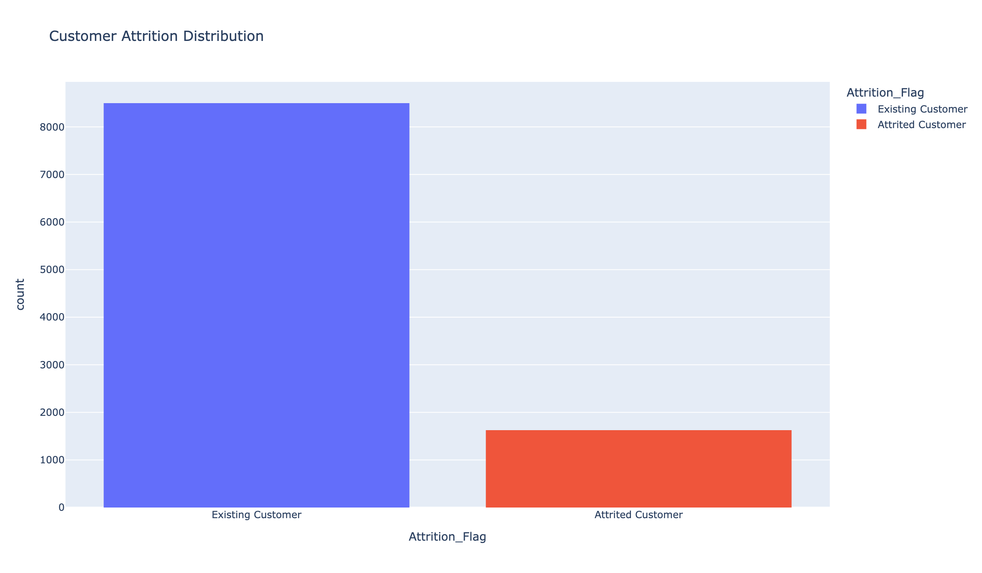
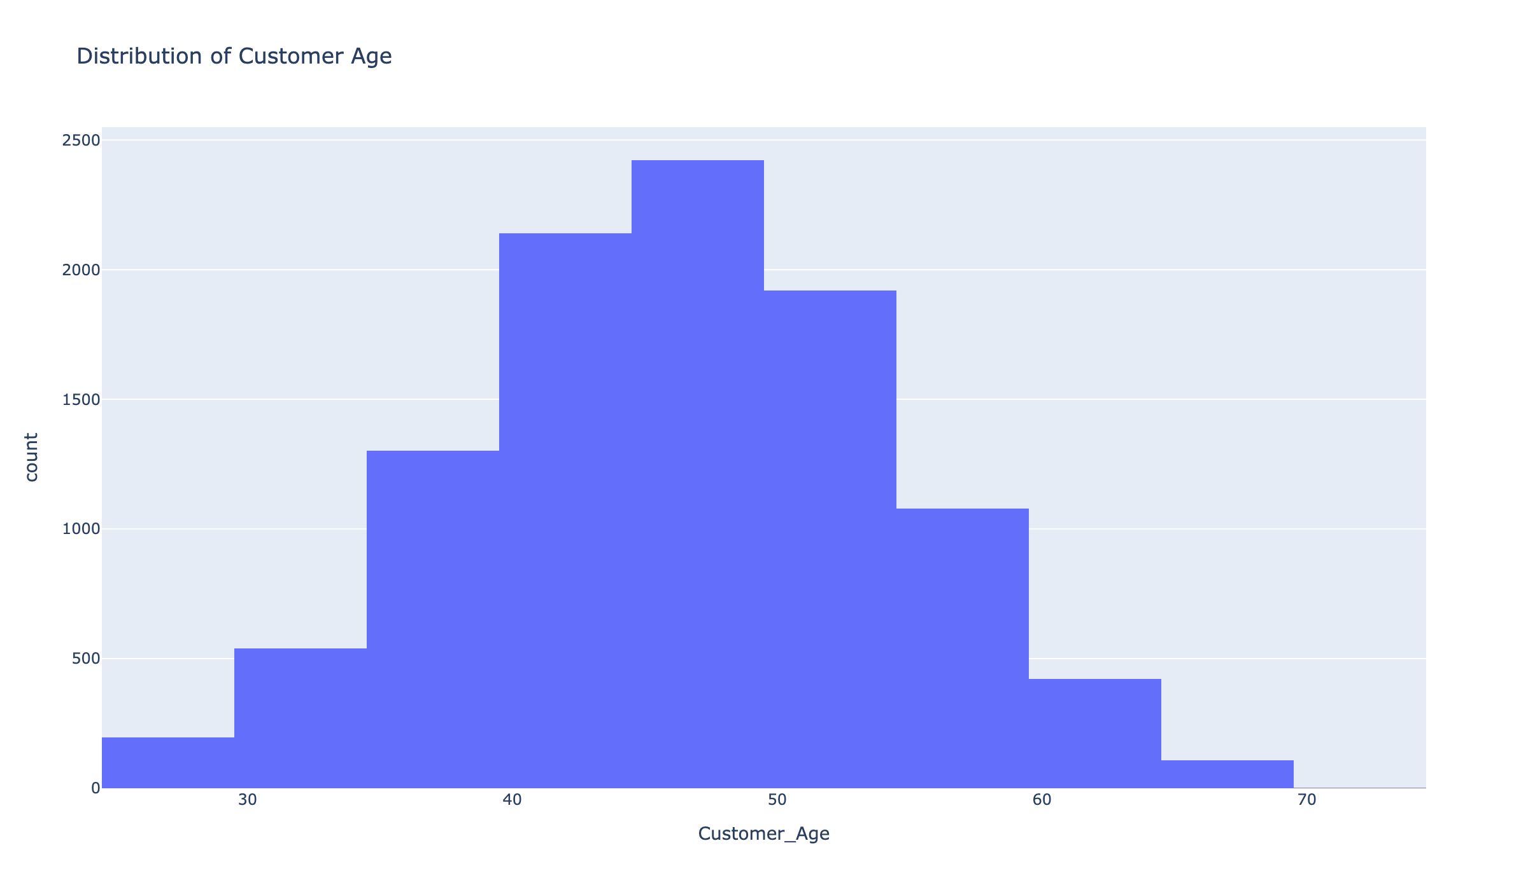
APPENDIX
Supporting views
Attrition distribution (headcount)
Customer age distribution
Customer Attrition Executive Briefing
14

Slide 16
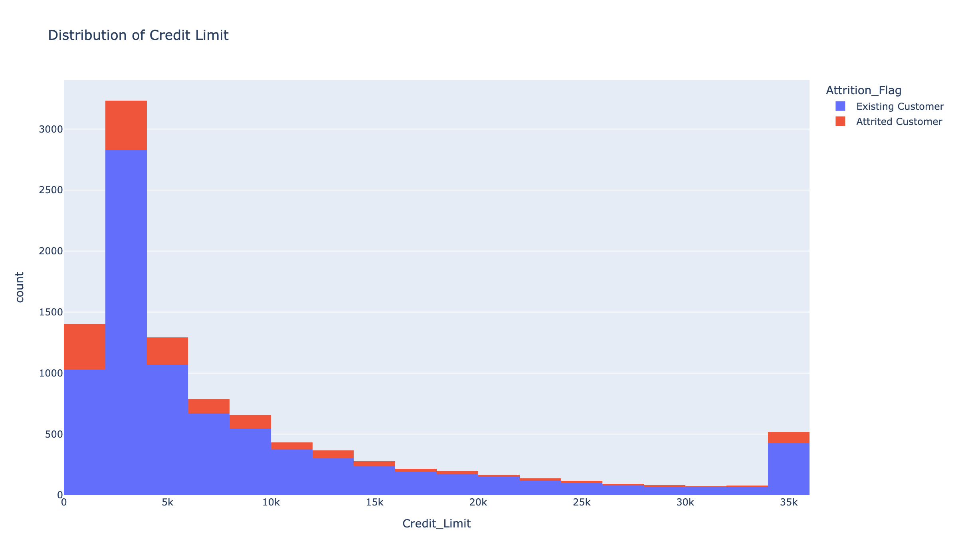
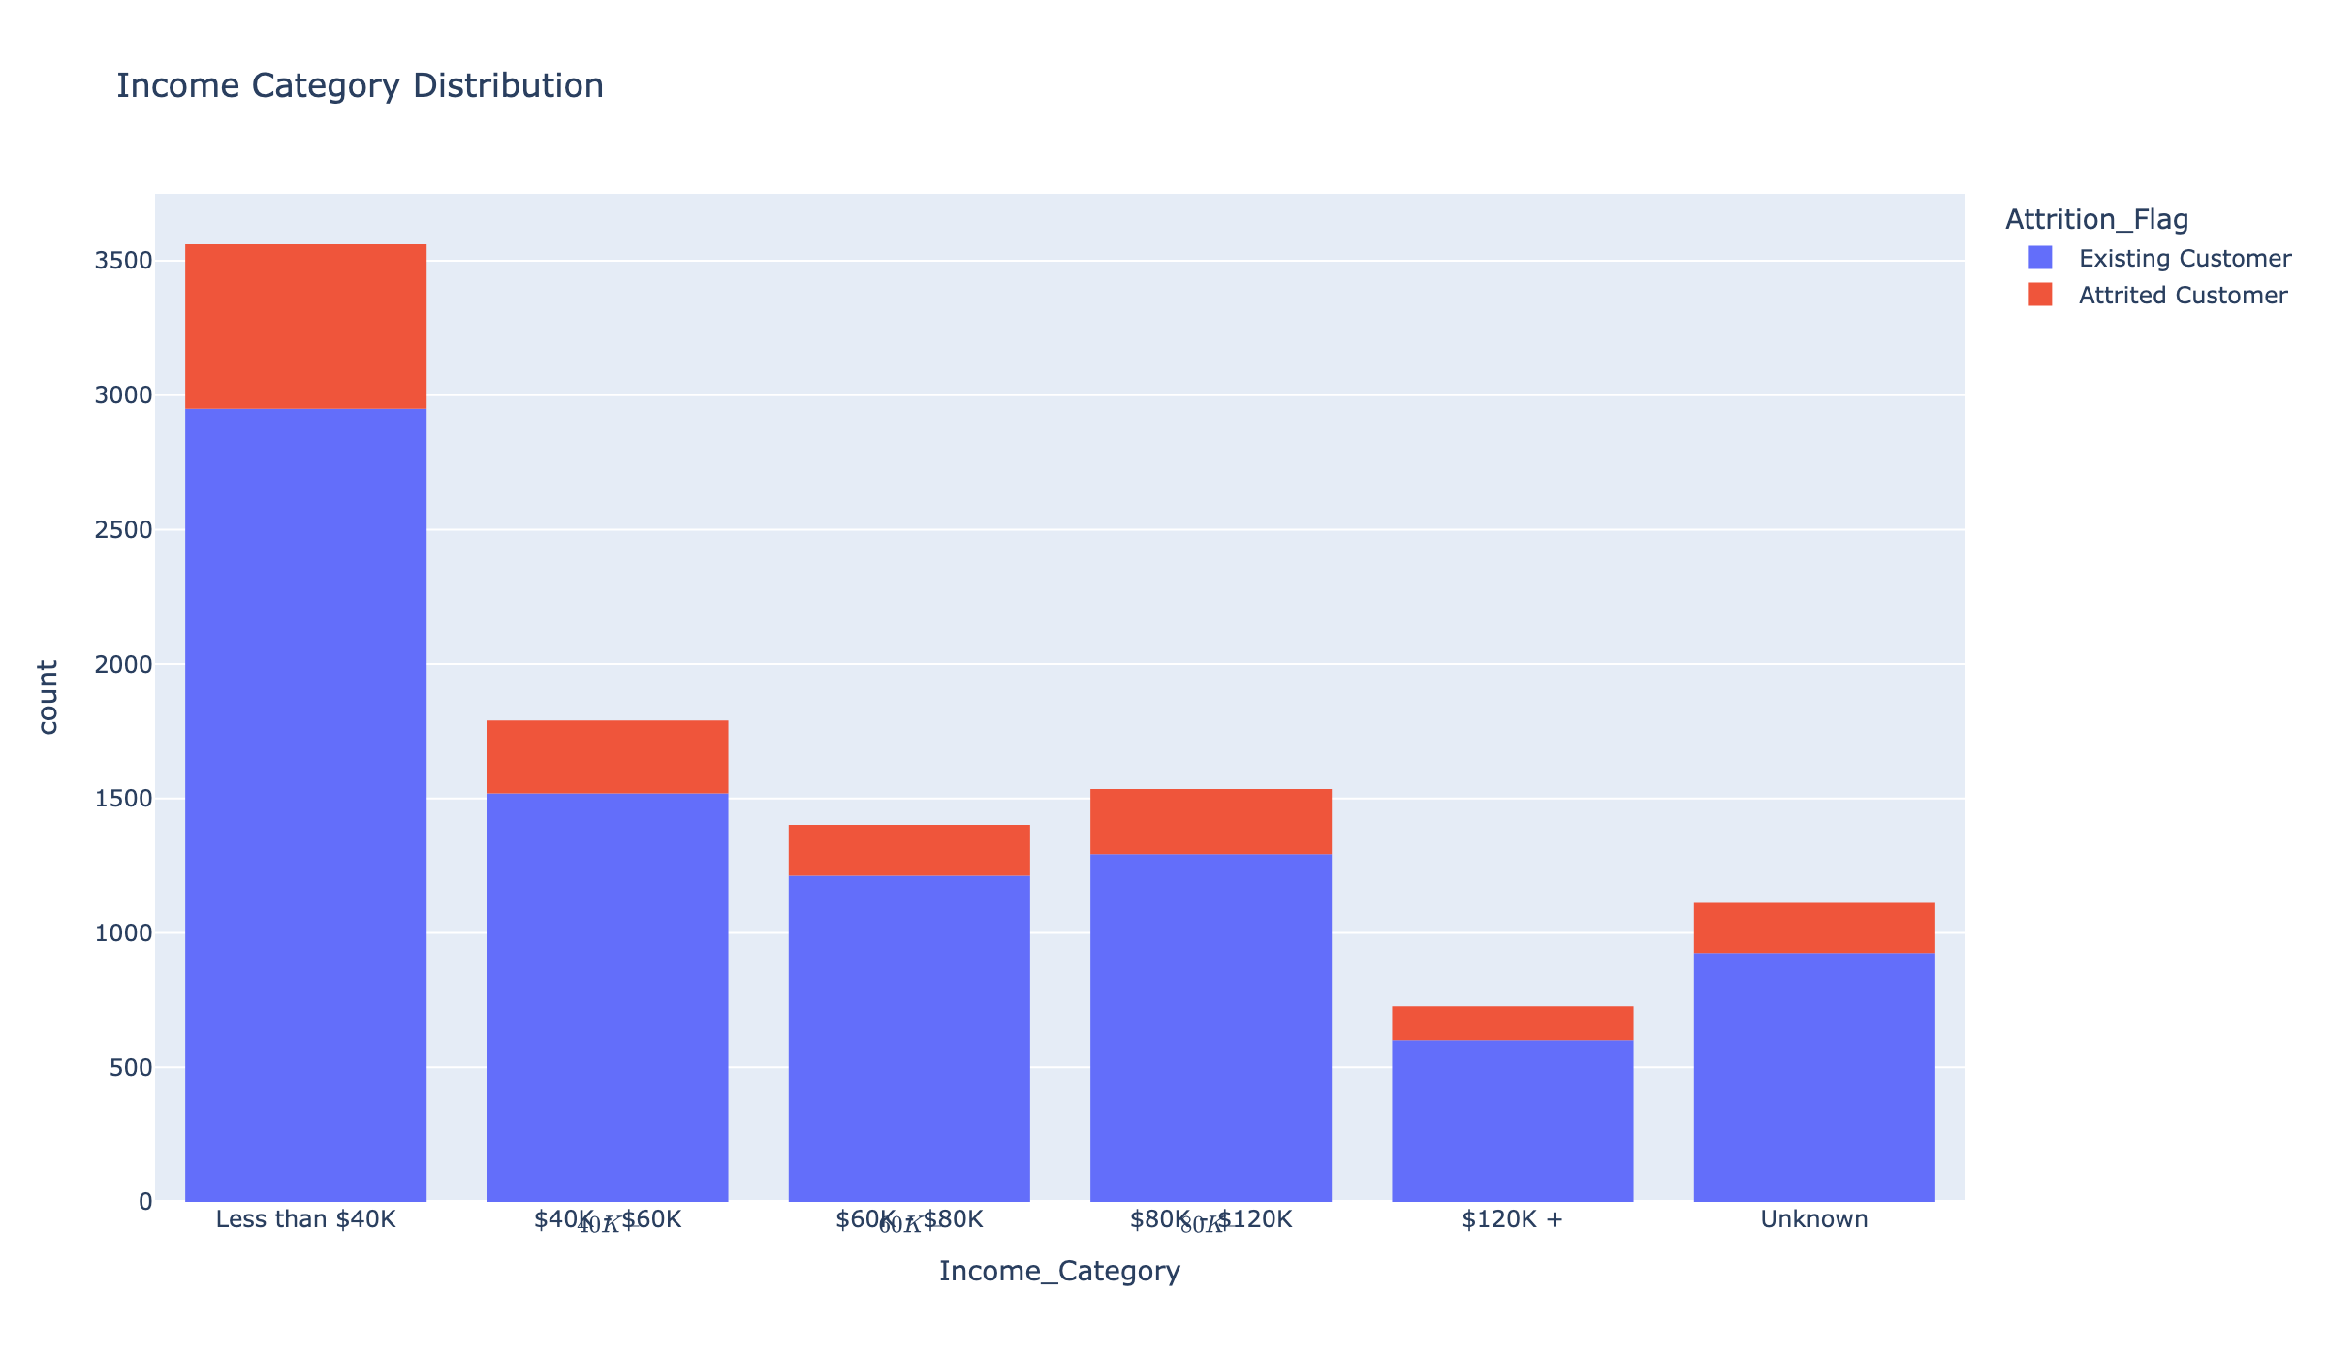
APPENDIX
Supporting views
Credit limit distribution
Income category distribution
Customer Attrition Executive Briefing
15

Slide 17
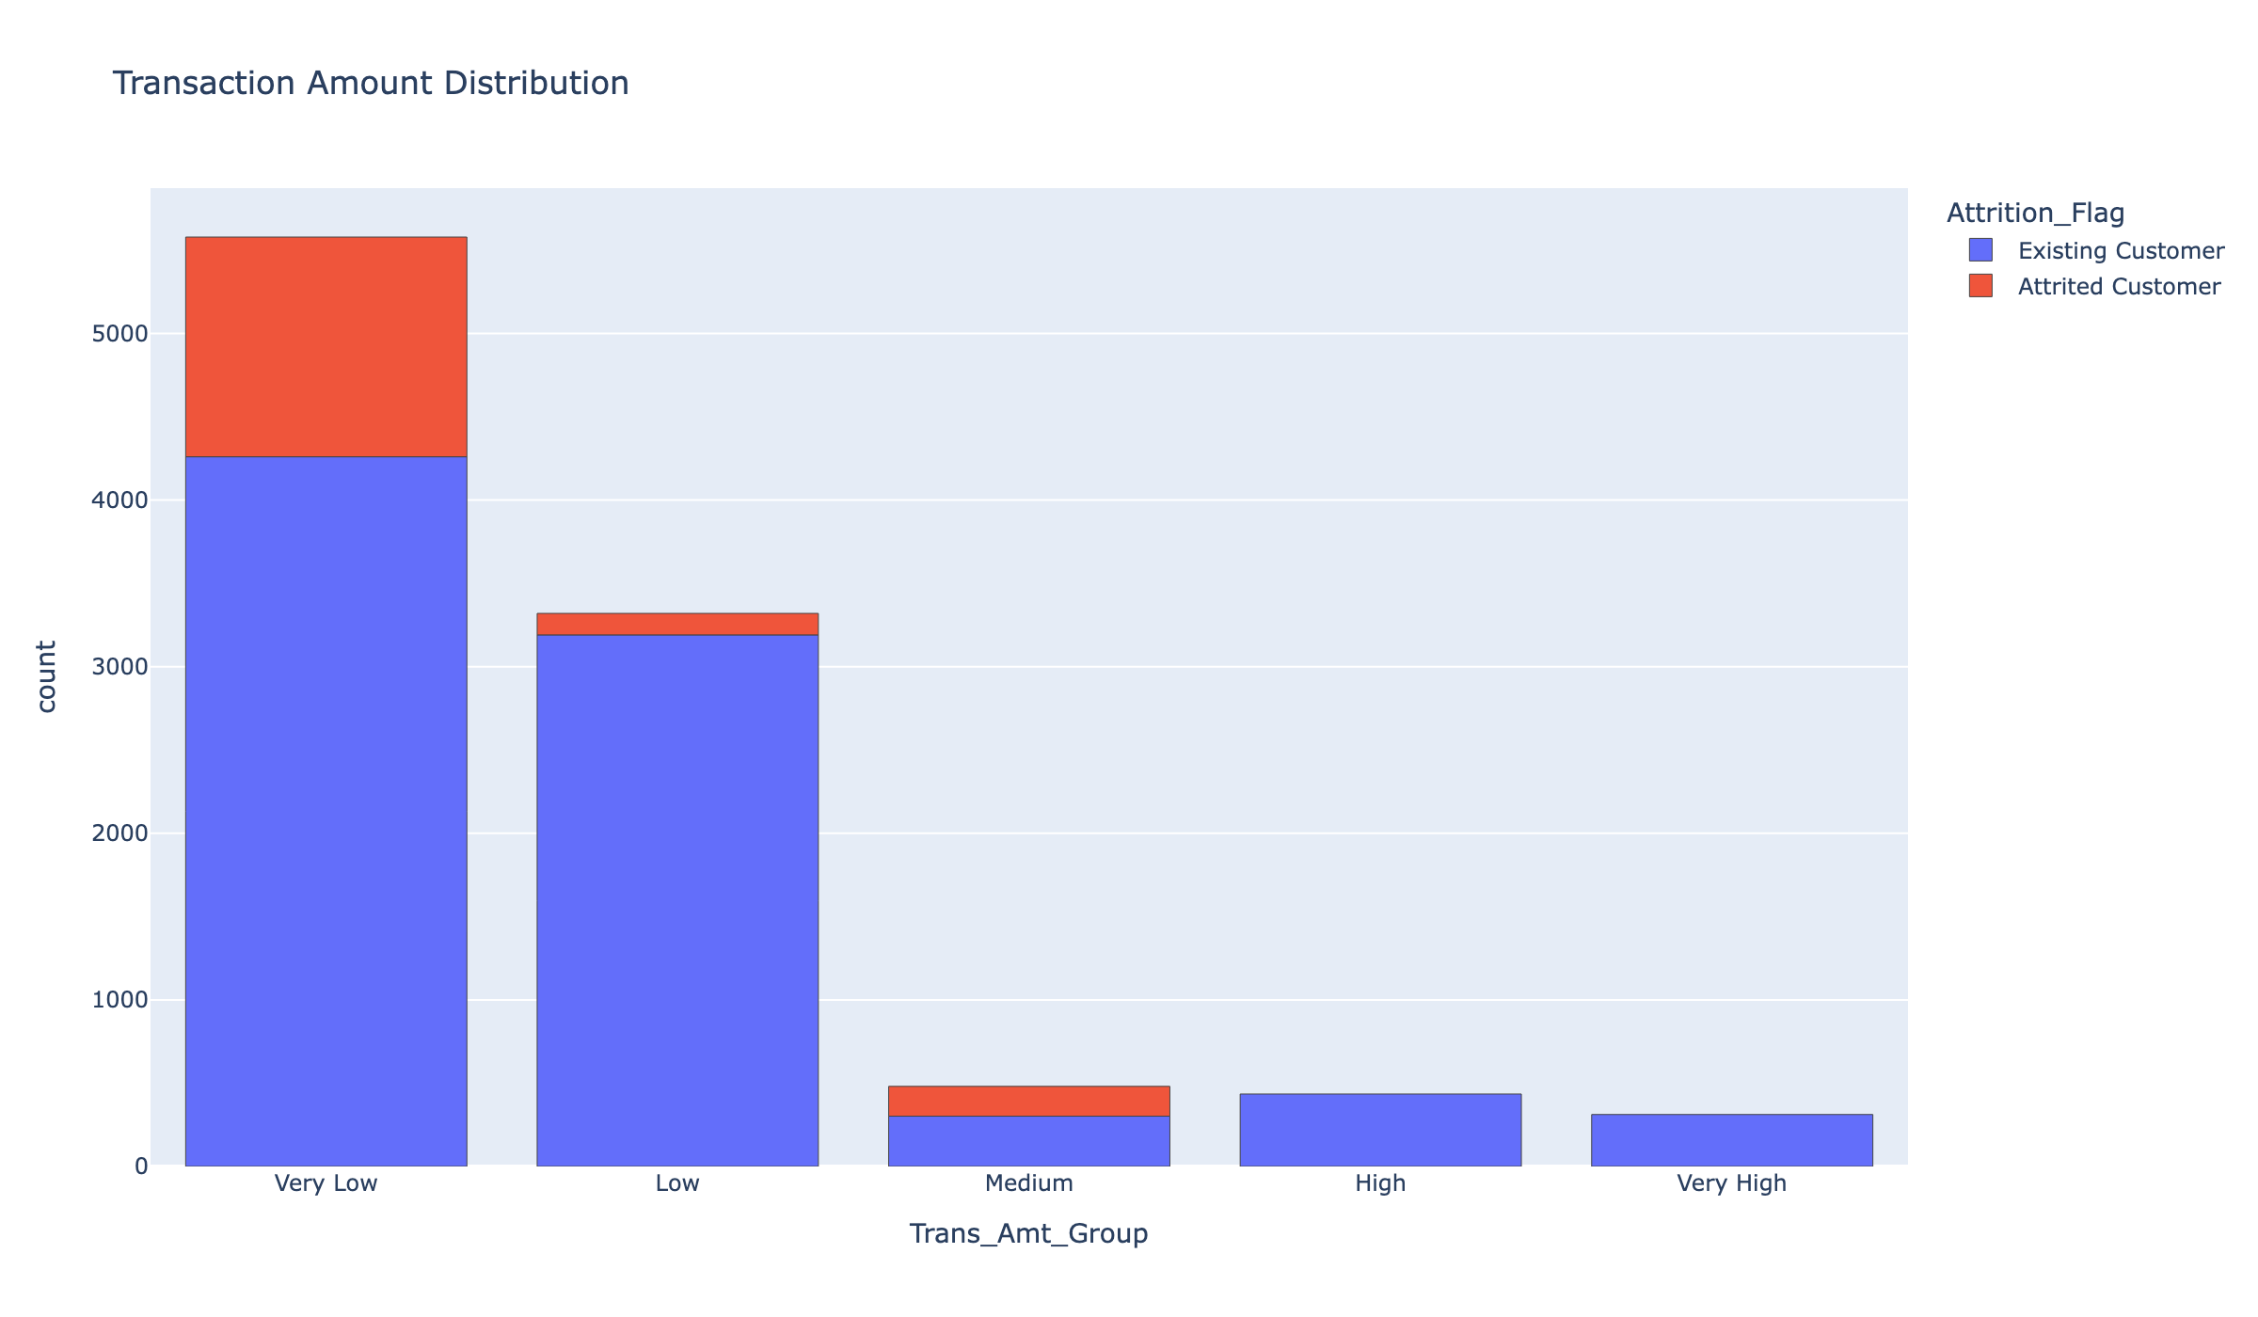
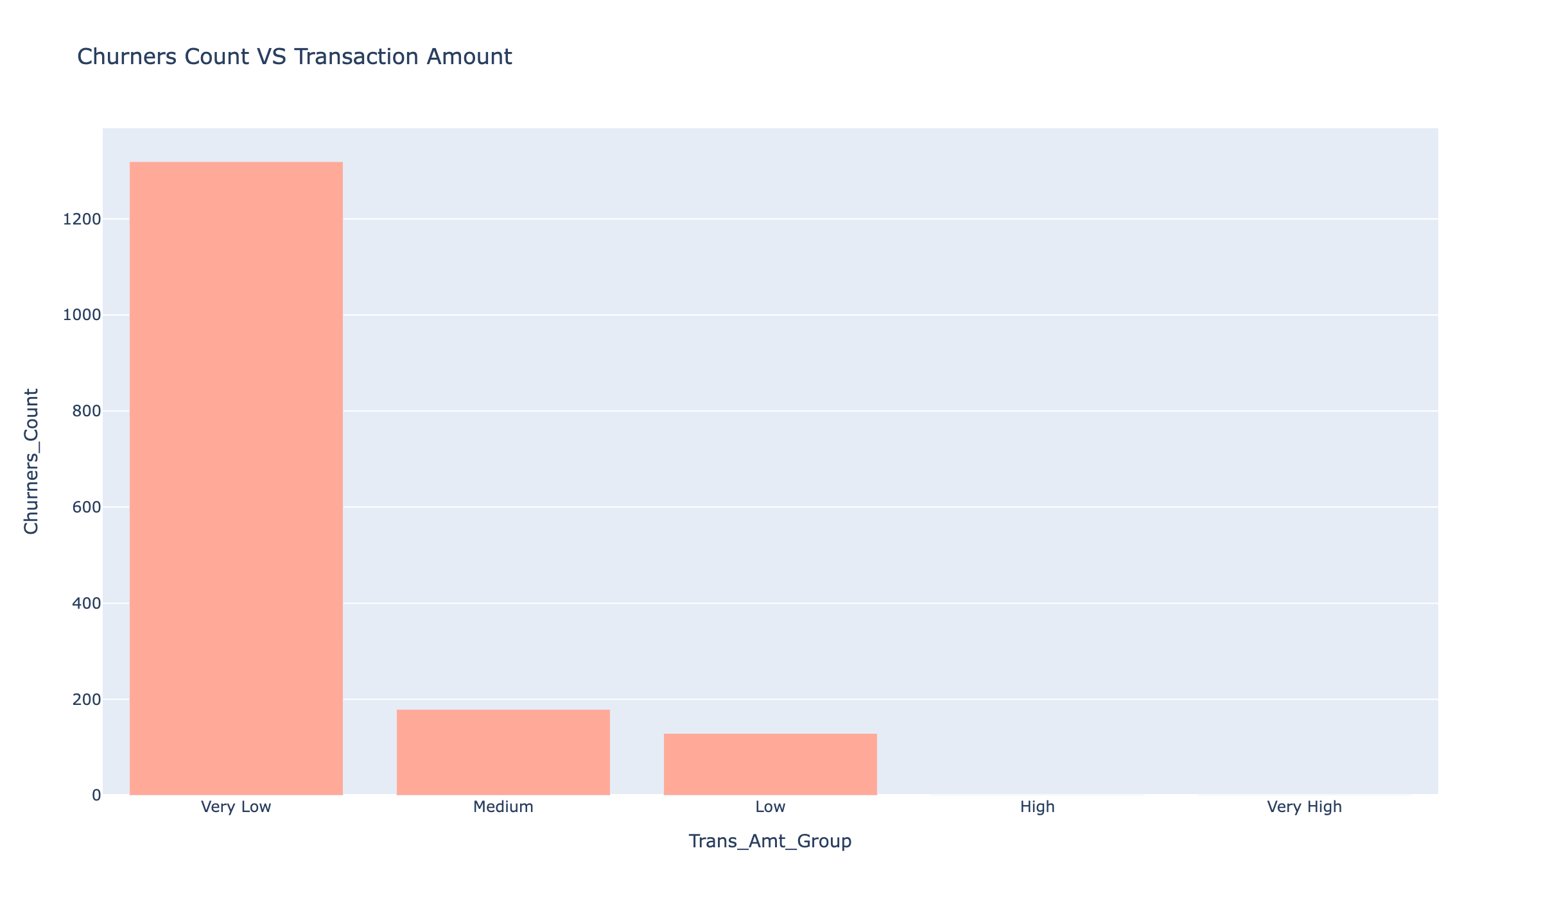
APPENDIX
Supporting views
Transaction amount distribution
Churn % vs transaction amount (detail)
Customer Attrition Executive Briefing
16

Slide 18
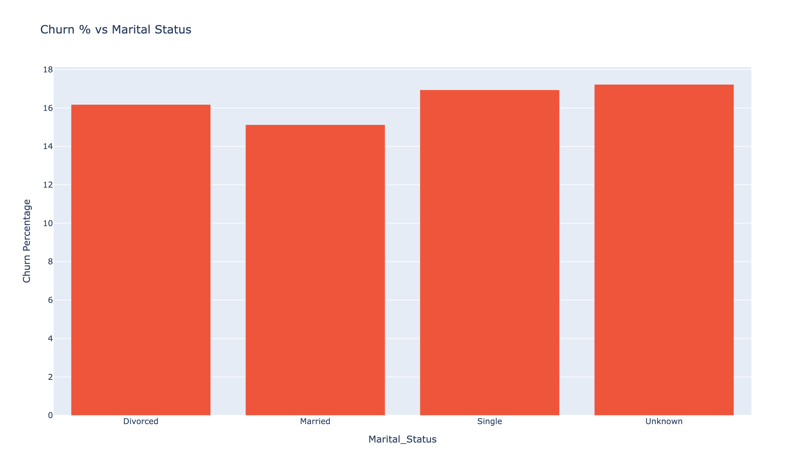

APPENDIX
Supporting views
Churn % vs marital status
Inactivity distribution (last 12 months)
Customer Attrition Executive Briefing
17

Slide 19
Thank you.
Let's pick one play and run it this quarter.

