Slide 1
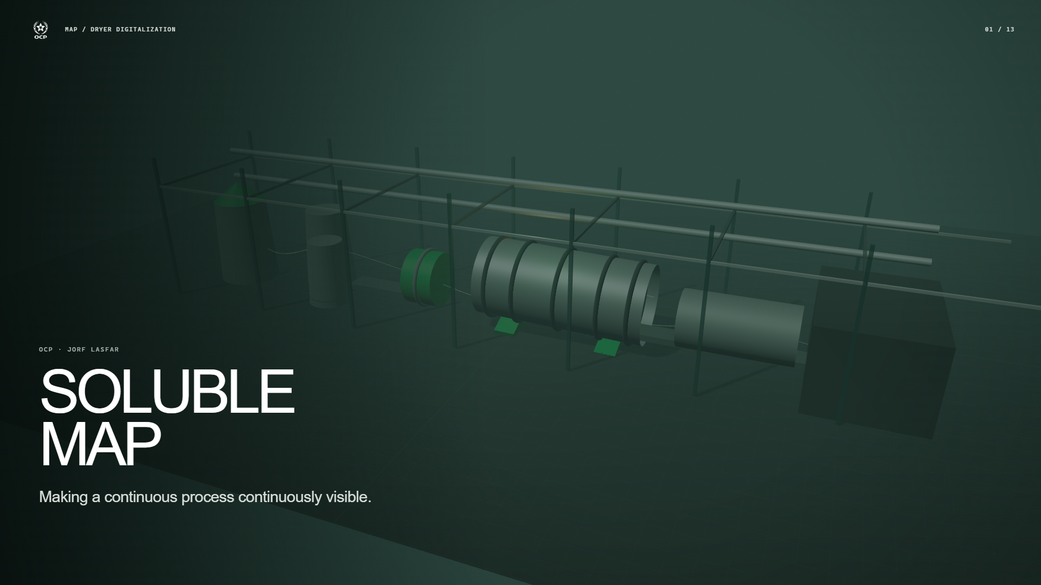
Notes:
Soluble MAP production is a continuous industrial operation: material moves, energy is exchanged, and product quality evolves whether or not a new laboratory result is available. This project starts from a simple supervision question: how can we make that continuous evolution continuously readable to the people operating the dryer? The work is positioned as industrial digitalization and supervision. The models are enabling components inside a larger chain that starts with physical process signals and ends with operator interpretation. The prototype is advisory. It does not write to the process, replace laboratory measurements, or claim autonomous control. Transition: follow the visible production line from the full site into the sequence of transformations that produces soluble MAP.
Sources: final_report/MAP_Dryer_AI_Internship_Report.pdf; final_report/figures/process_photos/drying_section_structure.jpeg

Slide 2
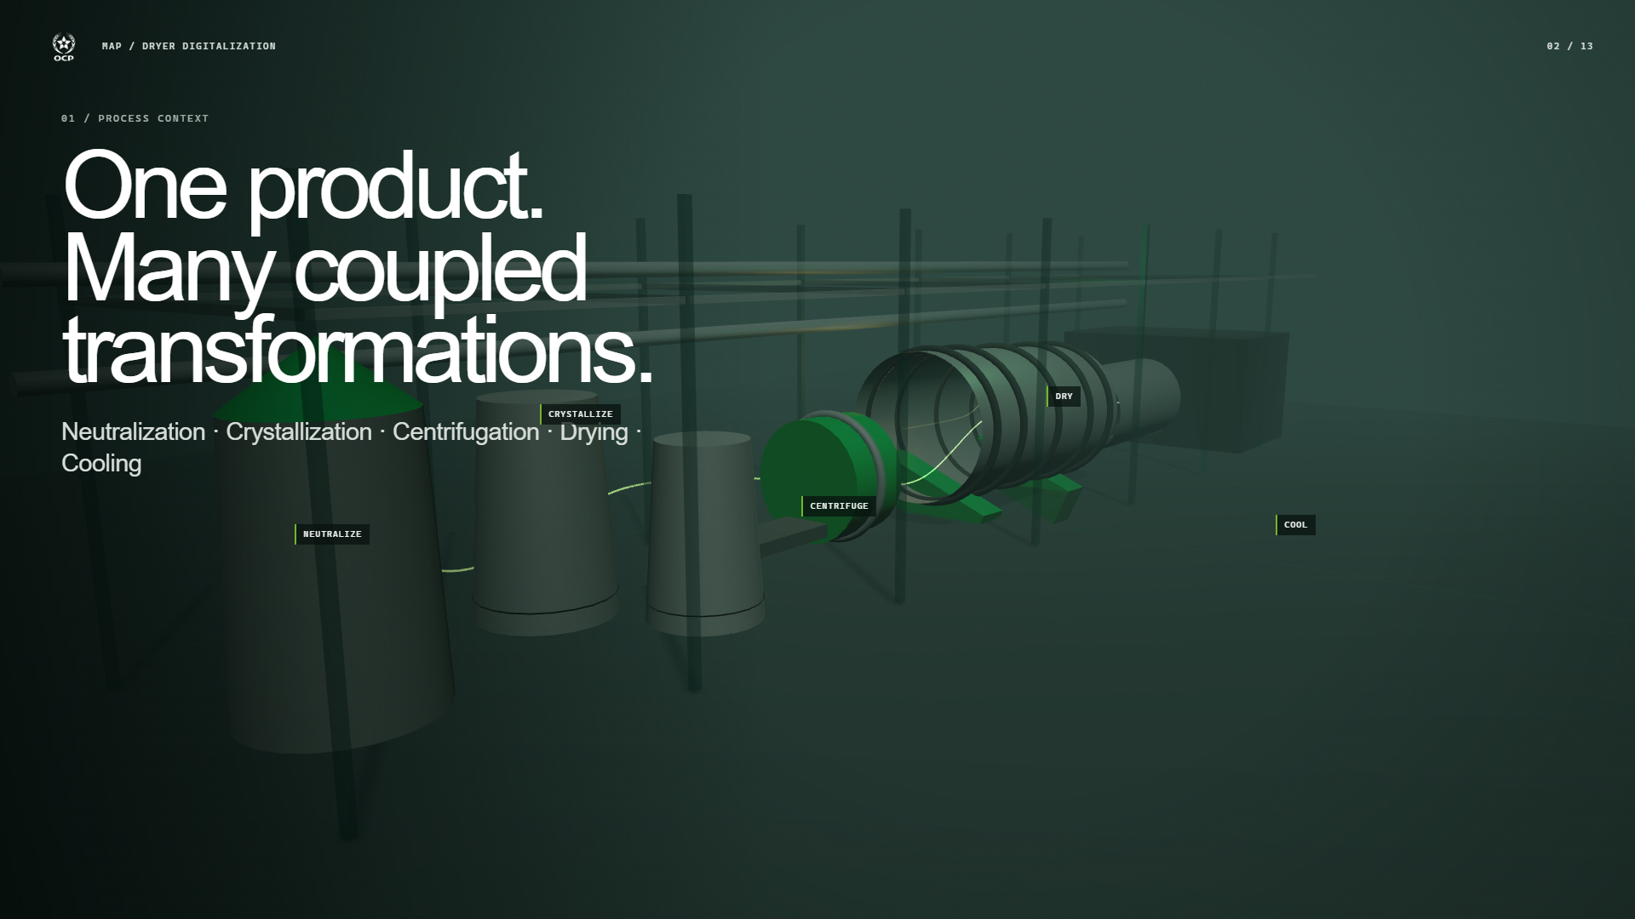
Notes:
The soluble-MAP chain couples several transformations: reactant preparation and neutralization, crystallization, centrifugation, drying, then cooling and conditioning. A disturbance introduced upstream can arrive later, mixed with other effects. That is why the dryer cannot be understood as an isolated asset with a single input and output. The moving green granules give us one stable visual reference through the presentation. They let us connect the chemistry and solids handling to the supervision problem without turning this defense into a process-flow diagram lecture. Transition: the camera leaves the whole chain and locks onto the equipment where final moisture is strongly shapedâ€”the rotary dryer.
Sources: final_report/MAP_Dryer_AI_Internship_Report.pdf, Chapter 2

Slide 3
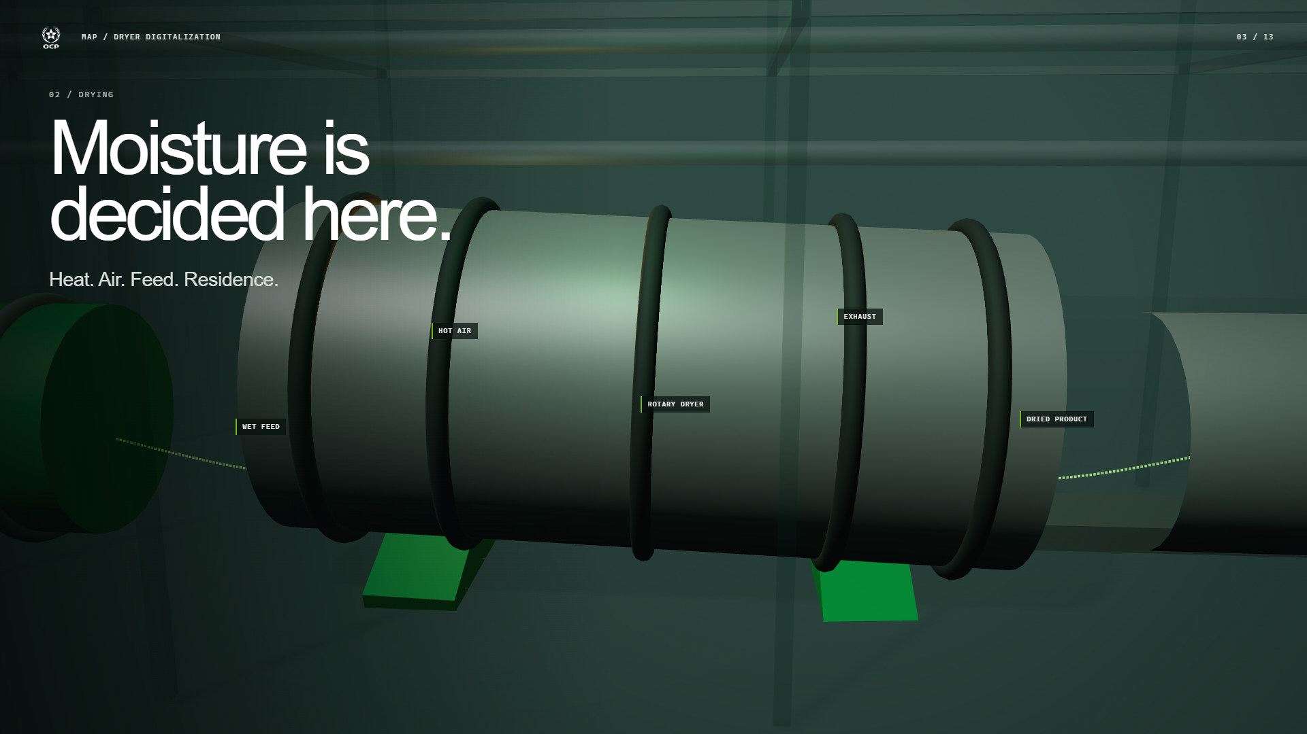
Notes:
Inside the dryer, moisture responds to coupled operating conditions. Hot air supplies the energy for heat and mass transfer. Wet-feed loading, air flow, temperature, residence time, steam pressure, vacuum, fan speed, and related temperature differences influence how much water is removed before the product leaves the drum. The animation is intentionally schematic; it is not a CFD model. Its purpose is to show why one instantaneous value cannot explain the whole result. Material has a history inside the equipment, so the data preparation includes residence-aware alignment and derived interactions rather than treating every signal as independent. Transition: rotate the dryer into the time axis and expose the fundamental gap between process evolution and laboratory visibility.
Sources: final_report/MAP_Dryer_AI_Internship_Report.pdf, Chapters 2â€“3; final_report/figures/process_photos/rotary_dryer_shell.jpeg

Slide 4
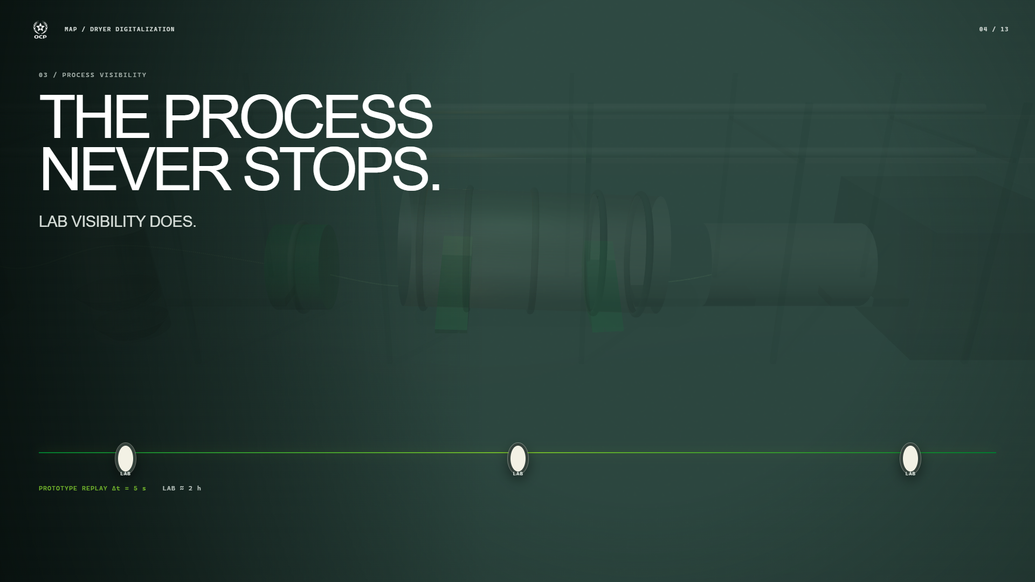
Notes:
The process continues continuously, while final-moisture laboratory observations are available approximately every two hours. Those samples remain the quality reference, but the interval between them is operationally important: conditions can drift, recover, or become unusual before the next result arrives. The dense line here represents the five-second prototype replay and visualization cadence. It must not be interpreted as a claim about the plant historian frequency. The sparse orbs represent the approximate laboratory spacing. The projectâ€™s central problem is the space between those orbs. Transition: restore the physical dryer and layer sensing and structure onto the same object.
Sources: final_report/MAP_Dryer_AI_Internship_Report.pdf, Chapter 3; models/prototype_manifest.json; data/processed/MAP_Dryer_Canonical_5s.manifest.json

Slide 5
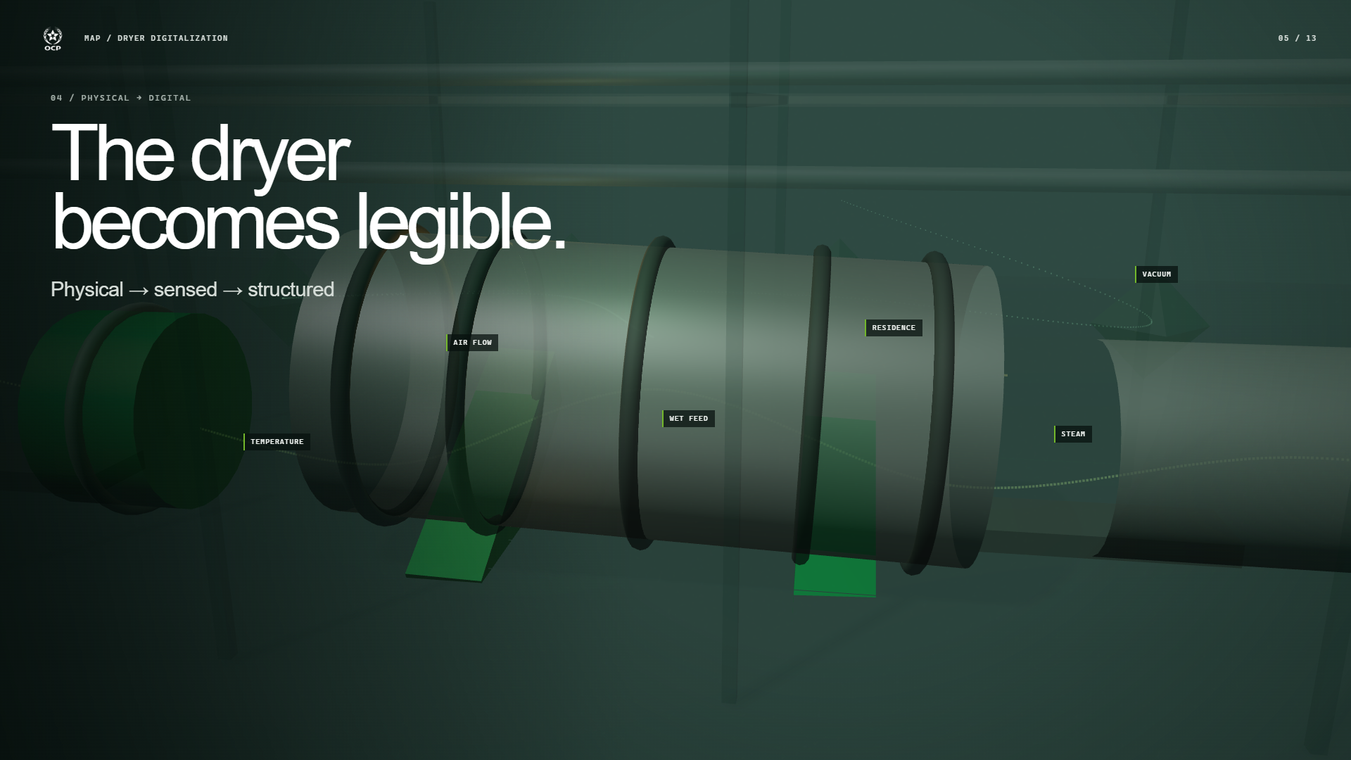
Notes:
The first digitalization step is not a modelâ€”it is a disciplined representation of the process. Fast variables are cleaned, aligned, enriched with engineering relationships, and connected to the latest available laboratory context. The green wireframe means â€œdigitally readable dryer,â€ not a high-fidelity first-principles digital twin. This distinction matters. The prototype organizes the signals required for monitoring and estimation; it does not simulate every physical phenomenon inside the equipment. Transition: the sensor pulses detach as data packets and move into the full runtime architecture.
Sources: final_report/MAP_Dryer_AI_Internship_Report.pdf, Chapters 2â€“3; final_report/figures/screenshots/pcs7_drying.jpeg

Slide 6
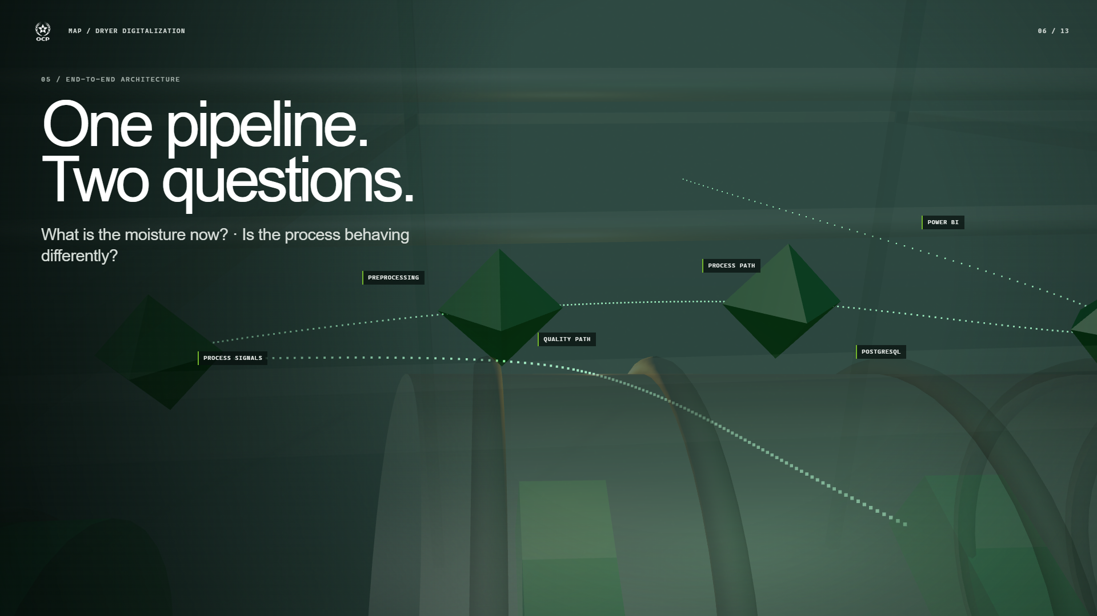
Notes:
The architecture asks two different questions from the same process stream. The quality path asks: what is the estimated final moisture between laboratory measurements? The process path asks: is the current combination of operating variables different from learned normal behavior? Python performs preprocessing and inference. The two outputs and their context are written into PostgreSQLâ€”three operational tables exposed through five views. Power BI connects through DirectQuery with automatic page refresh configured around the prototype replay. The dashboard visualizes; it does not run the models. Transition: take the left branch first and examine quality estimation.
Sources: README.md; models/model_registry.json; powerbi dashboard/README.md

Slide 7
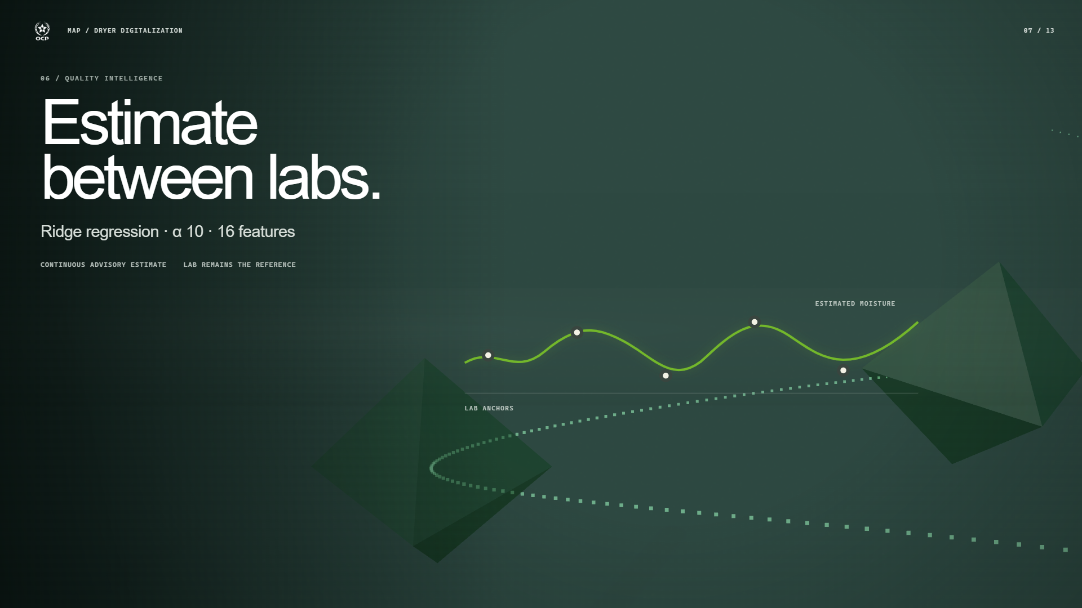
Notes:
The soft sensor is a Ridge regression model with alpha 10 and sixteen features. Those features combine current process measurements, previous laboratory context, and derived engineering relationships such as temperature drop, air-to-feed ratio, steam-temperature interaction, and a heating index. Ridge was selected after chronological validation against linear, elastic-net, random-forest, and gradient-boosting candidates. The output is a continuous advisory estimate between lab measurements. It does not redefine the laboratory value or hide uncertainty at start-up and boundary conditions. Transition: move across the shared architecture to the process-intelligence branch.
Sources: models/5s/training_report.json; models/model_metadata.json

Slide 8
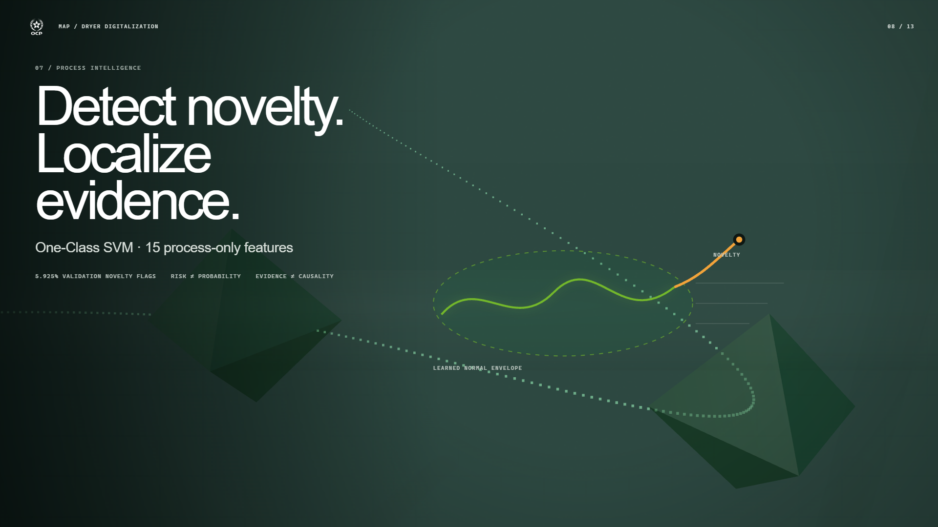
Notes:
The anomaly detector is a One-Class SVM trained only on fifteen process features. It learns the geometry of normal prototype operation. A negative decision function indicates novelty. For display, that score is transformed into a risk scale with warning and critical boundaries, but the displayed risk is not a calibrated probability. When novelty appears, robust quantiles and ranked direct contributors localize which signals provide the strongest evidence. This helps an operator decide what to verify. It does not prove root cause, so the dashboard language remains diagnostic guidance rather than causal certainty. The validation novelty flag rate was 5.925 percent. Transition: flatten the model geometry into a calm evidence stage. Before discussing ambition, show what held out.
Sources: models/5s/training_report.json; artifacts/notebook04_anomaly_evaluation.json

Slide 9
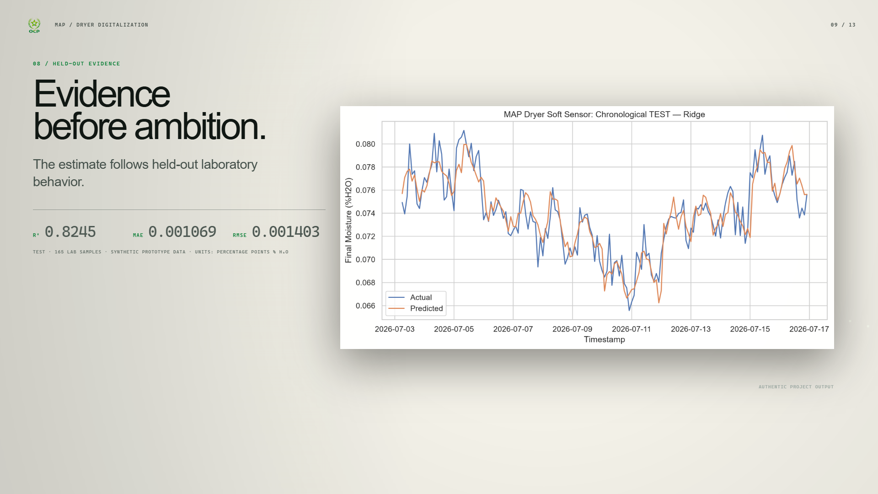
Notes:
The model was evaluated chronologically on a held-out TEST period containing 165 laboratory samples. The authentic plot shows actual laboratory moisture and the Ridge estimate over that period. The shape and turning points are followed closely, while the remaining separation is visible rather than cosmetically removed. The TEST results are R-squared 0.8245, MAE 0.001069, and RMSE 0.001403. These errors are percentage points of moistureâ€”0.001 is not one tenth of one percent expressed as a fraction. The entire 92-day dataset used for prototype development is deterministic and synthetic, with 1,589,760 gap-free five-second replay rows and 1,104 laboratory observations. That supports reproducibility, not a claim of live plant generalization. Transition: let the evidence surface expand into the real supervision artifact.
Sources: models/5s/training_report.json; figures/03_Model1_SoftSensor/05_final_holdout_predictions.png

Slide 10
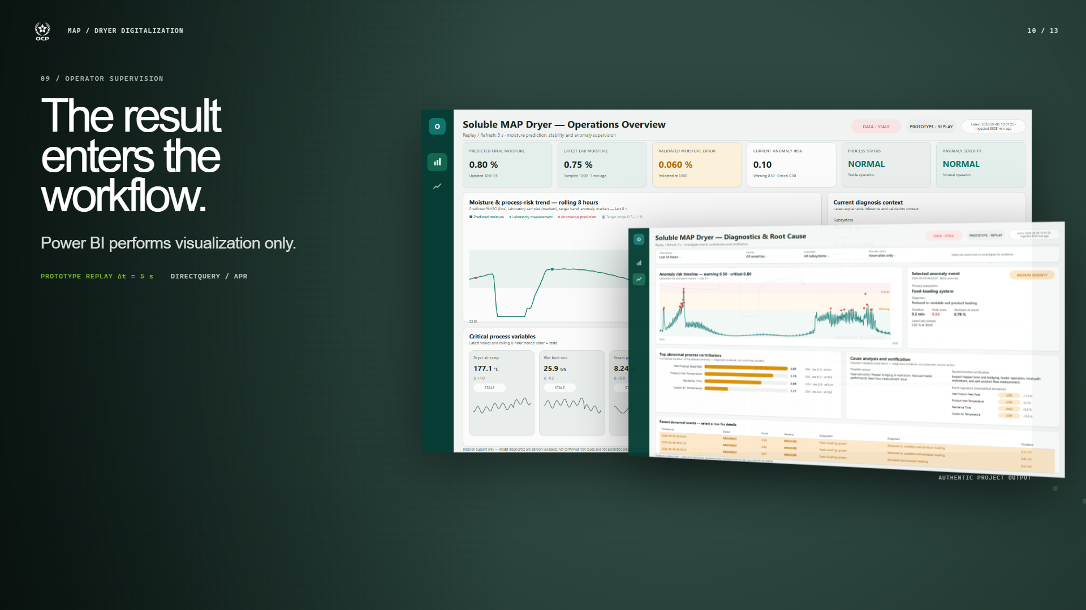
Notes:
The first Power BI page provides the operating overview: predicted moisture, latest lab value, validated error context, anomaly risk, process status, severity, recent trends, and critical variables. The second page supports investigation by selecting an anomaly event, reviewing its risk timeline, inspecting ranked contributors, and reading verification guidance. These are authentic previews from the project. Power BI performs visualization only. Native click behavior and DirectQuery refresh should be verified on the presentation machine before an optional live demo; the local web presentation itself does not fabricate filters or imitate a live data connection. Transition: move behind the dashboard and follow the data back through the entire operating loop.
Sources: powerbi dashboard/preview/preview_page1_overview.png; powerbi dashboard/preview/preview_page2_diagnostics.png

Slide 11
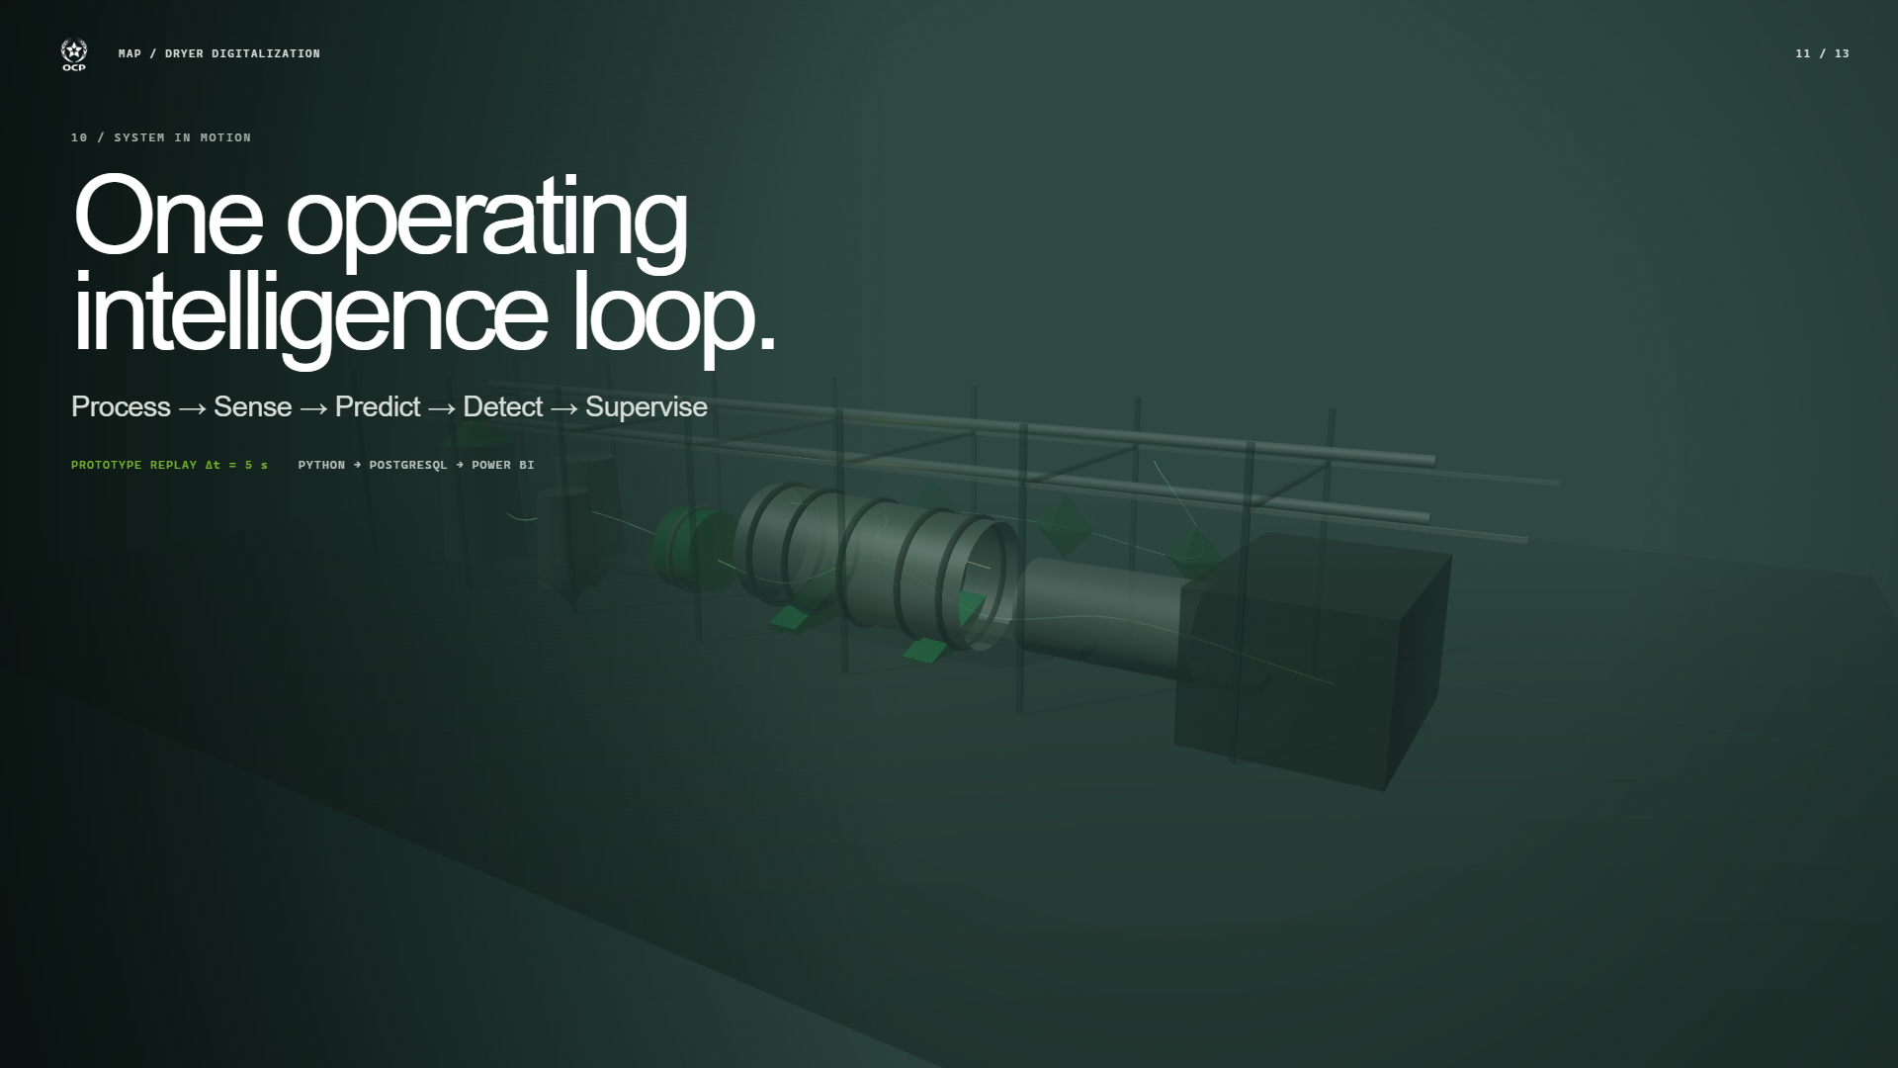
Notes:
Now the complete chain is visible at once. The physical process produces signals. The digital layer structures them. The quality path estimates moisture, the process path detects novelty and localizes evidence, PostgreSQL provides the operational interface, and Power BI returns the information to supervision. The five-second rhythm shown here is the prototype replay and visualization interval. In a plant deployment, ingestion frequency, latency, data contracts, and operating procedures must be validated against real source systems. The current implementation demonstrates integration logic and decision support, not autonomous action. Transition: freeze what exists today and draw the next stages as outlines rather than pretending they are already built.
Sources: README.md; models/prototype_manifest.json; powerbi dashboard/README.md

Slide 12
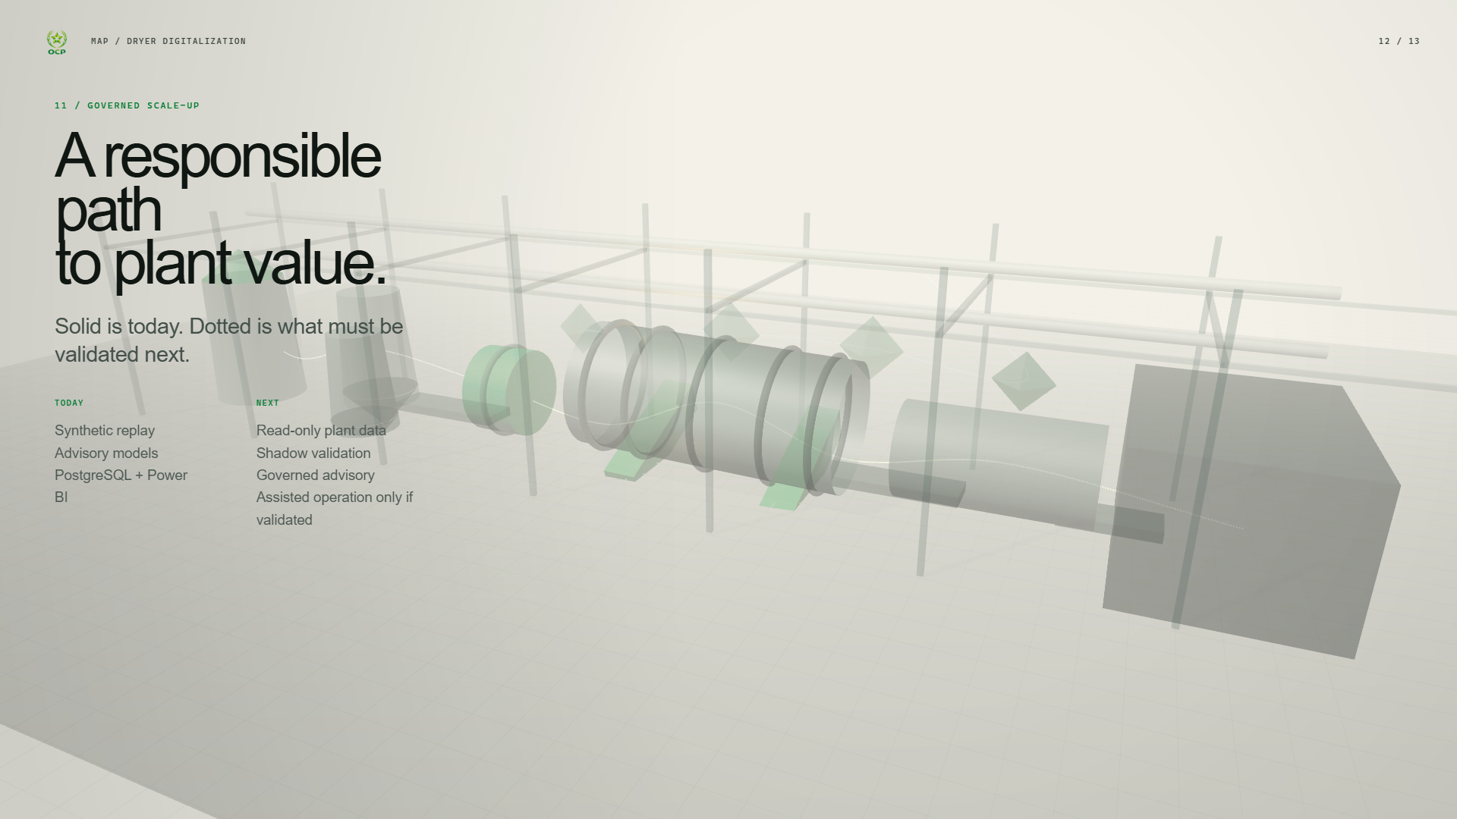
Notes:
Today, the project delivers a reproducible synthetic replay, a validated advisory soft sensor, process novelty detection with evidence localization, PostgreSQL persistence, and two Power BI supervision pages. It also delivers clear operating boundaries and tests: the repository suite passes 33 tests and 8 subtests. The next responsible step is a read-only connection to representative plant data, followed by data-quality assessment and shadow-mode validation against laboratory results and operator observations. Only after governance, performance, failure-mode, and human-factors review should the system move toward a governed advisory deployment. Assisted operation would be a later possibility only if evidence supports it; closed-loop control is not part of the current work. Transition: remove the dotted future objects and return to the same industrial world that opened the presentation.
Sources: artifacts/FINAL_VALIDATION_2026-08-24.md; final_report/MAP_Dryer_AI_Internship_Report.pdf, Conclusion

Slide 13
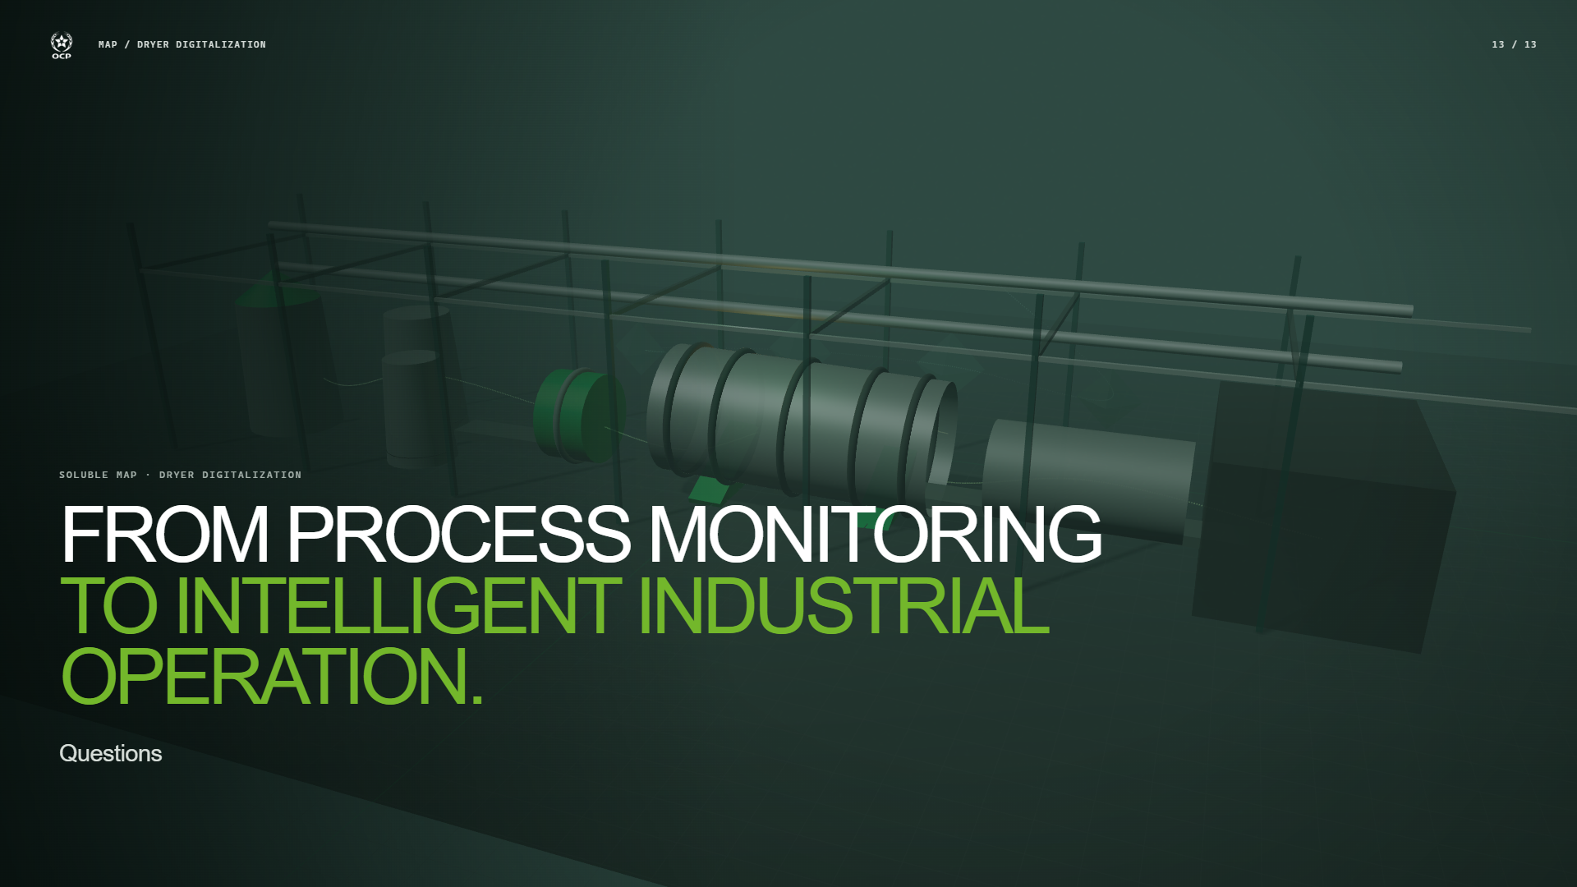
Notes:
The projectâ€™s contribution is not a single model score. It is a coherent path from process monitoring toward more intelligent industrial operation: physical variables become structured data; two complementary forms of intelligence turn that data into quality and process context; and supervision places those results in front of the operator while keeping verification, laboratory reference, and governance intact. The dryer never stops moving. The goal is to ensure that visibility and decision support no longer stop at the last laboratory point. Invite questions. If requested, open the optional Power BI demo or return to the validation scene for model detail.
Sources: final_report/MAP_Dryer_AI_Internship_Report.pdf; repository implementation and verified model artifacts

