Slide 1
Introduction to Accounting, Financial and Economic Terms.
Welcome

Slide 2
Accounting – Finance- Economics
Finance is all about raising and using money and generating more money.
Companies don’t work in a vacuum but within the economic environment
Financial Accounting is about recording the acquired and allocated capital and analyzing the financial position of the Business
Management Accounting is planning, control and Decision making using costs

Slide 3
The Relationship of accounting and finance
Financial management
Acquiring and allocation of the capital
Financial accounting
Managerial accounting
Accounting of acquired and allocated capital
Financial analysis
planning, controlling and decision-making based on calculations of costs

Slide 4
The Balance Sheet Model
  Total Value of Assets:
  Total Firm Value to Investors:
Current Assets
Current Liabilities
Long-Term Debt
Fixed Assets
1 Tangible
2 Intangible
Shareholders’ Equity

Slide 5
The Balance Sheet Model
The Capital Budgeting Decision
(Investment Decision)
Current Assets
Current Liabilities
Long-Term Debt
  What long-term investments should the firm engage in?
Fixed Assets
1 Tangible
2 Intangible
Shareholders’ Equity

Slide 6
The Balance Sheet Model
The Capital Structure Decision
(Financing Decision)
Current Assets
Current Liabilities
Long-Term Debt
How can the firm raise the money for the required investments?
Fixed Assets
1 Tangible
2 Intangible
Shareholders’ Equity

Slide 7
The Balance Sheet Model
The Net Working Capital Investment Decision
(Financial Decision)
Current Assets
Current Liabilities
Net Working Capital
Long-Term Debt
  How much short-term cash flow does a company need to pay its bills?
Fixed Assets
1 Tangible
2 Intangible
Shareholders’ Equity

Slide 8
The Firm and the Financial Markets
Firm issues securities (A)
Firm
Financial
markets
Invests
in assets
(B)
Retained
cash flows (F)
Cash flow
from firm (C)
Dividends and
debt payments (E)
Short-term debt
Long-term debt
Equity shares
Current assets
Fixed assets
Taxes (D)
The cash flows from the firm must exceed the cash flows from the financial markets.
Ultimately, the firm must be a cash generating activity.
Government

Slide 9
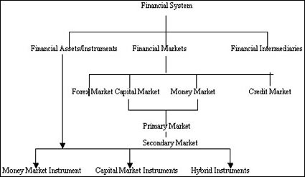

Slide 10
Indian Financial System – An Overview
STRUCTURE OF FINANCIAL MARKETS IN INDIA
Financial Markets in India
Debt Market Primary / Secondary
Forex Market
Capital Market Primary / Secondary & Depository
Insurance Life/General
Banks (including RRBs, co-op etc)
Mutual Funds, Venture Funds, Investment Bonds
RBI
RBI
SEBI
IRDA
RBI
RBI/SEBI
REGULATORY AUTHORITY

Slide 11
Thanks

