Slide 1
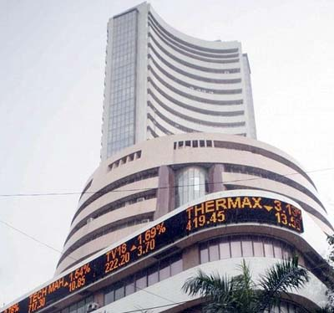
PRESENTAION ON SENSEX

Slide 2
Making sense of the Sensex
1. "Sensex" is the popular name for the Bombay Stock Exchange Sensitive Index.
2. It is the oldest stock market index currently in use.
3. Sensex is the index of market capitalization.
4. The base value is 100 on April 1, 1979.
5. Sensex consists of only 30 representative stocks.
6. These 30 are the most active and representative stocks selected from over 6,300 scrip's that are listed on the BSE.
7. The total market capitalization of these 30 stocks accounts for more than 38 per cent of the aggregate market capitalization of all BSE stocks.
8. The Sensex composition is modified by the BSE authorities at irregular intervals, to keep it in tune with the latest realities of the market.

Slide 3
List of BSE SENSEX companies
The BSE Sensex currently consists of the following 30 major Indian
Name of the company Industry Name Market cap Axis Bank Ltd. Bank – Private Large Cap
Bajaj Auto Ltd. Automobile Large Cap
Bharat Heavy Electricals Ltd. Electric Equipment Large Cap
Bharti Airtel Ltd. Telecommunication - Large Cap
Cipla Ltd. Pharmaceuticals & Drugs Large Cap
Coal India Ltd. Mining & Minerals Large Cap
Dr. Reddys Laboratories Ltd. Pharmaceuticals & Drugs Large Cap
GAIL (India) Ltd. Gas Transmission/Marketing Large Cap
HDFC Bank Ltd. Bank - Private Large Cap
Hero MotoCorp Ltd. Automobile Two & Three Wheelers Large Cap
Hindalco Industries Ltd. Aluminum & Aluminum Products Large Cap
Hindustan Unilever Ltd. Household & Personal Products Large CAP
Infosys Ltd. IT - Software Large Cap

Slide 4
Name of the company Industry Name Market cap
ITC Ltd. Cigarettes/Tobacco Large Cap
Larsen & Toubro Ltd. Engineering - Construction Large Cap
Mahindra & Mahindra Ltd. Automobiles-Tractors Large Cap
Maruti Suzuki India Ltd. Automobiles - Passenger Cars Large Cap
NTPC Ltd. Power Generation/Distribution Large Cap
Oil & Natural Gas Corporation Ltd. Oil Exploration Large Cap
Reliance Industries Ltd. Refineries Large Cap
Sesa Sterlite Ltd. Mining & Minerals Large Cap
State Bank Of India Bank - Public Large Cap
Sun Pharmaceutical Industries Ltd. Pharmaceuticals & Drugs Large Cap
Tata Consultancy Services Ltd. IT - Software Large Cap
Tata Motors Ltd. Automobiles-Trucks/Lcv Large Cap
Tata Power Company Ltd. Power Generation/Distribution Large Cap
Tata Steel Ltd. Steel/Sponge Iron/Pig Iron Large Cap Wipro Ltd. IT - Software Large Cap

Slide 5
Index (Sensex & NIFTY)....!!!
Stock is the smallest unit of ownership of a company in other words stock is a share in the ownership of the company. Stock is also called as share and equity. If a person purchases stocks of a company it means that he is one of the owners of the company, and ownership increases as he goes on purchasing more amount of stocks. Technically speaking a shareholder of a company owns a small part of every assets of the company such as building, furniture, trademarks, etc. A share holder holds ownership in all tangible and intangible assets of the company.
Initially stocks were represented by share certificates which worked as the proof of ownership of the company but now it is dematerialized and every trading transaction happens through computer using DEMAT accounts. There are many stock exchanges in our country like BSE, NSE, Calcutta stock exchange, Bangalore Stock Exchange, etc. But NSE and BSE are major among them most of the stocks are traded in these two Exchanges.

Slide 6
SENSEX
Sensex stands for “sensitive index”, it represents BSE (Bombay Stock Exchange). Sensex indicates all major companies of BSE. Sensex is calculated using share prices of 30 major companies which are listed in BSE. If the Sensex goes up it means that share values of most of the major companies have gone up and vice versa.
NIFTY
Nifty indicates NSE; it is the leading index for large companies in the National Stock Exchange of India. It consists of 50 companies representing 24 sectors of the economy. NIFTY represents approximately 47% of the traded value of all stocks on the National Stock Exchange. It is calculated using base year 1995 and base index value 1000.

Slide 7
Criteria for selecting stocks to calculate Index
Below given are the criteria for selecting stocks to calculate Index
Listing history: The Company should have listing history on BSE for at least one year
Track record: company should have good track record.
Market capitalization: Company should be one among 100 market capitalizations of BSE, and each company should have more than 0.5% of total market capitalization of BSE index.
Frequency of trading: company stocks should be traded on each and every trading day for the last one year.
Industrial representation: company should be a leader in the industry it represents.

Slide 8
Market Capitalisation
Market capitalization is the total worth of all outstanding (issued) shares of a company. It represents the total worth of a company.
Market capitalization= No of shares outstanding x market price of share
Free Float Market Capitalization
Free float concept is an index construction methodology which makes use of free float shares in the market. Free float market capitalization is the total worth of all shares of a company which are available for trading in the open market. These shares are called free float shares and are available for trading by anyone.

Slide 9
Example: Company ‘X’ issues 1000 shares, out of which 200 shares held by government, 500 shares by directors of the company and remaining 300 shares are available in the open market for trading. Market price of share is 10 Rs.
Here;
Total Shares = 1000
Shares Held by Government = 200
Shares Held by Directors = 500
Shares available in the Open Market = 300
Market price of share = 10
Here total market capitalization of the company is 1000 X 10 = 10000 and
Free float market capitalization of the company is 300 X 10 = 3000

Slide 10
Calculation of SENSEX and NIFTY
Sensex calculation is practiced since 1986. Initially it had been calculated using total market capitalization method but the methodology changed to free float market capitalization since from 2003. Hence these days Sensex is calculated using free float market capitalization of 30 major BSE listed companies and by using base value 100 (1978-79). SENSEX is calculated for every 15 seconds.
Formula for Sensex
SENSEX = (sum of free float market cap of 30 major companies of BSE) X Index value in 1978-79 / Market cap value in 1978-79.

Slide 11
Example: suppose BSE index (SENSEX) consist of only two stocks such as ‘X’ and ‘Y’
Company ‘X’ has 1000 outstanding shares out of which only 500 are available for trading in open market. Market price of share is Rs.100.
Company ‘Y’ has 2000 outstanding shares out of which 1000 shares are held by promoters and remaining 1000 are free float shares (open market shares). Market price of share is Rs.50.

Slide 12
Calculation of Market Capitalization
Stock Issued Stocks Market price Market Cap.
X 1000 100 100000
Y 2000 50 100000
Calculation of Free Float market capitalization
Stock Op Market Stocks Market price Market Cap.
X 500 100 50000
Y 1000 50 50000

Slide 13
Sum of free float market cap of company X and company Y is 50000+50000 = 100000
Assume market cap during 1978-79 is 25000
Now Apply formula;
100000*100/25000 = 400
The same method is used to calculate NSE nifty but includes two major changes.
Base year is 1995 and base value (index value) is 1000
Nifty represents stocks of 50 major companies of NSE.
Formula for NIFTY
NIFTY = (Sum of free flow market cap of 50 major stocks of NSE) X Index value in 1995 / market cap value in 1995.

Slide 14
Basics of Sensex calculation
1. Calculate market capitalisation of all 30 Sensex stocks on a particular date in the same manner and add this up to get the total market capitalisation of Sensex stocks.
2. Assume that this total market capitalisation is equal to the closing Sensex value on that particular date. The Sensex of any future date can be calculated as a proportion of market capitalisation applied to this Sensex value.
3. An example below shows that the total market capitalisation on April 10, 2000 was Rs 3,731.38 billion, when the Sensex value was 5442.86. If, the total market capitalisation on April 17, 2000 was Rs 3,346.18 billion, then the Sensex for April 17, 2000 is calculated as:
5442.86 * 3346.18 / 3731.38 = 4880.97

Slide 15
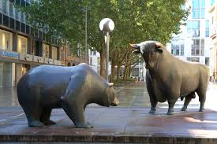
Terminologies of sensex:
Stock
Bull market
Broker
Bear market

Slide 16
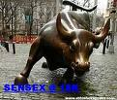
stock: Stock means representation of ownership in a company. stock, share, equity, and scrips mean one and the same thing. Bull market: It refers to a continuous phase of rising share prices. Bull market is characterized by optimism about the upward movement of prices in the future.

Slide 17
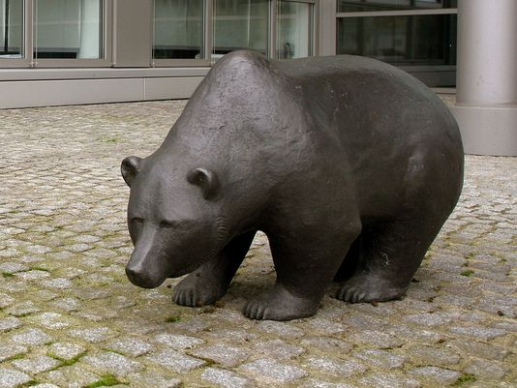
Broker: A member of the stock exchange who is licensed to buy or sell shares on his own or on his clients behalf.
Bear market:
A bear market refers to a continuous phase of declining share prices. Bear market is characterized by over all pessimism as market participants expect price to decline in future.

Slide 18
How sensex can effect indian economy?
An indicator of the faith of the investors. if it is high its shows that economic conditions are quite good and the future is prosperous.
Foreign investors get attracted towards investing in the country if sensex is rising, because they think its safe to invest, so this brings foreign investment in country which causes further development.
When sensex is declining neither local or foreign investors invest hence leading to downfall in economy of country.

Slide 19

Stock Market Definitions and Meanings
Stock market : Stock market / Share market / Equity market / Capital market is a public market for the trading of company stocks & derivatives at an agreed price conducted by professional stock brokers. Share market : Share market / Stock market / Equity market / Capital market is a public market for the trading of company shares and derivatives at an agreed share price through stock exchanges. Stock Exchange: Exchange or transfer of shares ownership by professionally qualified stockbrokers. Stock trading: A stock trader / stock investor who buys and sells stocks or financial instruments in the financial markets.

Slide 20
Investment: Financial instrument to appreciate the capital in future. Technical analysis: Security analysis for forecasting the direction of prices through the study of historical market / stocks price data. Fundamental analysis: Method of security valuation (stocks analysis) by examining the company's financials and operations without past performance. Forex: Worldwide decentralized over-the-counter financial market for currency trading of various global countries. Market capital: Market capitalization of a company by multiplying the current market price(CMP) of share by the total number of shares issued by the company.
FPO: Follow on public offer is same as initial public offer (IPO), but second time come to rise the capital. Open offer: Same as rights issue, but cannot sell entitlement in an open offer.

Slide 21
Stock: The stock or capital stock of a business entity represents the original capital invested in the business by promoters. Share: Part of the company or enterprise issues to public or private to rise Money. Equity: The value of an ownership in property or business, generic term for equity is stock. Multibagger: Company with strong fundamental values to increase investor wealth in future. Derivatives: Derivatives is a financial instrument, an agreement between two people or two parties. Stock broker: Regulated professional broker who buys and sells equity shares. Intraday: Trade process of Buy and Sell within single trading day, It means square off the open positions before close of markets.

Slide 22
BTST: BTST is buy the stocks today to sell tomorrow, able to sell the shares before receives the delivery of shares. STBT: STBT is different when compare with BTST, It is possible only if holding shares in account. Demat account: In India, refers to a dematerialized account(Demat). Securities are held in electronic form instead of paper certificates bu NSDL and CDSL. Swing trading: Swing Trading is non intraday based trading at the same time not for long-term, purely short-term means more than one day to within some weeks. Brokerage: Brokerage gives two different meanings, first one is a firm engaged in buying and selling of stocks for clients is the business or office of a broker. Second one is fee / charge paid to broker. stock brokers charges a fee to act as intermediary between buyer and seller.

Slide 23
Business: A legally approved organization designed to provide goods, services, or both to consumers. also known as company, enterprise or firm. Speculation: Generally an opinion based on incomplete evidence, purchasing risky investments in share market without proper knowledge or fundamental news that present the possibility of large profits, but including higher-than-average possibility of capital loss. EPS: Earnings per share(EPS), using to analyze the company's earnings performance. PE ratio: Price earning(PE), divide the share price by EPS to know the PE ratio. Top line: Top lines of an income statement like Sales and Revenue. Bottom line: Bottom lines of an balance statement like net profit. Bonus share: Bonus share means an extra dividend paid to shareholders in the form of shares. IPO: Initial public offer(IPO) of shares to public through stock exchanges. Rights issue: Offer the shares to existing share holders at discount price.

Slide 24
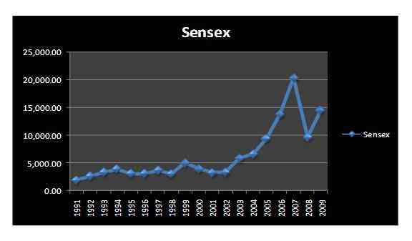
Graph showing sensex of few years:

Slide 25
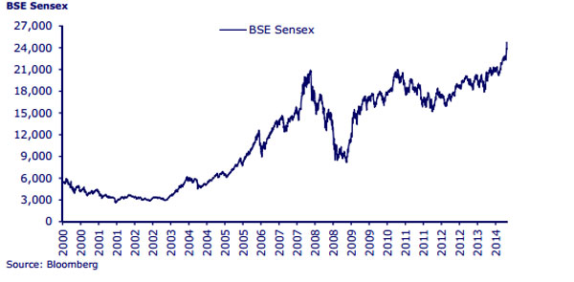

Slide 26

LONDON INTERNATIONAL STOCK EXCHANGE

Slide 27
LONDON INTERNATIONAL STOCK EXCHANGE

Slide 28
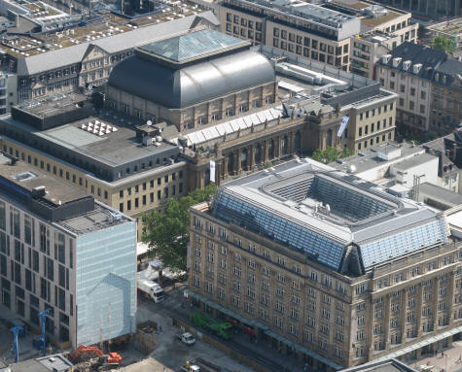
FRANKFURT STOCK EXCHANGE

Slide 29
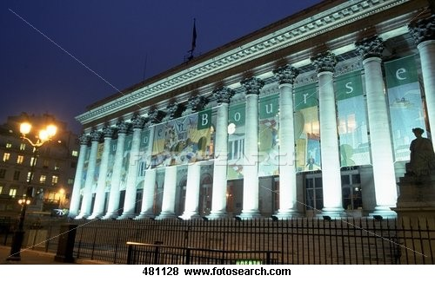
PARIS BOURSE

Slide 30

TOKYO STOCK EXCHANGE

Slide 31
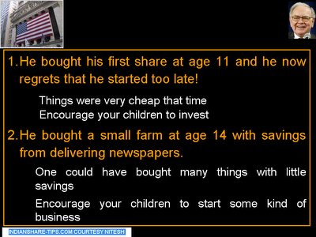

Slide 32
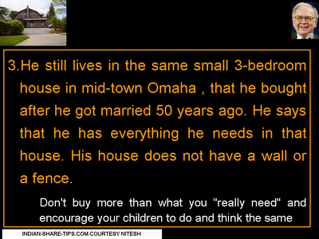

Slide 33


Slide 34
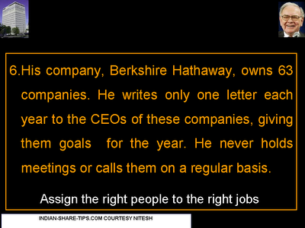

Slide 35
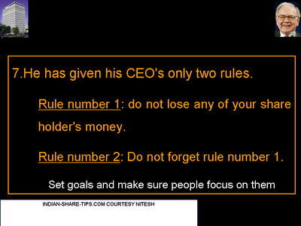

Slide 36


