Slide 1
Physical Design Patterns in Information Systems
Karim Ali & Sarah Nadi
CS848 – Spring 2010
July 14th, 2010

Slide 2
Outline
Database lifecycle
Elements of Physical Design in Information Systems
Different Physical Designs
Disk Based Relational Database Systems (DRDB)
Memory Based Relational Database Systems (MMDB)
XML Databases
Data Warehouses
Future Work
Open Problems
Summary & Conclusions

Slide 3
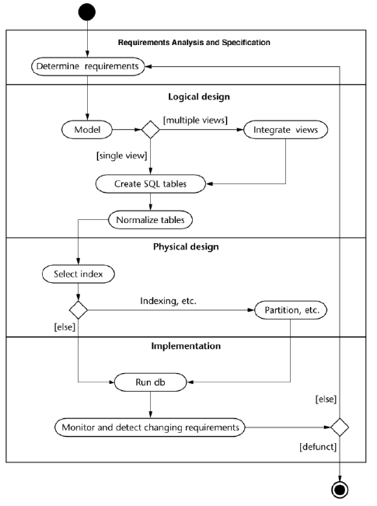
Database Lifecycle

Slide 4
Elements of Physical Design

Slide 5
Materialized Views
Repeated complicated queries should not have to be executed every time
Save execution time, and I/O reads by pre-computing the results & storing them
Materialized views are stores on disk
Rewriting queries using materialized views speeds up execution

Slide 6
Indexes
Data needs to be organized for quick searching
Need to minimize expensive I/O operations

Slide 7
Partitioning
Divides the data into related partitions
Horizontal Partitioning: divides tables into sets of rows according to a specific attribute (E.g. Date ranges)
Group Horizontal Partitioning: groups tuples that are more frequently used together
Single Vertical Partitioning: divides data into groups by attributes of the same type
Group Vertical Partitioning: divides table into the sets of attributes that are usually accessed together
Reduces table scan time
Improves performance

Slide 8
Clustering
Records that are accessed together are physically located together
Reduces the number of pages to be queried
Can have multi-dimensional clustering based on more than one criteria

Slide 9
Other Methods
Data Compression:
Fitting more data into a fixed amount of space
Striping:
Distribute data that is accessed together accross multiple disks
Mirroring:
Duplicating the data to multiple disks
Denormalization:
Refine global schema to reflect query and transaction requirements

Slide 10
Physical Design of Different Information Systems

Slide 11
Disk Based Relational Database Systems (DRDB)
Data is stored on disk as relations (i.e. tables)
Data is organized based on a relational model (first order predicate logic)
Less expensive than in-memory databases
Queries are expressed in
Relational calculus (i.e. declarative)
Relational algebra (i.e. procedural)

Slide 12
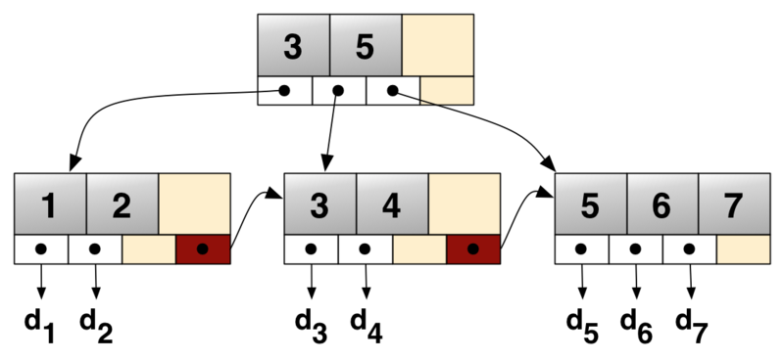
DRDB: Indexes
B+tree

Slide 13
DRDB: Indexes Cont’d
B+tree
Primary indexing method used for DRDB
DB2, Oracle, SQL Server
Pros
Fast scans (short tree depth)
Dynamic maintenance (self-balancing tree)
Stores key values in sorted order (i.e. facilitates range search)
Cons
Splitting/Consolidation costs

Slide 14
DRDB: Indexes Cont’d
Composite Index
Defined on multiple attributes
Based on B+tree index
Concatenated key values
Useful for cases when it is inadequate to index one attribute alone
E.g. CITY & STATE

Slide 15
DRDB: Indexes Cont’d
Bitmap Index
Bit array data structure (bitset, bitmap)
Pros
Outperforms B⁺-trees for low cardinality attributes (e.g. gender)
Less storage space
Queries are answered using bitwise logical operations
Cons
Not amenable to index updates (locking)

Slide 16
DRDB: Partitioning
 | Range Partitioning | List Partitioning | Hash Partitioning | Composite Partitioning
How ? | If key falls in range | List of keys | Hash function | Hybrid
Why? | Disk limits | Group point values | Range/List are N/A | According to needs
Benefits | Partition elimination Improved administration Fast roll-in/out Implicit clustering
Example | - Zipcode Time range | Regions States | EmployeeId ProductId | Hash then List
DBMS | MySQL, DB2, Oracle, PostgreSQL, SQL Server | MySQL, Oracle, PostgreSQL, SQL Server | MySQL, Oracle | MySQL, Oracle

Slide 17
DRDB: Clustering
Grouping related items together for
Efficiency of access
Resource utilization
Achieved on the page level on disk
Pros
Very useful for multidimensional queries (e.g. group by)
Reduced I/O operations
Reduce CPU cost
Cons
Difficult to define clustering keys, clustering scheme, and the granularity of clustering

Slide 18
Main Memory Database Systems (MMDB)
Primary copy of data resides in main memory
Cheaper to access main memory
MMDB have better performance
Usually have an archived copy of the data in case of crashes

Slide 19
MMDB: Indexes
Use:
Reduce overall computation time without using too much extra space
Factors to consider:
I/O operations are cheaper
Should be cache conscious
No need to store data in the index structure
Categories of indexes used:
B Trees
T Trees
Search Trees

Slide 20
MMDB: Indexes Cont’d
Index Structure | Features suitable for MMDB | Cache Consciousness
B Tree | Good storage utilization Reasonably quick searching Fast updating | Reasonable cache behaviour if node fits in cache line
B+ Tree | Wastes space since all data is stored in the leaves Reasonably quick searching Fast updating | Reasonable cache behavior if node fits in cache line
Cache Sensitive B+ Tree (CSB+Tree) | Same features of B+ Trees | Good cache performance due to improved locality & lower tree height
Prefetching B+ Tree (pB+ Tree) | Same features of B+ Trees | Improved cache performance by prefetching more data in each cache miss Increased node size leads to same benefits of CSB+ Tree

Slide 21
MMDB: Indexes Cont’d
Index Structure | Features suitable for MMDB | Cache Consciousness
Cache Sensitive T Tree (CST Tree) | Binary Search Tree used for maximum value of each node used for faster search More space efficient by removing pointers and using array stores. Index calculation used to allocate values | Node size is aligned with cache line wize to avoid misses
Cache Sensitive Search Tree (CSS Tree) | Fast traversal in log_{m+1}n (m is the number of keys per node) Mainly suitable for read environments | Good cache behaviour since m is chosen to fit in the cache line size

Slide 22
MMDB: Materialized Views
Not beneficial to MMDB
Cost of computing complicated queries is much less
Maintenance costs will outweigh benefit

Slide 23
MMDB: Partioning
Not necessary in main memory
Used for the secondary storage on disk to speed up reload
Horizontal partitioning
Single vertical partitioning

Slide 24
MMDB: Clustering
Not applicable to MMDB
equential access in main memory is not cheaper than random or dispersed access

Slide 25
Data Warehouses
Collection of data and decision support technologies
Used in:
Retail: user profiling
Finance: claims analysis, risk analysis, credit card analysis, and fraud detection
Healthcare: outcomes analysis

Slide 26
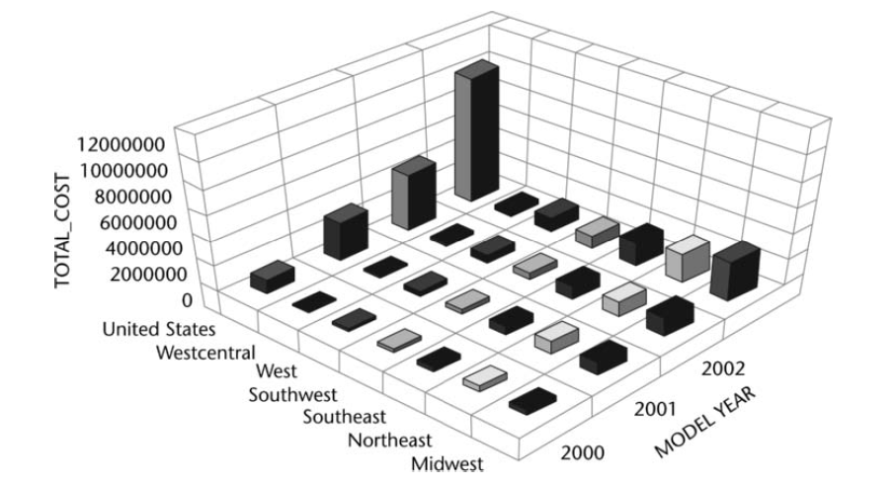
Data Warehouses Cont’d

Slide 27
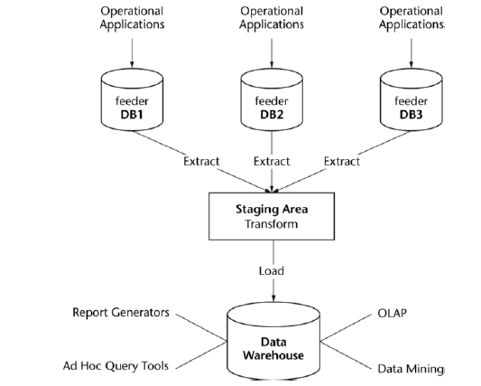
DW: Design

Slide 28
DW: Design Cont’d
 | ROLAP | MOLAP | HOLAP
Storage | Relational DBs | Data Cubes | Hybrid
Dimensions | Composite Keys | Arrays
Characteristics | Each row is a cell in the cube | Each cell is represented by a fixed calculable location
Good For | Sparse Data | Dense Data

Slide 29
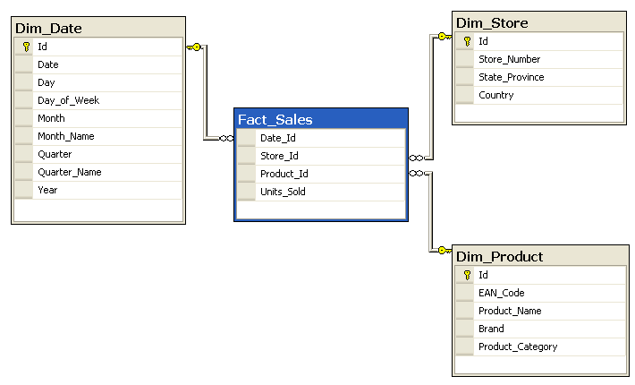
DW: Design Cont’d
Star Schema

Slide 30
DW: Challenges
Data is usually
Extremely large
Multi-dimensional
Priority for aggregated and summarized data
Ad-hoc and complex queries
Expensive operations: aggregation, and joins
the fact table participates in every join
Figure ??

Slide 31
DW: Indexes
Universal B⁺-Trees (UB-Trees)
Variation of B⁺-trees
Records are stored at the leaves
Multidimensional data is linearized
Records are stored according the Z-order
Pros
Well suited for high cardinality attributes
Excellent for point and interval queries
Cons
Poor performance with low cardinality attributes
More I/O operations (result ordered by key values)

Slide 32
DW: Indexes Cont’d
Bitmap Index
Pros
Useful when combined with star schema
Joining a large fact table with multiple small dimension tables
Reduces search space before performing expensive joins
Cons
Not amenable to index updates (though not an issue for DW)

Slide 33
DW: Indexes Cont’d
Projection Index
Values preserve their table row order in the index
Pros
More results per I/O operation since a query in DW usually retrieves a few columns from a given table
Cons
Can only fetch raw data (e.g. column list in selection)

Slide 34
DW: Materialized Views
Materialize frequent queries of the base tables as views
Pre-compute and store aggregated data (i.e. summaries)
Pre-compute expensive joins
To materialize or not?
Workload characteristics
Cost for incremental update
Storage requirements

Slide 35
DW: Materialized Views Cont’d
Pros
Behaves like an index
Improves performance through fast lookups
Useful for rollup and drilldown operations
Cons
Not applicable to all queries (e.g. ad-hoc queries)

Slide 36
DW: Partitioning
Dividing database objects into smaller more manageable pieces
Pros
Ability to manage larger databases
Enhances query performance over large tables
Enables parallel processing
Facilitates data compression
Cons
Complexity: managing partitions
Efficiency: number of partitions affects the performance of meta data operations (e.g. browsing the data cube definition)
Might affect data refresh operations

Slide 37
DW: Partitioning Cont’d
 | Horizontal Partitioning | Vertical Partitioning
How? | Splitting out rows | Splitting out columns
Based on? | Time dimension (type of range partitioning) Predefined table size Usage | Normalization Move seldom used columns (i.e. row splitting)

Slide 38
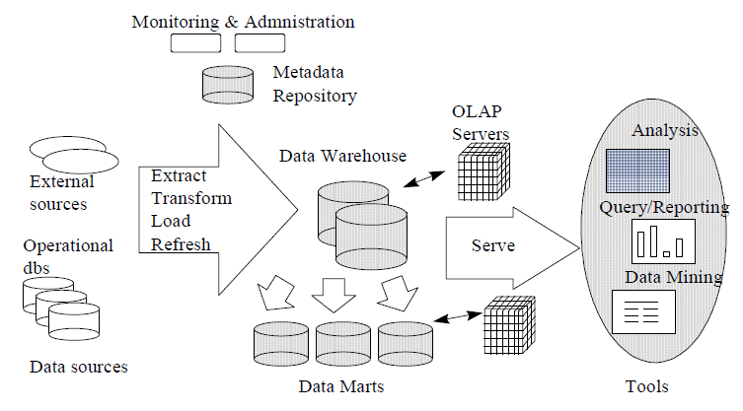
DW: Clustering
Data is clustered by nature

Slide 39
XML Databases
Store, organize & query XML documents
XML-enabled DBs:
Maps XML documents to relational tables
Native XML DBs:
Data structures store actual XML

Slide 40
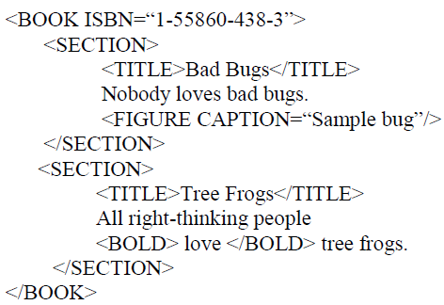
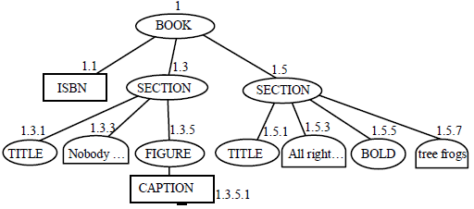
XML DBs: Indexes
XML-enabled DB (Microsoft SQL Server 2005)
Shred XML data in a relational table with columns: ORDPATH, tag, node type, value, path ID
Use a B+ Tree index based on combination of primary key of base table & the ORDPATH

Slide 41
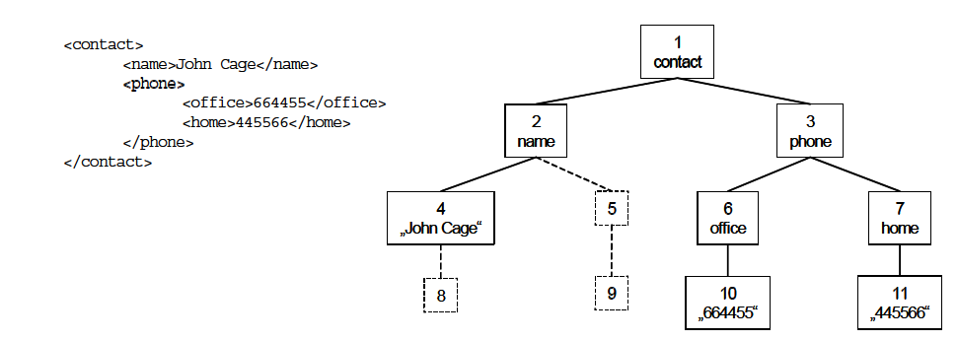
XML DBs: Indexes Cont’d
Native XML DB (E.g. eXist, TIMBER)
Numbering schema for the XML nodes
B+ Tree used on the numbered nodes

Slide 42
XML DBs: Materialized Views
Greatly enhances performance
XQuery and Xpath query results are materialized
Query rewriting is more tricky due to semi-structured nature & complicated querying languages

Slide 43
XML DBs: Paritioning
Horizontal partitioning
Based on node type
Through inlining

Slide 44
XML DBs: Clustering
Elements & sub-elements are clustered together
XML documents are clustered based on structural similarity

Slide 45
Future Work & Open Problems

Slide 46
Future Work
Looking at automating physical design (put some examples of work here and say its time permitting)

Slide 47
Open Problems in Physical Design

Slide 48
Summary & Conclusions

Slide 49
 | Index Structures | Materialized Views | Partitioning | Clustering
DRDB
MMDB | No need to store actual data values in index Larger node size that is aligned with cache line size Uses: B Tree, B+ Tree, pB+ Tree, CSB+ Tree, T Tree, CST Tree, CSS Tree | Not needed since processing and memory access is cheap | Only needed in secondary storage to speed up reloading in case of a crash Horizontal & single vertical partitioning | Not needed since random access in main memory costs the same as sequential access
Data Warehouses
XML DB | Need a numbering scheme B+ Tree used | XQuery and XPath results are materialized | Horizontal partitioning based on inlining or node type | Based on document order or structural similarity

Slide 50
Conclusions

Slide 51
Thank you

Slide 52
References

