Slide 1
Physical Design Patterns in Information Systems
Karim Ali & Sarah Nadi
CS848 – Spring 2010
July 14th, 2010

Slide 2
Outline
Database lifecycle
Elements of Physical Design in Traditional Databases
Different Physical Designs
Memory Based Relational Database Systems (MMDB)
XML Databases
Data Warehouses
Future Work
Summary & Conclusions

Slide 3
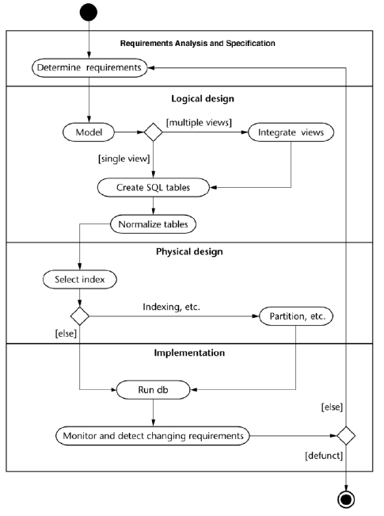
Database Lifecycle

Slide 4
Elements of Physical Design
Traditional Disk Based Relational Databases

Slide 5
Traditional database systems
Disk Based Relational Databases (DRDB)
Data is stored on disk as relations (i.e. tables)
Data is organized based on a relational model
Elements of physical design:
Index Structures
Materialized Views
Partitioning
Clustering
Data compression, striping, mirroring & denormalization

Slide 6
1. Index Structures
Data needs to be organized for quick searching
Need to minimize expensive I/O operations
Examples:
B Trees
Bitmap Index
Hashtable
...

Slide 7
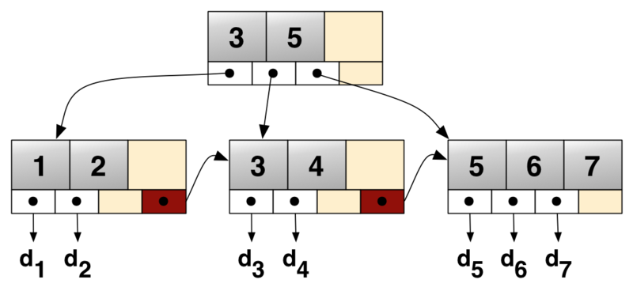
1. Index Structures Cont’d
B+tree

Slide 8
2. Index Structures Cont’d
Index Structure | Features | Pros | Cons
B+tree | Can be defined on one or more attributes (composite index) Primary indexing method used for DRDB (DB2, Oracle, SQL Server) | Fast scans (short tree depth) Dynamic maintenance (self-balancing tree) Stores key values in sorted order (i.e. Facilitates range search) | Splitting/consolidation costs
Bitmap Index | Bit array data structure (bitset, bitmap) | Outperforms B+ trees for low cardinality attributes (e.g. Gender) Less storage space Queries are answered using bitwise logical operations More efficient joins | Not amenable to index updates (locking)

Slide 9
2. Materialized Views
Repeated complicated queries should not have to be executed every time
Saves execution time & I/O reads by pre-computing the results
Materialized views are stored on disk
Rewriting queries using materialized views speeds up execution

Slide 10
3. Partitioning
Divides the data into related partitions
Horizontal Partitioning: divides tables into sets of rows according to a specific attribute (E.g. Date ranges)
Group Horizontal Partitioning: groups tuples that are more frequently used together
Single Vertical Partitioning: divides data into groups by attributes of the same type
Group Vertical Partitioning: divides table into the sets of attributes that are usually accessed together
Reduces table scan time
Improves performance

Slide 11
3. Partitioning Cont’d
Types of Horizontal Partitioning:
 | Range Partitioning | List Partitioning | Hash Partitioning | Composite Partitioning
How ? | If key falls in range | List of keys | Hash function | Hybrid
Why? | Disk limits | Group point values | Range/List are N/A | According to needs
Benefits | Partition elimination Improved administration Fast roll-in/out Implicit clustering
Example | - Zipcode Time range | Regions States | EmployeeId ProductId | Hash then List
DBMS | MySQL, DB2, Oracle, PostgreSQL, SQL Server | MySQL, Oracle, PostgreSQL, SQL Server | MySQL, Oracle | MySQL, Oracle

Slide 12
4. Clustering
Grouping related items together for
Efficiency of access
Resource utilization
Achieved on the page level on disk
Pros
Very useful for multidimensional queries (e.g. group by)
Reduced I/O operations
Reduce CPU cost
Cons
Difficult to define clustering keys, clustering scheme, and the granularity of clustering

Slide 13
5. Other Methods
Data Compression:
Fitting more data into a fixed amount of space
Striping:
Distribute data that is accessed together accross multiple disks
Mirroring:
Duplicating the data to multiple disks
Denormalization:
Refine global schema to reflect query and transaction requirements

Slide 14
Physical Design of Different Information Systems

Slide 15
1. Main Memory Databases (MMDB)

Slide 16
MMDB Overview
Primary copy of data resides in main memory
Cheaper to access main memory
MMDB has better performance
Usually has an archived copy of the data in case of crashes

Slide 17
MMDB 1. Index Structures
Use:
Reduce overall computation time without using too much extra space
Factors to consider:
I/O operations are cheaper
Should be cache conscious
No need to store data in the index structure
Categories of indexes used:
B Trees
T Trees
Search Trees

Slide 18
MMDB 1. Index Structures Cont’d
 | Features suitable for MMDB | Cache Consciousness
B+ Tree | Some space waste since all data is stored in the leaves Reasonably quick searching Fast updating | Reasonable cache behaviour if node fits in cache line
Cache Sensitive B+ Tree (CSB+Tree) | Same features of B+ Trees | Good cache performance due to improved locality & lower tree height (larger node size)
T Tree | Contain pointers to data values instead of the values themselves leading to better space utilization Good update & storage characteristics of B Tree | Cache behaviour was not considered at time of design
Cache Sensitive T Tree (CST Tree) | Binary Search Tree used for maximum value of each node for faster search More space efficient by removing pointers and using array stores. Index calculation used to allocate values | Node size is aligned with cache line size to avoid misses

Slide 19
MMDB 2. Materialized Views
Not beneficial to MMDB
Cost of computing complicated queries is much less
Maintenance costs will outweigh benefit

Slide 20
MMDB 3. Partioning
Not necessary in main memory
Used for the secondary storage on disk to speed up reload
Horizontal partitioning
Single vertical partitioning

Slide 21
MMDB 4. Clustering
Not applicable to MMDB
Sequential access in main memory is not cheaper than random or dispersed access

Slide 22
2. Data Warehouses

Slide 23
Data Warehouses Overview
Collection of data and decision support technologies
Used in:
Retail: user profiling
Finance: claims analysis, risk analysis, credit card analysis, and fraud detection
Healthcare: outcomes analysis

Slide 24
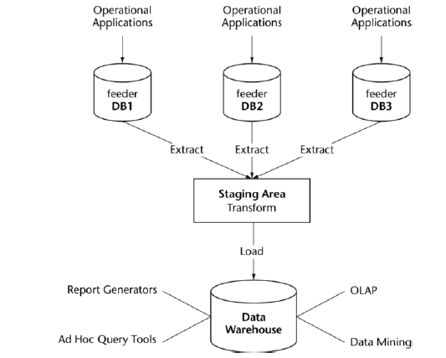
Data Warehouses Design

Slide 25
Data Warehouses Design Cont’d
 | ROLAP | MOLAP
Storage | Relational DBs | Data Cubes
Dimensions | Composite Keys | Arrays
Characteristics | Each row is a cell in the cube | Each cell is represented by a fixed calculable location
Good For | Sparse Data | Dense Data

Slide 26
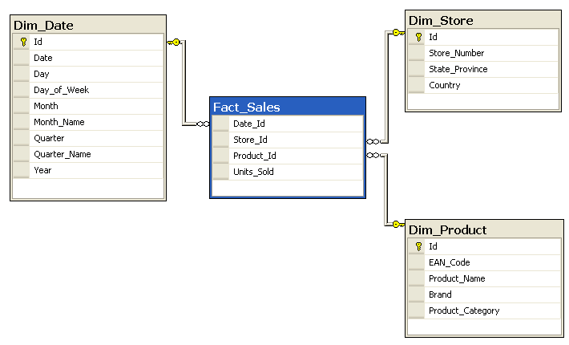
Data Warehouses Design Cont’d
Star Schema

Slide 27
Data Warehouses Challenges
Data is usually
Extremely large
Multi-dimensional
Priority for aggregated and summarized data
Ad-hoc and complex queries
Expensive operations: aggregation, and joins
The fact table participates in every join

Slide 28
Data Warehouses 1. Indexes
 | Features | Pros | Cons
Universal B⁺-Trees (UB+-Trees) | Variation of B+-Trees Multidimensional data is linearized. Records are stored according to Z-order | Well suited for high cardinality attributes Excellent for point and interval queries | Poor performance with low cardinality attributes More I/O operations (result ordered by key values)
Bitmap Index |  | Useful with star schema when joining a large fact table with multiple small dimension tables Reduces search space before performing expensive joins | Not amenable to index updates (though not an issue for DW)
Projection Index | Values preserve their table row order in the index | More results per I/O operation | Can only fetch raw data (e.g. Column list in selection)

Slide 29
Data Warehouses 2. Materialized Views
Materialize frequent queries of the base tables as views
Pre-compute and store aggregated data (i.e. summaries)
Pre-compute expensive joins
To materialize or not?
Workload characteristics
Cost for incremental update
Storage requirements

Slide 30
Data Warehouses 2. Materialized Views Cont’d
Pros
Behaves like an index
Improves performance through fast lookups
Useful for rollup and drilldown operations
Cons
Not applicable to all queries (e.g. ad-hoc queries)

Slide 31
Data Warehouses 3. Partitioning
Dividing database objects into smaller more manageable pieces
Horizontal & Vertical partitioning are used
Pros
Ability to manage larger databases
Enhances query performance over large tables
Enables parallel processing
Facilitates data compression
Cons
Complexity: managing partitions
Efficiency: number of partitions affects the performance of meta data operations (e.g. browsing the data cube definition)
Might affect data refresh operations

Slide 32
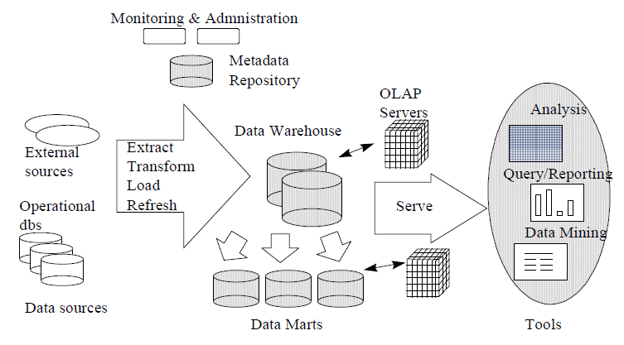
Data Warehouses 4. Clustering
Data is clustered by nature

Slide 33
3. XML Databases (XML DBs)

Slide 34
XML DBs Overview
Store, organize & query XML documents
XML-enabled DBs:
Maps XML documents to relational tables
Native XML DBs:
Data structures store actual XML

Slide 35
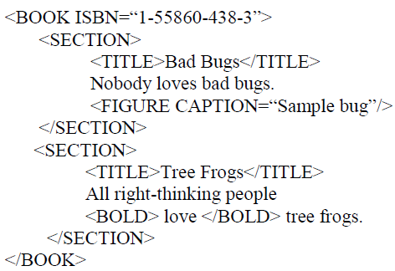
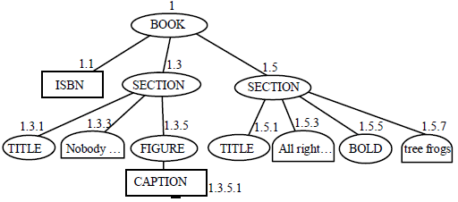
XML DBs 1. Index Structures
XML-enabled DB (e.g. MS SQL Server 2005)
Shred XML data in a relational table with columns: ORDPATH, tag, node type, value, path ID
Use a B+ Tree index based on combination of primary key of base table & the ORDPATH

Slide 36
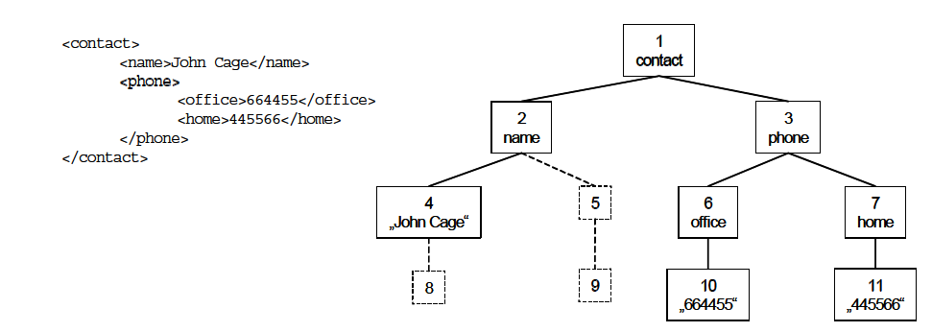
XML DBs 1. Index Structures Cont’d
Native XML DB (E.g. eXist, TIMBER)
Numbering schema for the XML nodes
B+ Tree used on the numbered nodes

Slide 37
XML DB 2. Materialized Views
Greatly enhances performance
XQuery and Xpath query results are materialized
Query rewriting is more tricky due to semi-structured nature & complicated querying languages

Slide 38
XML DB 3. Partitioning
Horizontal partitioning
Based on node type
Through inlining

Slide 39
XML DBs 4. Clustering
Elements & sub-elements are clustered together
XML documents are clustered based on structural similarity

Slide 40
Future Work

Slide 41
Future Work
Physical design of industrial systems
Automating physical design
List of the open problems in physical design

Slide 42
Summary & Conclusions

Slide 43
 | Index Structures | Materialized Views | Partitioning | Clustering
DRDB | E.g. B+ Trees, Bitmap Index | Stores results of common complicated queries on disk | Horizontal Partitioning (range, list, hash, composite) Vertical Partitioning | Group related items together on disk
MMDB | No need to store actual data values in index Larger node size that is aligned with cache line size E.g.: B+ Tree, CSB+ Tree, T Tree, CST Tree | Not needed since processing and memory access is cheap | Only needed in secondary storage to speed up reloading in case of a crash Horizontal & single vertical partitioning | Not needed since random access in main memory costs the same as sequential access
Data Warehouses | E.g. Universal B+ Tree, Bitmap Index, Projection Index. | Essential to improve performance Not applicable to ad-hoc queries | Horizontal partitioning based on time dimension Vertical partitioning of seldom used columns | Data is clustered by nature
XML DB | Need a numbering scheme B+ Tree used | XQuery and XPath results are materialized | Horizontal partitioning based on inlining or node type | Based on document order or structural similarity

Slide 44
Conclusions
Physical design patterns in traditional relational databases can be adapted to different systems
B+ Trees are the most popular index structure & have been adapted for the diff. Systems
Materialized views, partitioning & clustering are very important for performance except for MMDBs

Slide 45
Thank you

