Slide 1
Physical Design Patterns in Information Systems
Karim Ali & Sarah Nadi
CS848 – Spring 2010
July 14th, 2010

Slide 2
Outline
Database lifecycle
Elements of Physical Design in Information Systems
Different Physical Designs
Disk Based Relational Database Systems (DRDB)
Memory Based Relational Database Systems (MMDB)
XML Databases
Data Warehouses
Future Work
Open Problems
Summary & Conclusions

Slide 3
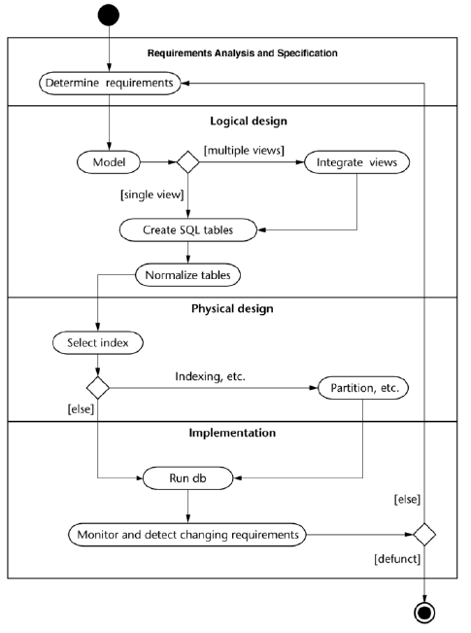
Database Lifecycle

Slide 4
Elements of Physical Design

Slide 5
Indexes
Data needs to be organized for quick searching
I/O operations are expensive --> need to minimize

Slide 6
Materialized Views
Repeated complicated queries should not have to be executed every time
Save execution time, and I/O reads by pre-computing the results & storing them
Materialized views are store on disk

Slide 7
Paritioning
Divides the data into related partitions
Horizontal Partitioning: divides tables into sets of rows according to a specific attribute (E.g. Date ranges)
Vertical Partitioning: divides table into the sets of attributes that are usually accessed together
Reduces table scan time
Improves performance

Slide 8
Clustering
Records that are accessed together are physically located together
Reduces the number of pages to be queried
Can have multi-dimensional clustering based on more than one criteria

Slide 9
Other Methods
Data Compression:
Striping:
Mirroring:
Denormalization:

Slide 10
Physical Design of Different Information Systems

Slide 11
Disk Based Relational Database Systems (DRDB)

Slide 12
DRDB: Indexes

Slide 13
DRDB: Materialized Views

Slide 14
DRDB: Paritioning

Slide 15
DRDB: Clustering

Slide 16
DRDB: Summary
Summary table/figure

Slide 17
Main Memory Database Systems (MMDB)
Primary copy of data resides in main memory
Cheaper to access main memory
MMDB have better performance
Usually have an archived copy of the data in case of crashes

Slide 18
MMDB: Indexes
Use:
Reduce overall computation time without using too much extra space
Factors to consider:
I/O operations are cheaper
Should be cache conscious
No need to store data in the index structure
Categories of indexes used:
B Trees
T Trees
Search Trees

Slide 19
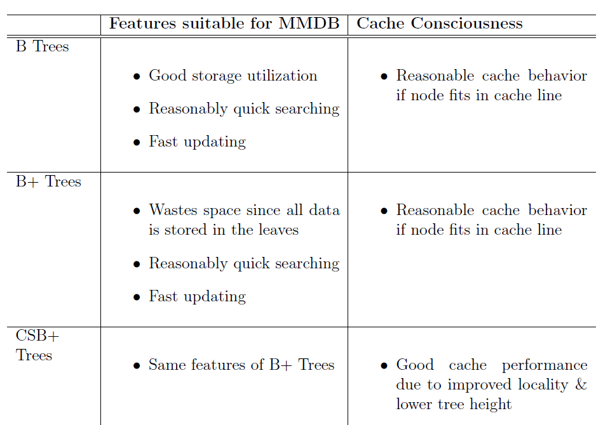
MMDB: Indexes Cont’d

Slide 20
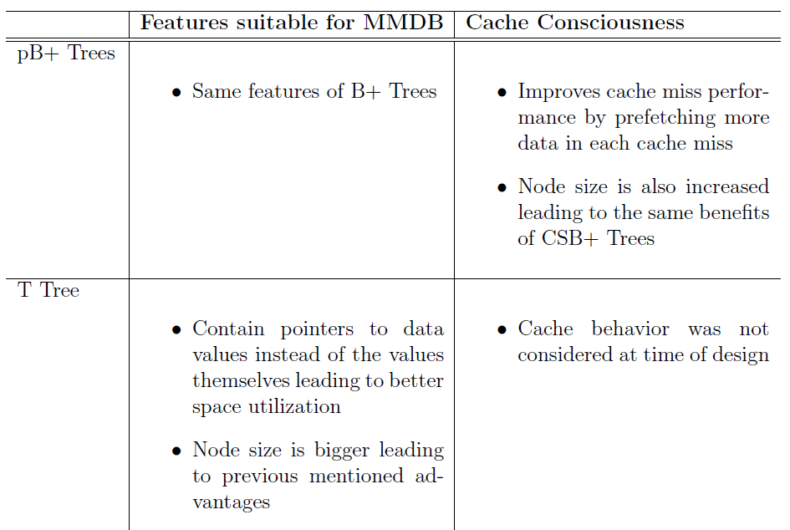
MMDB: Indexes Cont’d

Slide 21
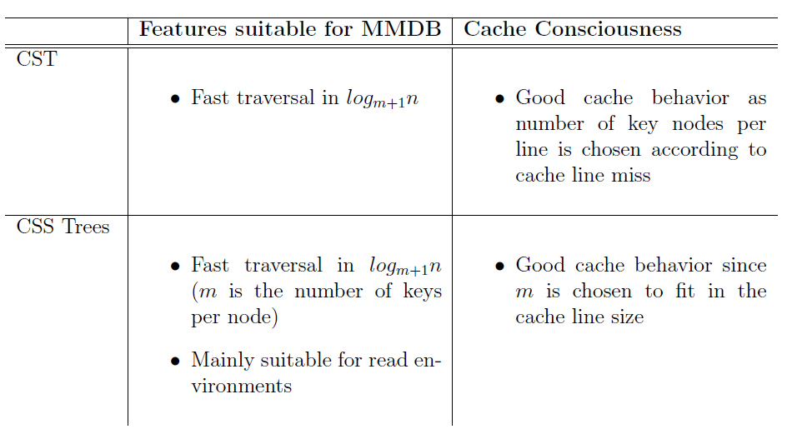
MMDB: Indexes Cont’d

Slide 22
MMDB: Materialized Views
Not beneficial to MMDB
Cost of computing complicated queries is much less
Maintenance costs will outweigh benefit

Slide 23
MMDB: Partioning
Not necessary in main memory
Used for the secondary storage on disk to speed up reload
Horizontal partitioning
Single vertical partitioning

Slide 24
MMDB: Clustering
Not applicable to MMDB
Sequential access in main memory is not cheaper than random or dispersed access

Slide 25
MMDB: Summary
Summary table/figure

Slide 26
Data Warehouses
Collection of data and decision support technologies
Used in:
Retail: user profiling
Finance: claims analysis, risk analysis, credit card analysis, and fraud detection
Healthcare: outcomes analysis

Slide 27
DW: Challenges
Data is usually
Extremely large
Multi-dimensional
Priority for aggregated and summarized data
Ad-hoc and complex queries
Expensive operations: aggregation, and joins
the fact table participates in every join
Figure ??

Slide 28
DW: Design
ROLAP
Relational implementation of DW
Multidimensional view of data is achieved through star scheme

Slide 29
DW: Indexes

Slide 30
DW: Materialized Views

Slide 31
DW: Partitioning

Slide 32
DW: Clustering

Slide 33
DW: Summary

Slide 34
XML Databases
XML-enabled DBs:
Maps XML documents to relational tables
Native XML DBs:
Data structures store actual XML

Slide 35
XML DBs: Indexes
Same index structures can be used
Need adjustments
Need a numbering schema for the XML nodes

Slide 36
XML DBs: Materialized Views

Slide 37
XML DBs: Paritioning

Slide 38
XML DBs: Clustering

Slide 39
XML DBs: Summary

Slide 40
Future Work & Open Problems

Slide 41
Future Work
Looking at automating physical design (put some examples of work here and say its time permitting)

Slide 42
Open Problems in Physical Design

Slide 43
Summary & Conclusions

Slide 44
Big summary table(s)

Slide 45
Conclusions

Slide 46
Thank you

Slide 47
References

