Slide 1



Doop: The Latest
Yannis Smaragdakis
University of Athens
with George Balatsouras, Martin Bravenboer (LogicBlox Inc.), Kostas Ferles, Neville Grech, George Kastrinis
and
Anastasis Antoniadis, Nikos Filippakis, Dimitris Mouris,
Nefeli Prokopaki, Kostas Saidis

Slide 2

Our Framework
Datalog-based pointer analysis framework for Java
Declarative: what, not how
Sophisticated, very rich set of analyses
  subset-based analysis, fully on-the-fly call graph discovery, field-sensitivity, context-sensitivity, call-site sensitive, object sensitive, thread sensitive, context-sensitive heap, abstraction, type filtering, precise exception analysis
Support for full semantic complexity of Java
  jvm initialization, reflection analysis, threads, reference queues, native methods, class initialization, finalization, cast checking, assignment compatibility
http://doop.program-analysis.org
Yannis Smaragdakis
University of Athens

Slide 3
Pointer (or points-to) Analysis
objects represented
by allocation sites
What objects can a variable point to?
program
points-to
void foo() {
Object a = new A1();
Object b = id(a);
}
void bar() {
Object a = new A2();
Object b = id(a);
}
Object id(Object a) {
return a;
}
foo:a new A1()
bar:a new A2()
Yannis Smaragdakis
University of Athens

Slide 4
Pointer Analysis
What objects can a variable point to?
program
points-to
void foo() {
Object a = new A1();
Object b = id(a);
}
void bar() {
Object a = new A2();
Object b = id(a);
}
Object id(Object a) {
return a;
}
foo:a new A1()
bar:a new A2()
id:a new A1(), new A2()
Yannis Smaragdakis
University of Athens

Slide 5
Pointer Analysis
What objects can a variable point to?
program
points-to
void foo() {
Object a = new A1();
Object b = id(a);
}
void bar() {
Object a = new A2();
Object b = id(a);
}
Object id(Object a) {
return a;
}
foo:a new A1()
bar:a new A2()
id:a new A1(), new A2()
foo:b new A1(), new A2()
bar:b new A1(), new A2()
can clearly see it is a
may-analysis
Yannis Smaragdakis
University of Athens

Slide 6
Datalog: Properties
Limited logic programming
  SQL with recursion
  Prolog without complex terms (constructors)
Captures PTIME complexity class
Strictly declarative
  as opposed to Prolog
    conjunction commutative
    rules commutative
Less programming, more specification
Yannis Smaragdakis
University of Athens

Slide 7
Datalog: Declarative Mutual Recursion
source
a = new A();
b = new B();
c = new C();
a = b;
b = a;
c = b;
Yannis Smaragdakis
University of Athens

Slide 8
Datalog: Declarative Mutual Recursion
source
Alloc
VarPointsTo
a = new A();
b = new B();
c = new C();
a = b;
b = a;
c = b;
a new A()
b new B()
c new C()
a new A()
b new B()
c new C()
a new B()
b new A()
c new B()
c new A()
Move
a b
b a
c b
VarPointsTo(var, obj) <-
Alloc(var, obj).
VarPointsTo(to, obj) <-
Move(to, from),
VarPointsTo(from, obj).
Yannis Smaragdakis
University of Athens

Slide 9
Datalog: How Well Has It Worked?
Our decision to write a full Datalog frameworked has worked extraordinarily well
  ease of development, maintenance
  ease of experimentation, communication
  different engines, parallelization
But not all is rosy
  some analyses hard to express
    e.g., Steensgaard-style points-to analysis
Yannis Smaragdakis
University of Athens

Slide 10
One Such Instance: Must-Alias Analysis (latest work)
Flow-sensitive must-alias analysis on access paths:
  “must-” : under-approximation
    do two access paths definitely alias at a program point?
  alias classes are equivalence classes
    a ~ b, b ~ c => a ~ c
    not true of may-alias analyses, unless grossly imprecise (Steensgaard)
  classes need to be maintained compactly
    much like the union-find trees of Steensgaard
      though union operations do not arise here
  access-paths maintained implicitly
Yannis Smaragdakis
University of Athens

Slide 11
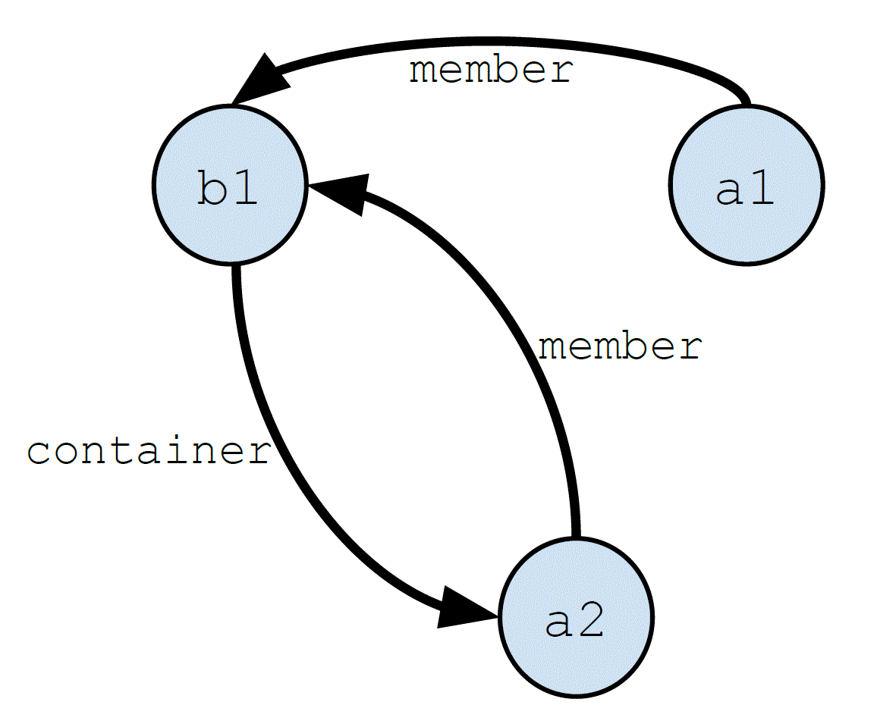
Solution: Specialized Data Structure for Must-Alias
Yannis Smaragdakis
University of Athens

Slide 12
Benefits: Lots of Interesting, Fast Algorithms
Intersection is the main one
Often >20x speedup relative to Datalog implementation
  different factors of 10 due to access path implicit representation, equivalence classes
But: need to do this outside Datalog
Yannis Smaragdakis
University of Athens

Slide 13
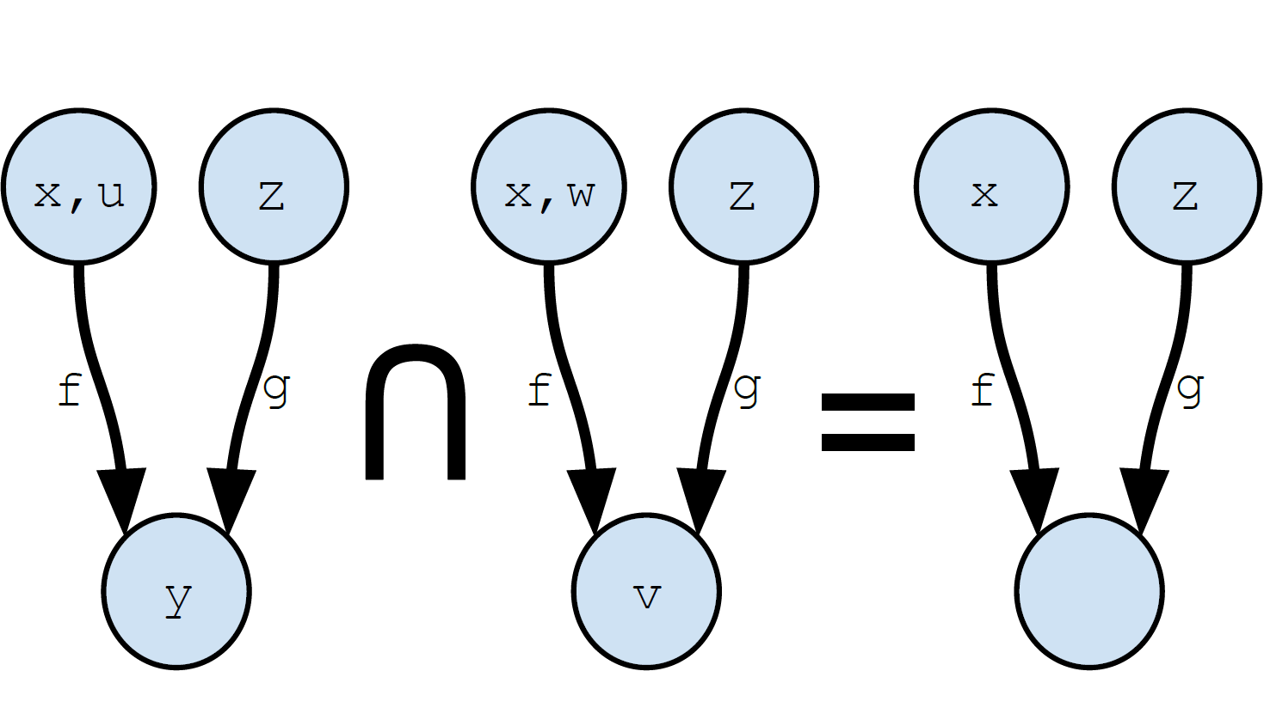
Example Algorithm (Intersection)
Yannis Smaragdakis
University of Athens

Slide 14
Generalization: DeepDoop
Extension of Datalog (a DSL) for staging Datalog analyses, importing/exporting to external analyses
Kudos to Souffle for ideas!
Also highly useful in other recent work
  sound may-point-to analysis
E.g.,
  point-to → call-graph → point-to → escape → point-to → …
  why non-monotonicity?
    points-to maintained if !escape
    points-to strong update if must-alias
Yannis Smaragdakis
University of Athens

Slide 15
Advertising Portion
What else are we doing?
  much faster Soot front-end (multi-threaded)
  open-sourcing LogicBlox engine
  experiment with Souffle
  web-based program comprehension service
  Android analysis
  reflection improvements
  information-flow
Ask me!
Yannis Smaragdakis
University of Athens

