Slide 1


Slide 2
What is the Issue? Detecting spam or harmful messages
Email spam refers to unwanted, and often inappropriate or irrelevant messages sent to a large number of email addresses.
Typically sent by
advertisers
Scammers
Also, pose security risks if they contain malicious links or attachments

Slide 3
Goal
Analyzing emails on the internet for users, groups or organizations to automatically detect whether an email is a spam or not.
Additionally, We want to present this product as a Web Service to programmers, companies, users and etc.
According to being Web Service, we can use it on all platforms such as Androids, IOS and etc.

Slide 4
Solution
For this issue, We have used Machine learning technologies to develop a model
We have utilized Multinomial Naive Bayes which is a Natural language processing tool for processing and understanding human language to develop a model
This model that we develop has an accuracy of around 70% to 80%

Slide 5
Why machine learning?
Detection can be done using rule-based filters or Machine learning
Rule-based filters use a set of predefined rules to identify spam messages, while machine learning algorithms use statistical models to learn patterns
Rule-based filters may not be as effective at detecting new or evolving types of spam messages
However, Machine learning can adapt to changing spam patterns and it is better at detecting both known and new types of spam messages

Slide 6
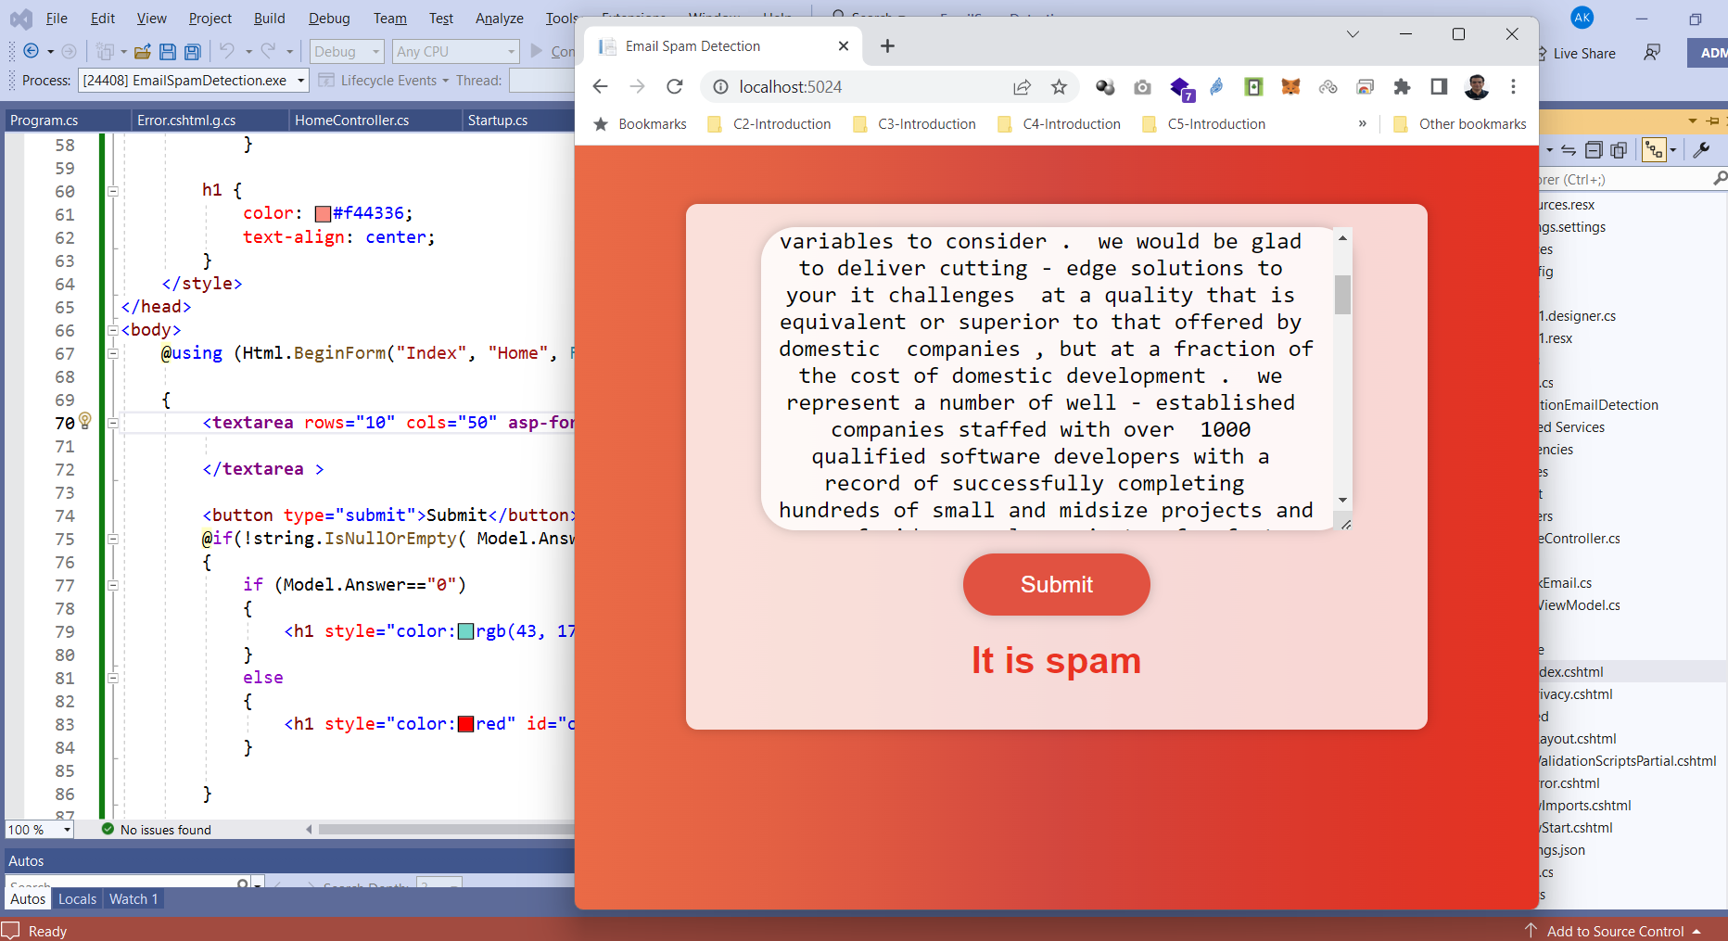

Slide 7
