Slide 1
Démonstration des algorithmes de couplage à travers un graphe
Gale-Shapley
Irving

Slide 2
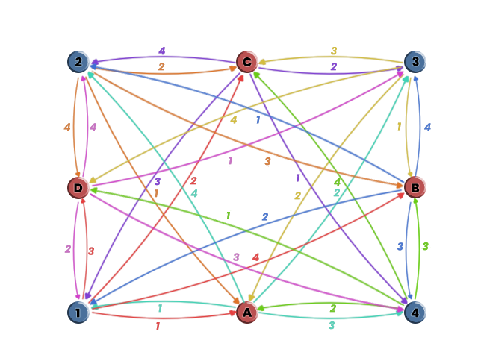
(1, ?)
(2, ?)
(3, ?)
(4, ?)

Slide 3
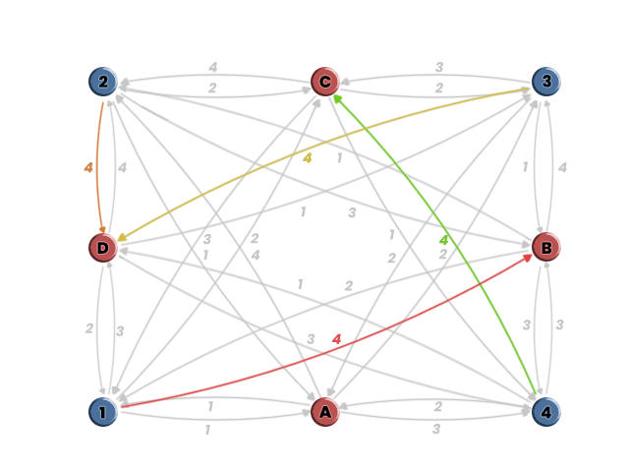
(1, B)
(2, D)
(3, D)
(4, C)

Slide 4
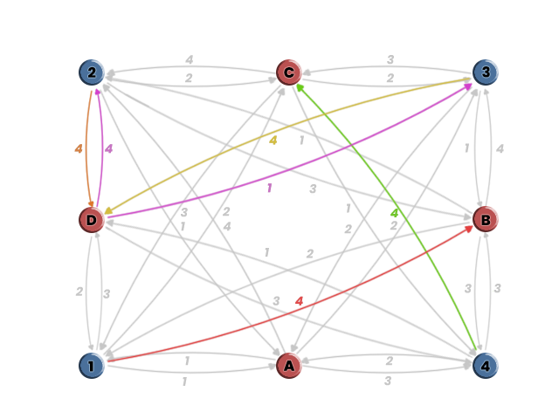
(1, B)
(2, D)
(3, ?)
(4, C)

Slide 5
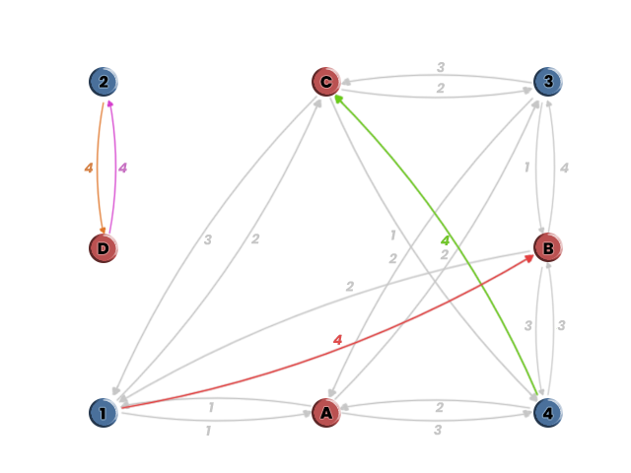
(1, B)
(2, D)
(3, ?)
(4, C)

Slide 6
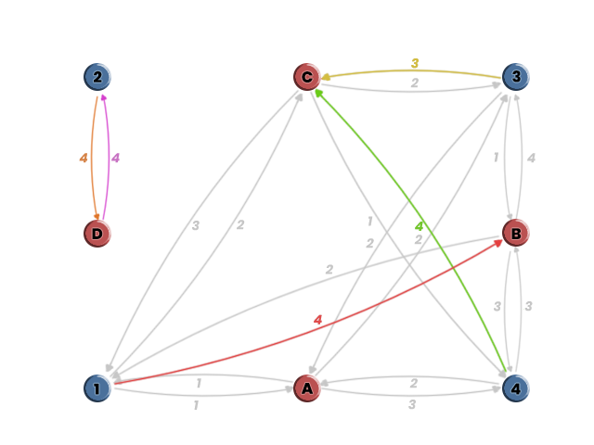
(1, B)
(2, D)
(3, C)
(4, C)

Slide 7
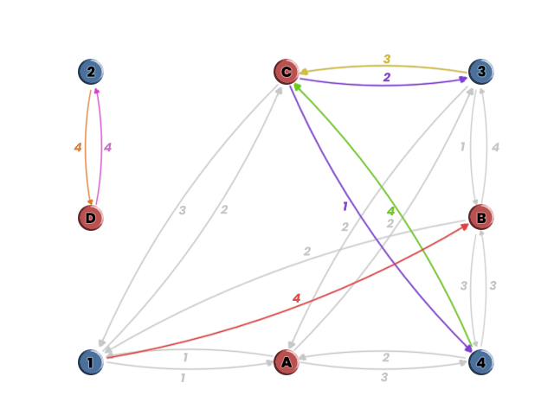
(1,B)
(2, D)
(3, C)
(4, C)

Slide 8
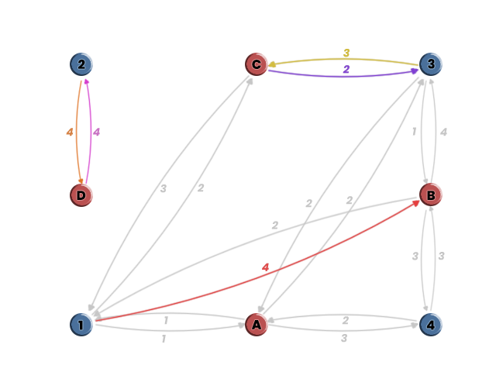
(1, B)
(2, D)
(3, C)
(4, ?)

Slide 9
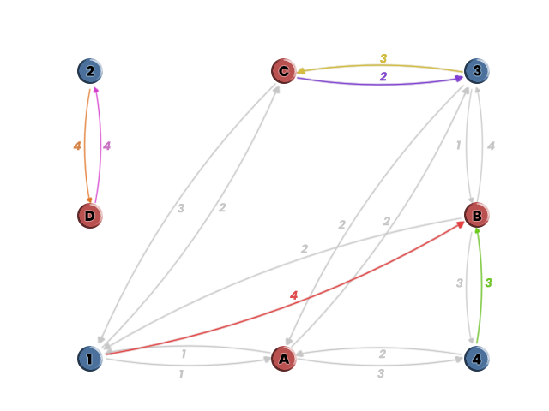
(1, B)
(2, D)
(3, C)
(4, B)

Slide 10
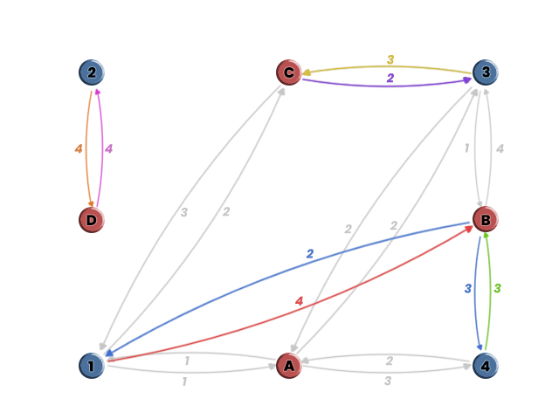
(1, B)
(2, D)
(3, C)
(4, B)

Slide 11
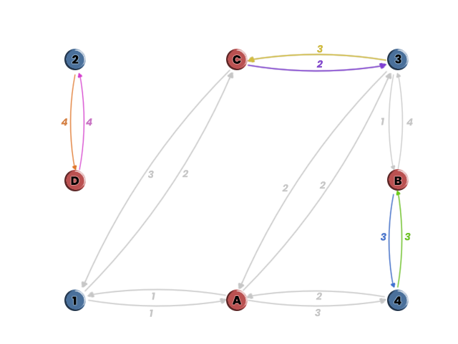
(1, ?)
(2, D)
(3, C)
(4, B)

Slide 12
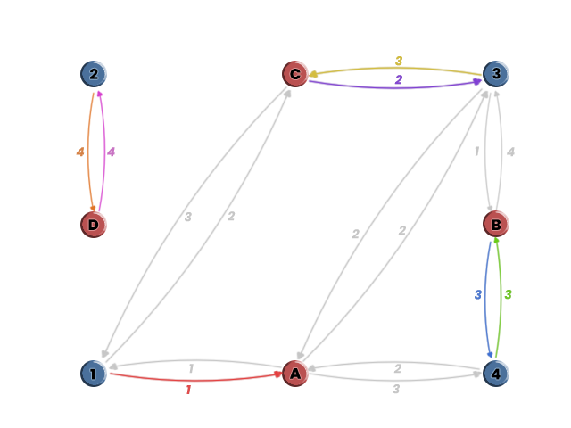
(1, A)
(2, D)
(3, C)
(4, B)

Slide 13
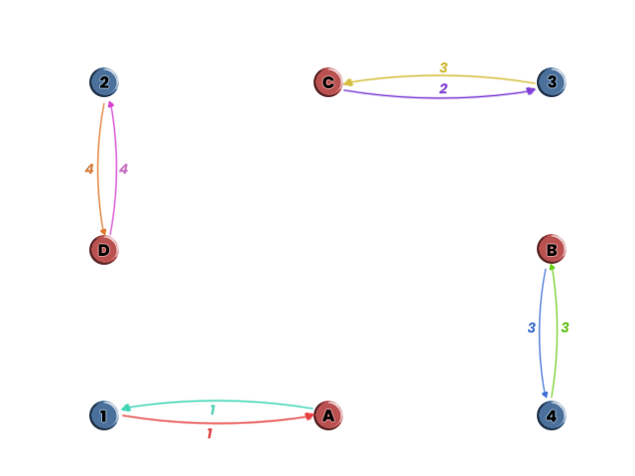
(1, A)
(2, D)
(3, C)
(4, B)

Slide 14
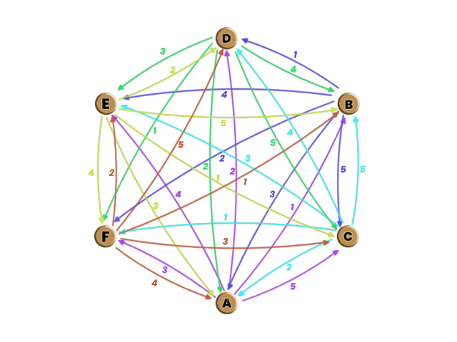
Phase 1
(A, ?)
(B, ?)
(C, ?)
(D, ?)
(E, ?)
(F, ?)

Slide 15
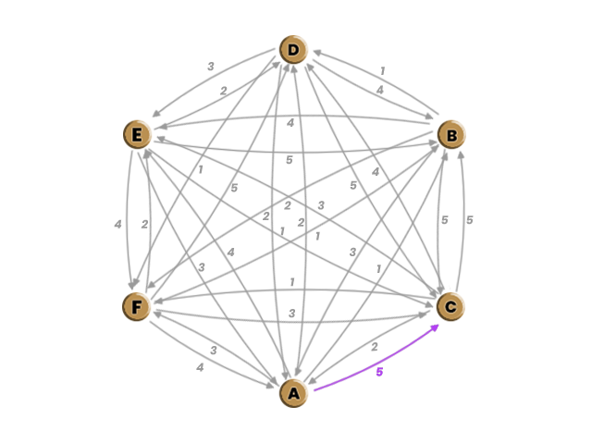
Phase 1
(A, C)
(B, ?)
(C, ?)
(D, ?)
(E, ?)
(F, ?)

Slide 16
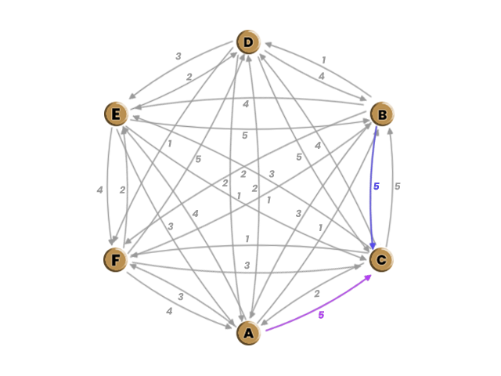
Phase 1
(A, C)
(B, C)
(C, ?)
(D, ?)
(E, ?)
(F, ?)

Slide 17
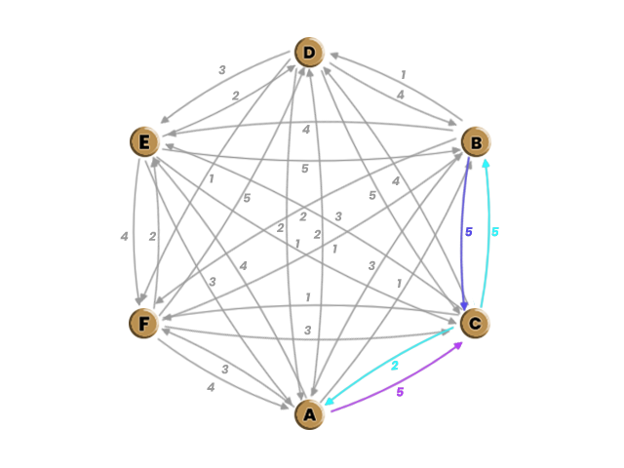
Phase 1
(A, C)
(B, C)
(C, B)
(D, ?)
(E, ?)
(F, ?)

Slide 18
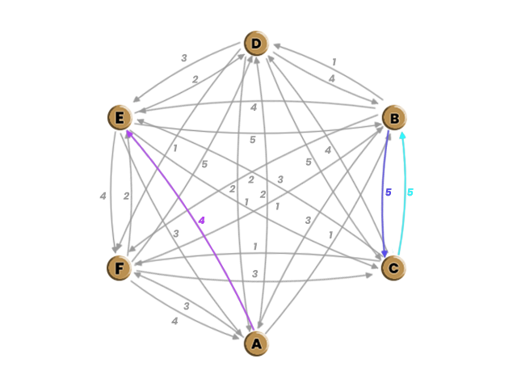
Phase 1
(A, E)
(B, C)
(C, B)
(D, ?)
(E, ?)
(F, ?)

Slide 19
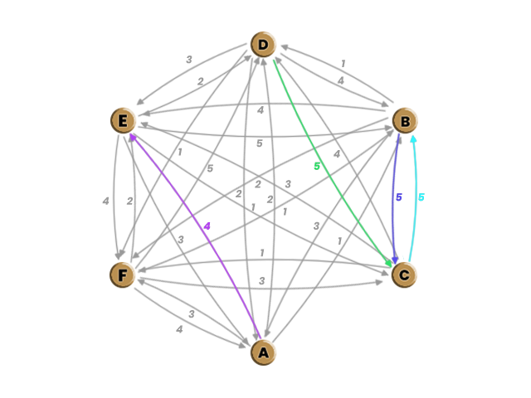
Phase 1
(A, E)
(B, C)
(C, B)
(D, C)
(E, ?)
(F, ?)

Slide 20
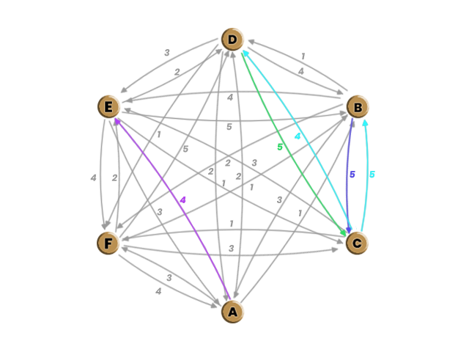
Phase 1
(A, E)
(B, C)
(C, B)
(D, C)
(E, ?)
(F, ?)

Slide 21
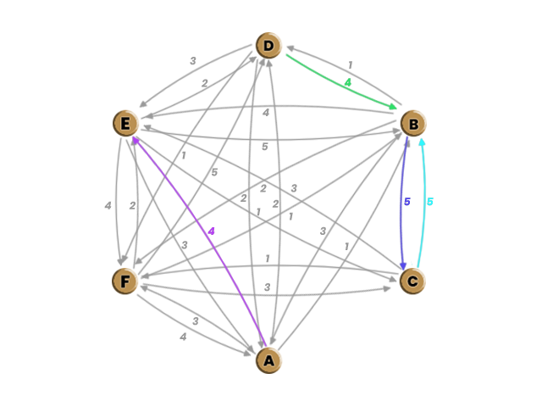
Phase 1
(A, E)
(B, C)
(C, B)
(D, B)
(E, ?)
(F, ?)

Slide 22
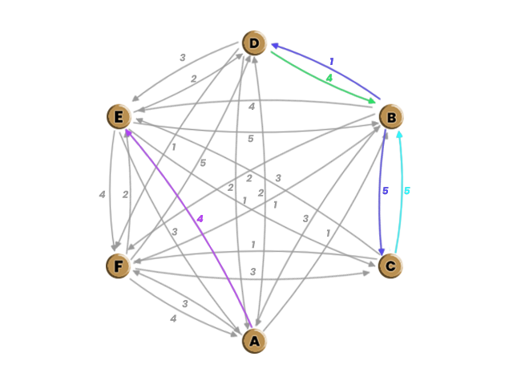
Phase 1
(A, E)
(B, C)
(C, B)
(D, B)
(E, ?)
(F, ?)

Slide 23
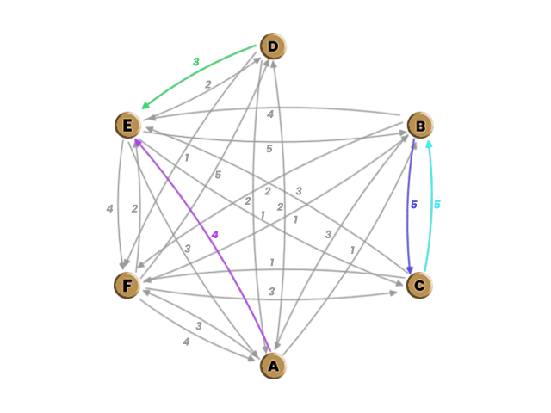
Phase 1
(A, E)
(B, C)
(C, B)
(D, E)
(E, ?)
(F, ?)

Slide 24
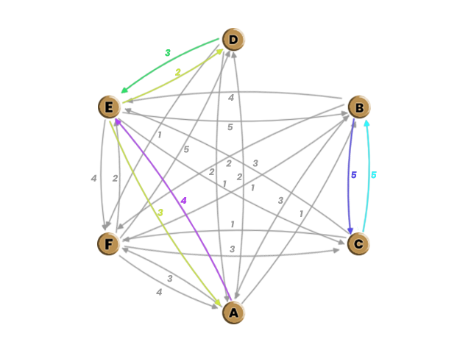
Phase 1
(A, E)
(B, C)
(C, B)
(D, E)
(E, ?)
(F, ?)

Slide 25
Phase 1
(A, E)
(B, C)
(C, B)
(D, E)
(E, ?)
(F, ?)

Slide 26
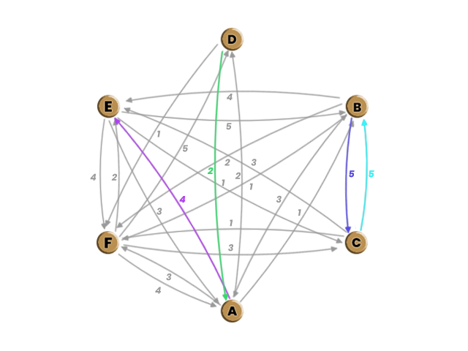
(A, E)
(B, C)
(C, B)
(D, A)
(E, ?)
(F, ?)
Phase 1

Slide 27
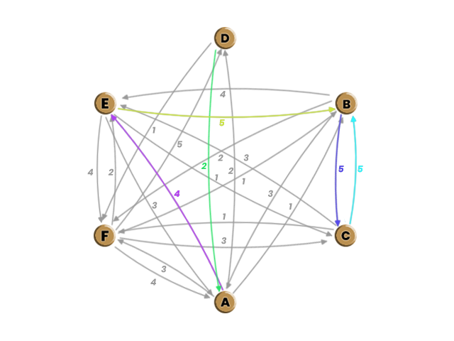
Phase 1
(A, E)
(B, C)
(C, B)
(D, A)
(E, B)
(F, ?)

Slide 28
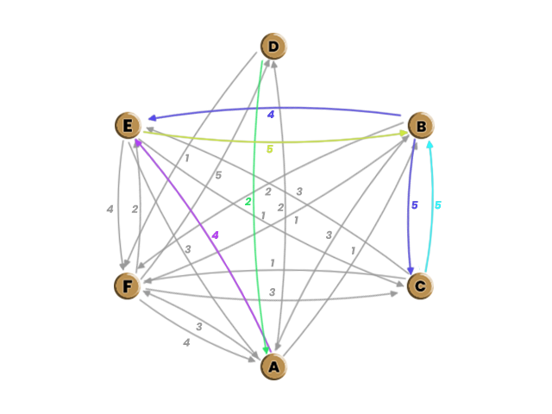
Phase 1
(A, E)
(B, C)
(C, B)
(D, A)
(E, B)
(F, ?)

Slide 29
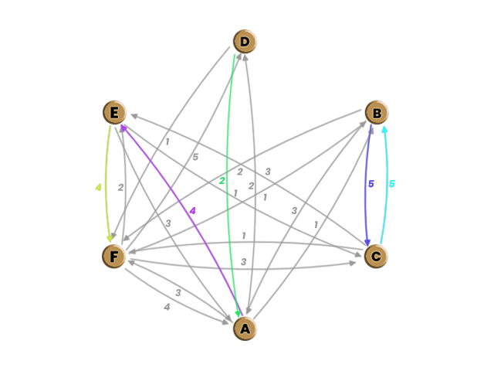
Phase 1
(A, E)
(B, C)
(C, B)
(D, A)
(E, F)
(F, ?)

Slide 30
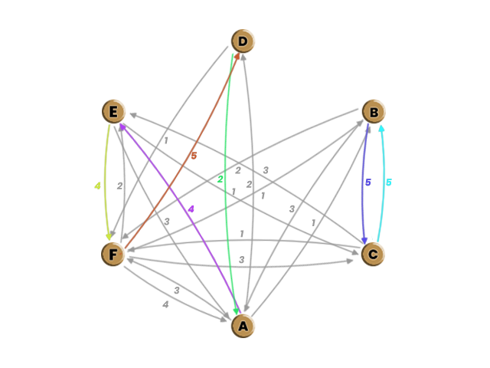
Phase 1
(A, E)
(B, C)
(C, B)
(D, A)
(E, F)
(F, D)

Slide 31
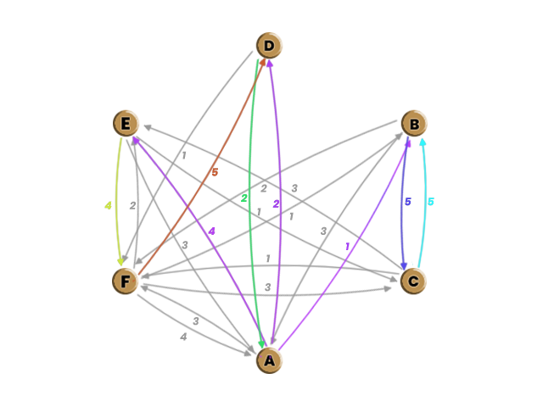
Phase 2
(A: BDEF)
(D: AF)
(E: ACF)
(F: ABCDE)
(B, C)

Slide 32
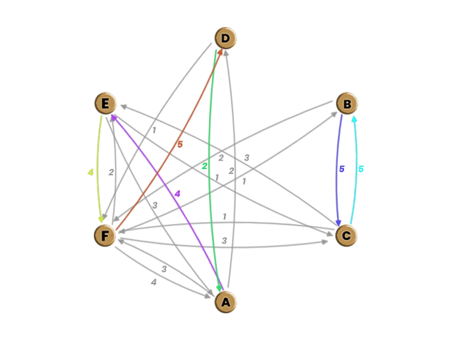
Phase 2
(A: DEF)
(D: AF)
(E: ACF)
(F: ABCDE)
(B, C)

Slide 33
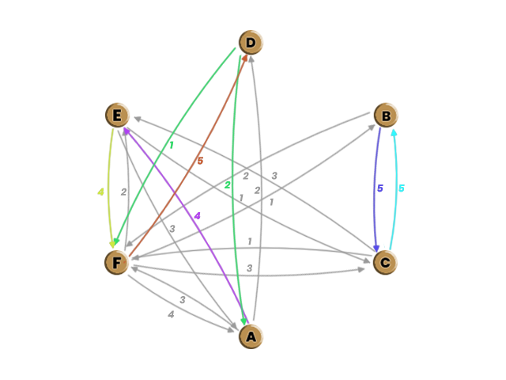
Phase 2
(A: DEF)
(D: AF)
(E: ACF)
(F: ABCDE)
(B, C)

Slide 34
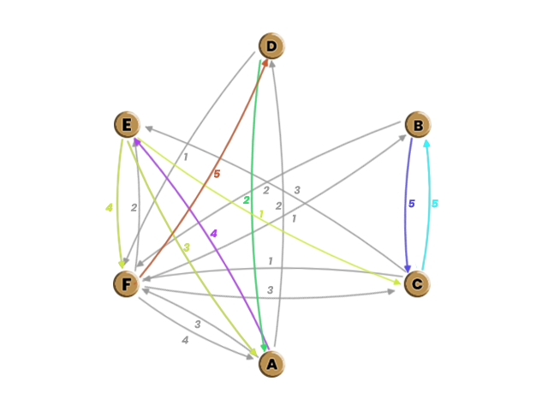
Phase 2
(A: DEF)
(D: AF)
(E: ACF)
(F: ABCDE)
(B, C)

Slide 35
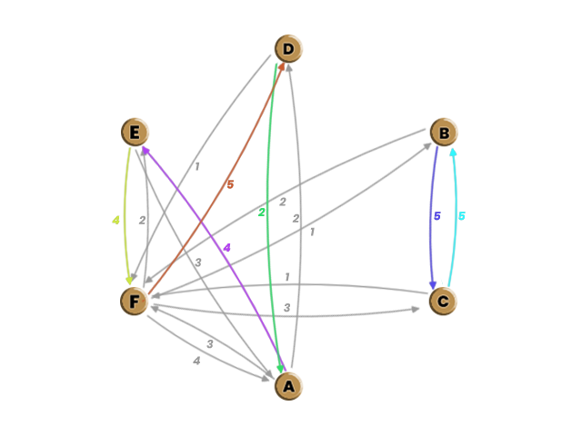
Phase 2
(A: DEF)
(D: AF)
(E: AF)
(F: ABCDE)
(B, C)

Slide 36
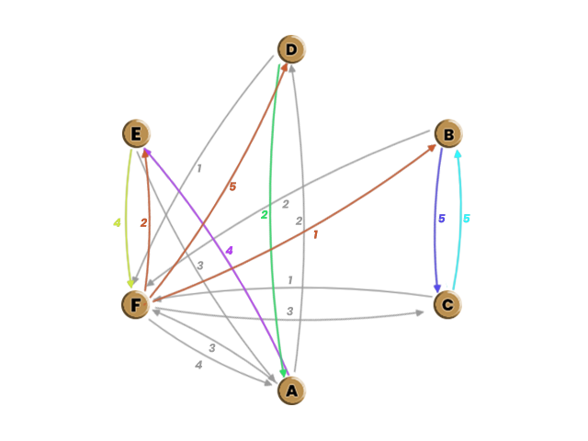
Phase 2
(A: DEF)
(D: AF)
(E: AF)
(F: ABCDE)
(B, C)

Slide 37
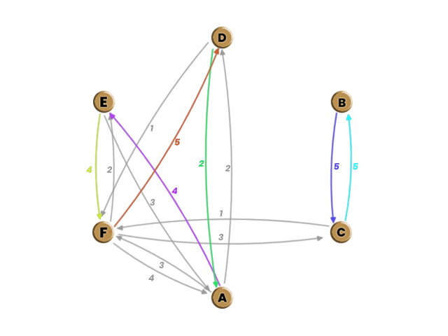
Phase 2
(A: DEF)
(D: AF)
(E: AF)
(F: ACDE)
(B, C)

Slide 38
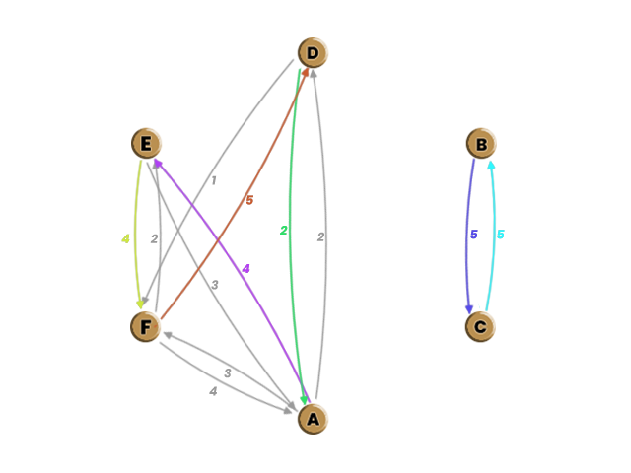
Phase 2
(A: DEF)
(D: AF)
(E: AF)
(F: ADE)
(B, C)

Slide 39
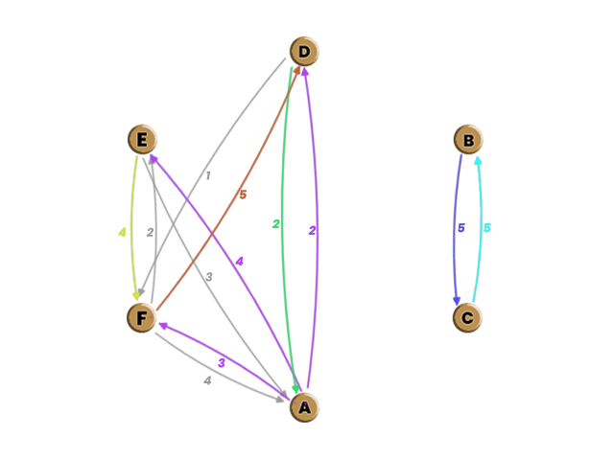
Phase 3
(A: DEF)
(D: AF)
(E: AF)
(F: ADE)
(B, C)
(C, B)

Slide 40
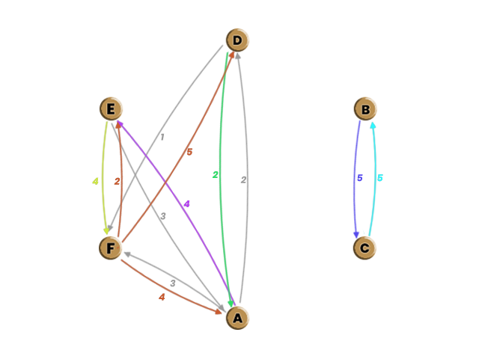
Phase 3
(A: DEF)
(D: AF)
(E: AF)
(F: ADE)
(B, C)
(C, B)

Slide 41
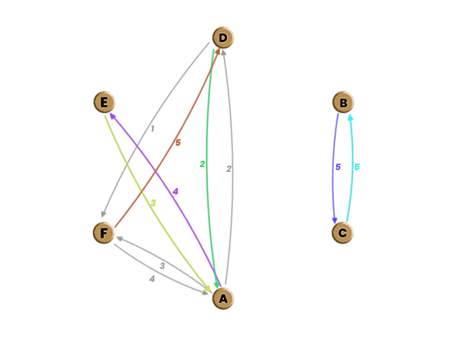
Phase 3
(A: DEF)
(D: AF)
(E: A)
(F: AD)
(B, C)
(C, B)

Slide 42
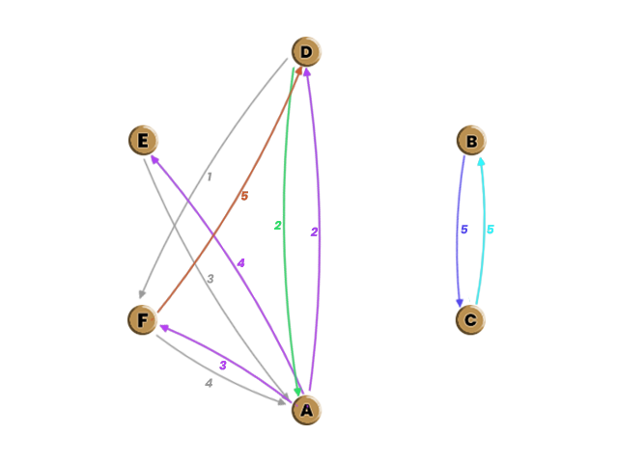
Phase 3
(A: DEF)
(D: AF)
(E: A)
(F: AD)
(B, C)
(C, B)

Slide 43
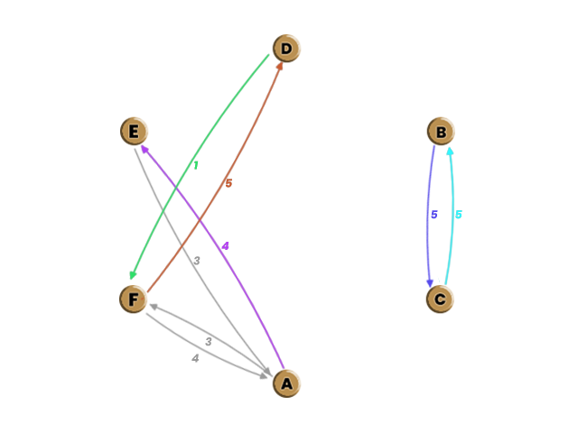
Phase 3
(A: EF)
(D: F)
(E: A)
(F: AD)
(B, C)
(C, B)

Slide 44
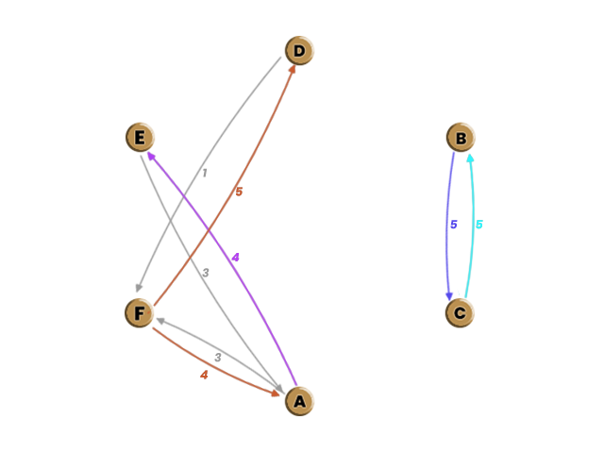
Phase 3
(A: EF)
(D: F)
(E: A)
(F: AD)
(B, C)
(C, B)

Slide 45
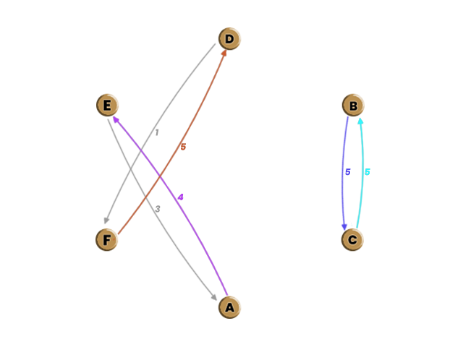
Phase 3
(A: E)
(D: F)
(E: A)
(F: D)
(B, C)
(C, B)

Slide 46
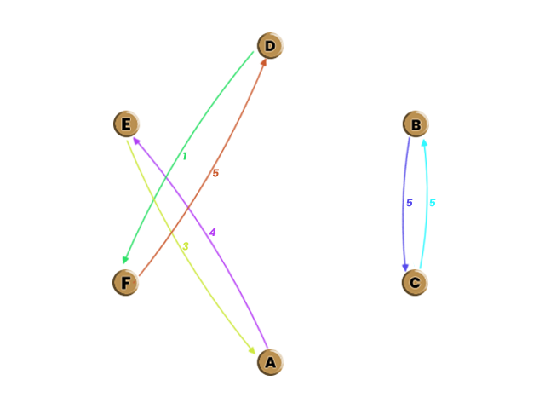
Phase 3
(A, E)
(B, C)
(D, F)

