Slide 1
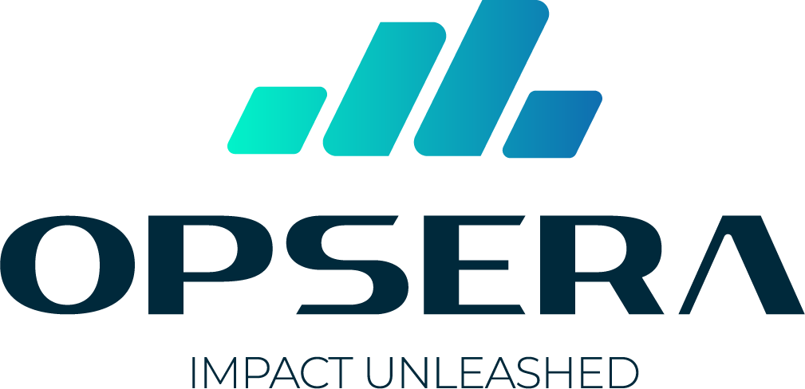

AI-Powered DevSecOps Pipeline Solutions
SonarQube AI + Red Hat ACS + Kaspersky KCS + Prisma Cloud

Slide 2
Agenda
Three AI DevSecOps pipeline architectures powered by SonarQube AI
01
Technology Stack
Red Hat ACS, Kaspersky KCS, Palo Alto Prisma Cloud, SonarQube AI
02
Use Case 1: Red Hat ACS + SonarQube AI
K8s-native container security with AI-powered SAST and code quality gates
03
Use Case 2: Kaspersky KCS + SonarQube AI
ML-powered container defense with Astraea engine and AI code analysis
04
Use Case 3: Prisma Cloud + SonarQube AI
Full CNAPP platform with code-to-cloud security and attack-path AI
05
Feature Comparison
Side-by-side comparison of all three pipeline architectures

Slide 3




Technology Stack
Four integrated platforms powering AI-driven DevSecOps pipelines
Red Hat ACS
Kaspersky KCS
Prisma Cloud
SonarQube AI
K8s-native container security
ML-powered container defense
Code-to-cloud CNAPP
AI-powered code quality
StackRox-based container security with eBPF runtime monitoring, image scanning, admission control, and network segmentation for Kubernetes.
Astraea ML engine for zero-day malware detection, CVE scanning, behavioral analysis, and threat intelligence integration for containers.
Unified CNAPP with 8 modules: SAST, SCA, IaC, CSPM, CWP, CIEM, ASPM, and Precision AI attack-path analysis.
AI CodeFix auto-remediation, AI Code Assurance for AI-generated code governance, SonarLint IDE plugin, and deep SAST analysis.

Slide 4
01
Red Hat ACS + SonarQube AI
Kubernetes-native container security with AI-powered code quality, vulnerability detection, and eBPF runtime monitoring

Slide 5

Use Case 1
Red Hat ACS + SonarQube AI Pipeline
The Challenge
Results
Kubernetes environments need both deep code quality analysis and container-native runtime security. Traditional SAST tools miss container-specific vulnerabilities, while security scanners ignore code quality. Teams need a unified 7-stage pipeline from IDE to production.
7
Pipeline stages with AI injection
6
AI-powered security checkpoints
The Solution
95%
SonarQube AI provides SAST, AI CodeFix auto-remediation, and AI Code Assurance for AI-generated code governance. Red Hat ACS delivers StackRox-based image scanning, admission control, eBPF runtime monitoring, and network policy enforcement across all Kubernetes clusters.
Faster vulnerability remediation
SonarQube handles code quality and AI governance while ACS secures the container lifecycle — complete coverage from first line of code to runtime.

Slide 6
02
Kaspersky KCS + SonarQube AI
ML-powered container security with Astraea engine, AI code analysis, and zero-day malware detection

Slide 7
Use Case 2
Kaspersky KCS + SonarQube AI Pipeline
The Challenge
Results
Container workloads face sophisticated supply-chain attacks and zero-day malware that signature-based scanners miss. Organizations need ML-powered behavioral analysis combined with deep code quality gates to catch threats before they reach production.
7
Pipeline stages with dual AI engines
6
AI + ML security checkpoints
The Solution
99.5%
SonarQube AI delivers deep SAST analysis, AI CodeFix, and AI Code Assurance. Kaspersky KCS adds Astraea ML engine for zero-day malware detection, behavioral runtime monitoring, threat intelligence enrichment, and admission control for Kubernetes environments.
Malware detection rate
SonarQube AI governs code quality while Astraea ML catches what signatures miss — dual AI engines protecting the entire pipeline.

Slide 8
03
Prisma Cloud + SonarQube AI
Full CNAPP platform with code-to-cloud security, Precision AI attack-path analysis, and AI code governance

Slide 9
Use Case 3
Prisma Cloud + SonarQube AI Pipeline
The Challenge
Results
Multi-cloud environments create sprawling attack surfaces spanning code, containers, cloud infrastructure, IAM, and runtime. Point tools generate thousands of unconnected alerts with no way to prioritize by actual exploitability or attack path.
7
Pipeline stages with AI at every gate
8
Unified Prisma Cloud modules
The Solution
85%
SonarQube AI provides deep SAST and AI-generated code governance. Prisma Cloud CNAPP unifies 8 security modules — Code Security, Supply Chain, Container, IaC, CSPM, CWP, CIEM, ASPM — with Precision AI attack-path analysis stitching code-to-cloud-to-runtime risk.
Alert reduction via attack-path AI
One platform replaces five-point tools — Precision AI stitches CVE + exposure + IAM + runtime into prioritized attack paths.

Slide 10
Feature Comparison
ACS + Sonar vs KCS + Sonar vs Prisma + Sonar
Feature | ACS + Sonar | KCS + Sonar | Prisma + Sonar
SAST AI CodeFix | ✓ | ✓ | ✓
AI Code Assurance | ✓ | ✓ | ✓
Container Image Scan | ✓ | ✓ | ✓
eBPF Runtime Monitor | ✓ | ✗ | ✗
ML Malware Detection | ✗ | ✓ | ✗
Admission Controller | ✓ | ✓ | ✓
Attack-Path AI | ✗ | ✗ | ✓

Slide 11


Thank You
Let us build your AI-powered DevSecOps pipeline
sales@opsera.org
www.opsera.org
Questions & Answers

