Slide 1
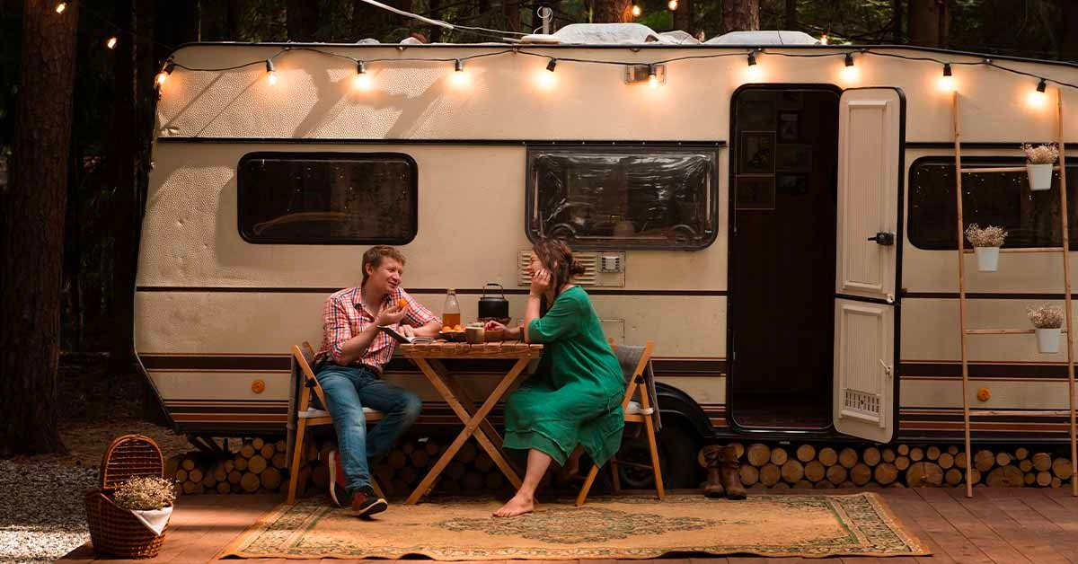
CARAVAN insurance
Presented by
karim & mustafa
Model 4 is recommend if we care about accuracy and not buyers

Slide 2

BUSINESS PROBLEM
TO IDENTIFY CUSTOMERS WHO WILL BUY CARAVAN INSURANCE

Slide 3
Motivation
To perform data analysis on a real world dataset to understand the following:
Problems Encountered and how to handle them
How to report results
How to interpret them
Help business to make informed/better decisions

Slide 4
RESEARCH QUESTIONS
Question 1
1
Who is more likely to buy caravan insurance?
Question 2
2
What are the characteristics of those groups?
Question for you
3
What are the factors you consider when buying an insurance?

Slide 5
Understanding the data
Categorical data 99.99%
86 variables
Only 2 numeric, 84 categorical
Categorical data is a representation of a range of a group
For example income marked by 2 means income range is between $30k - $45k
Creating dummies and converting a few categorical variables to numeric [as we shall see]
No missing data
Duplicates inapplicable
Outliers did not make much sense moving up the ranks just pushed the previous one into mild and then an extreme outlier

Slide 6
GOAL
Was to determine how feature selection plays an important role in regression to have best model selection

Slide 7
Technique Selection
Why not PCA?
Why Dimension Reduction?
Why not linear regression?
Why we choose logistic regression not multi nominal regression?

Slide 8
Characteristics
Customer having 3 household
Customer have one house
Age of customer is between 40 to 50
Customer are Driven Growers
Customer belongs to Lower class large families
Notes:
Saw those characteristics that were buying caravan insurance

Slide 9
Challenges
86 Categorical variables
Class Im balance problem (Oversampling)
Levels of factors different in testing and training data
Dimension reduction
Feature selection
Cost of stepwise regression
Data Categorization

Slide 10
Models
Visualization Based
01
Dimension reduction using correlation analysis and stepwise backward regression
02
Domain knowledge
03
04
Classification Tree

Slide 11

Model 1
Customer Sub type, Average household size, 1 house, Average income (numerical), Average Age (numerical)
Accuracy 11%, Sensitivity 95% and Specificity 6% at Cutoff level 0.5

Slide 12
Model 2
Max and Min correlation 1 and -0.99
Exclude correlated independent variables at 0.75 cutoff (29)
Exclude variables included in model 1.
Assessing correlation with response variable.
Perform GLM on 57 variables
Perform backward stepwise on GLM model.
Accuracy 54% Sensitivity 59% Specificity 54%
Cutoff 0.5
Left with 41 variables

Slide 13
Model 3
Contribution fire policies, Customer subtype, Contribution car policies, Purchasing power class, homeowners
Hit/try and domain knowledge approach
Accuracy 60% Sensitivity 59% Specificity 59% Cutoff 0.5

Slide 14
Model 4
Variables – Contribution Car Policies, Fire Policies, Moped policies, Customer Sub-Type, Income < 30k, High Status, Protestant, Home-owners, Avg Income
Classification Tree
Accuracy 65% Sensitivity 55% Specificity 65% Cutoff 0.5

Slide 15
Goodness of fit
 | MODEL 1 | MODEL 2 | MODEL 3 | MODEL 4
Null-Residual Difference | 837 | 5439 | 3152 | 3835
AIC-Score | 14374 | 10311 | 12163 | 11548
Based on the above Model 1 is a good but because the residual difference is less

Slide 16
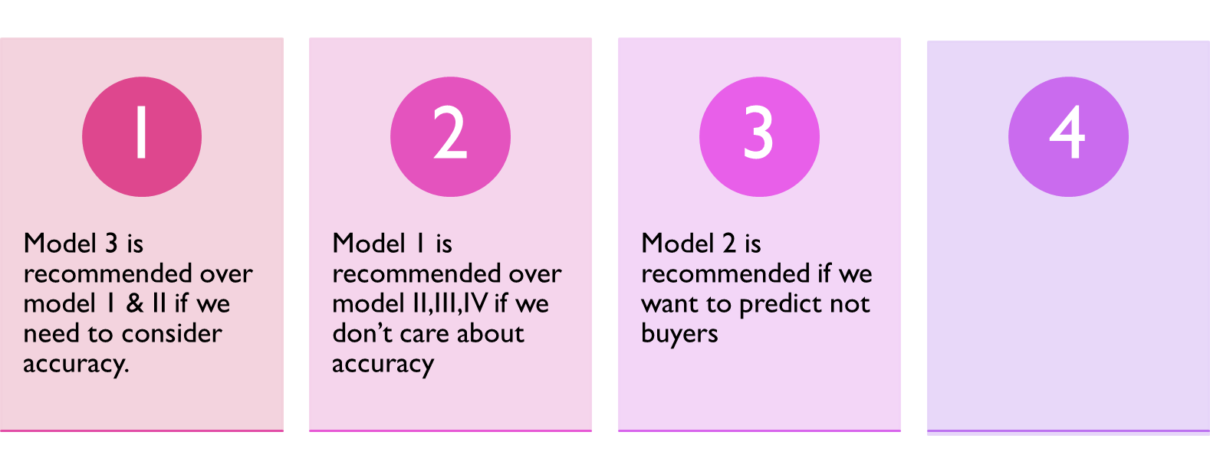
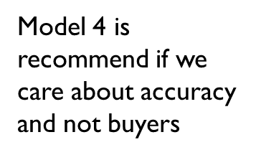
DATA MINING Recommendations
 | Model1 | Model 2 | Model 3 | Model 4
Accuracy | 11% | 54% | 60% | 65%
Sensitivity | 95% | 59% | 65% | 55%
Specificity | 6% | 54% | 59% | 65%
Model 1 is recommended because of high sensitivity
Model II is recommended over Model 1 because of high accuracy
Model III is recommended over I & II because of high accuracy and sensitivity from II
Model IV is recommend overall because of high accuracy

Slide 17
Marketing recommendations
Identifying attributes/characteristics could help in market segmentation
Could create a relational database to assign relationships
Explore potential customer life-time value
Could identify target based marketing by cluster analysis
Could perform K-NN should a new customer be added
Connecting with insurance companies offering Caravan Insurance
Yasir Muhammad [Data Scientist @ Gieco]

Slide 18
THANK YOU

