Slide 1
Foundations of Programming – Spring 1 2022 March 1 , 2021 Capstone Project Presentation
By Group 1:
Zaiba Bhaidani
Abdoul-Salam Boundaogo
Vy Ngan Dinh
Seojeong Ko
Karim Liaquat
Muhammad Maarij Mufti

Slide 2
Introduction
The threat profile that businesses face is continuously moving, and the cybersecurity landscape is ever-changing.
The introduction of captcha and the widespread use of two-factor authentication appeared to have reduced account creation fraud.
Fraudulent account creation is on the rise once more, mainly to the advent of sophisticated and inexpensive hacking tools.

Slide 3
Problem Statement
While building user information databases, there are possibilities of having invalid records creeping into database for various reasons.
Underlying business consequences of malicious accounts
Devalued user base
Objective
The purpose of this project is to build logics that can help in distinguishing legitimate accounts from malicious accounts.
Wasted money
Reputation damage
Compliance / legal problems

Slide 4
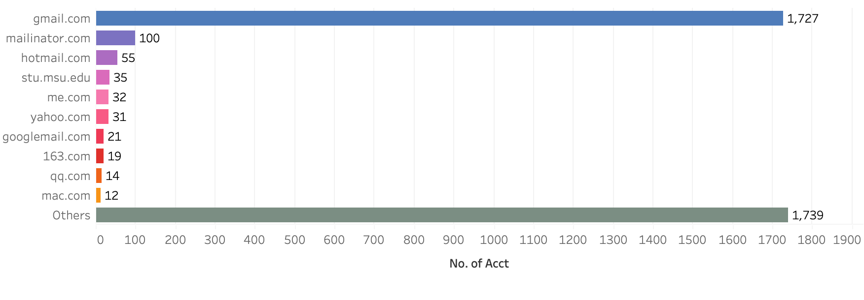

Let’s understand the given dataset
The dataset was created partially from the Google public dataset of GitHub users.
The given dataset contains information about accounts created on GitHub in a day. Each account is called as a “case”. In most of this dataset, each row contains information about an individual.
We are dealing with 3844 cases in the given dataset
Email grouping
Data Field | FIELD Type
created_at | Temporal
account | Strings
name | Strings
location | Strings
email | Strings
ip_address | Strings

Slide 5
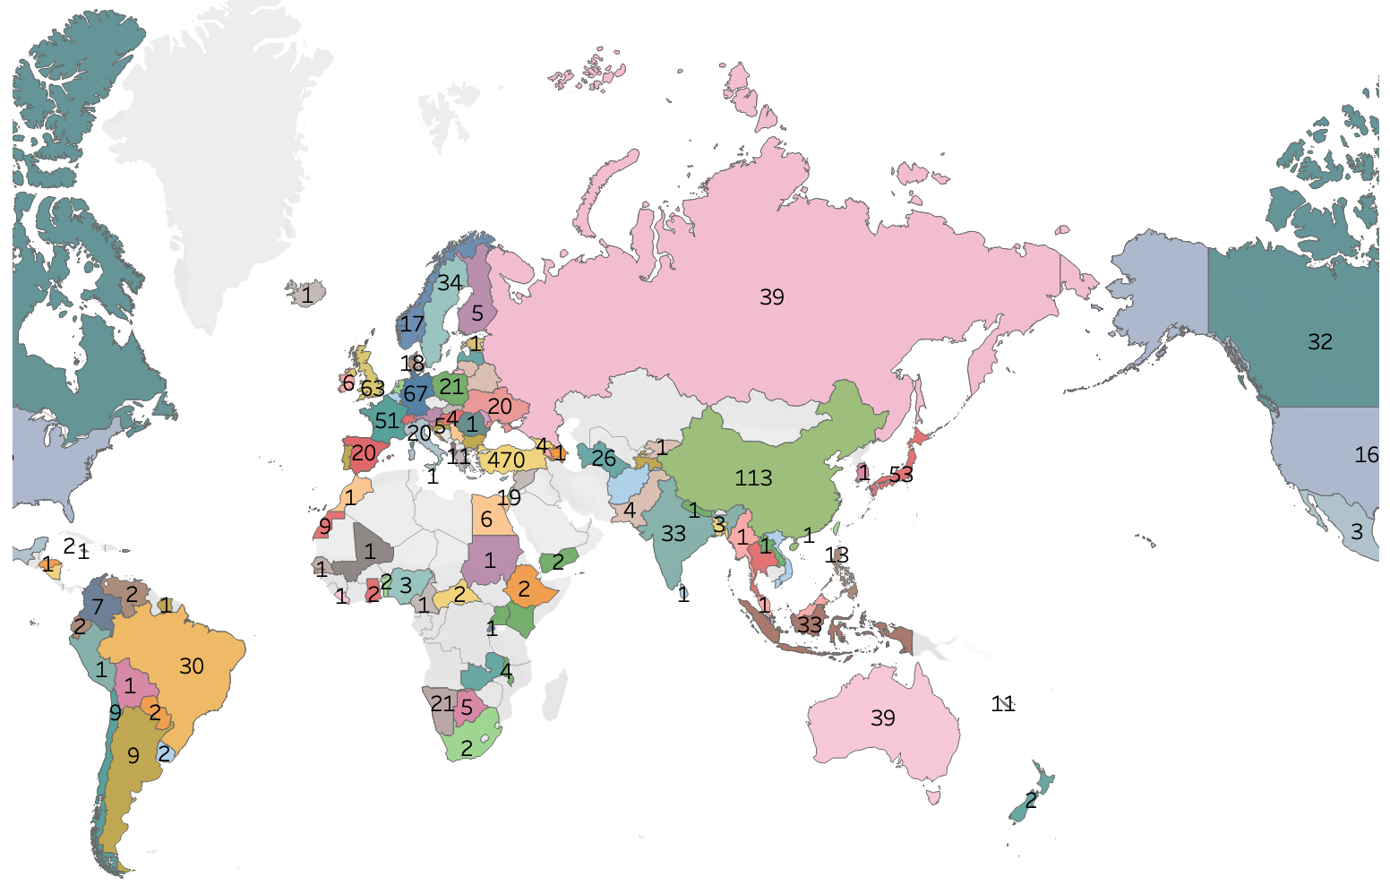
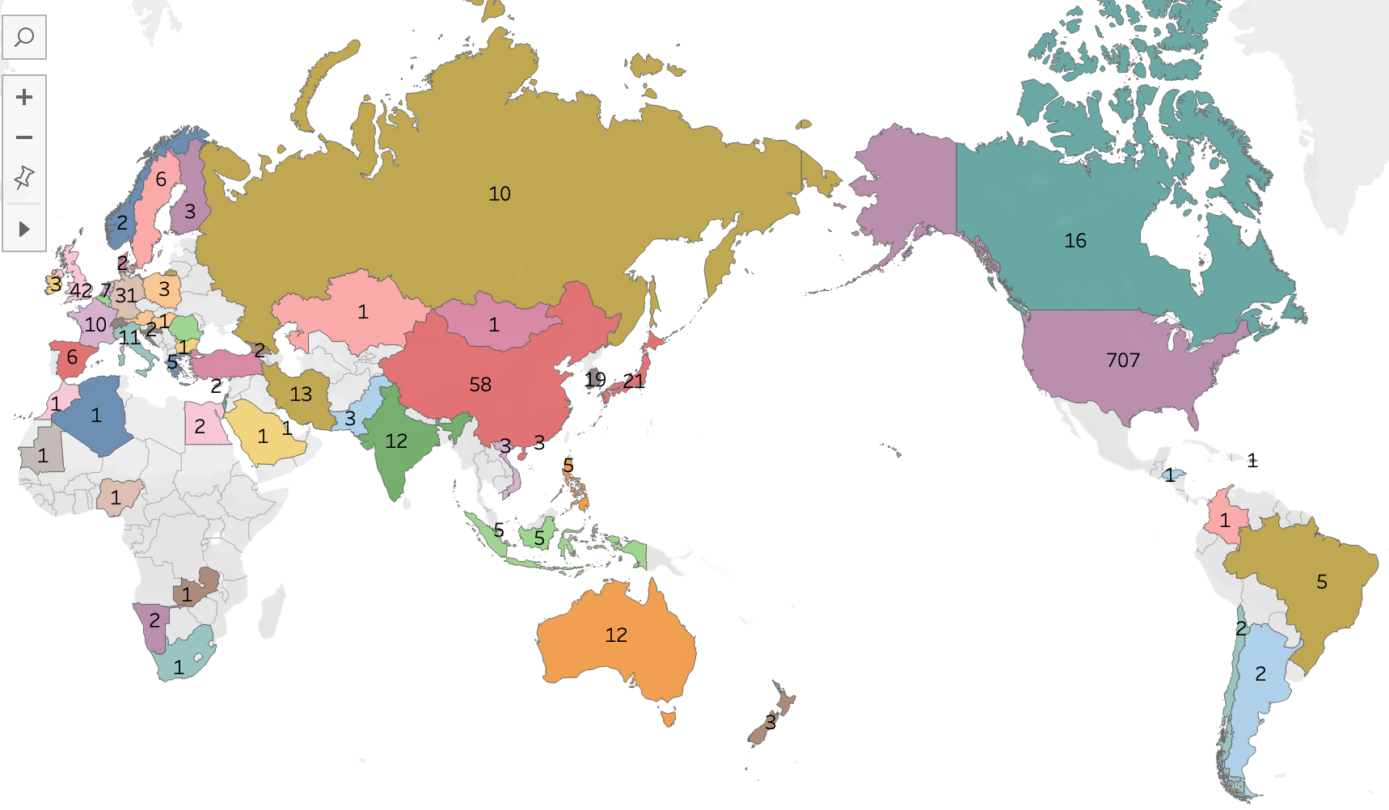

Map based on original country
Map based on country from external data sources
Accounts plotted against locations provided in original dataset
Please note that there are 769 unknown entries, which means, location was missing for these accounts
Accounts plotted against locations identified based on IP address by applying data manipulation techniques using external data source (ip2location)
IP address was converted to IP number and location was plotted with the range identified for each location

Slide 6
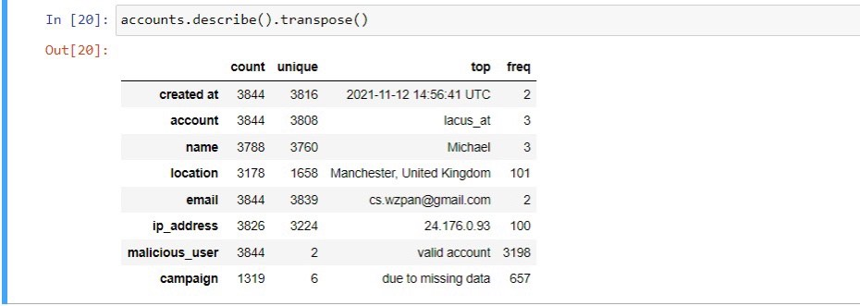

Data Cleaning & Underlying Assumptions
Accounts with missing IP address are considered invalid
All the IP addresses are validated based on numerical values not exceeding 255 in each segment of the IP address format

Slide 7

Diagnostic Approach
Grouping accounts created from same IP address
Sorting them by timestamp
Validating time difference for these accounts
Filtering out the accounts that were created in less than 3 minutes
Other validations applied
Email Validation – Format (Abc@Abc.Abc) with minimum of 2 letters after ‘.’
IP Address Validation – Four segments separated by a ‘.’ and each segment <= 255
Other validations applied but excluded
Name Validation - Removing numbers and special characters
Location – No numbers and special characters
IP Address Validation – Validating IP address against location

Slide 8
How did we proceed ?
Step 1 - Convert categorical data into numerical
Step 2 - add new column in df for each categorical data
Step 3 - sum the score and divide by total number of scenarios considered
Step 4 - assign each row with campaign and malicious values
- - -
Rules ( final values for score would be between 1 or 0 )
- Email score : valid or fake email address
- Geography score : look for ip address from which account is created valid or not
- Duplication score : if more than one account is created with same email and same account name

Slide 9
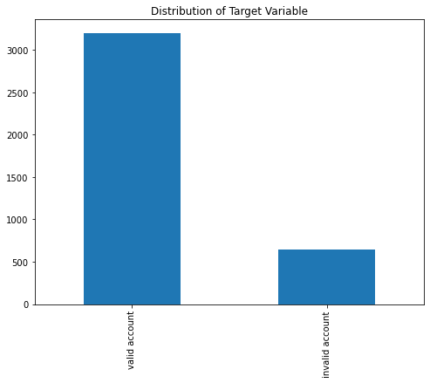
Conclusion
In this project, we as a group have done cleaning of the data and provided diagnostical Data Analysis in order to obtain some understanding of the data for further analysis of the final output. We can summarize that:
The given data has 647 malicious accounts
Only IP address and timestamp were the reliable data attributes to pull final conclusion

Slide 10
Recommendations
To avoid getting numerous fake accounts into Github, we recommend:
Adding an email validation system to filter out fake email at first.
We need to make sure the user has a valid location.
Not allowing user to create multiple accounts using the same account name and same email.

Slide 11
